Slide 1

Unit 8: Food
Lesson 1.2: Speaking
Page: 51

Slide 2
Lesson Outline
Warm-up
Speaking
Practice
Consolidation
Wrap-up

Slide 3
Objectives
By the end of this lesson, students will be able to gain the following:
Vocabulary:
Revise banana, cookie, sandwich
Sentence pattern:
Revise I want a (banana).
Skills:
Talk about food.

Slide 4

WARM UP

Slide 5




PLAY

Slide 6


Click on the SPIN buttons and guess the word which is refered.

Slide 7




banana
Which word is it?
NEXT
na
ar
fast
dr
fa
na
nvs
br
bre
st
ba
mes
ak
fast
br
Check

Slide 8
cookie
Which word is it?
NEXT
ie
co
ko
dr
fa
co
ki
ckie
bre
st
ok
mes
ak
fast
br
Check

Slide 9
sandwich
Which word is it?
NEXT
ich
dwi
fast
dr
fa
san
san
br
bre
st
dw
wic
ak
fast
br
Check

Slide 10

It’s time to learn…

Slide 11

Speaking

Slide 12


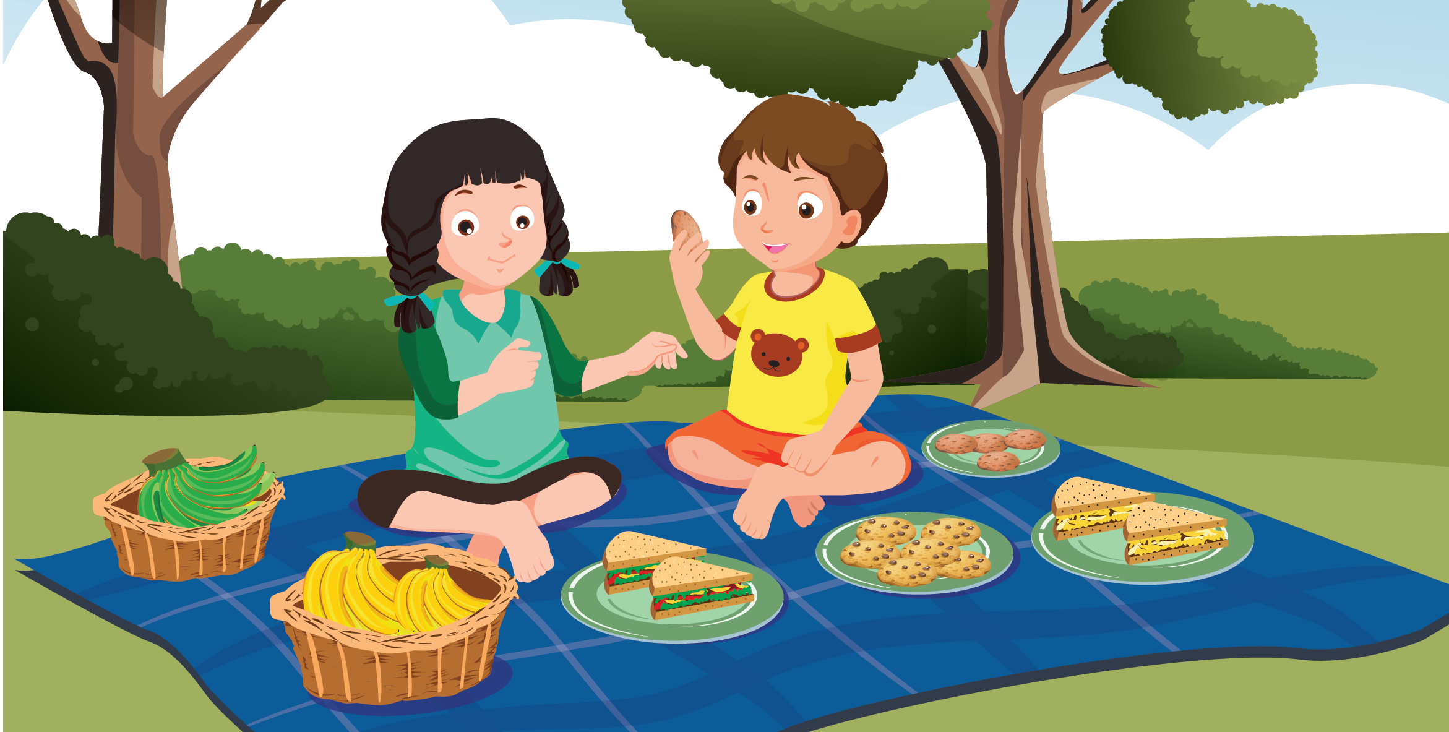

Slide 13

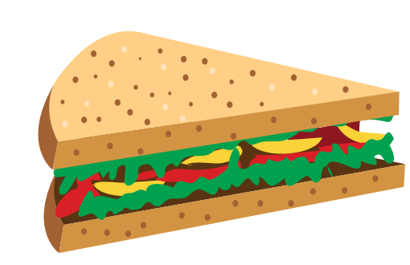
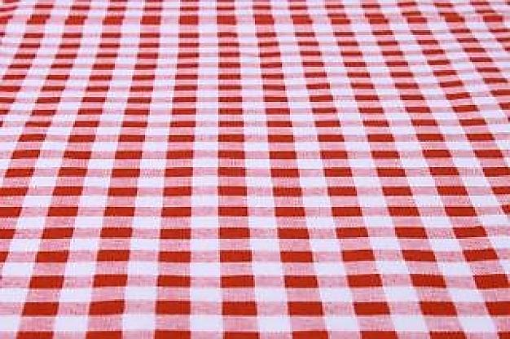

I want a…………………
cookie
sandwich
banana

Slide 14

I want a…………………
sandwich
cookie
banana

Slide 15

I want a…………………
cookie
sandwich
banana

Slide 16

Practice

Slide 17

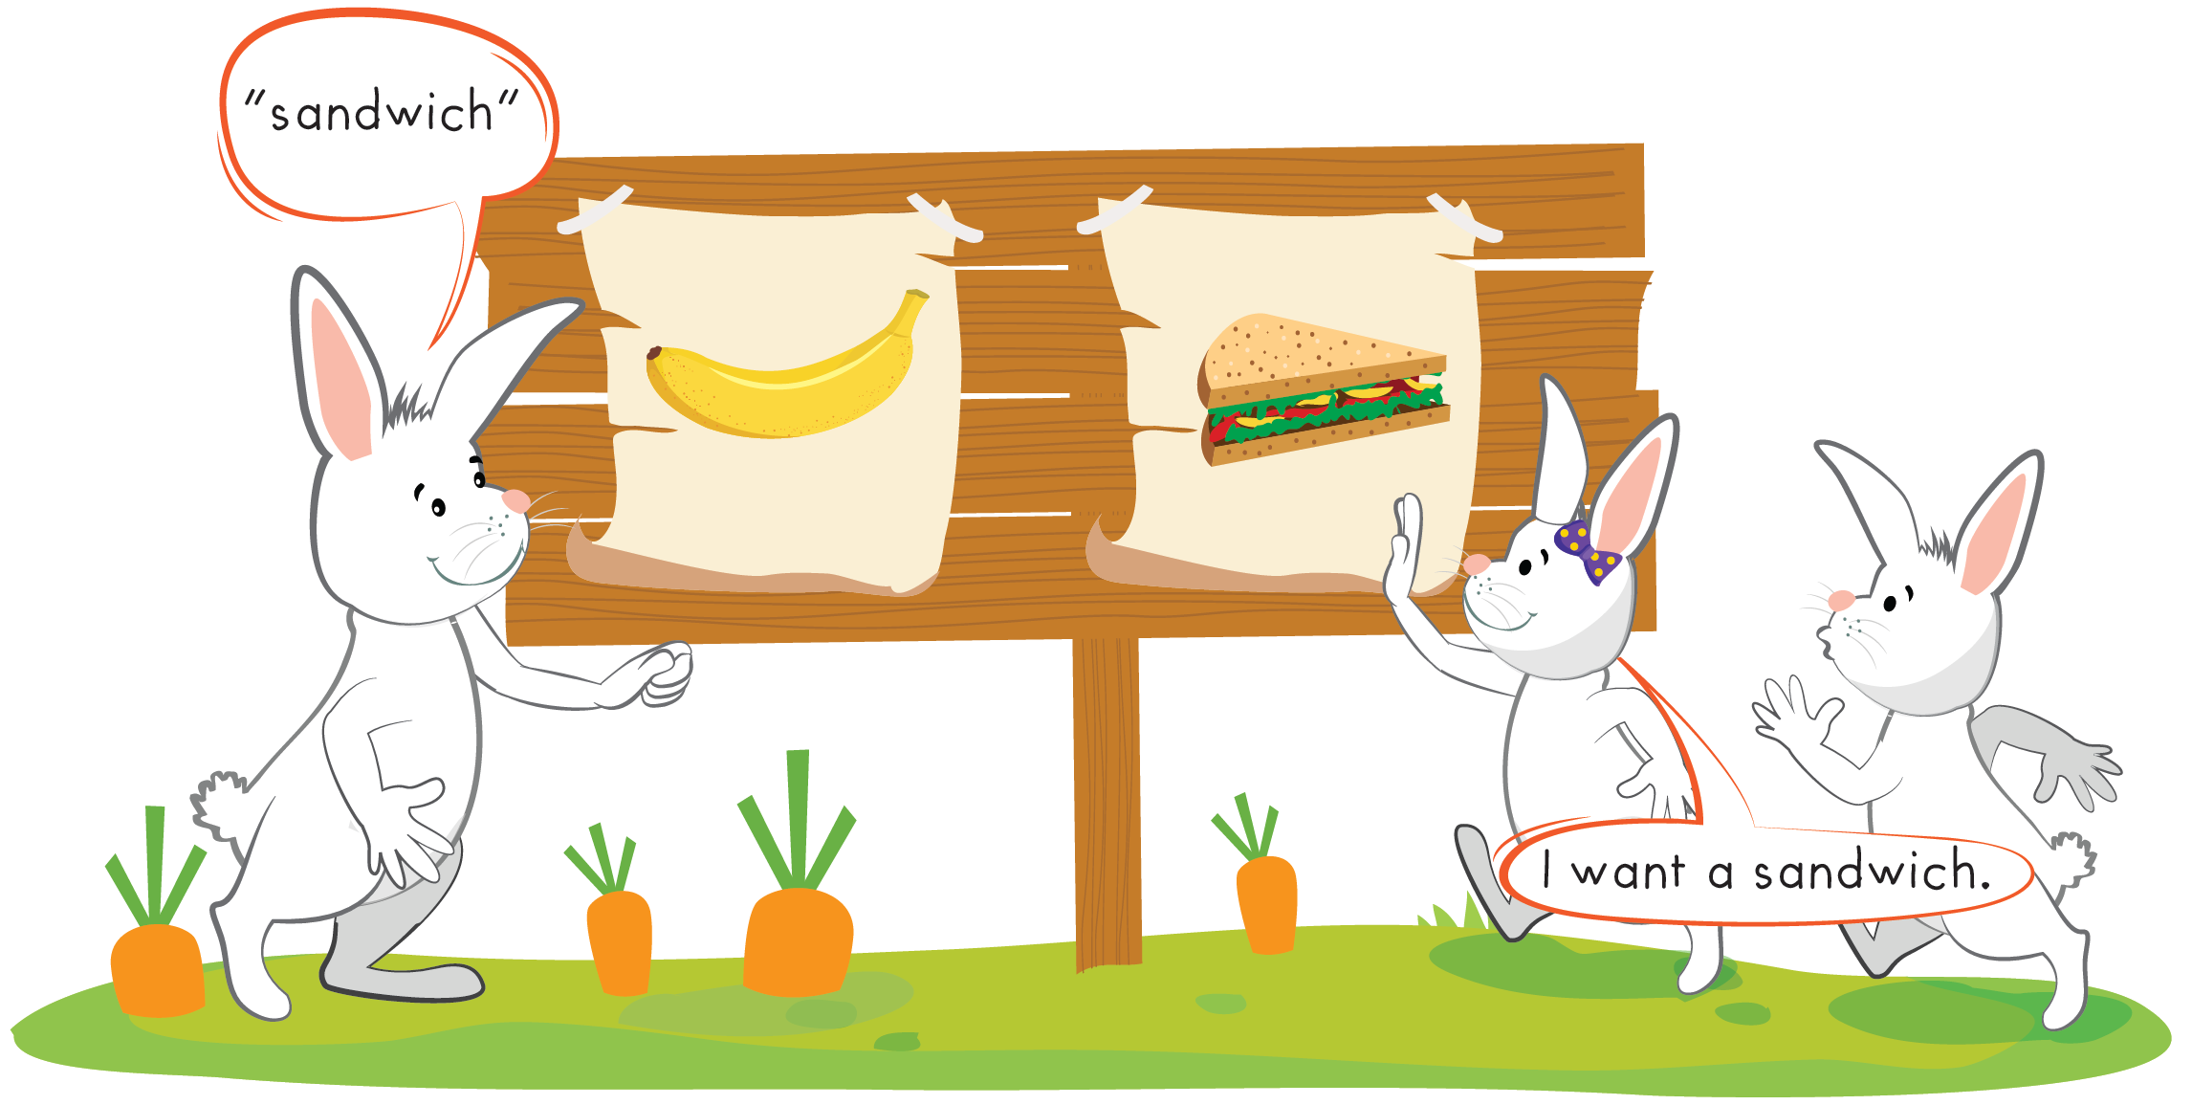

Slide 18
It’s time to play …

Slide 19


1
2
3
banana
sandwich
B
C
A
cookie

Slide 20
Further Practice

Slide 21





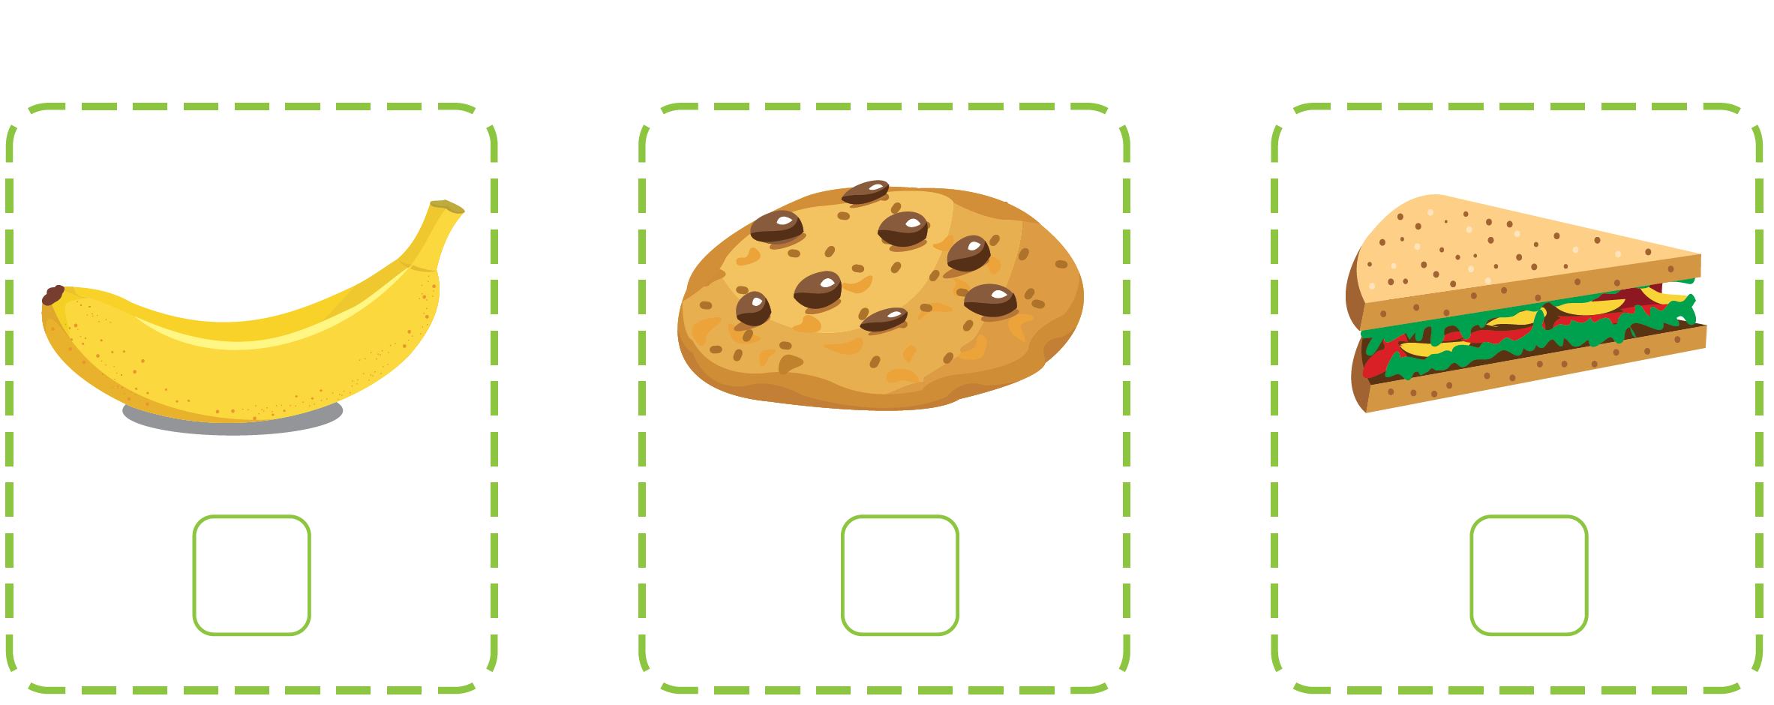


Workbook - Page 49

Slide 22

CONSOLIDATION

Slide 23
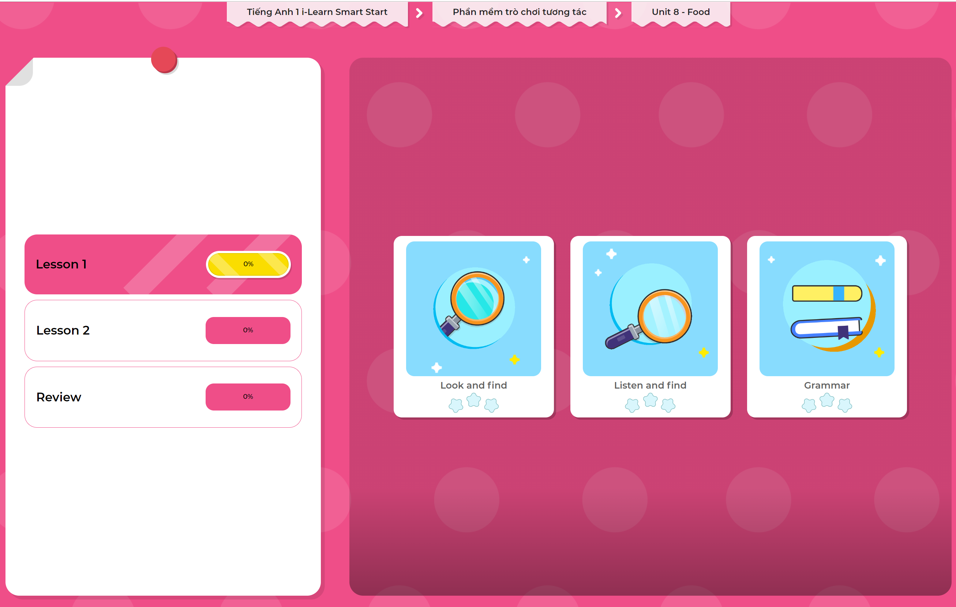
Extra Practice
DHA App
LET’S PLAY!
Click here to play the games

Slide 24

WRAP-UP

Slide 25
Today’s lesson
Structures/ Sentence patterns
I want a (banana).
Vocabulary
banana, cookie, sandwich

Slide 26
Homework
Review the vocabularies and structures. Make sentences using them.
Do the exercises in Tiếng Anh 1 i-Learn Smart Start Notebook (page 49).
Do the exercises in Tiếng Anh 1 i-Learn Smart Start Workbook (page 49).
Play the consolidation games in Tiếng Anh 1 i-Learn Smart Start DHA App on www.eduhome.com.vn
Prepare the next lesson (page 52).

Slide 27

Enjoy your day!

