Slide 1

Unit 8: Food
Lesson 2.1: Vocabulary & Phonics
Page: 52

Slide 2
Lesson Outline
Warm-up
Vocabulary
Phonics
Practice
Consolidation
Wrap-up

Slide 3
Objectives
By the end of this lesson, students will be able to gain the following:
Phonics: /k/
Vocabulary:
kick, kite
Skills:
Recognize the letter K/k and make the /k/ sound.

Slide 4

WARM UP

Slide 5


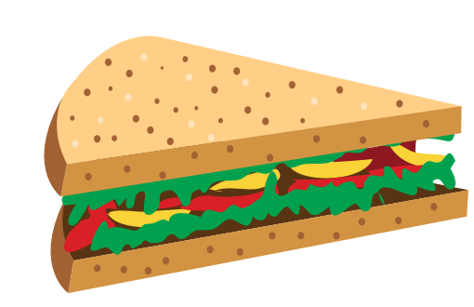



banana
cookie
sandwich
Click on the picture to hear the word.

Slide 6


sandwich
Click here to guess what food behind.

Slide 7
banana
Click here to guess what food behind.

Slide 8
cookie
Click here to guess what food behind.

Slide 9

It’s time to learn …

Slide 10

Phonics
/k/

Slide 11
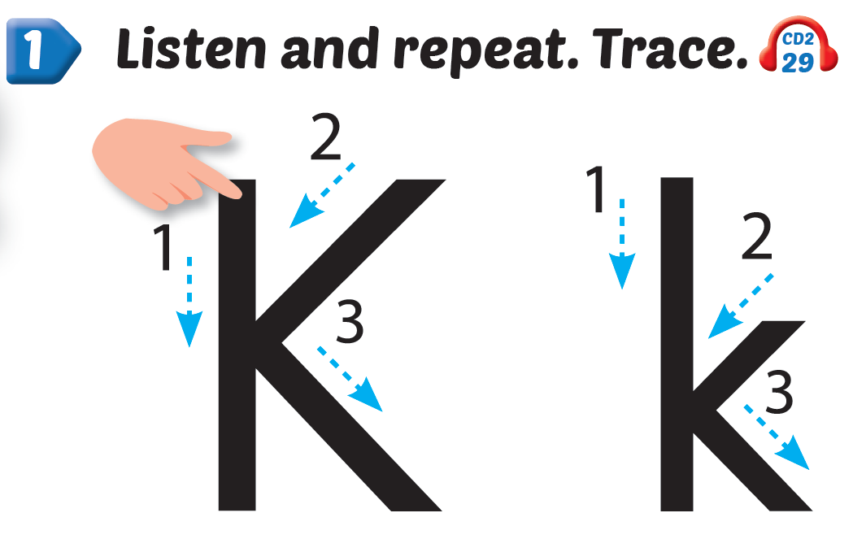

Click Alphabet to hear the sound
Click the icon to hear the sound

Slide 12

New words
kick, kite

Slide 13

kick
k
k
/kɪk/
đá

Slide 14

kite
k
k
/kaɪt/
con diều

Slide 15



Click the icon to hear the sound

Slide 16




I can ,
k, k, .
Click the icon to hear the sound
I can ,
k, k, k.

Slide 17

Practice

Slide 18


Click the icon to hear the sound

Slide 19
It’s time to play …

Slide 20



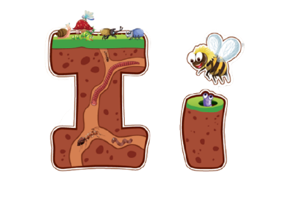

kick
kite
SPIN STOP
SPIN STOP
I
K

Slide 21

Further Practice

Slide 22


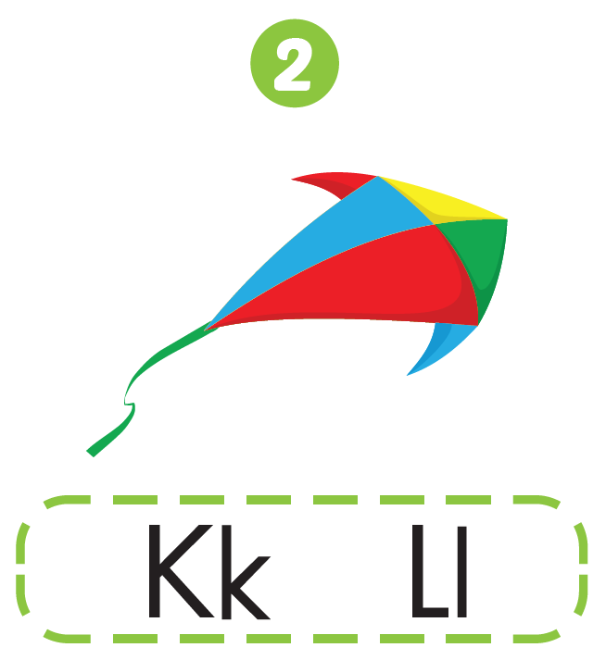

Workbook - Page 51

Slide 23

CONSOLIDATION

Slide 24
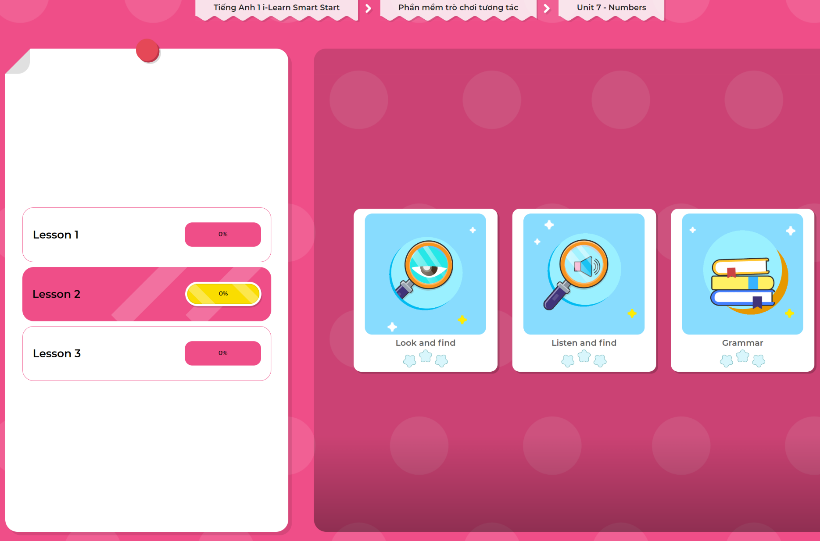
Extra Practice
DHA App
LET’S PLAY!
Click here to play the games

Slide 25

WRAP-UP

Slide 26
Today’s lesson
Phonics
/k/
Vocabulary
kick, kite

Slide 27
Homework
Practice vocabularies and phonics. Make sentences using them.
Do the exercises in Tiếng Anh 1 i-Learn Smart Start Notebook (page 50).
Do the exercises in Tiếng Anh 1 i-Learn Smart Start Workbook (page 50).
Play the consolidation games in Tiếng Anh 1 i-Learn Smart Start DHA App on www.eduhome.com.vn
Prepare the next lesson (page 53).

Slide 28

Enjoy your day!

