Slide 1

Unit 8: Food
Lesson 2.2: Vocabulary & Phonics
Page: 53

Slide 2
Lesson Outline
Warm-up
Vocabulary
Phonics
Practice
Consolidation
Wrap-up

Slide 3
Objectives
By the end of this lesson, students will be able to gain the following:
Phonics: /l/
Vocabulary:
love, leaf
Skills:
Recognize the letter L/l and make the /l/ sound.

Slide 4

WARM UP

Slide 5




What’s next?
?
kick
kite

Slide 6
What’s next?
?
kick
kite

Slide 7

What’s next?
?
kick
kite

Slide 8

What’s next?
?
kick
kite

Slide 9

What’s next?
?
kick
kite

Slide 10
What’s next?
?
kick
kite

Slide 11

What’s next?
?
kick
kite

Slide 12

What’s next?
?
kick
kite

Slide 13
What’s next?
?
kick
kite

Slide 14

It’s time to learn …

Slide 15

Phonics
/l/

Slide 16
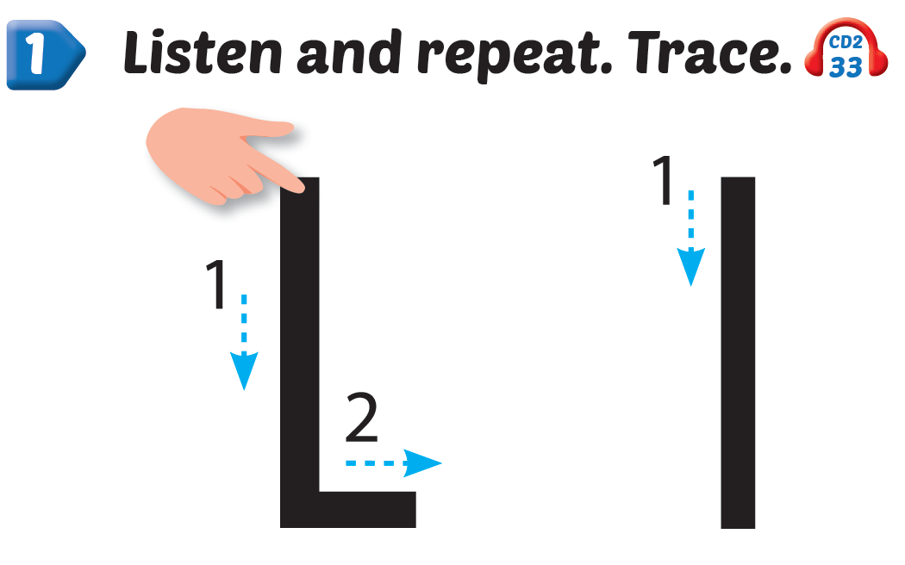

Click Alphabet to hear the sound
Notes:
Click vào hình A. 1. Listen and point. Repeat để cho cả audio full chạy

Slide 17
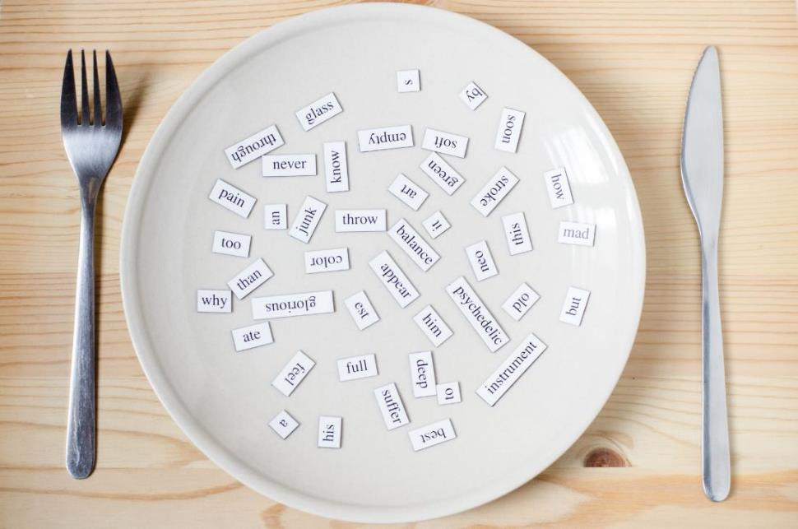
New words
love, leaf

Slide 18

love
l
l
/lʌv/
yêu, thương
Notes:
Click vào hình A. 1. Listen and point. Repeat để cho cả audio full chạy

Slide 19

leaf
l
l
/liːf/
chiếc lá
Notes:
Click vào hình A. 1. Listen and point. Repeat để cho cả audio full chạy

Slide 20





Notes:
Click vào hình A. 1. Listen and point. Repeat để cho cả audio full chạy

Slide 21




I my mom,
l, l, .
I my mom,
l, l, l.

Slide 22

Practice

Slide 23



Slide 24
It’s time to play …

Slide 25







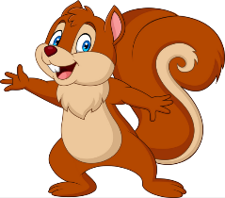
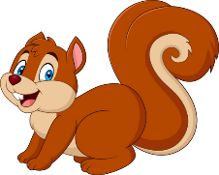
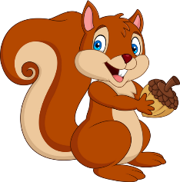


PLAY
NEXT
Brown squirrel
& acorn

Slide 26



What is the beginning sound?
“k”
“l”

Slide 27


Guessing the word.
love
leaf

Slide 28

What is the beginning sound?
“l”
“j”

Slide 29


What’s next?
?
leaf
love

Slide 30
What’s next?
?
leaf
love

Slide 31
What’s next?
?
love
leaf

Slide 32


Guess the word.
love
leaf

Slide 33



Good job!

Slide 34

Further Practice

Slide 35

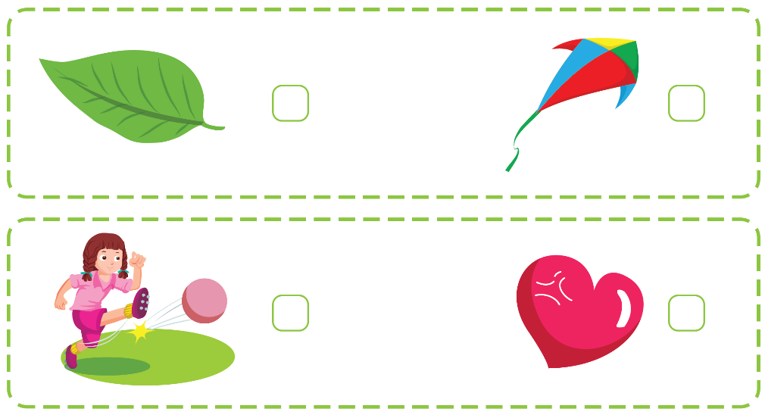




Slide 36


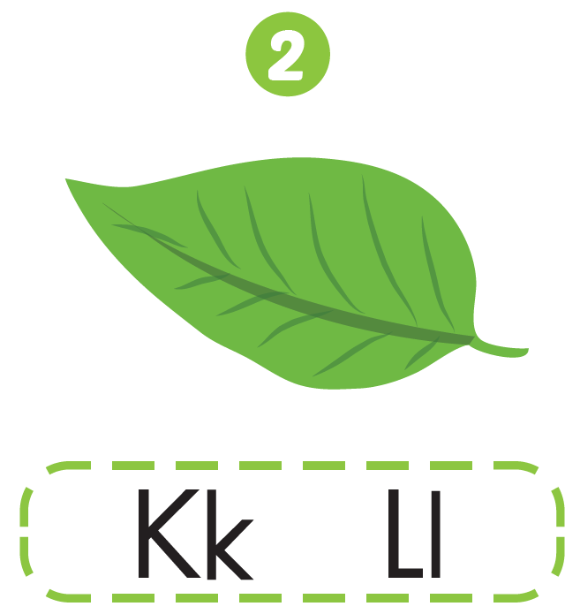


Slide 37

CONSOLIDATION

Slide 38
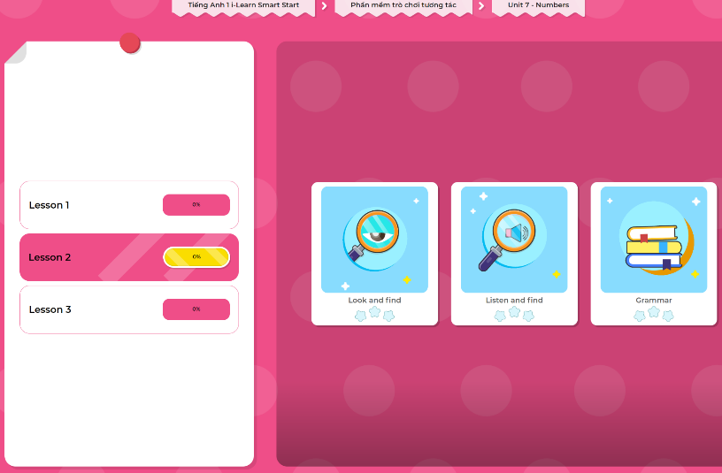
Extra Practice
DHA App
LET’S PLAY!
Click here to play the games

Slide 39

WRAP-UP

Slide 40
Today’s lesson
Phonics
/l/
Vocabulary
love, leaf

Slide 41
Homework
Practice vocabulary and phonics. Make sentences using them.
Practice the vocabulary and phonics in Tiếng Anh 1 i-Learn Smart Start Notebook (page 51).
Do the exercises in Tiếng Anh 1 i-Learn Smart Start Workbook (page 51).
Play the consolidation games in Tiếng Anh 1 i-Learn Smart Start DHA App on www.eduhome.com.vn
Prepare for the next lesson (page 54).

Slide 42

Enjoy your day!

