Slide 1

Review 7
Revise
Page: 54

Slide 2
Lesson Outline
Warm-up
Practice
Consolidation
Wrap-up

Slide 3
Objectives
By the end of this lesson, students will be able to gain the following:
Vocabulary:
Revise one, two, three, four, five, six
Skills:
Revise identifying numbers.

Slide 4

WARM UP

Slide 5












Review 7: Numbers

Slide 6

It’s time to learn …

Slide 7




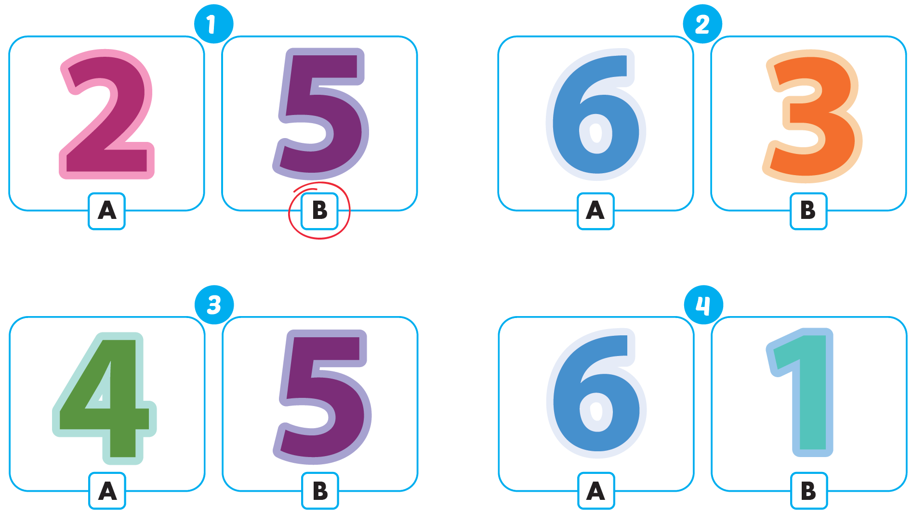



Click the icon to hear the sound
Notes:
Click vào hình A. 1. Listen and point. Repeat để cho cả audio full chạy

Slide 8

Practice

Slide 9

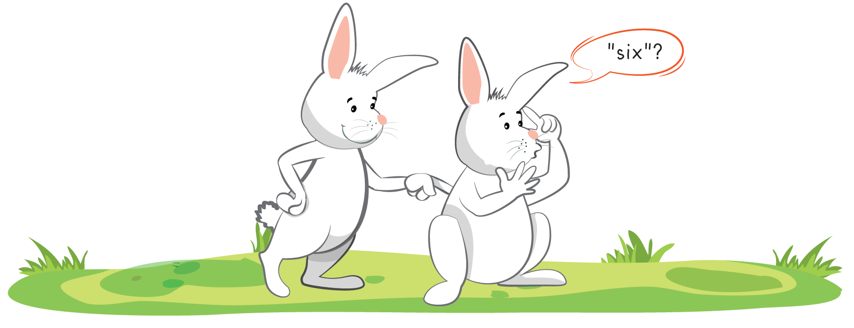

Slide 10
It’s time to speak…

Slide 11
1
2
3

Slide 12
4
5
6

Slide 13

Structure
It’s one.
“Đó là số 1”

Slide 14




Speaking
It’s ...

Slide 15
Speaking
It’s ...

Slide 16
It’s time to play …

Slide 17




Click on the right word
four
six
two

Slide 18

Click on the right word
five
four
three

Slide 19

Click on the right word
one
five
two

Slide 20

Click on the right word
five
four
three

Slide 21

Click on the right word
five
four
six

Slide 22

Click on the right word
six
one
three

Slide 23

Further Practice

Slide 24

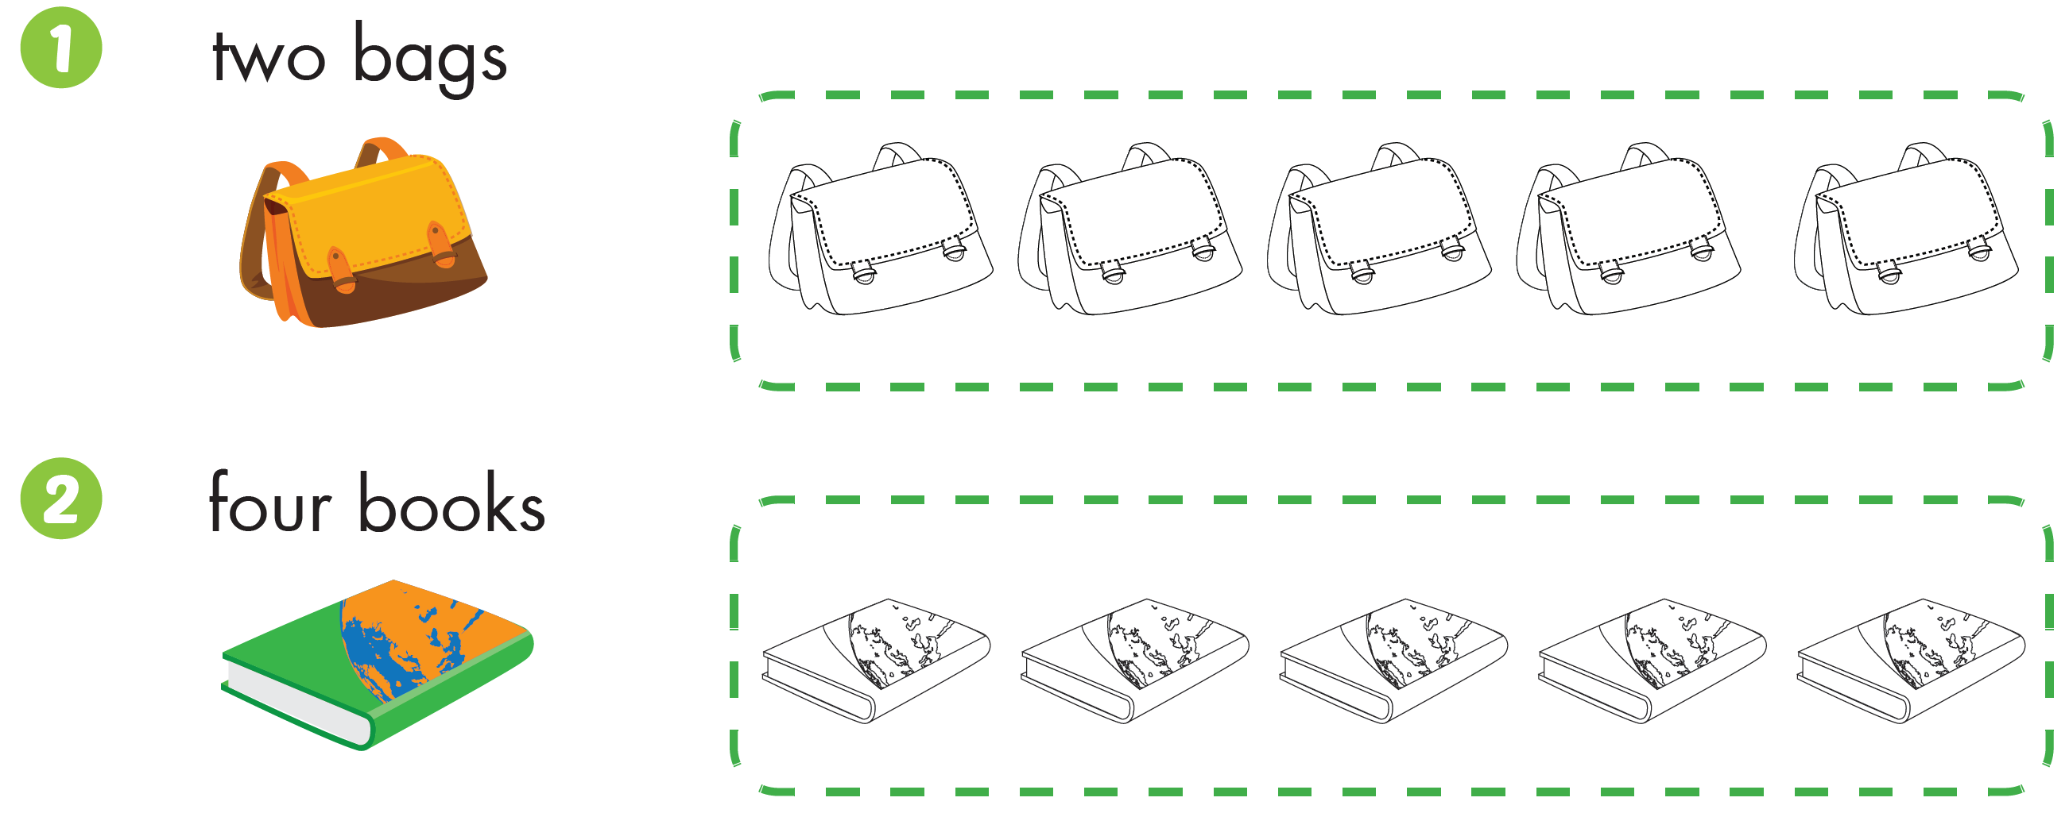



Slide 25

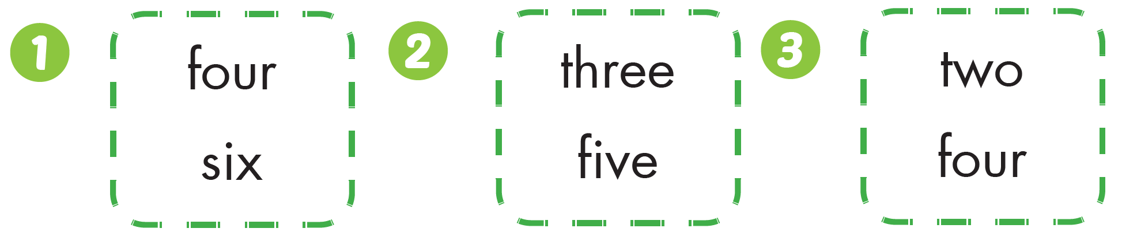




Click the icon to hear the sound
Workbook - Page 52

Slide 26

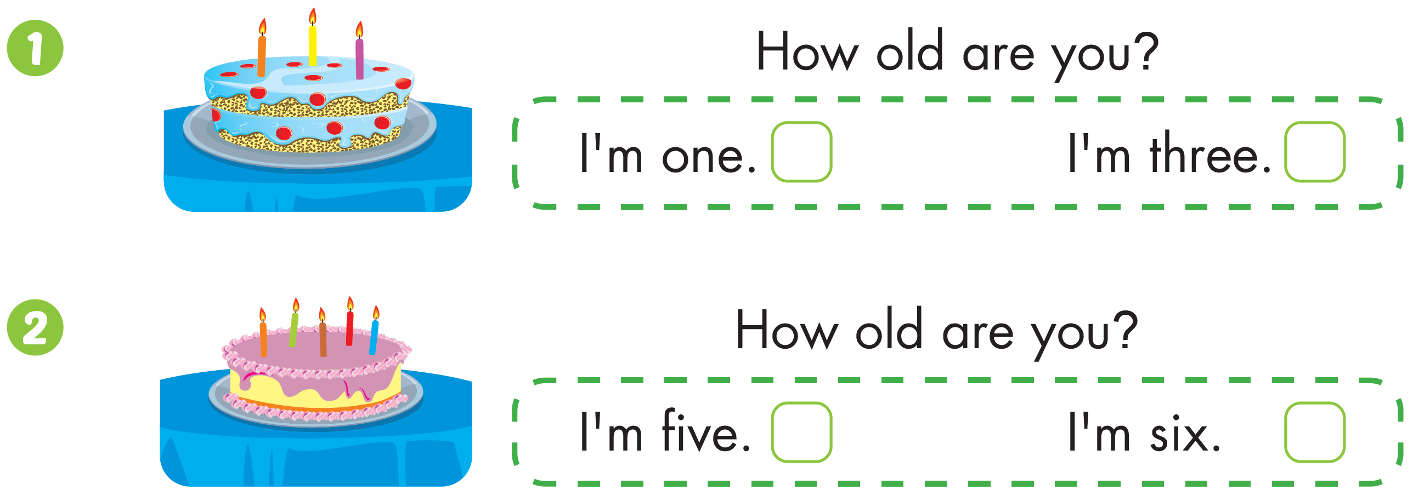

Workbook - Page 52

Slide 27

CONSOLIDATION

Slide 28
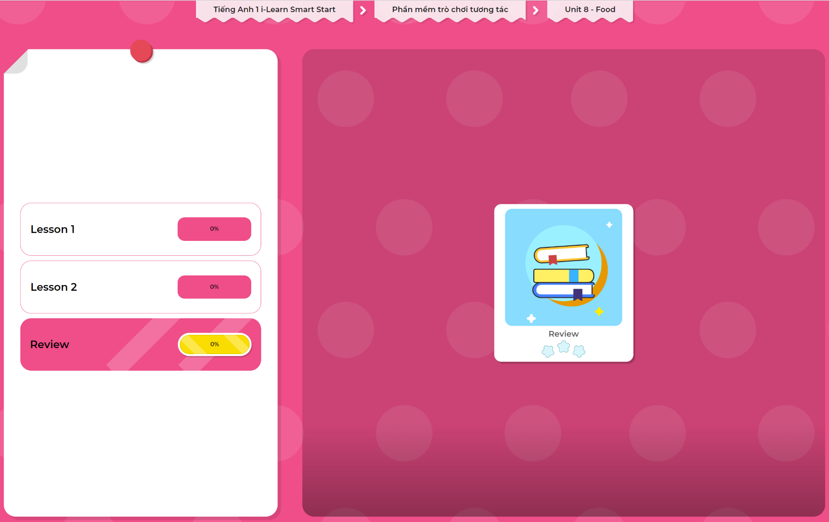
Extra Practice
DHA App
LET’S PLAY!
Click here to play the games

Slide 29

WRAP-UP

Slide 30
Today’s lesson
Vocabulary
Revise one, two, three, four, five, six

Slide 31
Homework
Practice vocabulary and structures. Make sentences using them.
Do the exercises in Tiếng Anh 1 i-Learn Smart Start Workbook (page 52).
Play the consolidation games in Tiếng Anh 1 i-Learn Smart Start DHA App on www.eduhome.com.vn
Prepare for the next lesson (page 55).

Slide 32

Enjoy your day!

