Slide 1

Review 8
Revise
Page: 55

Slide 2
Lesson Outline
Warm-up
Practice
Consolidation
Wrap-up

Slide 3
Objectives
By the end of this lesson, students will be able to gain the following:
Vocabulary:
Revise banana, cookie, sandwich
Sentence pattern:
Revise “I want a sandwich”
Skills:
Revise the topic Food.

Slide 4

WARM UP

Slide 5

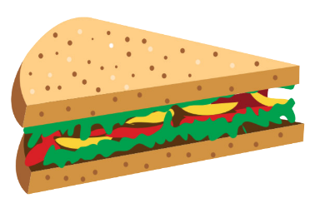

Review 8: Food
1
2
3
banana
cookie
sandwich

Slide 6

It’s time to learn …

Slide 7



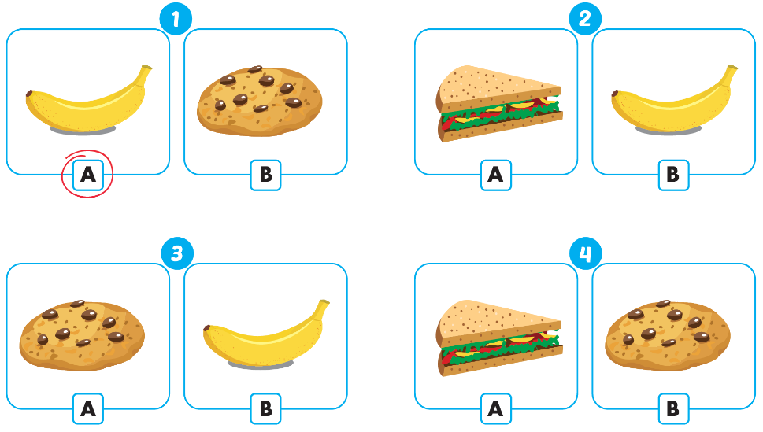



Click A to hear the sound
Notes:
Click vào hình A. 1. Listen and point. Repeat để cho cả audio full chạy

Slide 8

Practice

Slide 9

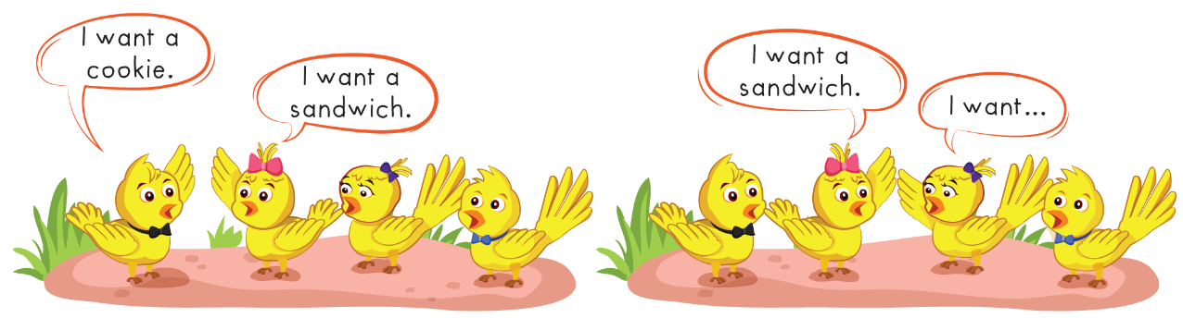

Slide 10
It’s time to speak…

Slide 11
1
2
3
banana
cookie
sandwich

Slide 12

Structure
I want a banana.
Dùng để đưa ra lời đề nghị muốn dùng đồ ăn nào đó:
“Tớ muốn 1 quả chuối.”

Slide 13



Speaking
I want a................

Slide 14
It’s time to play…

Slide 15

QUESTION
DUCKS
START

Slide 16


Listen and choose
five
two
four

Slide 17
Listen and choose
three
six
one

Slide 18

I like …
banana
cookie
sandwich

Slide 19
Listen and choose
two
four
five

Slide 20

I like…
banana
sandwich
cookie

Slide 21
Listen and choose
two
four
three

Slide 22

I like…
cookie
sandwich
banana

Slide 23
Listen and choose
two
three
six

Slide 24
Listen and choose
one
five
three

Slide 25

Further Practice

Slide 26

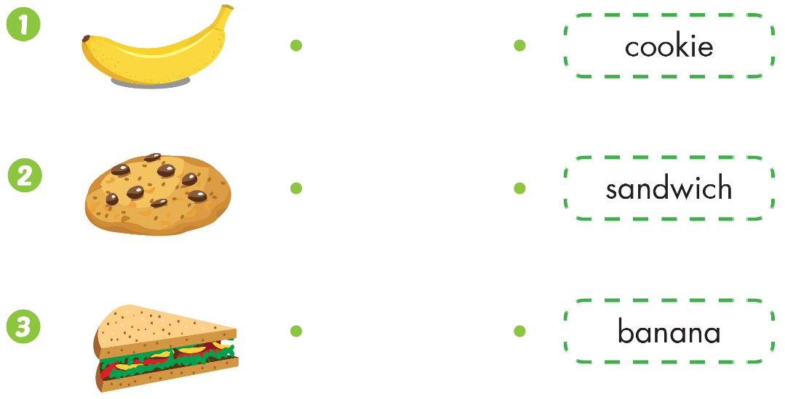

Slide 27


2
3
1

Slide 28

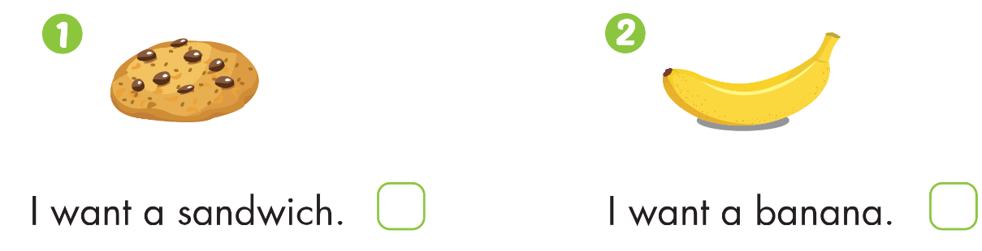



Slide 29

CONSOLIDATION

Slide 30
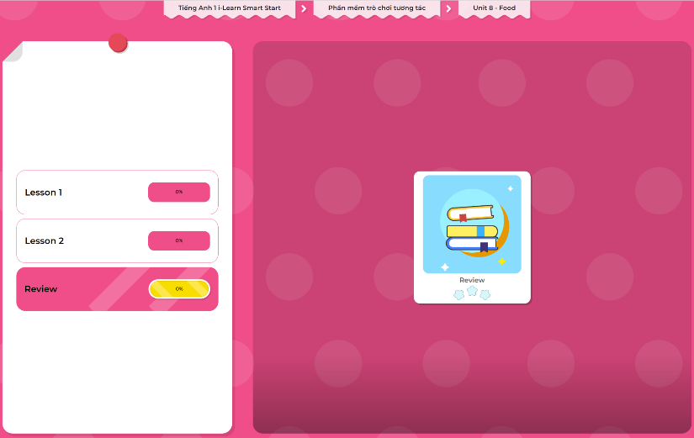
Extra Practice
DHA App
LET’S PLAY!
Click here to play the games

Slide 31

WRAP-UP

Slide 32
Today’s lesson
Structures/ Sentence patterns
I want a banana.
Vocabulary
Revise banana, cookie, sandwich

Slide 33
Homework
Practice vocabulary and structure. Make sentences using them.
Do the exercises in Tiếng Anh 1 i-Learn Smart Start Workbook (page 52).
Play the consolidation games in Tiếng Anh 1 i-Learn Smart Start DHA App on www.eduhome.com.vn
Prepare for the next lesson (page 56).

Slide 34

Enjoy your day!

