Slide 1

Unit 9: Toys
Lesson 1.1: Vocabulary & Sentence Patterns
Page: 56

Slide 2
Lesson Outline
Warm-up
Vocabulary
Structure
Practice
Consolidation
Wrap-up

Slide 3
Objectives
By the end of this lesson, students will be able to identify and use vocabulary for toys, using ….
Vocabulary:
car, teddy bear, ball
Sentence pattern:
I have a (car).

Slide 4

WARM UP

Slide 6
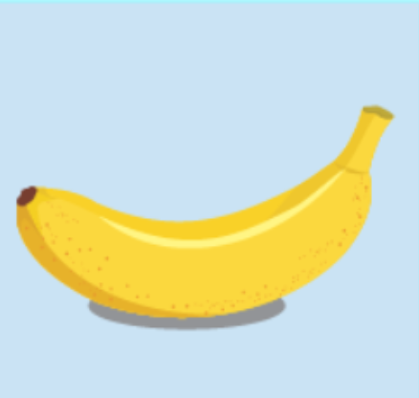
What is it?
banana

Slide 7
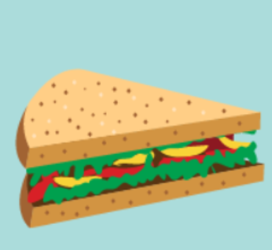
What is it?
sandwich

Slide 8
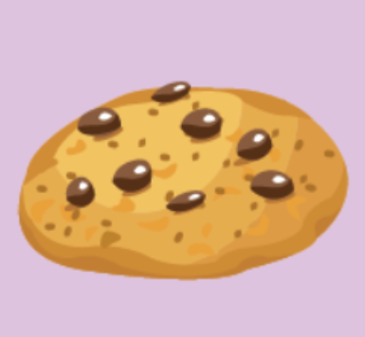
What is it?
cookie

Slide 9
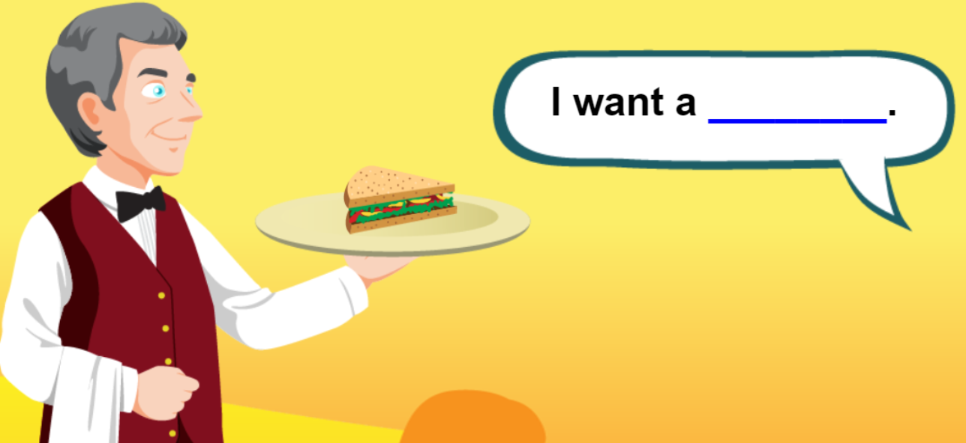
sandwich

Slide 10
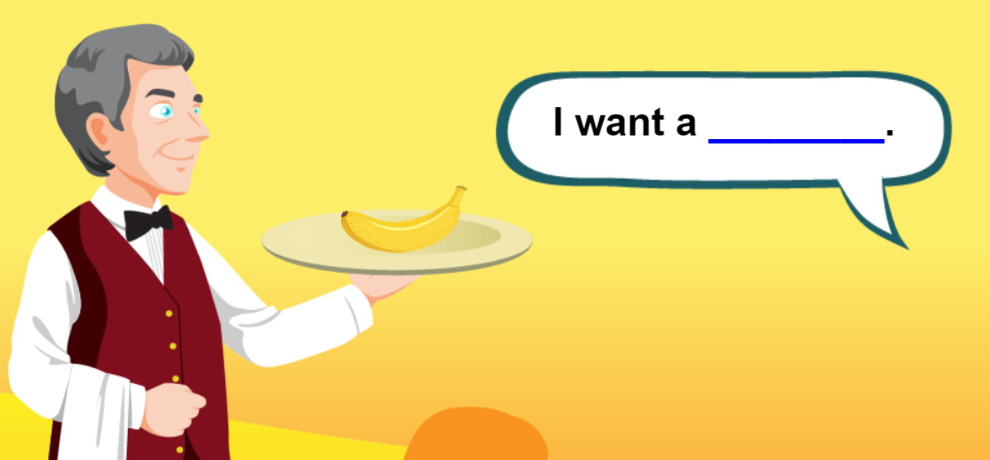
banana

Slide 11
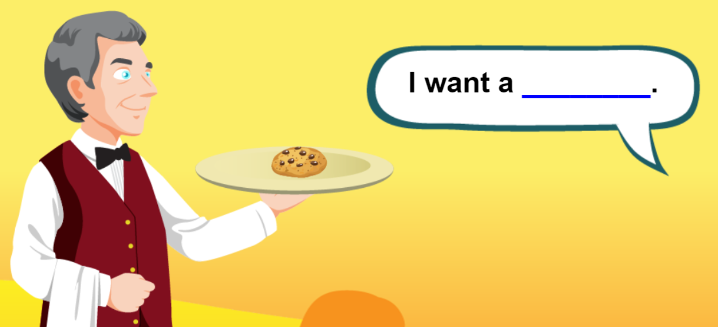
I ___ a cookie.
want

Slide 12
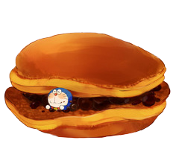
GOOD JOB !
END

Slide 13

It’s time to learn …

Slide 14

New words
car, teddy bear, ball

Slide 15


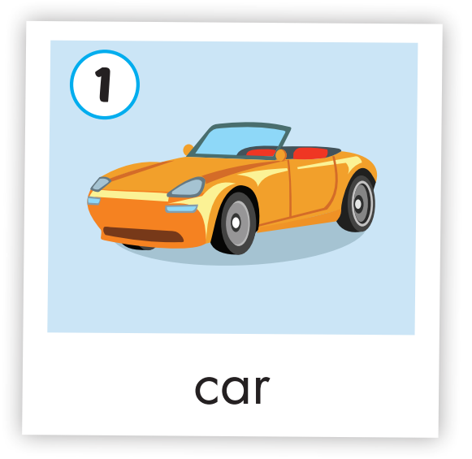

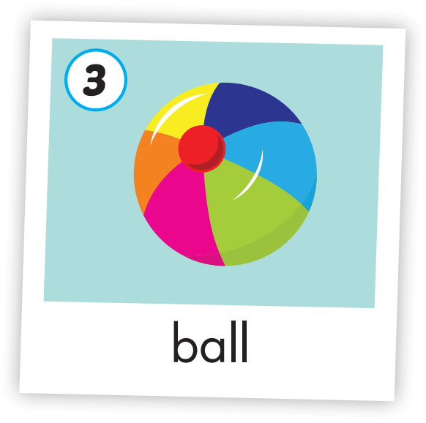
Click on each icon to hear the sound
/kɑːr/
xe hơi
/ˈtedi ber/
gấu bông
/bɑːl /
quả bóng

Slide 16
Click on the icon to hear the sound
/kɑːr/
xe hơi

Slide 17
Click on the icon to hear the sound
/ˈtedi ber/
gấu bông

Slide 18
Click on the icon to hear the sound
/bɑːl /
quả bóng

Slide 19

Structures
I have a (car).

Slide 20

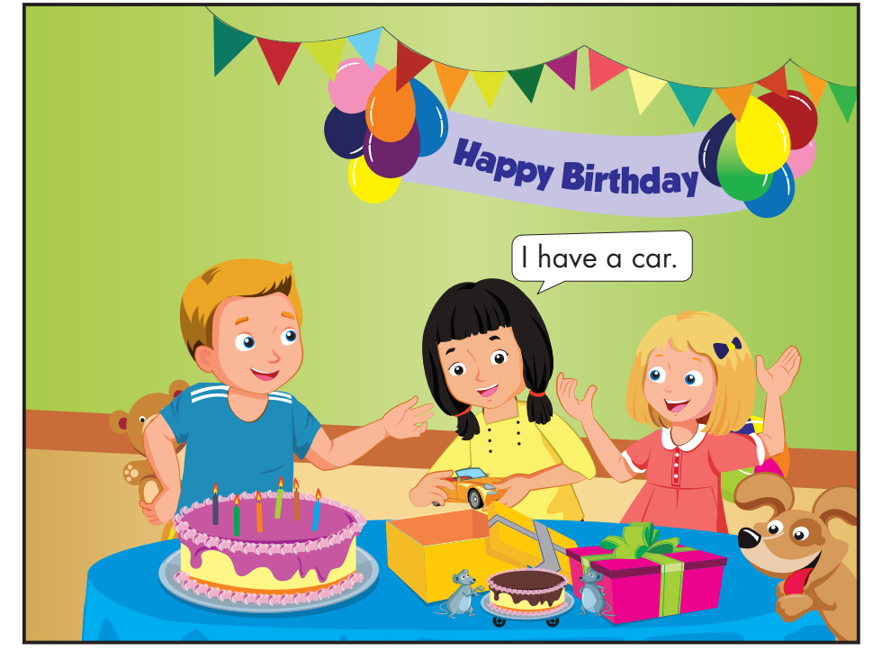
Click on the icon to hear the sound
I have a teddy bear.
I have a ball.

Slide 21

Practice

Slide 22


Click on the icon to hear the sound
I have a car.
I have a car.
I have a teddy bear.
I have a teddy bear.
I have a ball.
I have a ball.
I have a car.
I have a car.
I have a teddy bear.
I have a teddy bear.
I have a ball.
I have a ball.
Notes:
GV click lần 1 để follow lyric 1
Gv click lần 2 để follow lyric 2

Slide 23

Further Practice

Slide 24
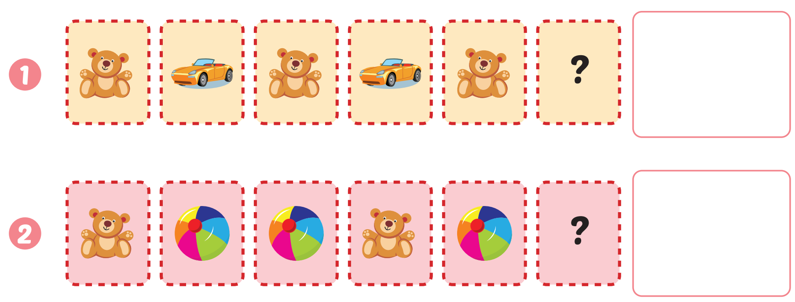
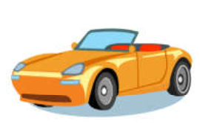
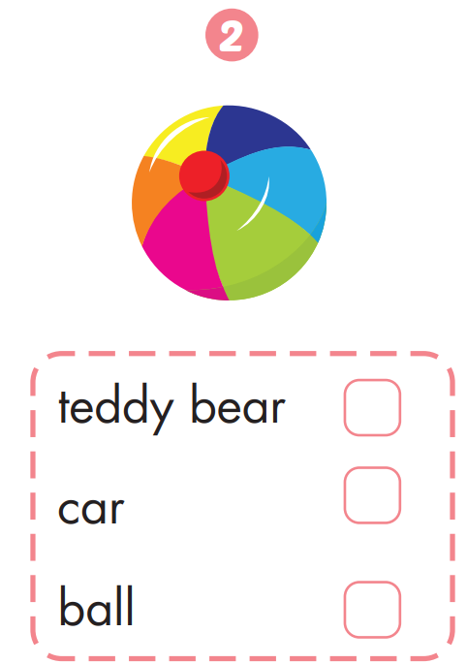
Extra Practice
WB, page 54.
Click on the square to show the answer

Slide 25
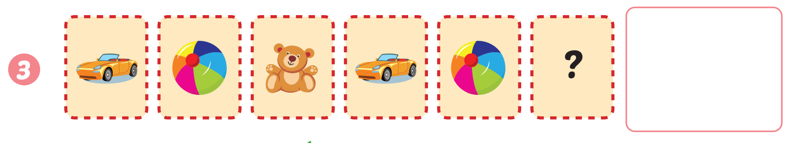

Extra Practice
WB, page 54.
Click on the square to show the answer

Slide 26

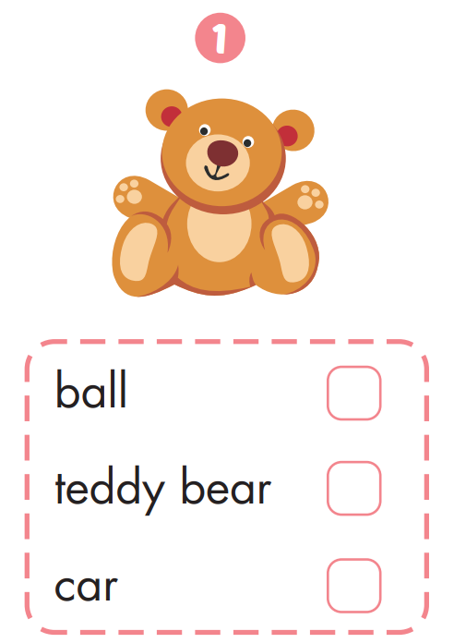
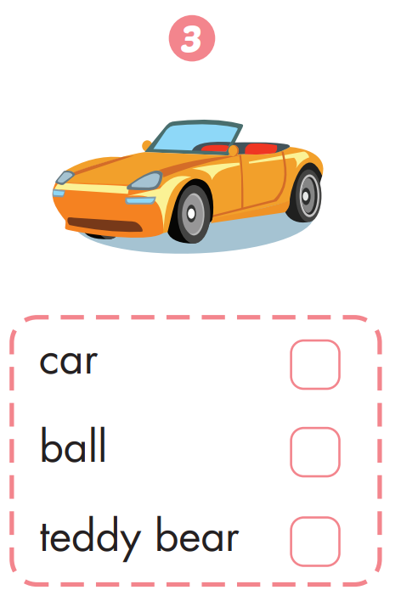
Extra Practice
WB, page 54.
✔️
✔️
✔️

Slide 27
It’s time to play …

Slide 28



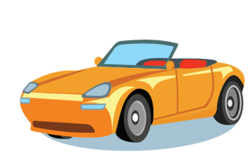
1
2
3
4
5
6
7
8
Click on the square to see the picture
Click on to close the picture
Notes:
Memory game. GV nhấn vào ô để mở, nếu HS chọn 2 hình không giống nhau, GV nhấn vào hình tròn để đóng hình lại, HS phải nhớ những hình đã mở.

Slide 29

CONSOLIDATION

Slide 30
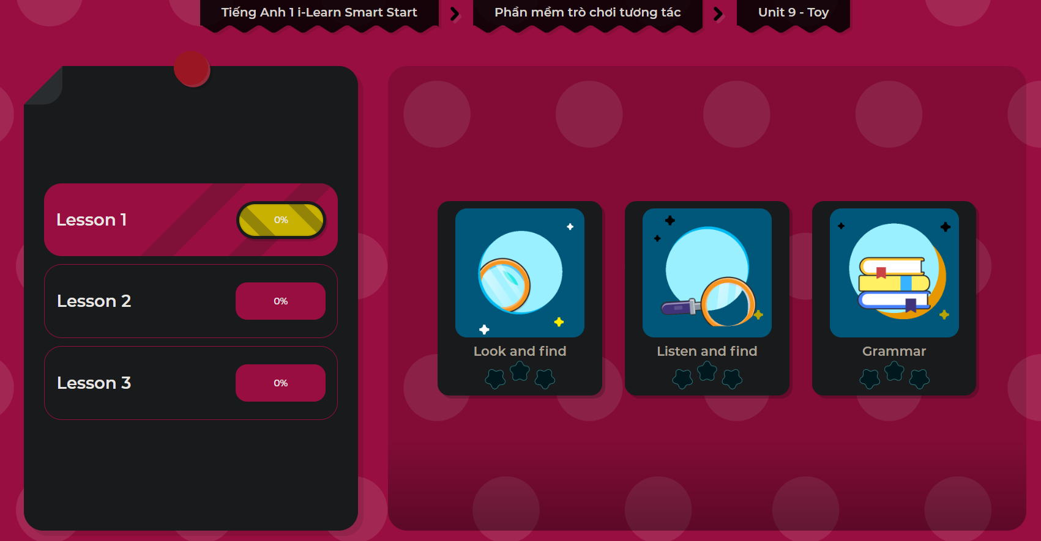
Extra Practice
DHA App
LET’S PLAY!

Slide 31

WRAP-UP

Slide 32
Today’s lesson
Vocabulary
car, teddy bear, ball
Structures/ Sentence patterns
I have a (car).

Slide 33
Homework
Practice vocabulary and structures. Make sentences using them.
Do the exercises in Tiếng Anh 1 i-Learn Smart Start Notebook (page 52).
Do the exercises in Tiếng Anh 1 i-Learn Smart Start Workbook (page 54).
Play the consolidation games in Tiếng Anh 1 i-Learn Smart Start DHA App on www.eduhome.com.vn
Prepare for the next lesson (page 57).

Slide 34

Enjoy your day!

