Slide 1

Unit 9: Toys
Lesson 3.1: Vocabulary & Sentence Patterns
Page: 60

Slide 2
Lesson Outline
Warm-up
Vocabulary
Structure
Practice
Consolidation
Wrap-up

Slide 3
Objectives
By the end of this lesson, students will be able to identify and use vocabulary for numbers.
Vocabulary:
seven, eight, nine, ten
Sentence pattern:
How many (cars)?
- (Seven) (cars).

Slide 4

WARM UP

Slide 5

Let’s play

Slide 6


How to play
. Listen to a sound
. Choose the correct answer

Slide 7







juice
mouse
ink
car

Slide 8
mouth
insect
mouse
ink

Slide 9
i
m
n
j

Slide 10



teddy
teddy bear
bear
bear teddy

Slide 11
bal
car
ball
mouth

Slide 12
GOOD JOB

Slide 13

It’s time to learn …

Slide 14

New words
seven, eight,
nine, ten

Slide 15


Click on the word to hear the sound.
seven
/ˈsevn/
eight
/eɪt/
nine
/naɪn/
ten
/ten/

Slide 16

Structures
(Seven) (cars).

Slide 17


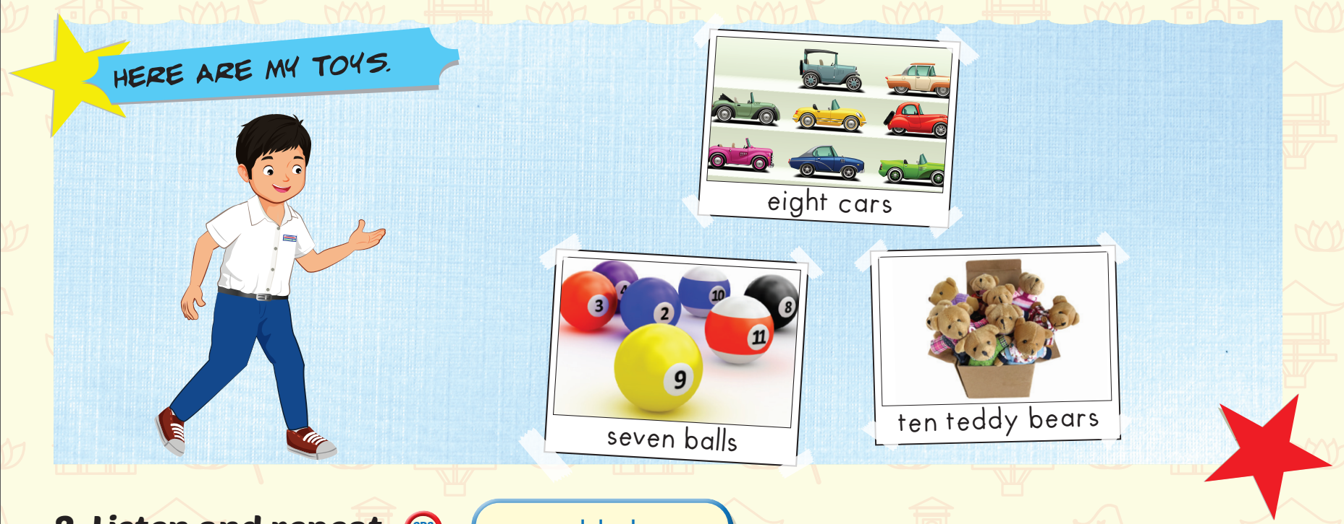
Click on each icon to hear the sound

Slide 18

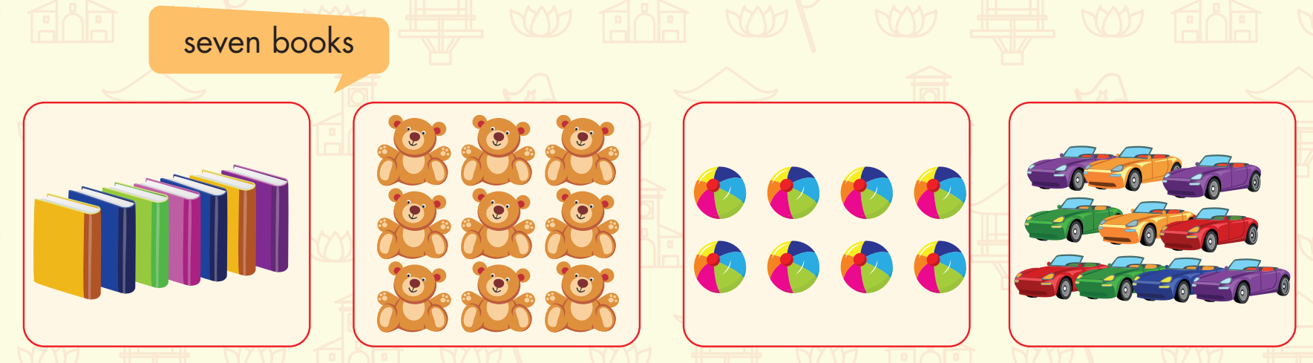
nine teddy bears
eight balls
ten cars

Slide 19

Practice

Slide 20

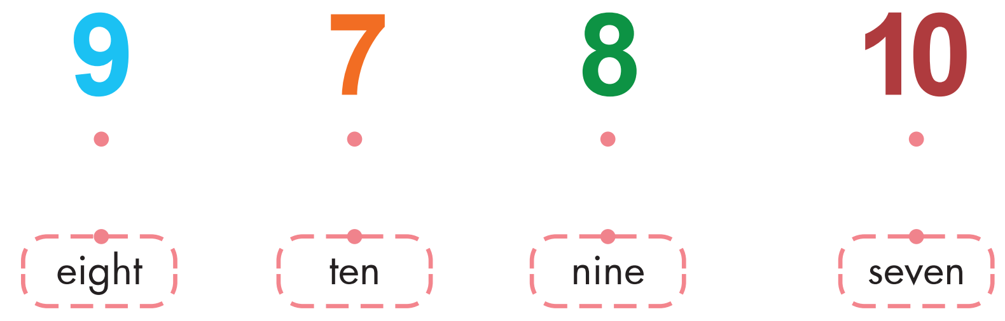
Extra Practice
WB, page 58.

Slide 21

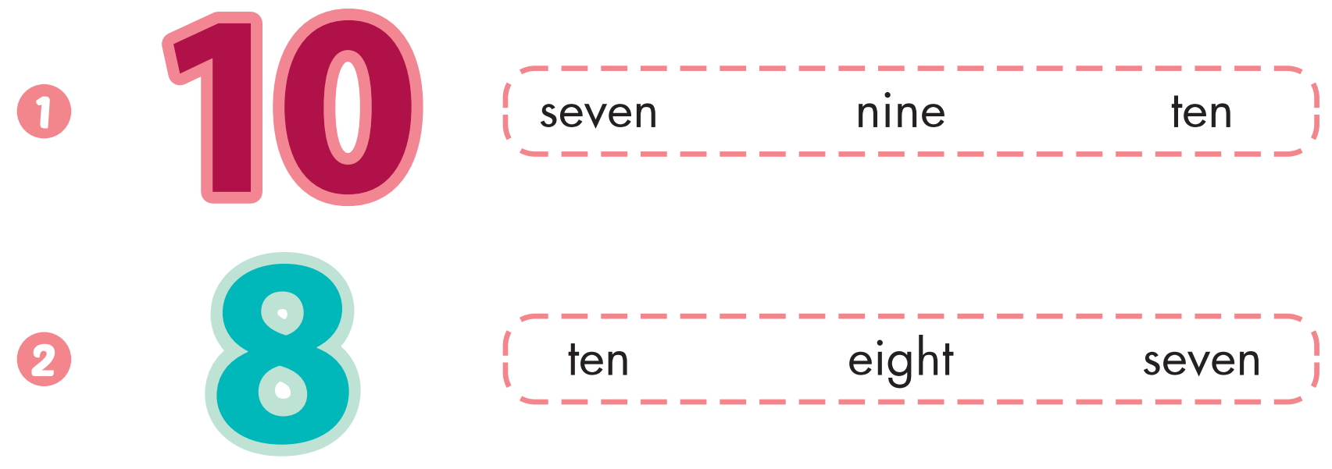
Extra Practice
WB, page 58.

Slide 22
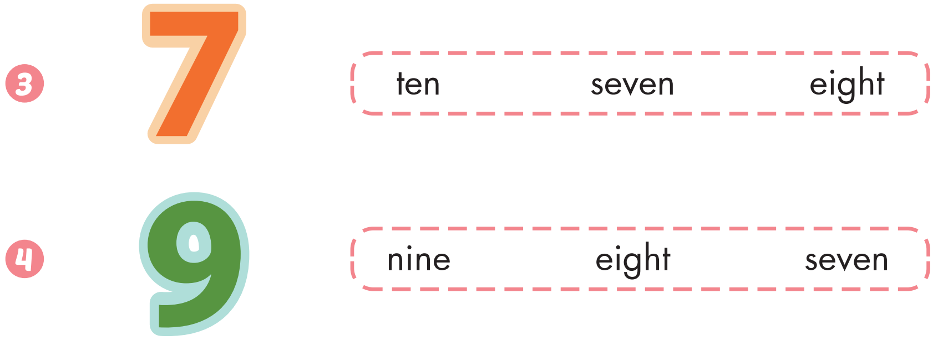

Slide 23
It’s time to play …

Slide 24



Slide 25


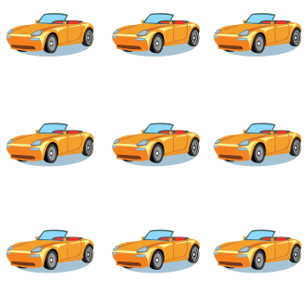

nine cars

Slide 26

ten books

Slide 27


seven teddy bears

Slide 28
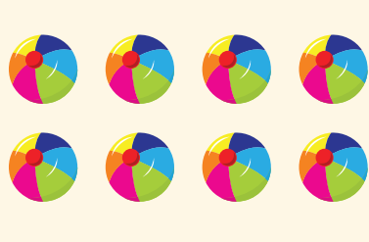
eight balls

Slide 29
Thank you

Slide 30

CONSOLIDATION

Slide 31
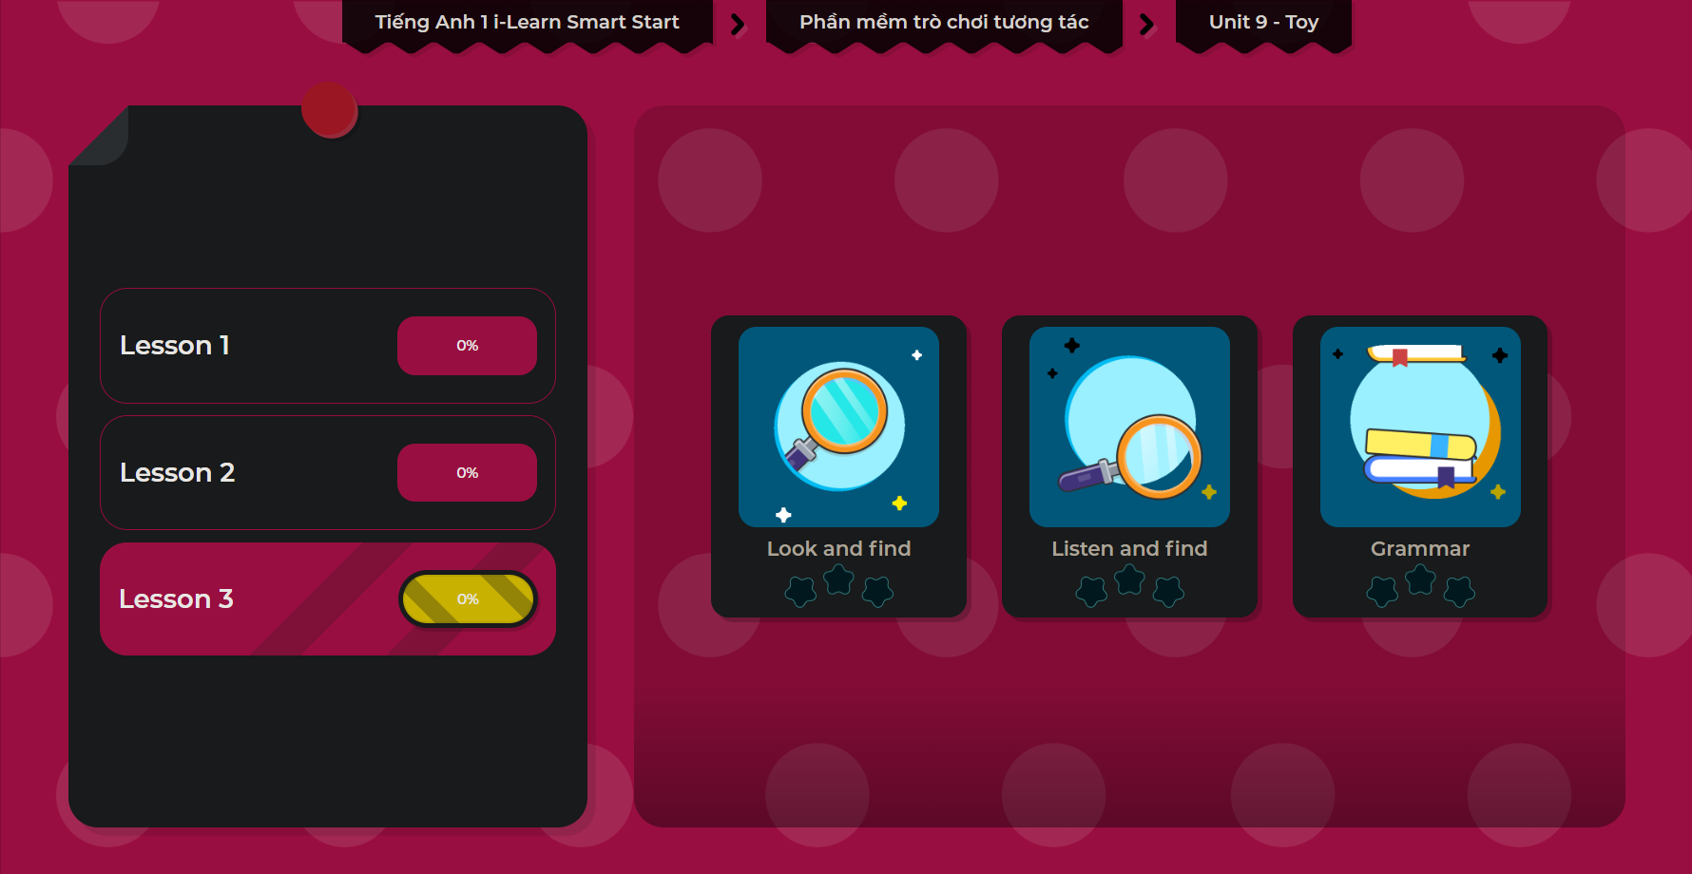
Extra Practice
DHA App
LET’S PLAY!

Slide 32

WRAP-UP

Slide 33
Today’s lesson
Vocabulary
seven, eight, nine, ten
Structures/ Sentence patterns
(Seven) (cars).

Slide 34
Homework
Practice vocabularyand structures. Make sentences using them.
Practice the vocabulary and structure in Tiếng Anh 1 i-Learn Smart Start Notebook (page 56).
Do the exercises in Tiếng Anh 1 i-Learn Smart Start Workbook (page 58).
Play the consolidation games in Tiếng Anh 1 i-Learn Smart Start DHA App on www.eduhome.com.vn
Prepare for the next lesson (page 61).

Slide 35

Enjoy your day!

