Slide 1

Unit 9: Toys
Lesson 3.2: Vocabulary & Sentence Patterns
Page: 61

Slide 2
Lesson Outline
Warm-up
Listening
Practice
Consolidation
Wrap-up

Slide 3
Objectives
By the end of this lesson, students will be able to gain the following:
Sentence pattern:
How many (cars)?
Seven (cars).

Slide 4

WARM UP

Slide 5

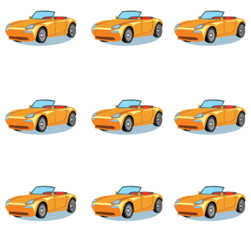


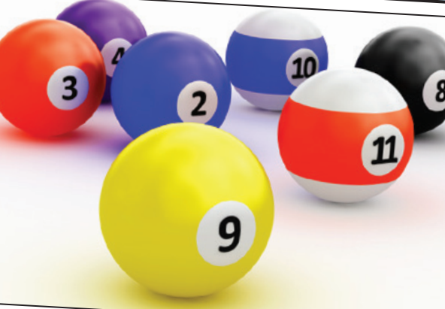

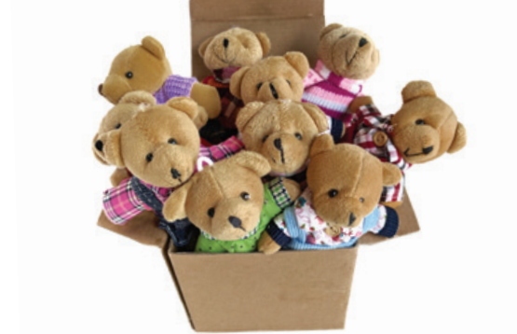
1
4
6
1
SPIN
5
2
2
5
4
3
3
6
Notes:
GV dùng vòng quay để HS chọn số ngẫu nhiên. Khi chọn vào ô số nào thì sẽ làm câu cho số đó

Slide 6

It’s time to learn …

Slide 7

Structures
How many (cars)?
Seven (cars).

Slide 8



How many cars?
Five cars.

Slide 9

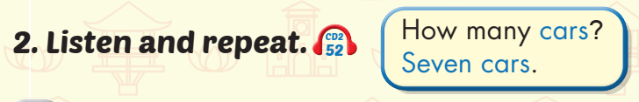


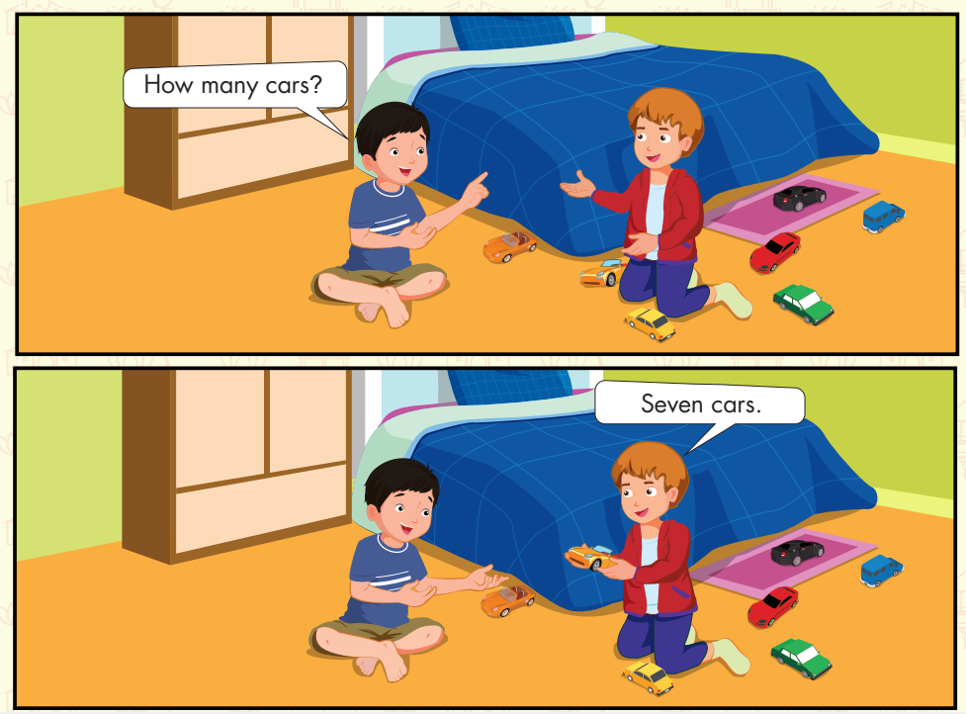
How many balls?
How many teddy bears?
Nine balls.
One teddy bear.

Slide 10


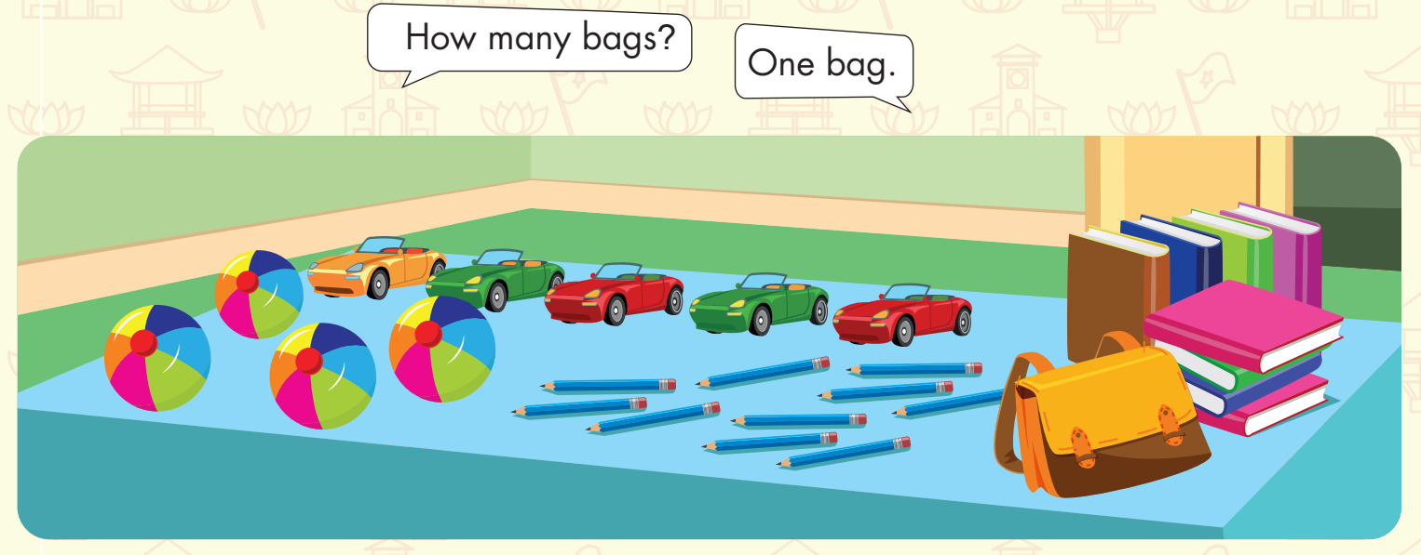

Slide 11

Practice

Slide 12

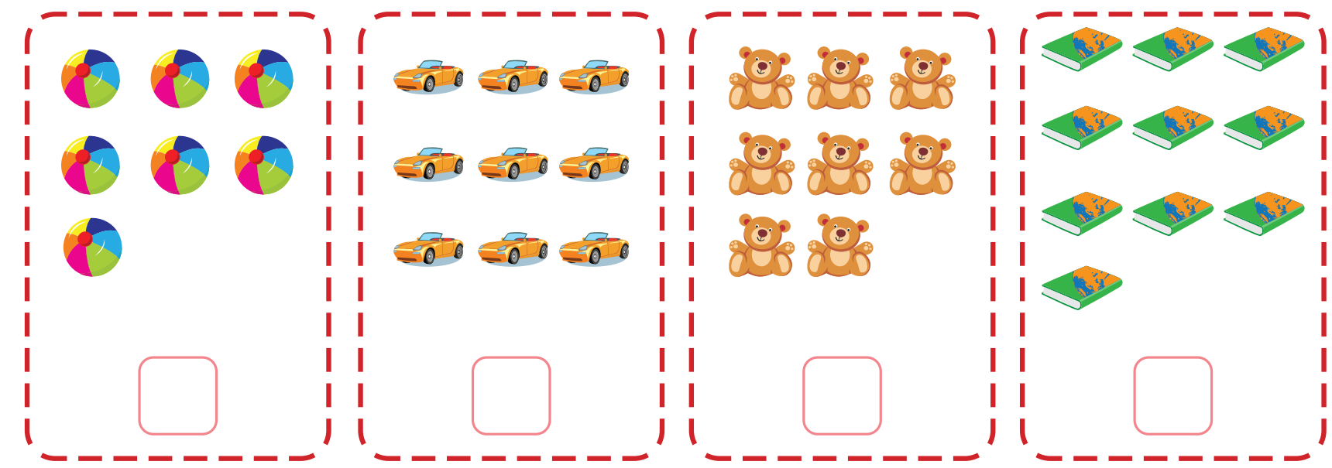
Extra Practice
WB, page 59.
Click on each icon to hear the sound
Click on the picture to show the answer
1
2
3
4
✔️
❌
❌
✔️

Slide 13

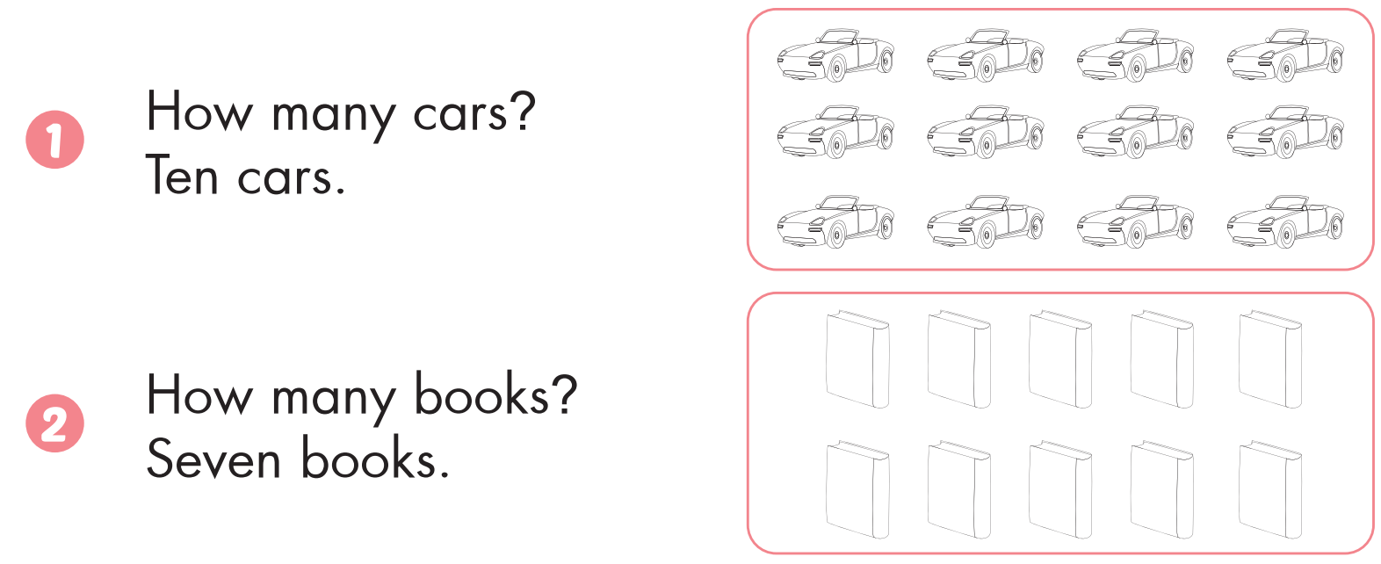
Extra Practice
WB, page 59.

Slide 14
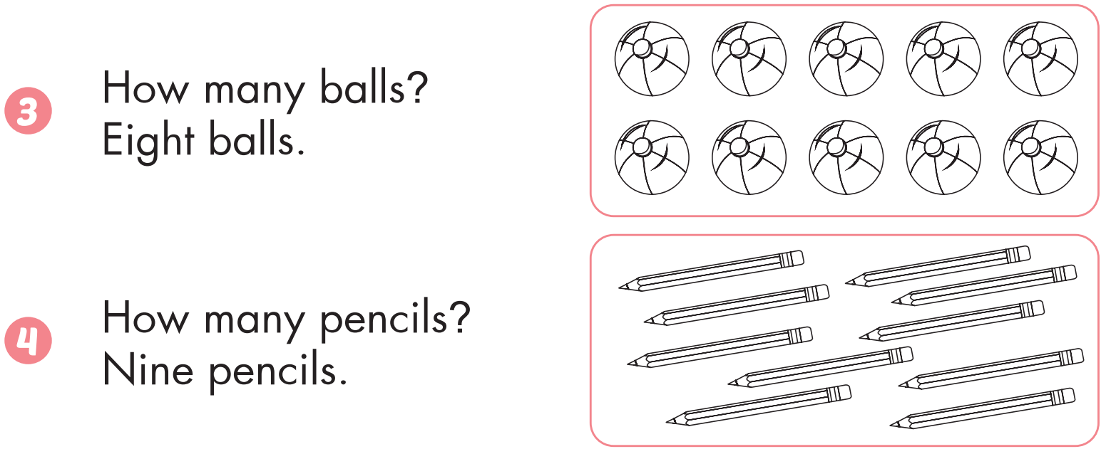
Extra Practice
WB, page 59.

Slide 15
It’s time to play …

Slide 16


Bow and arrows
Click on to choose the answer.

Slide 17




Yes
Oh, no!
One teddy bear
One teddy bears
Oh, no!
Oh, no!
Eight teddy bears
Ten teddy bears

Slide 18
Yes!
Oh, no!
Nine cars
Eight cars
Oh, no!
Oh, no!
Seven cars
Nine car

Slide 19

Oh, no!
Seven ball
Oh, no!
Six balls
Oh, no!
Yes!
Eight balls
Seven balls

Slide 20

Oh, no!
Oh, no!
Nine books
Ten book
Yes!
Oh, no!
Ten books
Eight books

Slide 21



Oh, no!
Oh, no!
Eight books
Nine pencils
Oh, no!
Yes!
Eight pencil
Eight pencils

Slide 22
many/ How/ cars?
Oh, no!
How cars many?
Oh, no!
Many how cars?
Oh, no!
Yes!
How many cars.
How many cars?

Slide 23
Gấu bông
Oh, no!
Oh, no!
Teddy baer
Tedy bear
Yes!
Teddy bear
Oh, no!
Bear teddy

Slide 24
Xe hơi
Oh, no!
Oh, no!
Caar
Cat
Yes!
Oh, no!
Car
Carr

Slide 25
llab
Yes!
Oh, no!
ball
blal
Oh, no!
Oh, no!
blla
allb

Slide 26

CONSOLIDATION

Slide 27
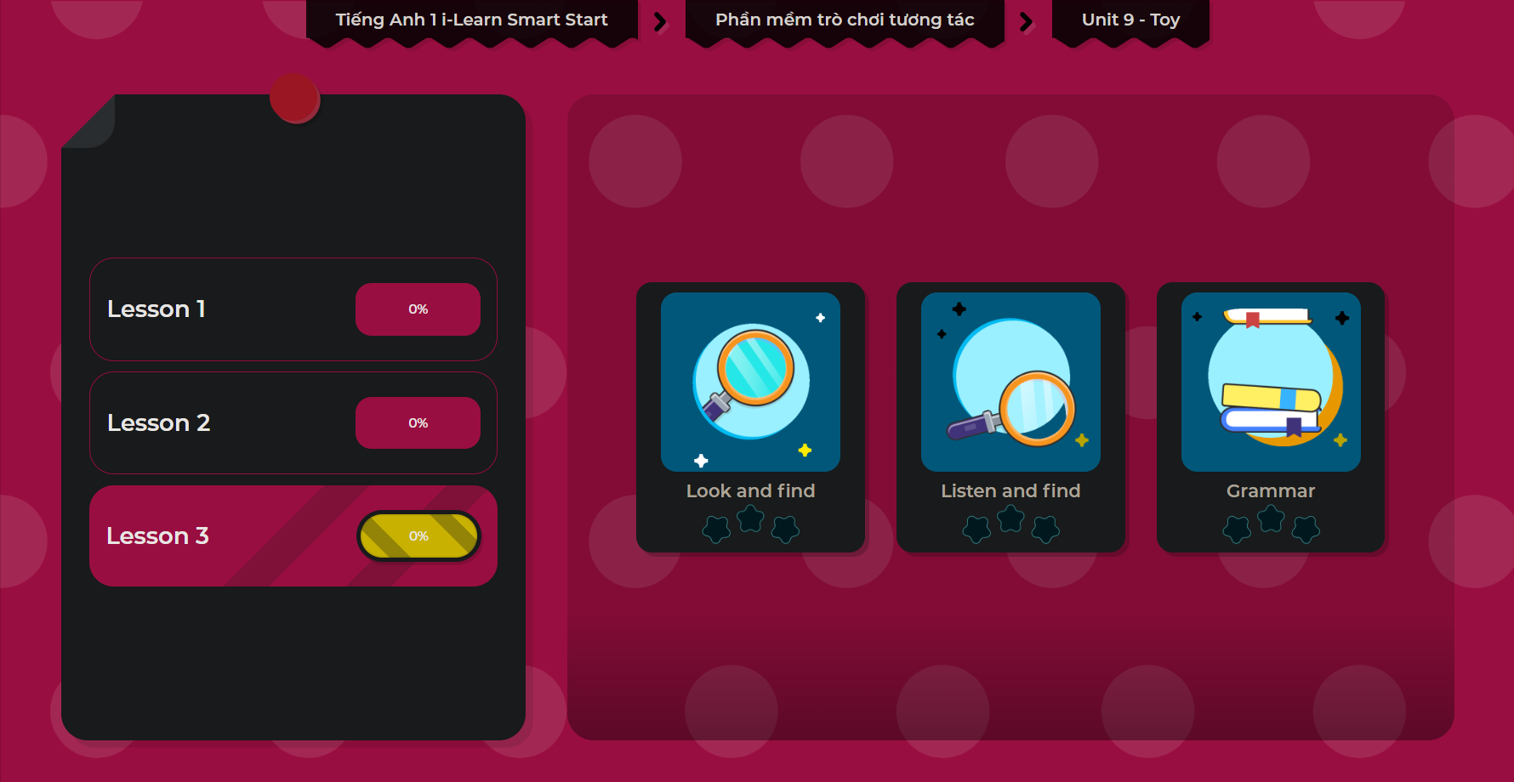
Extra Practice
DHA App
LET’S PLAY!

Slide 28

WRAP-UP

Slide 29
Today’s lesson
Structures/ Sentence patterns
How many (cars)?
Seven (cars).
Vocabulary
Revise

Slide 30
Homework
Practice vocabulary and structures. Make sentences using them.
Do the exercises in Tiếng Anh 1 i-Learn Smart Start Notebook (page 57).
Do the exercises in Tiếng Anh 1 i-Learn Smart Start Workbook (page 59).
Play the consolidation games in Tiếng Anh 1 i-Learn Smart Start DHA App on www.eduhome.com.vn
Prepare for the next lesson (page 62).

Slide 31

Enjoy your day!

