Slide 1


Unit 6: Activities
Lesson 1.1
Page 38

Slide 2
Lesson Outline
Warm-up
Vocabulary
Structure
Consolidation
Wrap-up

Slide 3
Objectives
By the end of this lesson, students will be able to talk about their abilities.
Vocabulary: swim, sing, run
Structure: I can (run).

Slide 4

WARM-UP

Slide 5
Let’s sing!

Slide 6


Slide 7

It’s time to learn …

Slide 8

New words
Swim,
Sing,
Run.

Slide 9

Presentation

Slide 10



Slide 11

Practice

Slide 12

Listening

Slide 13

swim
/swɪm/
bơi

Slide 14

sing
/sɪŋ/
hát

Slide 15

run
/rʌn/
chạy

Slide 16
Structures
I can (run).

Slide 17

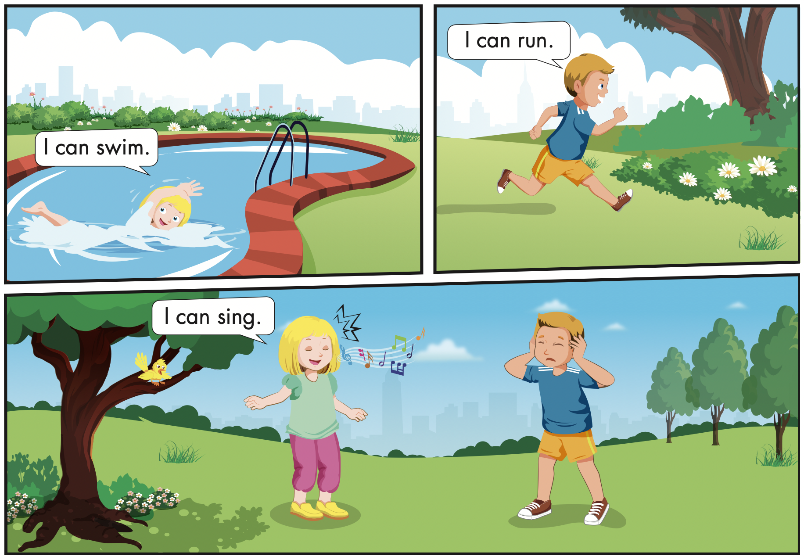

Slide 18

Speaking

Slide 19
Let’s say!
swim
I can swim.

Slide 20
Let’s say!
sing
I can sing

Slide 21
Let’s say!
run
I can run.

Slide 22



Slide 23


Slide 24

Production

Slide 25
Let’s play!
Look and guess

Slide 26


Start
Check

Slide 27
Start
Check

Slide 28
Start
Check

Slide 29


Slide 30

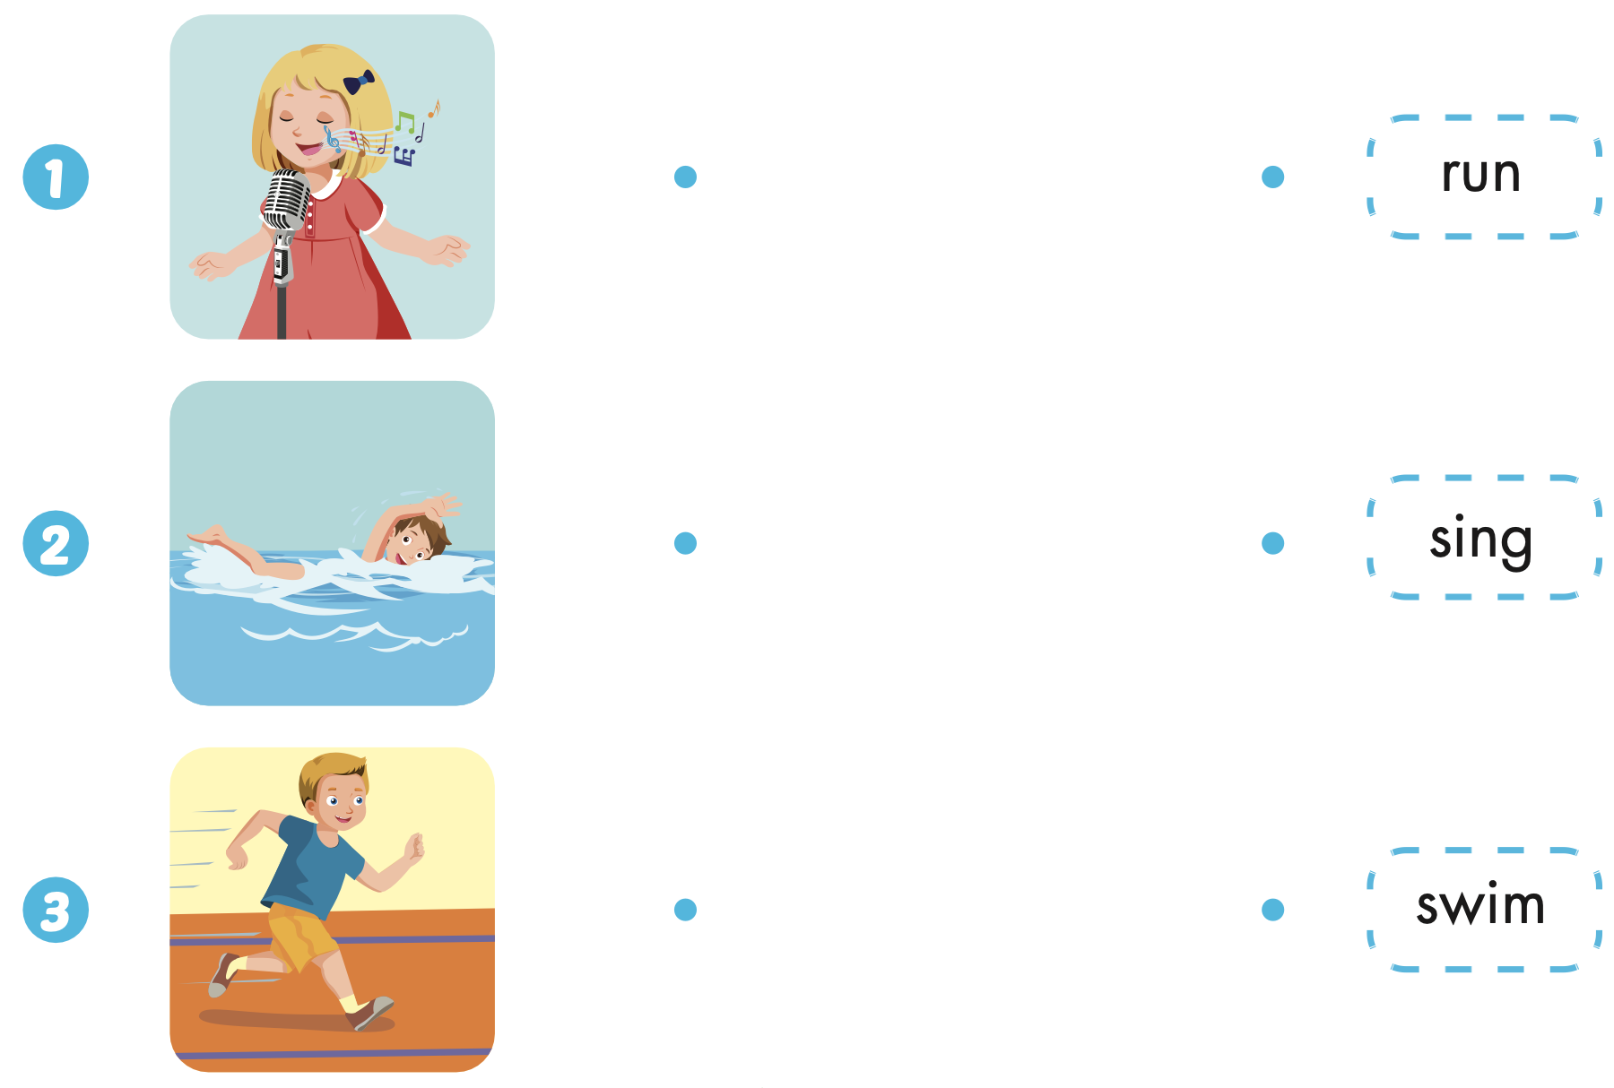
Extra Practice
WB, page 36

Slide 31
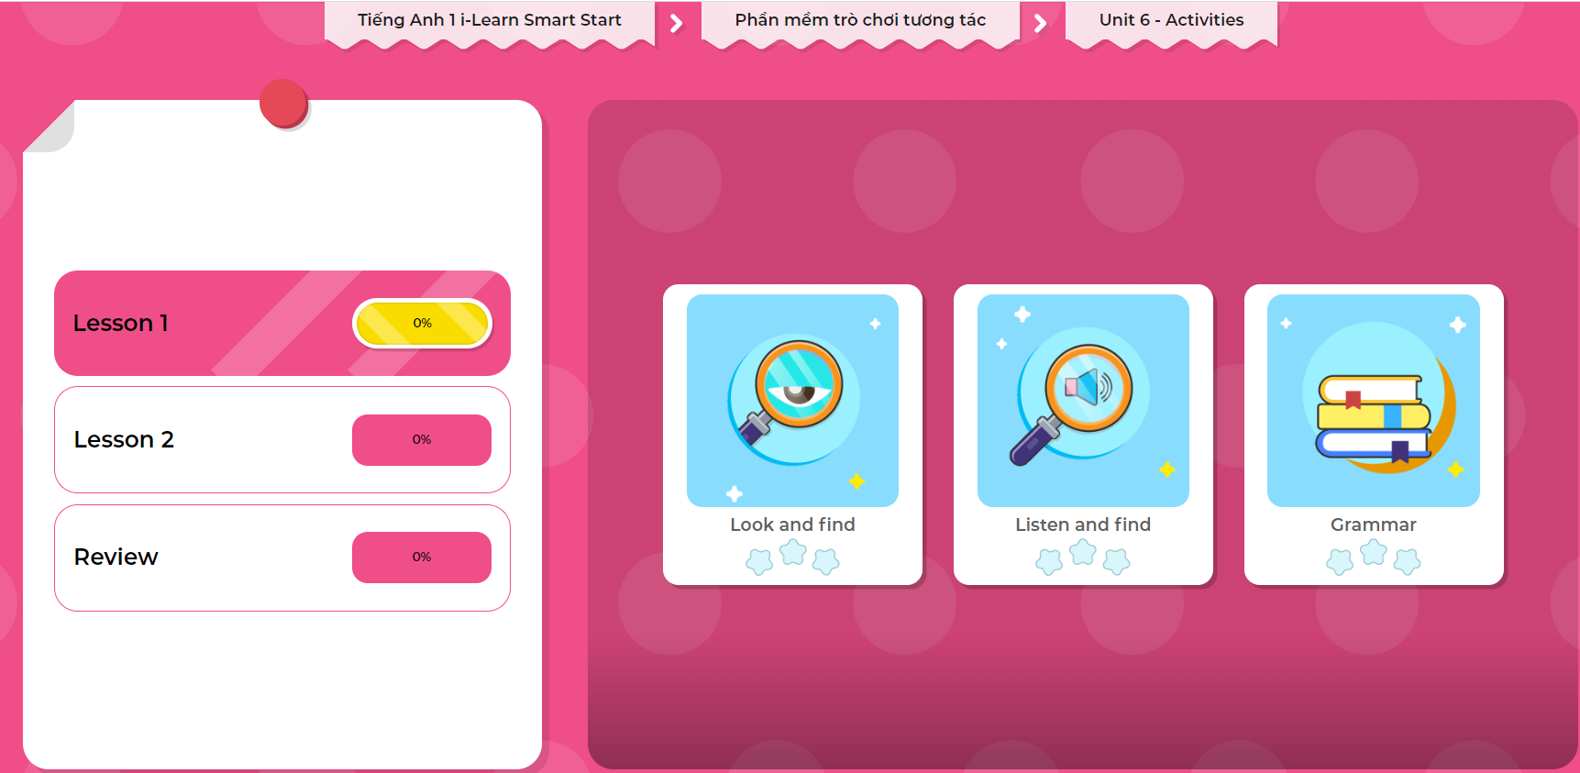
Extra Practice
DHA on Eduhome
LET’S PLAY!
Click on the picture below to play the games.

Slide 32

CONSOLIDATION

Slide 33
Let’s play!
Simon says Game

Slide 34

WRAP-UP

Slide 35
Today’s lesson
Vocabularies
Swim,
Sing,
Run.
Structures/ Sentence patterns
I can (run).

Slide 36
Homework
Practice the vocabularies and structure; and make sentences using them.
Do the exercises in Tiếng Anh 1 i-Learn Smart Start WB (page 36).
Do the exercises in Tiếng Anh 1 i-Learn Smart Start Notebook (page 38).
Prepare the next lesson (page 39 SB).
Play the consolidation games in Tiếng Anh 1 i-Learn Smart Start DHA App on www.eduhome.com.vn

Slide 37

Enjoy your day!

