Slide 1


Unit 6: Activities
Lesson 1.2
Page 39

Slide 2
Objectives
By the end of this lesson, students will be able to talk about their abilities.
Vocabulary: swim, sing, run
Structure: I can (run).

Slide 3
Lesson Outline
Warm-up
Practice
Production
Consolidation
Wrap-up

Slide 4

WARM-UP

Slide 5
Let’s sing!

Slide 6


Slide 7

It’s time to learn …

Slide 8

Review

Slide 9

New words
Swim,
Sing,
Run.

Slide 10

Let’s play!
What’s missing?

Slide 11
Structures
I can (run).

Slide 12

Speaking

Slide 13

Let’s say!
I can swim.

Slide 14

Let’s say!
I can sing.

Slide 15

Let’s say!
I can run.

Slide 16

Practice

Slide 17

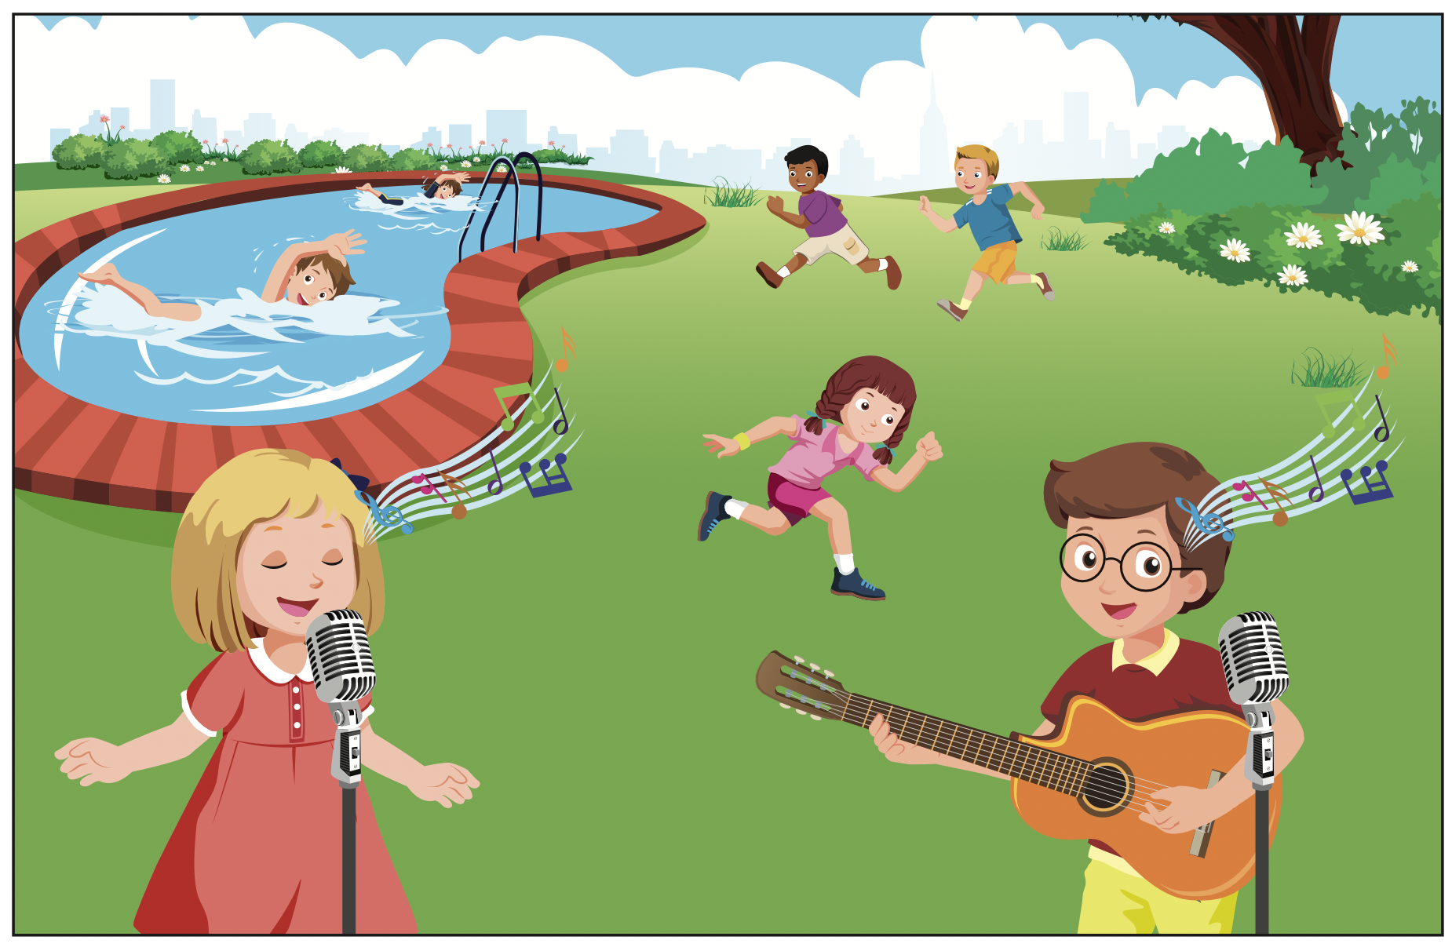


Slide 18
I can swim.

Slide 19
I can run.

Slide 20

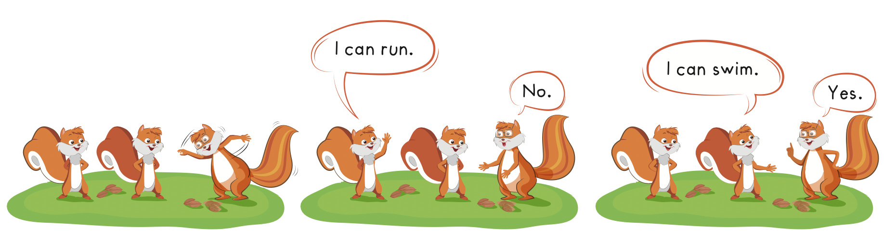

Slide 21

Production

Slide 22
Let’s play!
Listen and choose

Slide 23


I can swim.

Slide 24
I can run.

Slide 25
I can sing.

Slide 26
Good job!

Slide 27

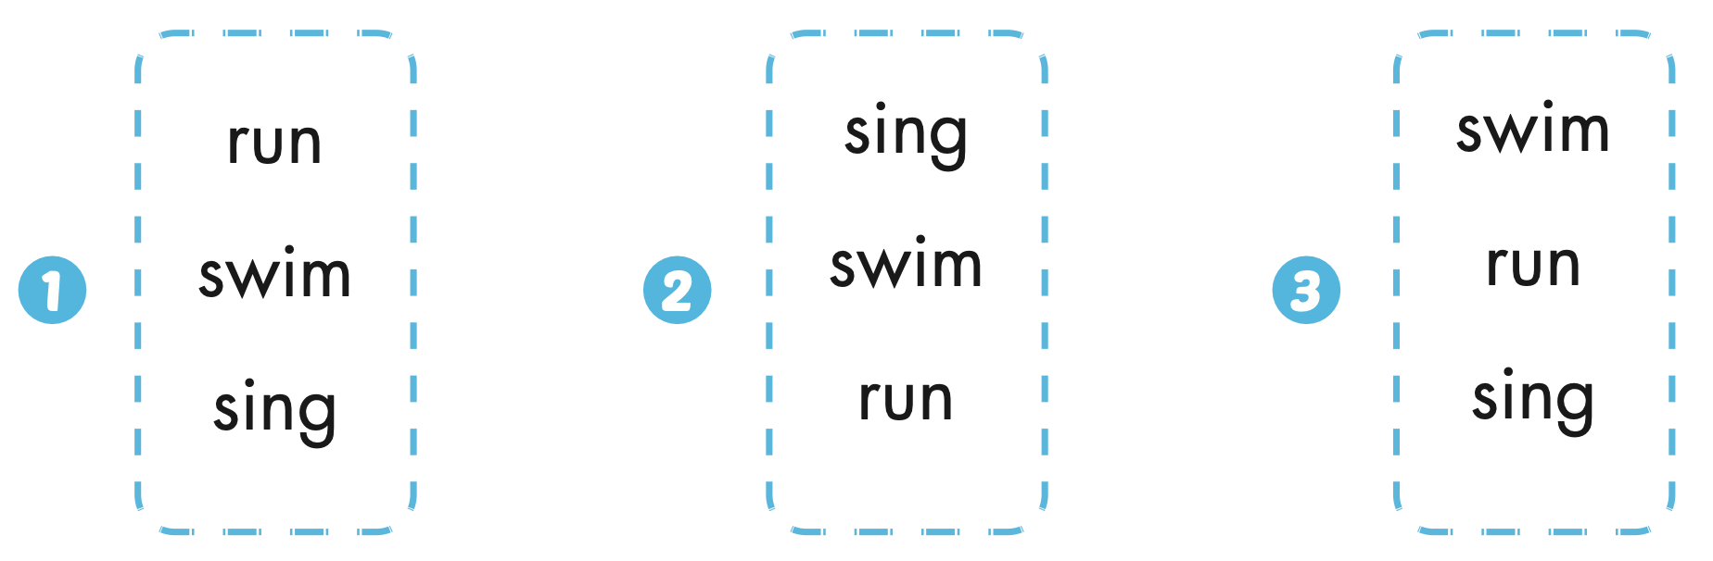
Extra Practice
WB, page 37

Slide 28
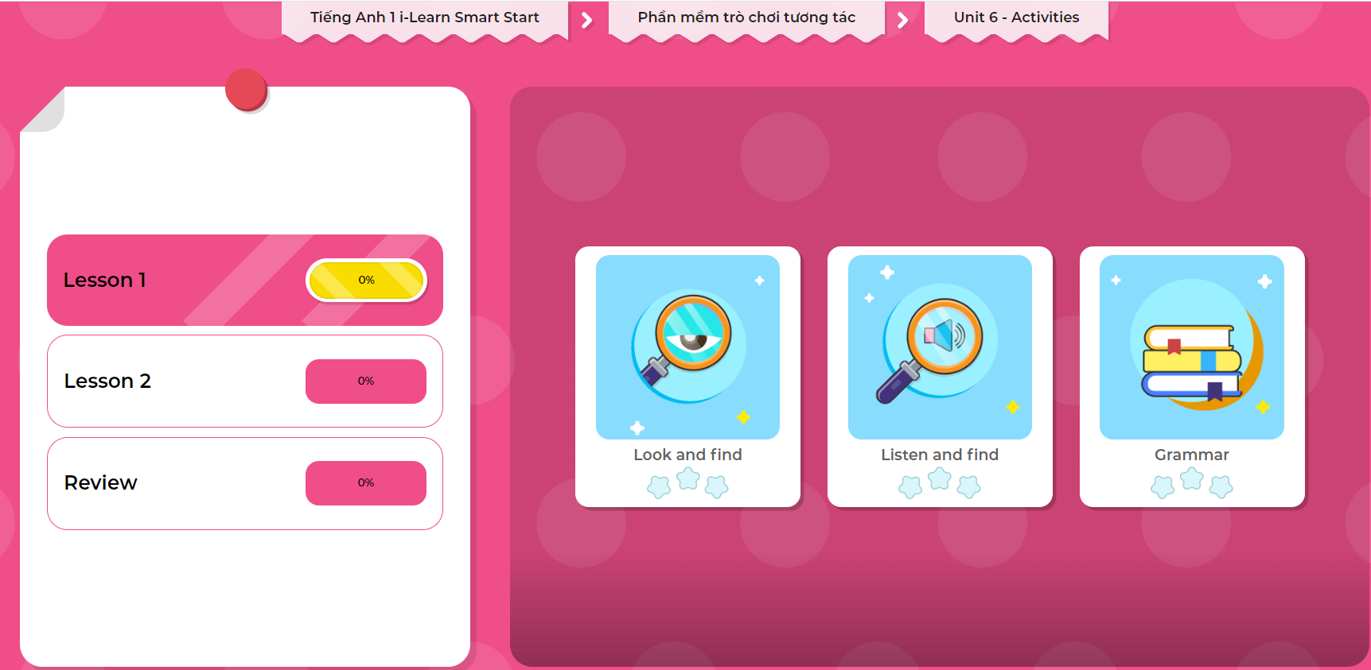
Extra Practice
DHA on Eduhome
LET’S PLAY!
Click on the picture below to play the games.

Slide 29

CONSOLIDATION

Slide 30
Let’s draw!
……………………………..

Slide 31

WRAP-UP

Slide 32
Today’s lesson
Vocabularies
Swim,
Sing,
Run.
Structures/ Sentence patterns
I can(run).

Slide 33
Homework
Practice the vocabularies and structure; and make sentences using them.
Do the exercises in Tiếng Anh 1 i-Learn Smart Start WB (page 37).
Do the exercises in Tiếng Anh 1 i-Learn Smart Start Notebook (page 39).
Prepare the next lesson (page 40 SB).
Play the consolidation games in Tiếng Anh 1 i-Learn Smart Start DHA App on www.eduhome.com.vn

Slide 34

Enjoy your day!

