Slide 1









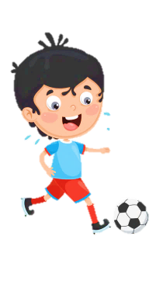













Slide 2

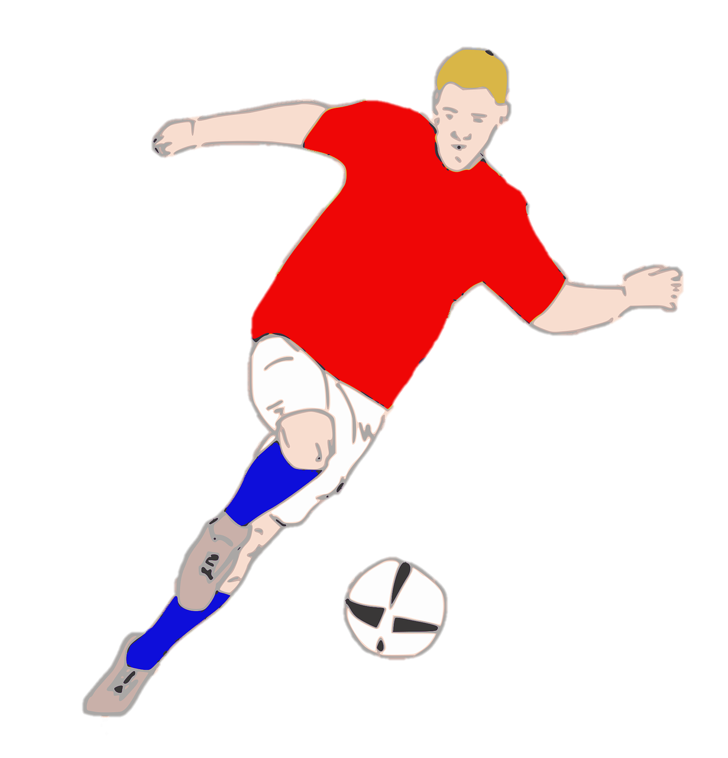
Unit 7:
SPORTS
Lesson 3 – Part 1, 2, 3

Slide 3





Table of contents
01
Warm-up
04
05
Production
Wrap-up &
Assessment
02
03
Review
Practice

Slide 4




1
Warm-up

Slide 5


Slide 6
2
Review

Slide 7

Choose and write
do exercise every day
play games 10 hours a day
eat fast food 5 days a week
learn to swim
listen to teachers
should | shouldn’t
We should do exercise every day.
We shouldn’t play games 10 hours a day.
We should learn to swim.
We shouldn’t eat fast food 5 days a week.
We should listen to teachers.

Slide 8
3
Practice

Slide 9
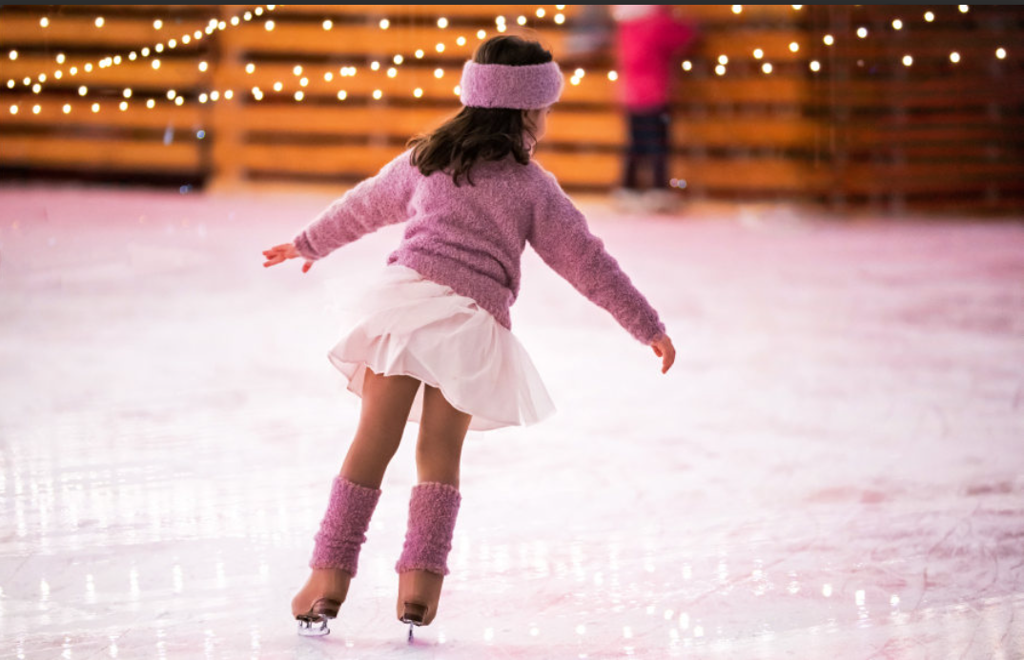

What sport is it?
It’s ice-skating.
What do we need to ice skate?
We need ice skates.
Is it popular in Vietnam?
No, it isn’t.
Do you like ice-skating? Why?

Slide 10

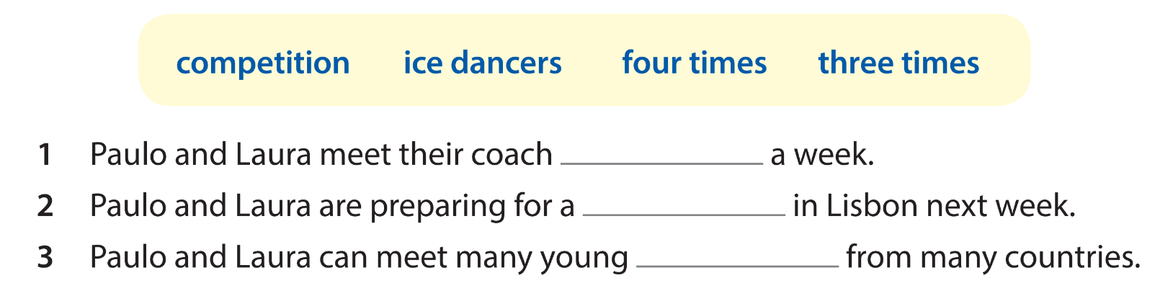
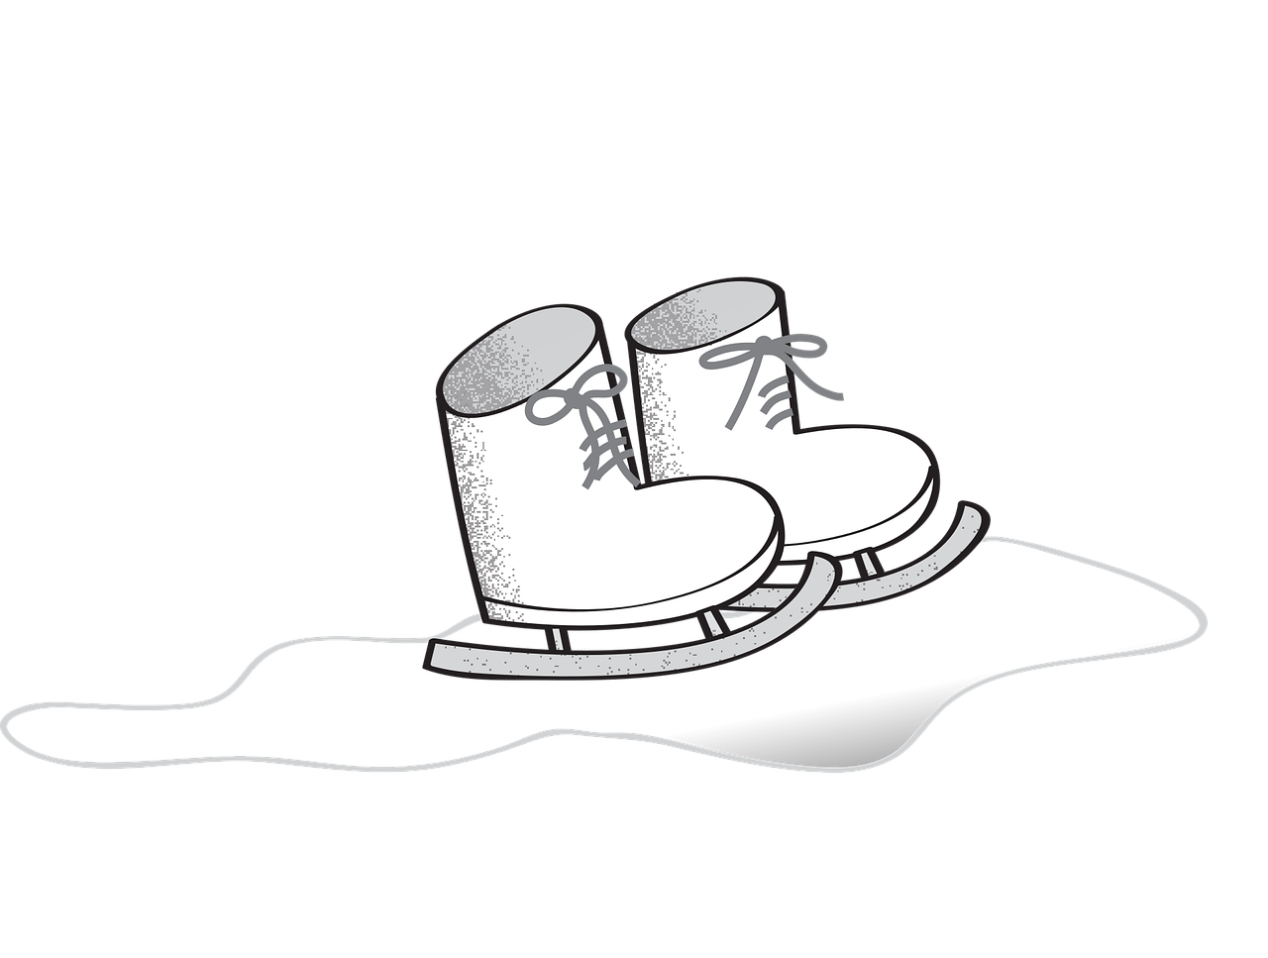
four times
competition
ice dancers

Slide 11
4
Production

Slide 12


Let’s play
“Guess the sport!”
I’ll show you some clues about each sport. Let’s try to guess what sports they are!

Slide 13




What sport is it?
It’s tennis.

Slide 14



What sport is it?
It’s swimming.

Slide 15



What sport is it?
It’s diving.

Slide 16

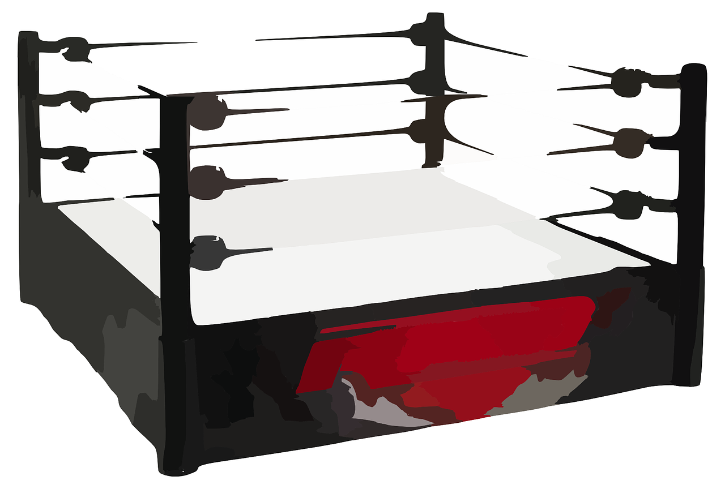

What sport is it?
It’s boxing.

Slide 17

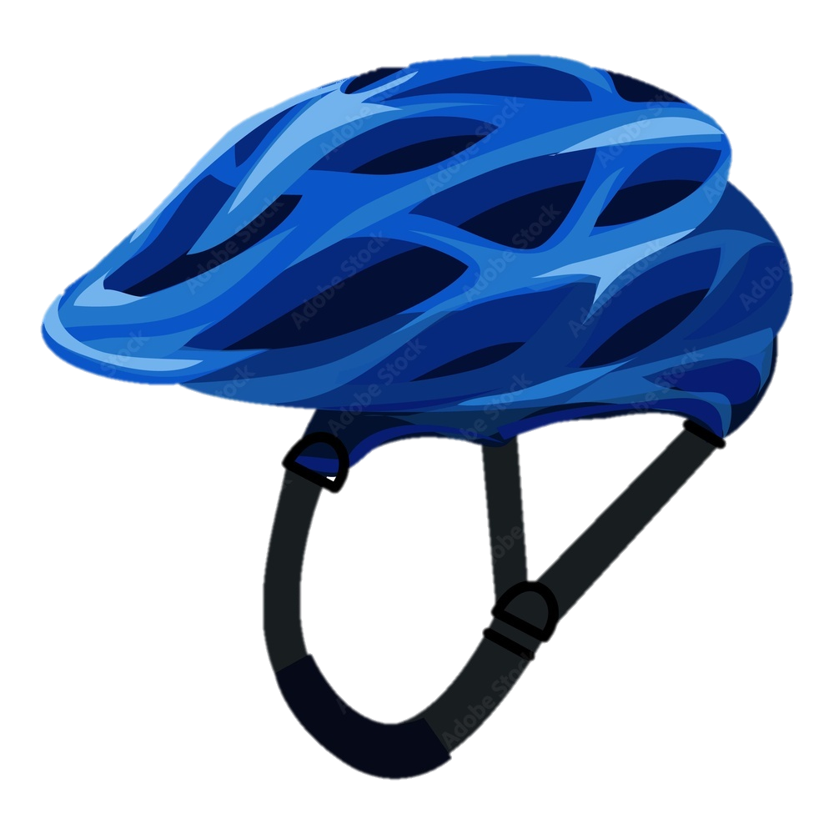

What sport is it?
It’s cycling.

Slide 18

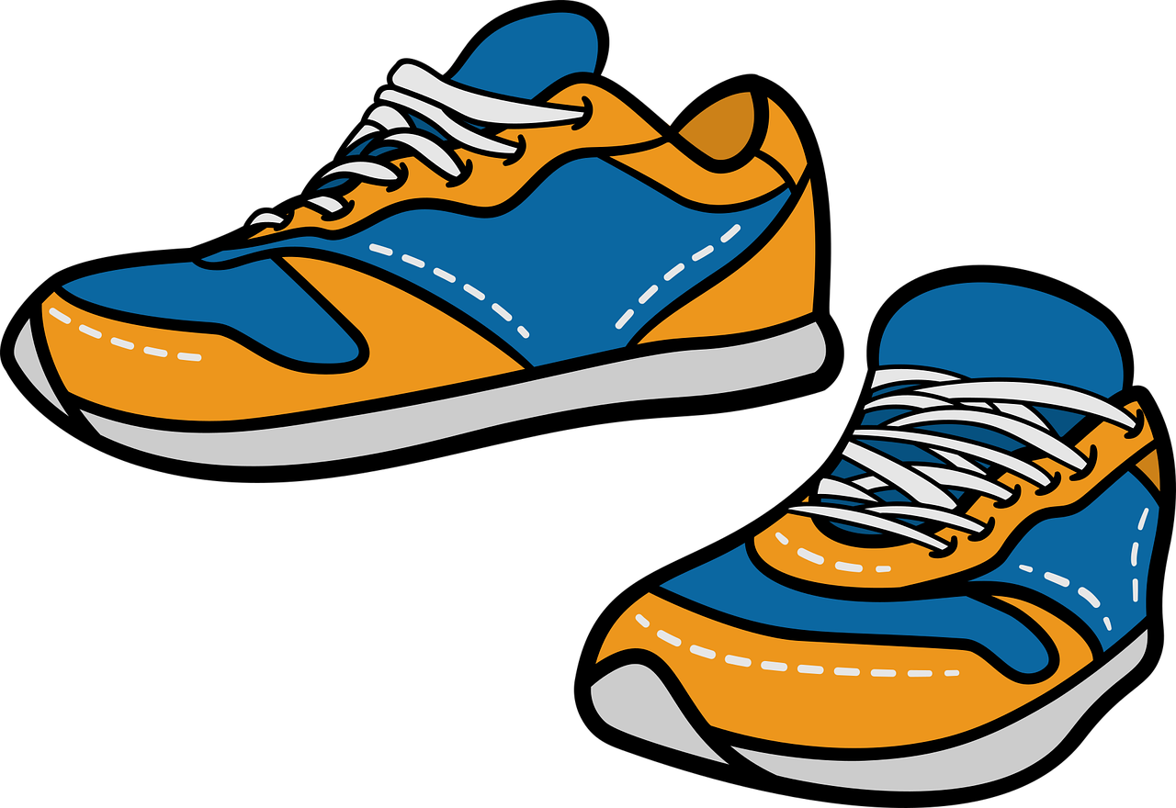
What sport is it?
It’s running.

Slide 19



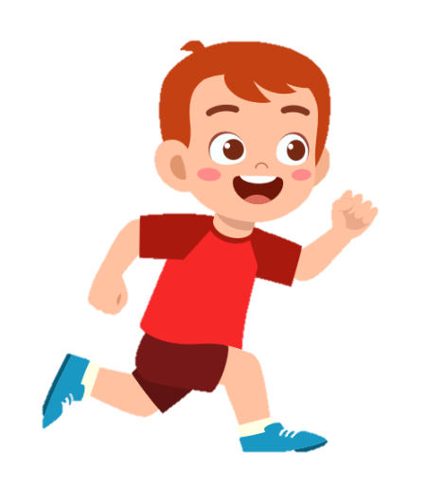
boxing dancing cycling running
diving swimming playing tennis
playing basketball playing football
Are you swimming?
No, I’m not.
Yes, I am.
Are you running?

Slide 20
5
Wrap-up & Assessment

Slide 21
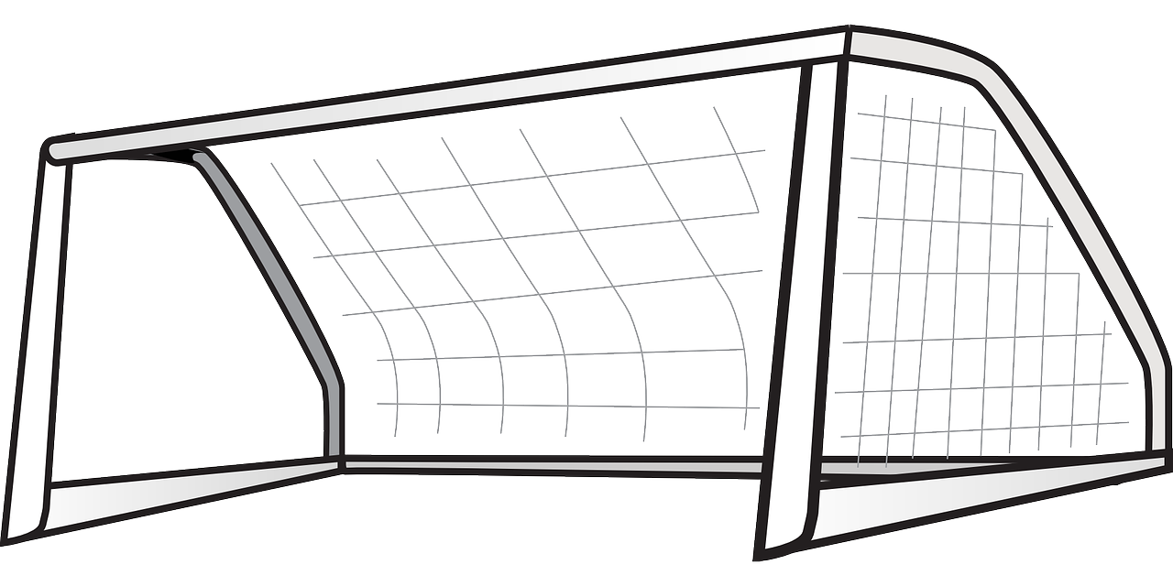

Find the wrong letters in each word.
foodball
=> football

Slide 22
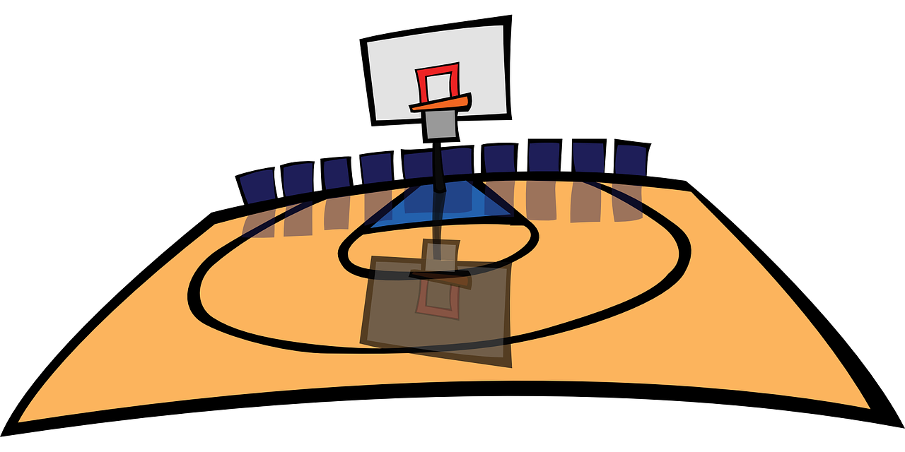

Find the wrong letters in each word.
batkitball
=> basketball

Slide 23

Find the wrong letters in each word.
daiving
=> diving

Slide 24


Find the wrong letters in each word.
betminton
=> badminton

Slide 25


Find the wrong letters in each word.
atchery
=> archery

Slide 26


Wrap-up
Unit 7: Sports
Lesson 3 – Part 1,2,3
What have we learnt today?
Practice listening and speaking about sports.

Slide 27


Thank you
& goodbye!

