Slide 1



















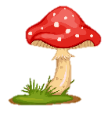
Notes:
Để nguyên trang bìa như này, chỉ thay đổi tên bài trong quá trình làm. Logo của sách Wonderful World

Slide 2






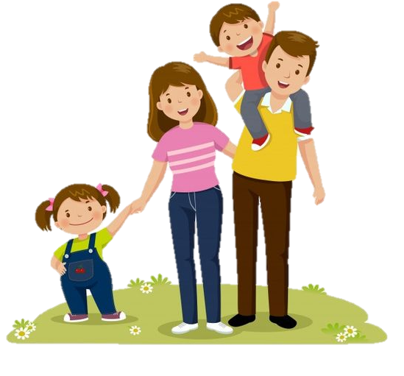
Review 3:
Part 2

Slide 3
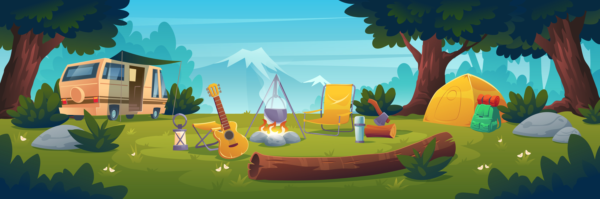
01
WARM-UP

Slide 4

Listen and sing!

Slide 5
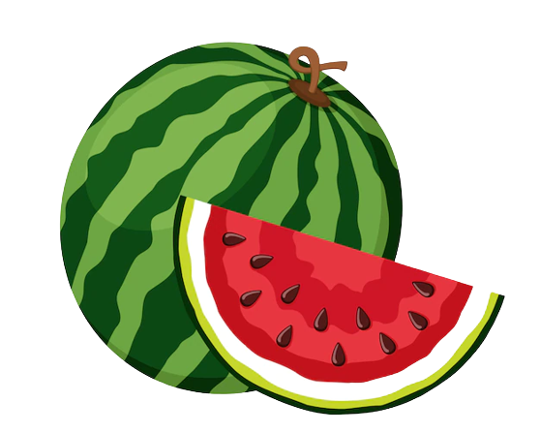





What’s your favourite fruit?

Slide 6
Pick one!
Next

Slide 7
They are _____ a game in the garden.
  playing
back

Slide 8
We can _____ swimming!
  go
back

Slide 9
What can we do ____ the mountain?
  on
back

Slide 10
Where ____ we go camping?
  can
back

Slide 11
We can have a picnic today because it’s _______
  warm / sunny
back

Slide 12
02
PRACTICE

Slide 13
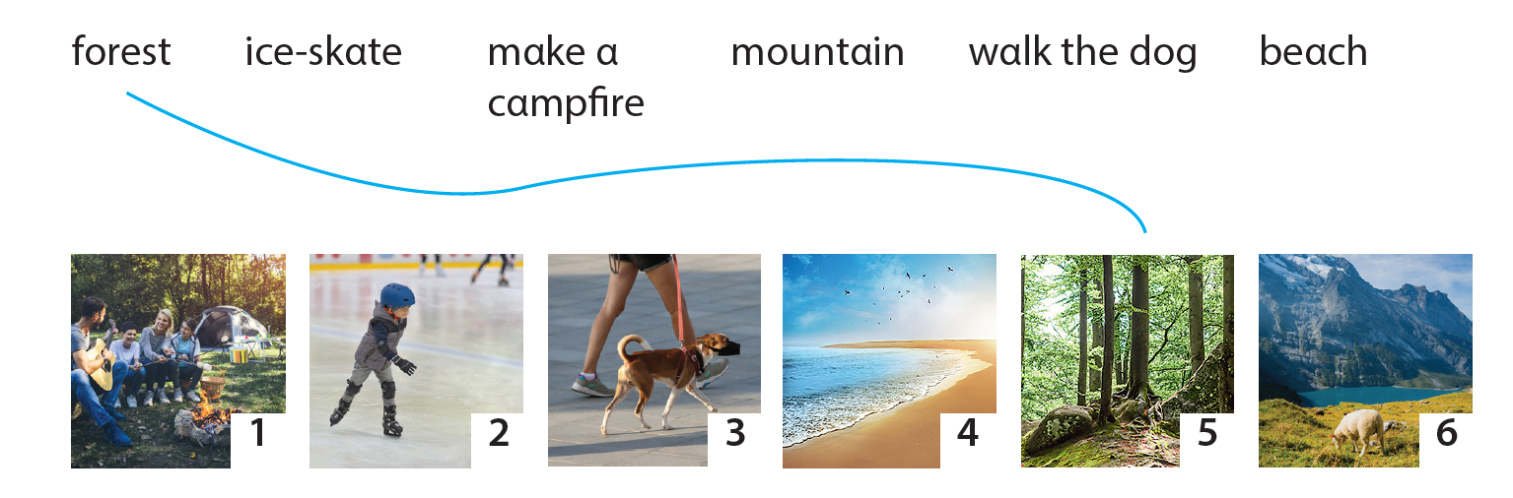
1. Match!
1
2
3
4
6

Slide 14
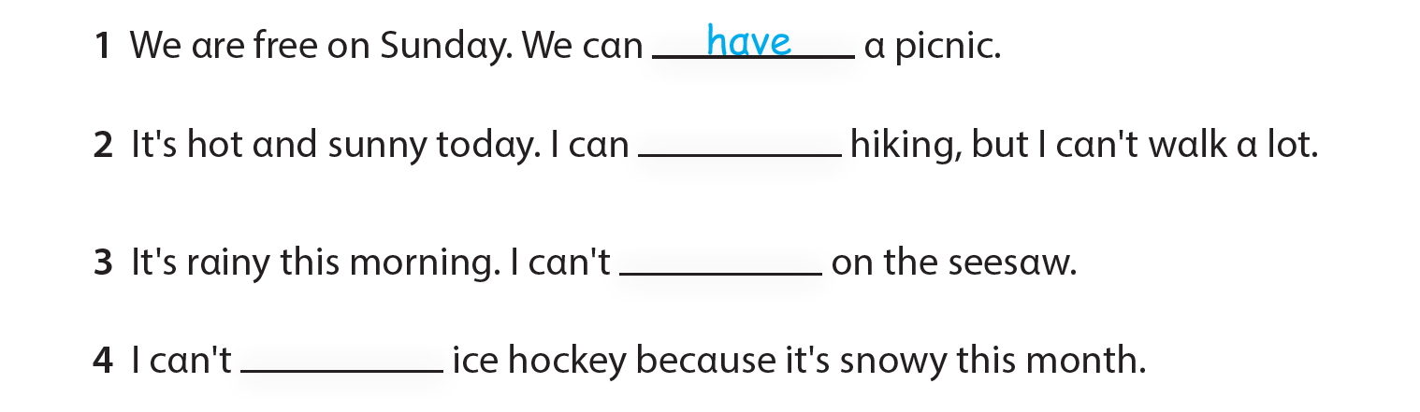
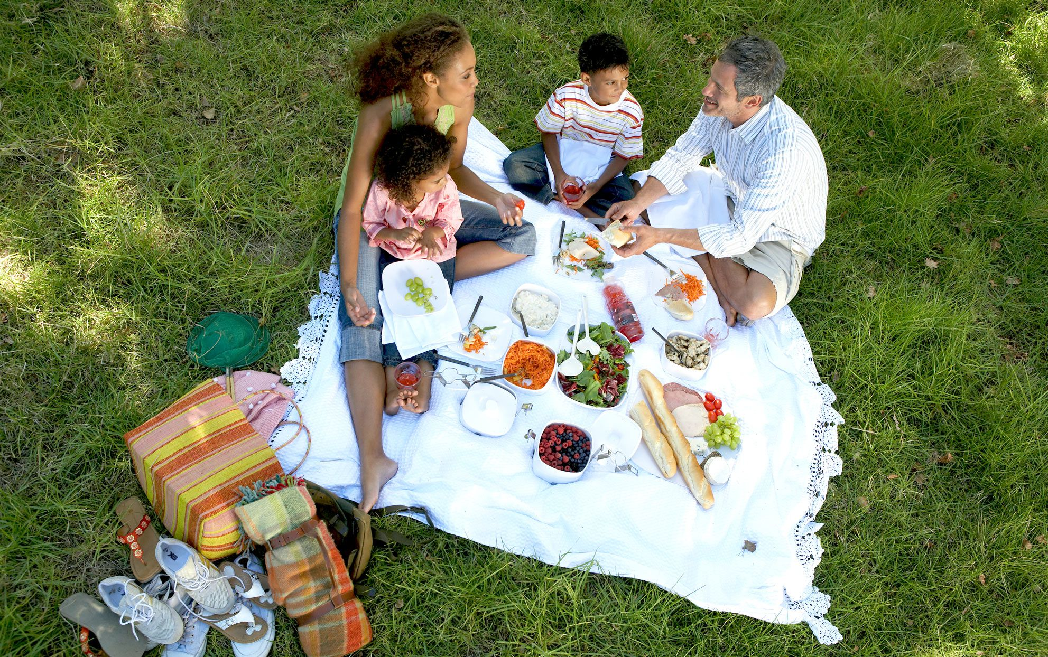
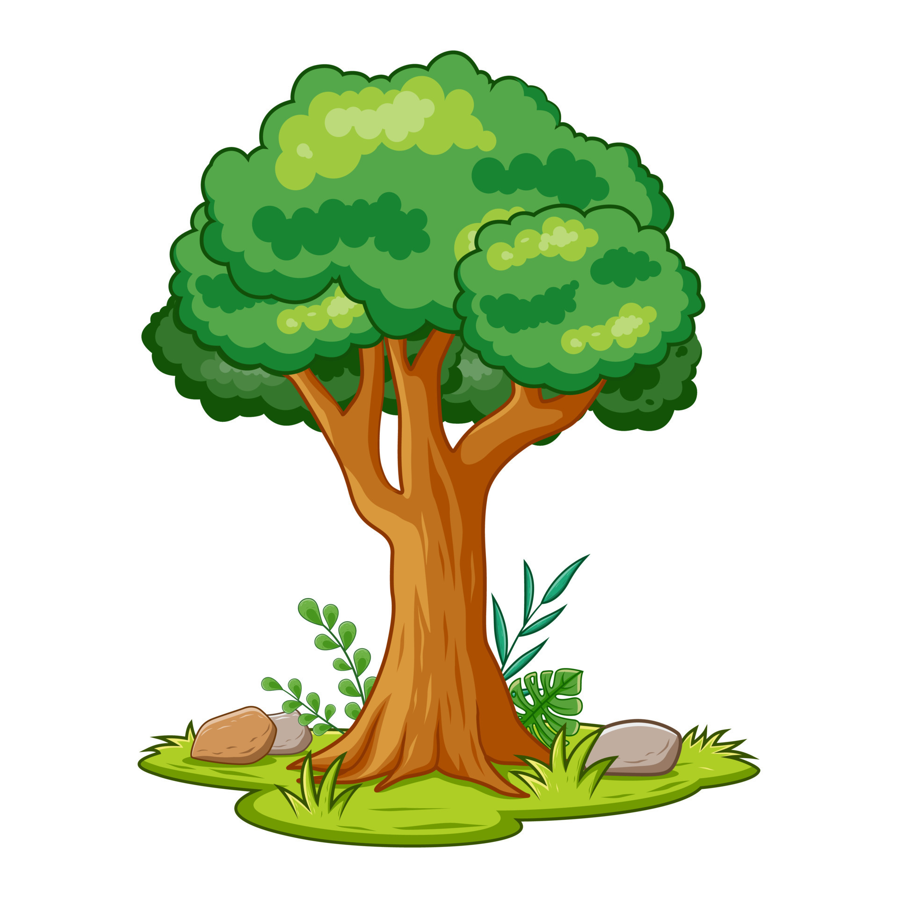

2. Write and Say. Use ONE word for each blank.

Slide 15
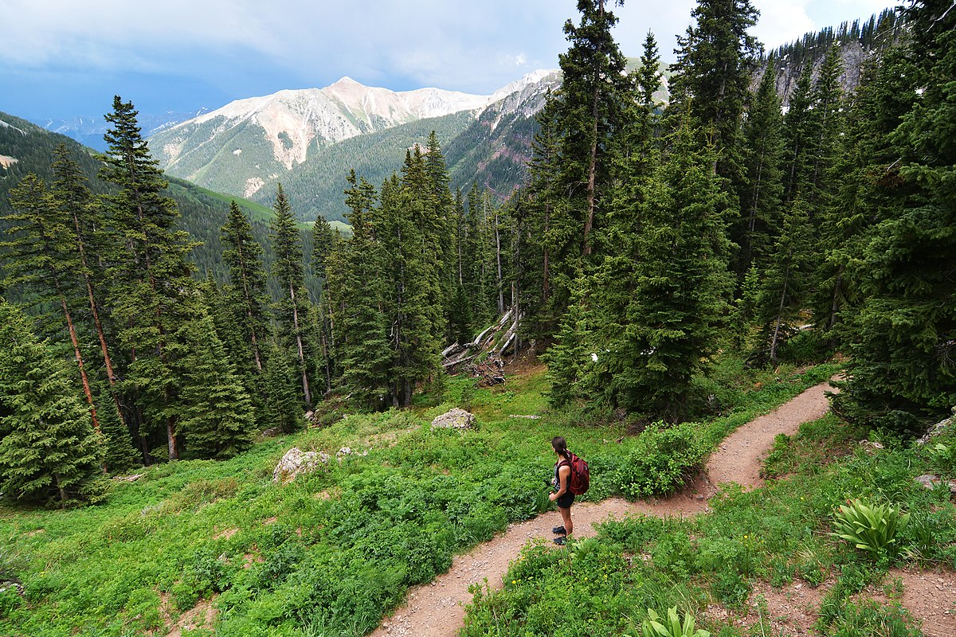
2. Write and Say. Use ONE word for each blank.
go

Slide 16
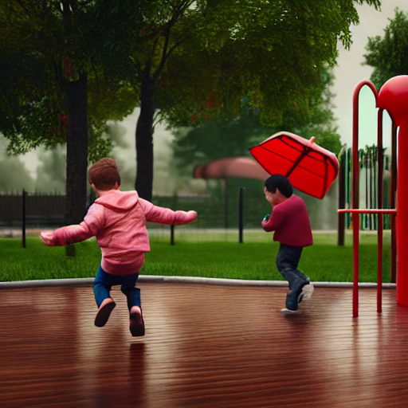
2. Write and Say. Use ONE word for each blank.
play

Slide 17
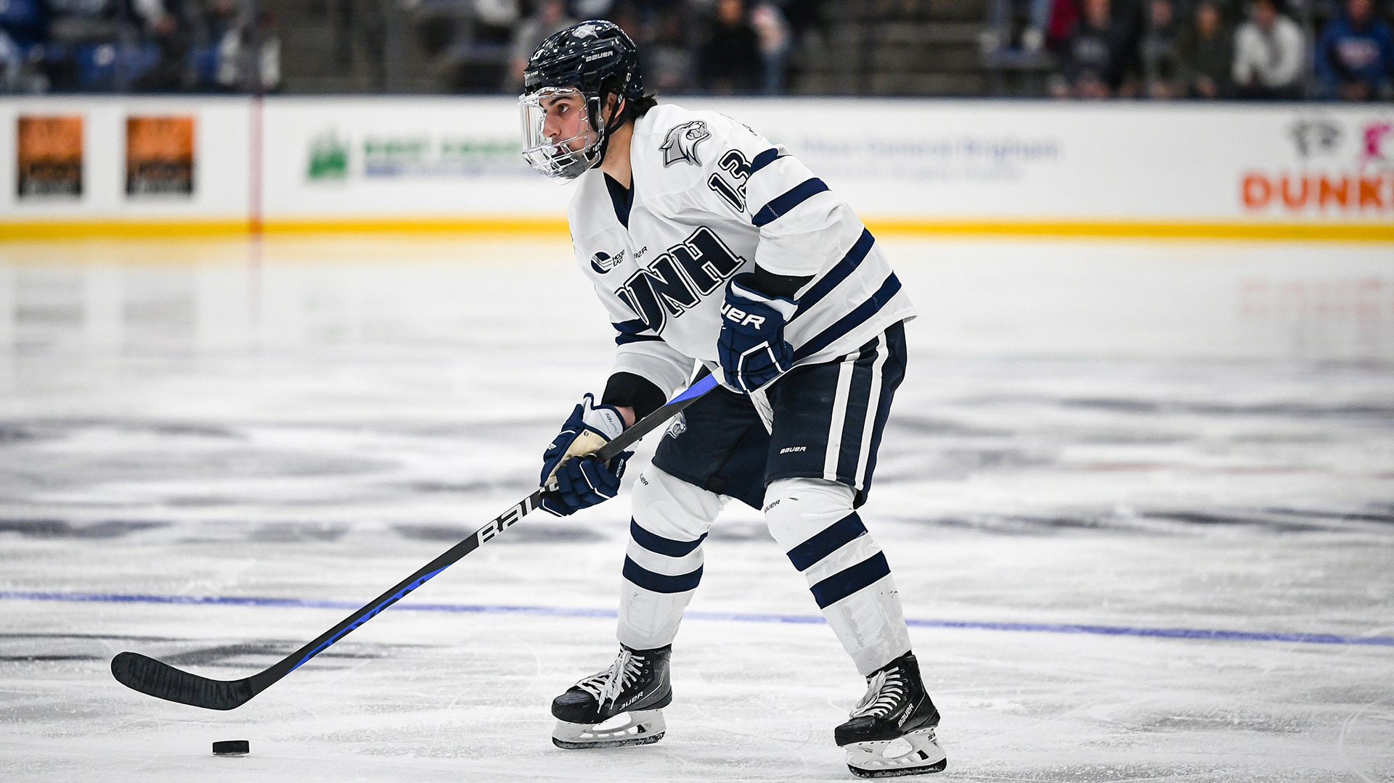
2. Write and Say. Use ONE word for each blank.
play

Slide 18
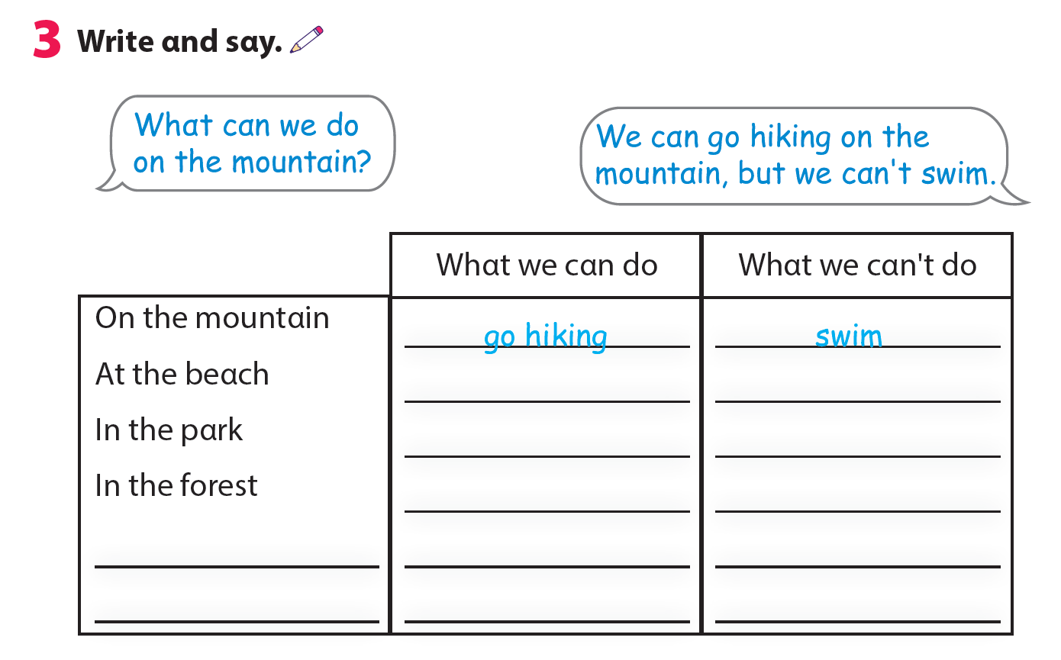
swim
go skiing
have a picnic
go hiking
ride a bike
play ice hockey

Slide 19
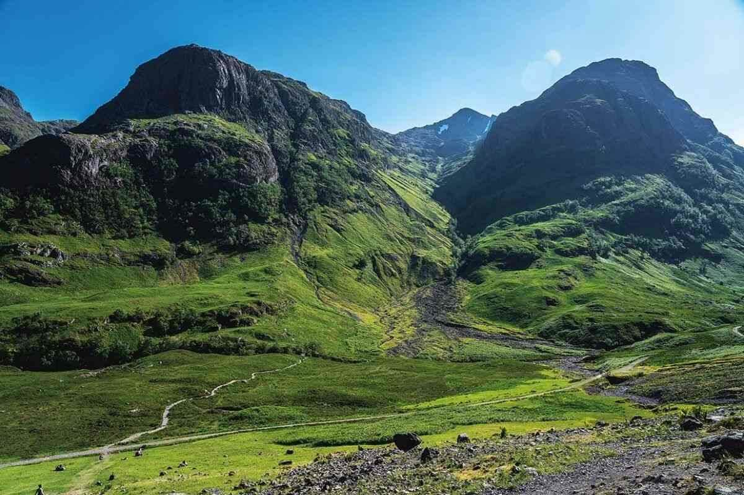
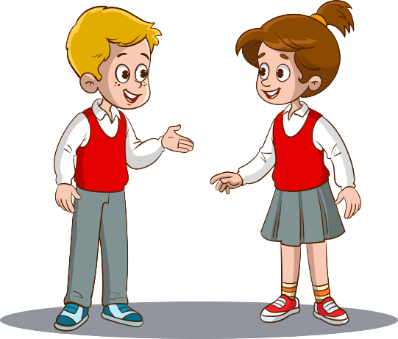
We can go hiking on the mountain, but we can’t swim.
What can we do on the mountain?

Slide 20
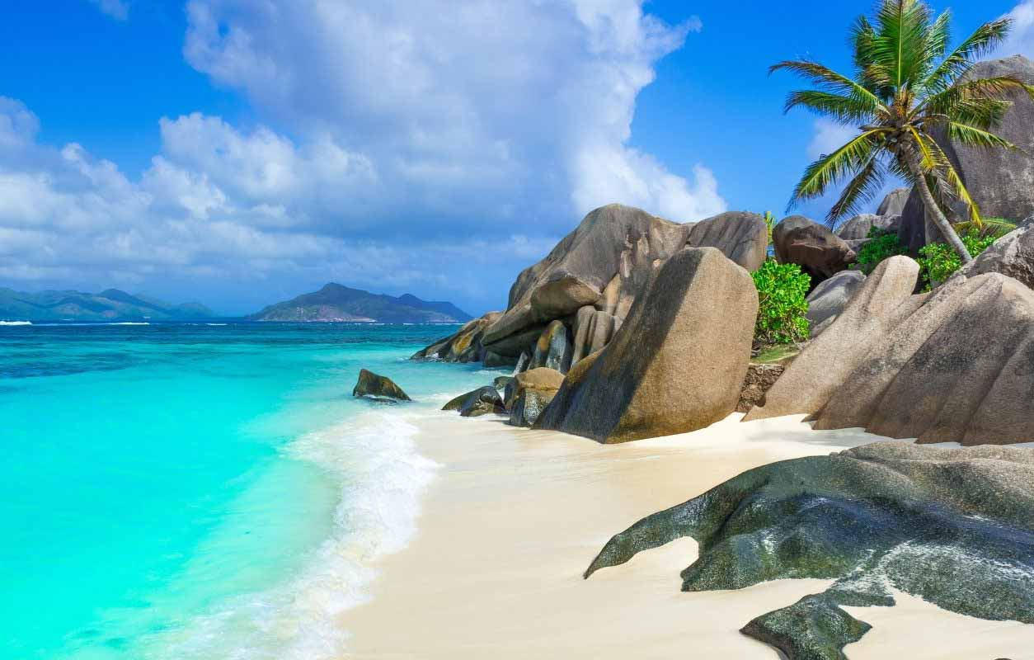
We can swim at the beach, but we can’t go skiing.
What can we do at the beach?

Slide 21
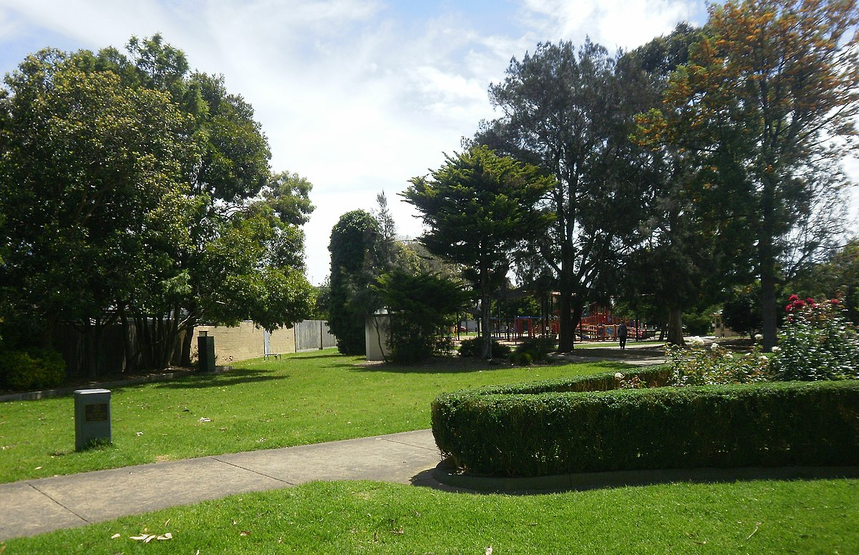
We can have a picnic in the park, but we can’t play ice hockey.
What can we do in the park?

Slide 22
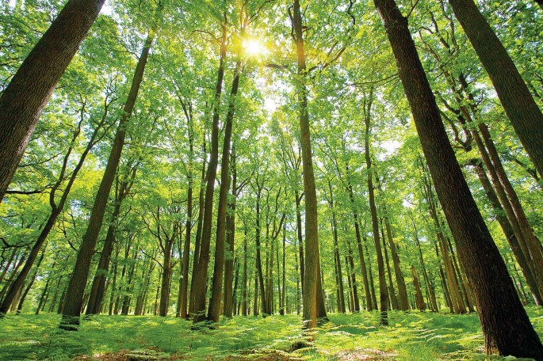
We can ride a bike in the forest, but we can’t swim.
What can we do in the forest?

Slide 23
03
ASSESSMENT

Slide 24
Circle the correct answer
It’s____. We can go skiing.
sunny B. warm C. snowy
Can we go hiking on the _____? Yes, we can.
park B. mountain C. forest
3. We can’t go skiing today because it’s _______.
sunny B. cold C. snowy
4. We can pitch a _______ and have a picnic.
park B. tent C. beach
5. It’s cold today. I’m wearing a ________.
coat B. pool C. forest

Slide 25


Thank you
& goodbye!

