Slide 1









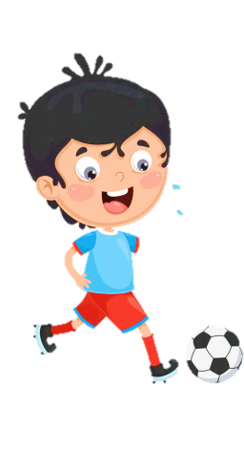
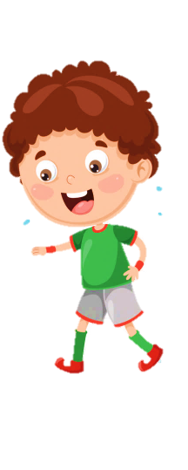





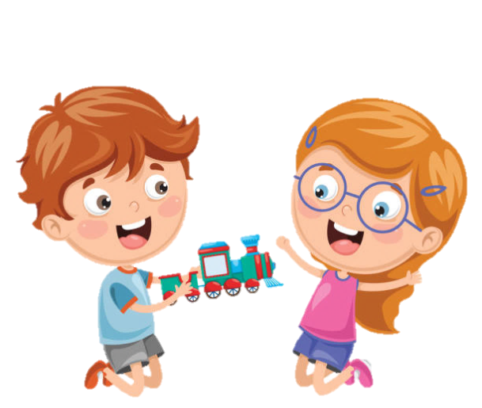




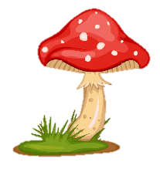

Slide 2

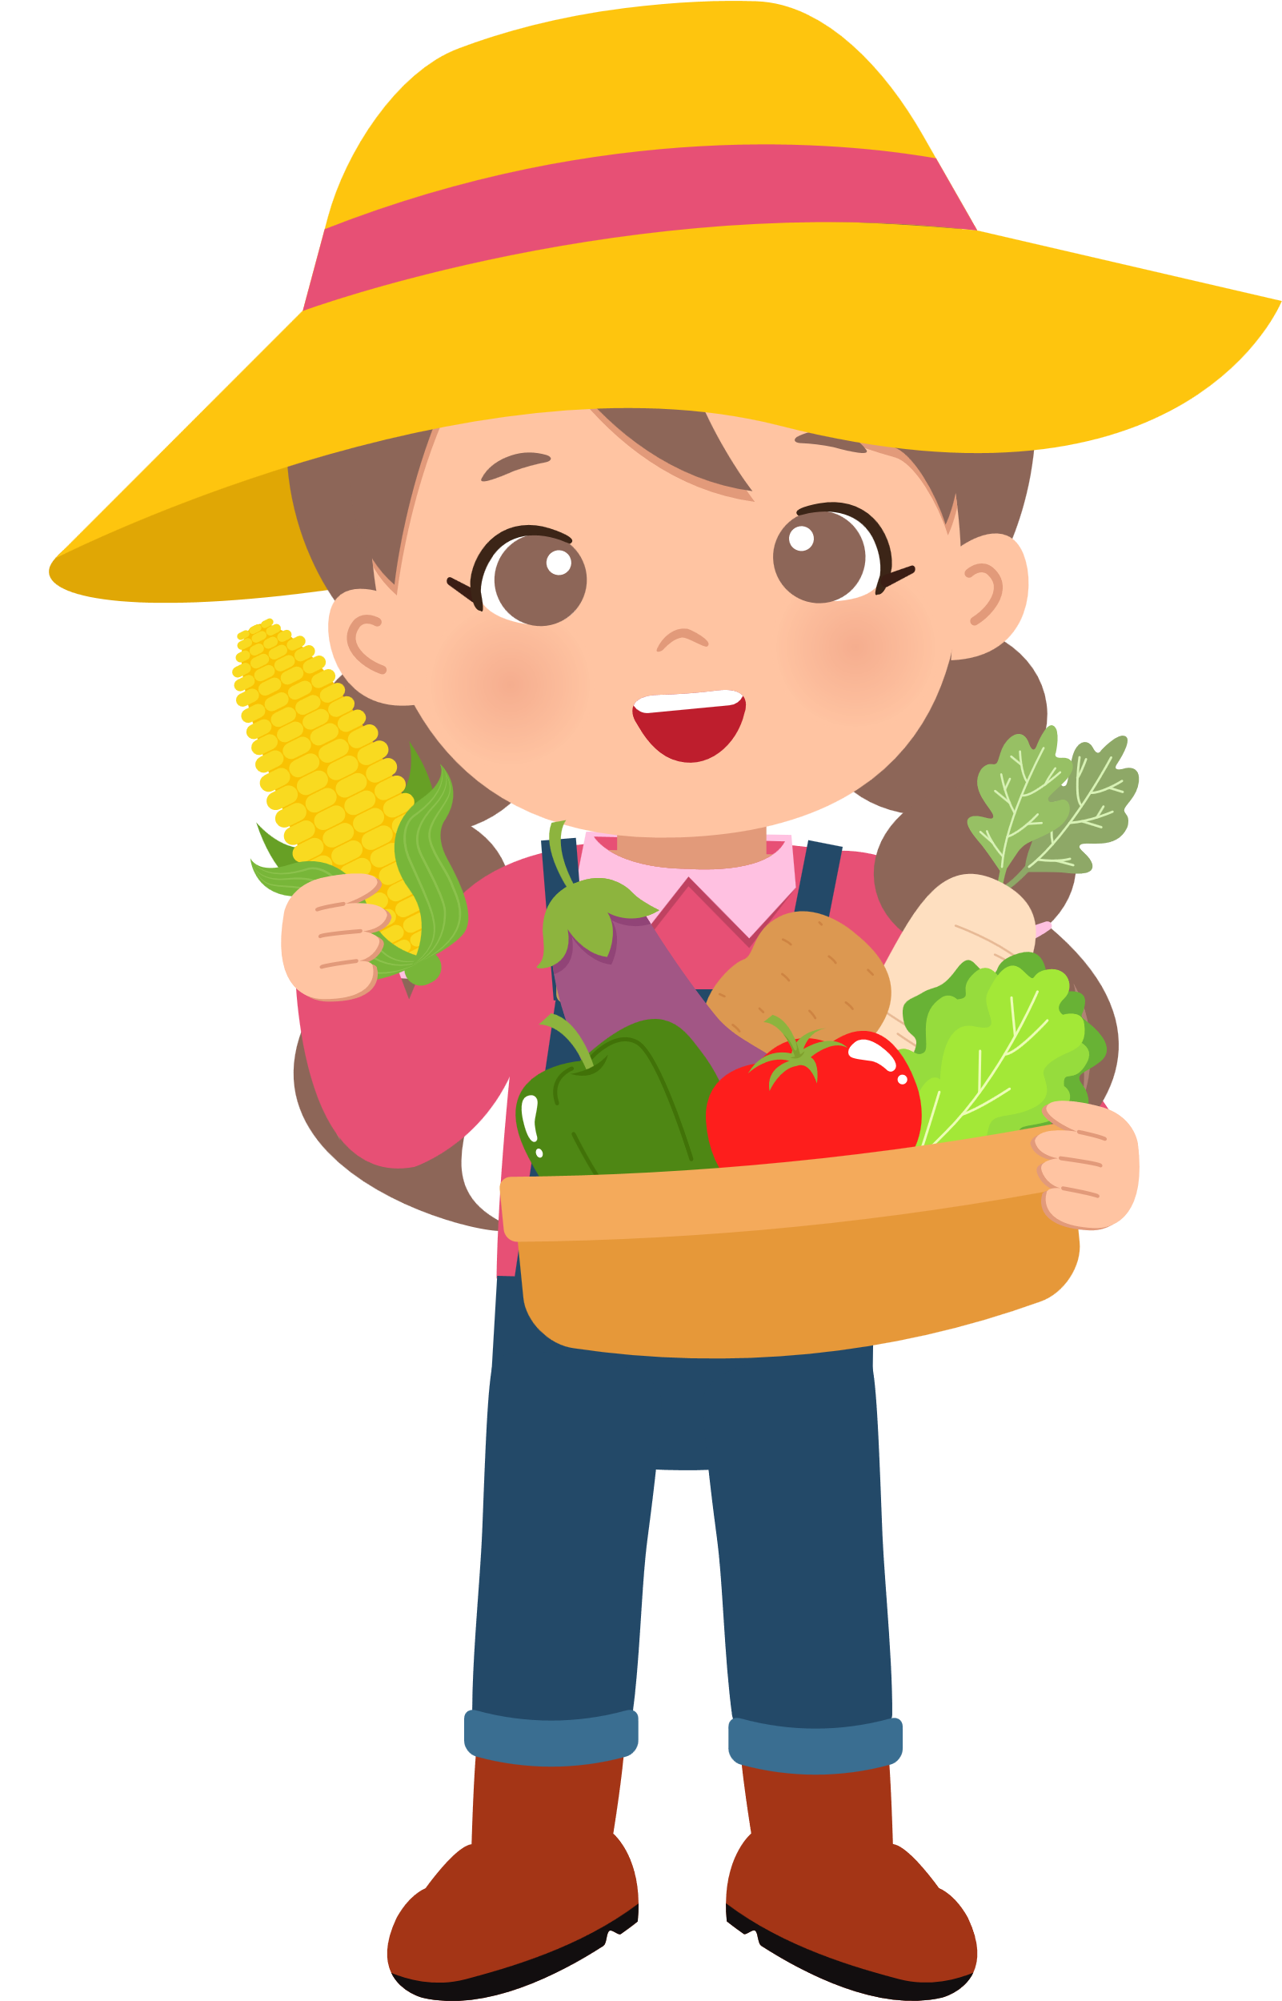
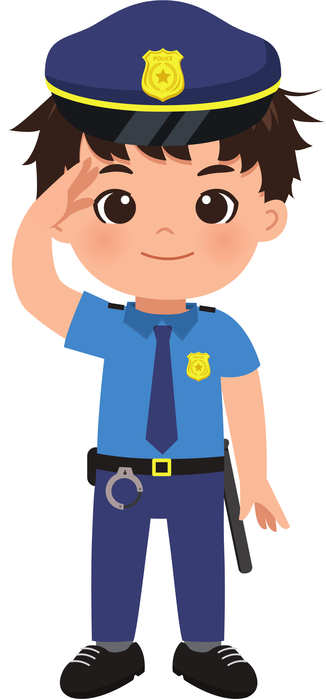
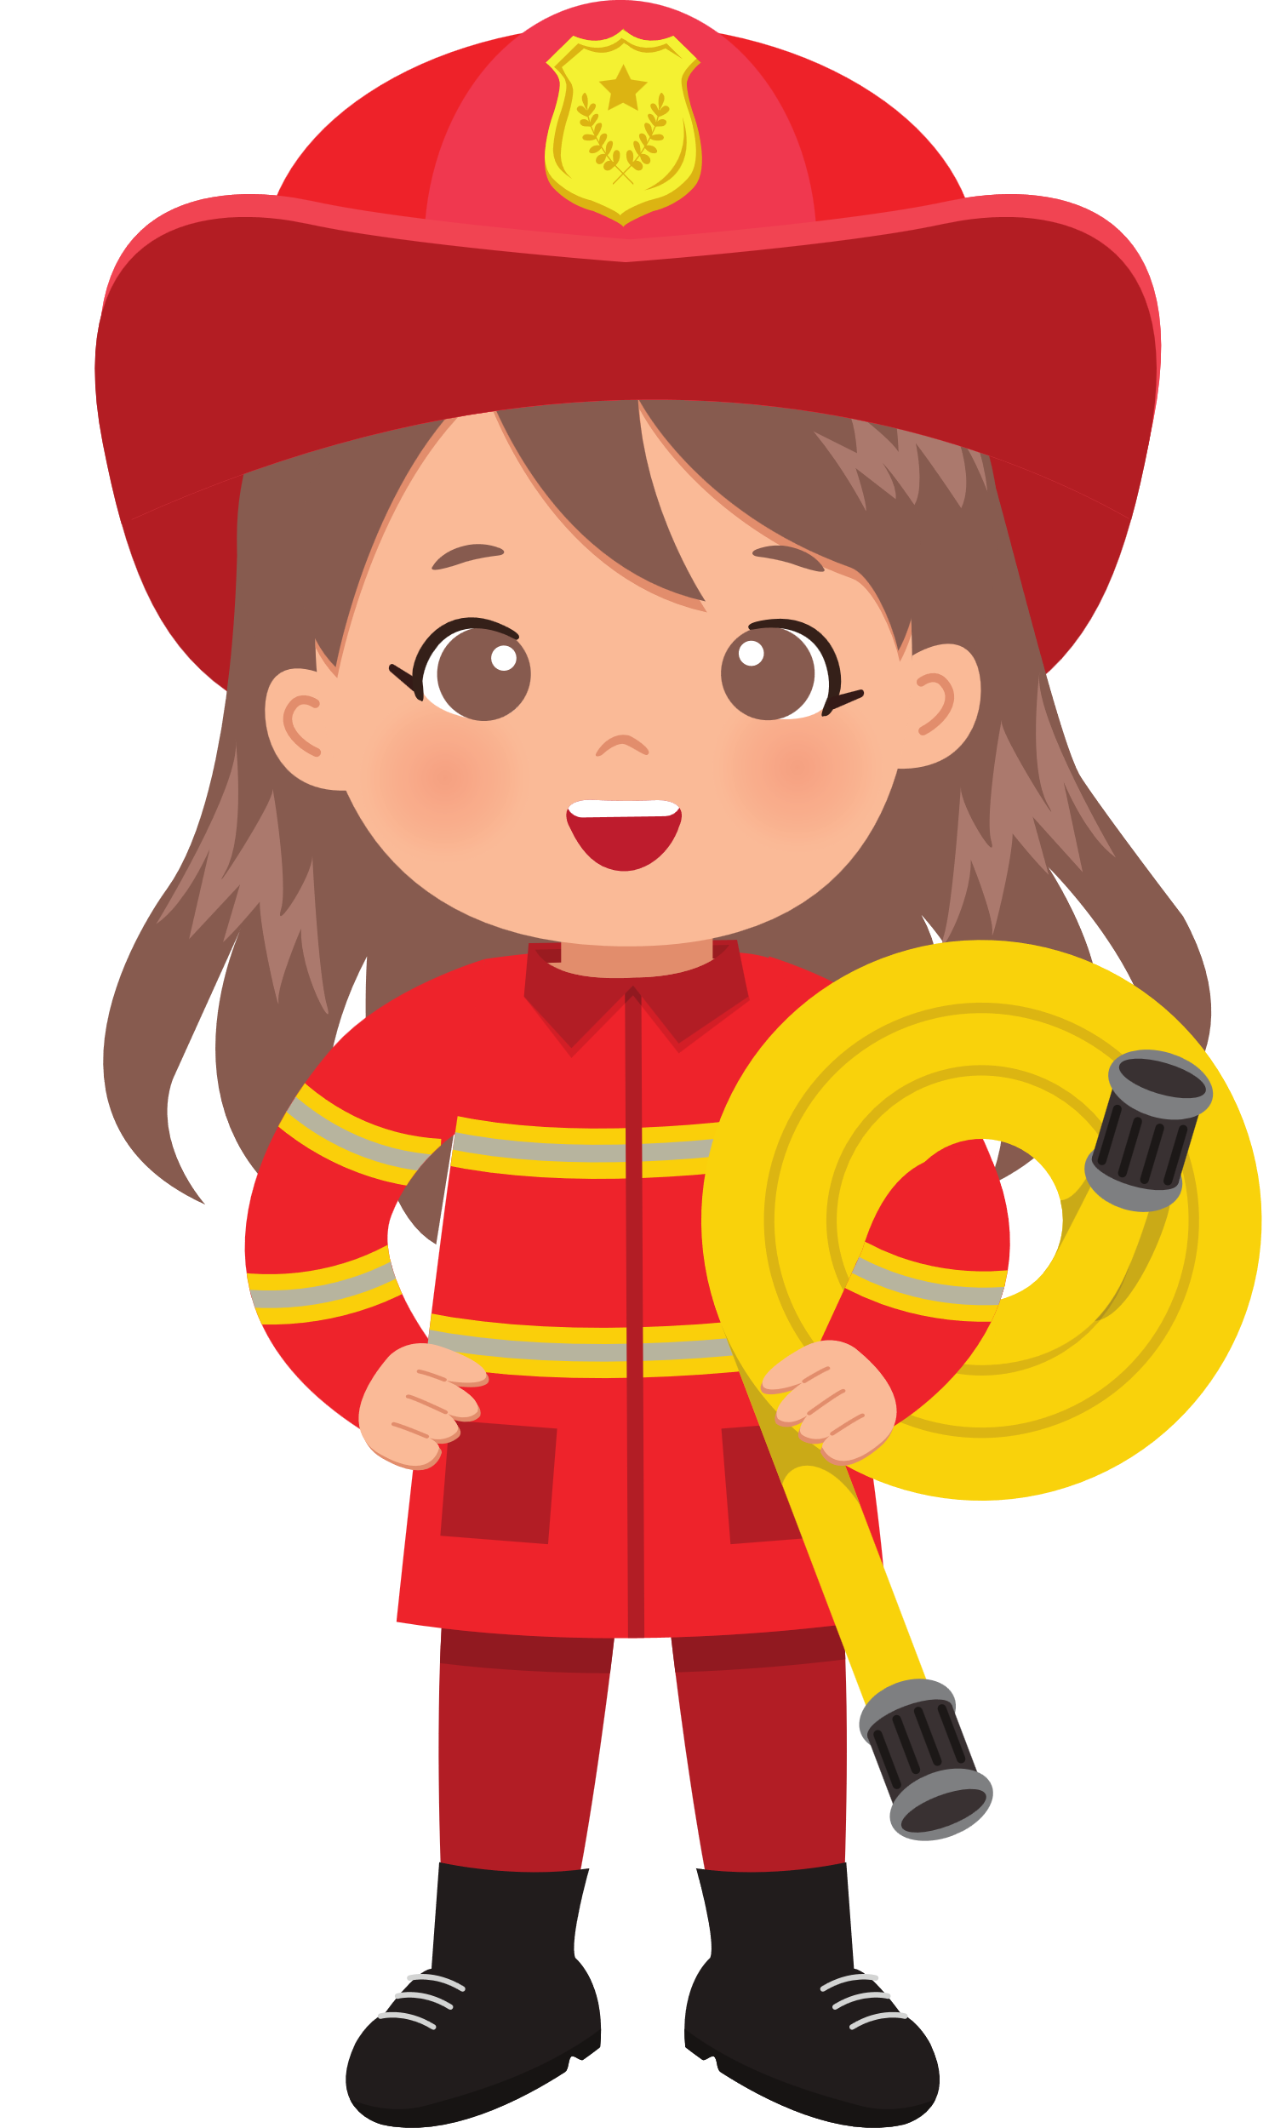
UNIT 7. JOBS
LESSON 1. TASK 4 5 6

Slide 3



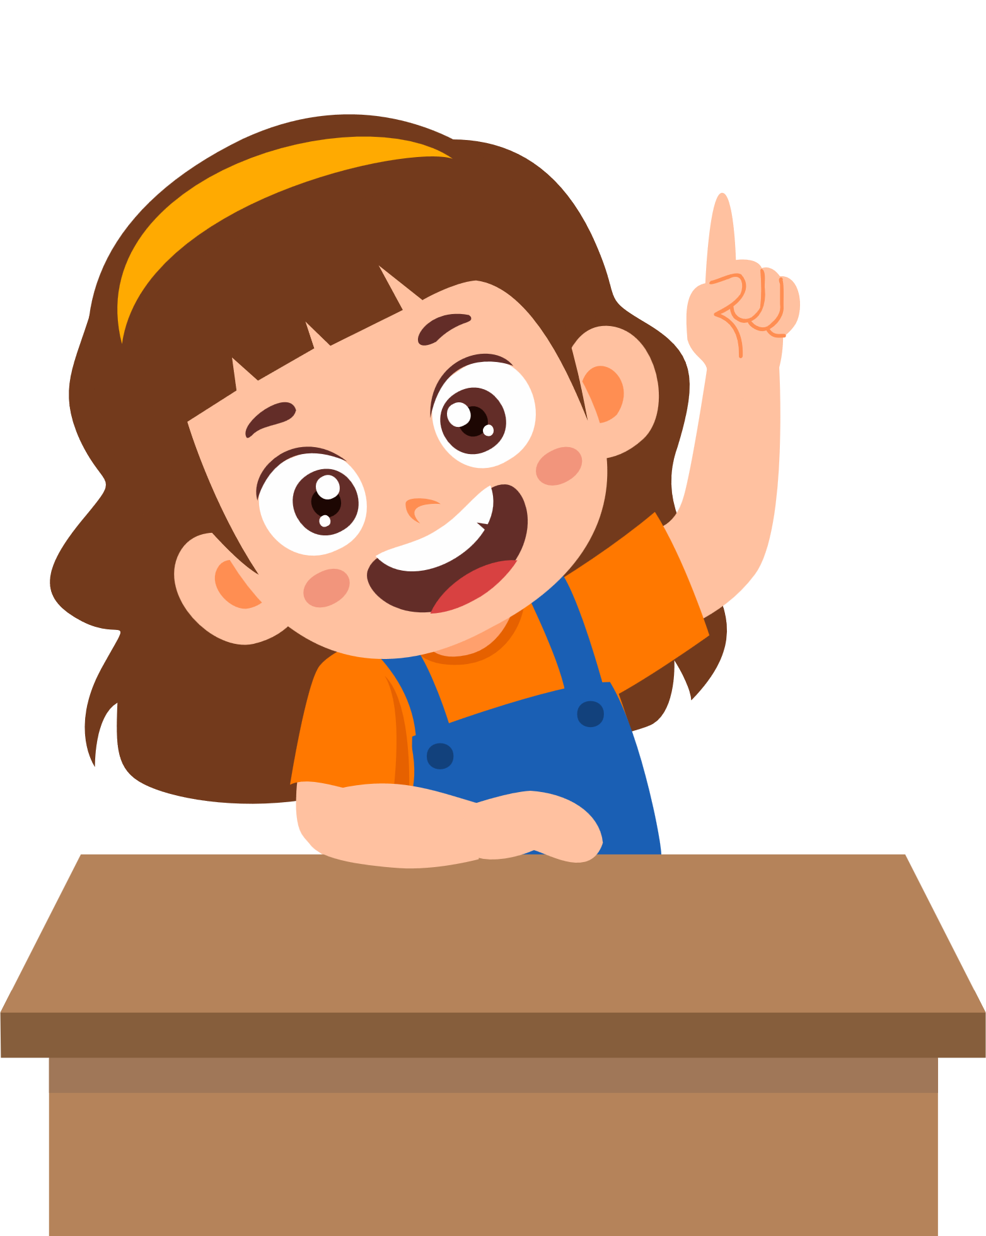
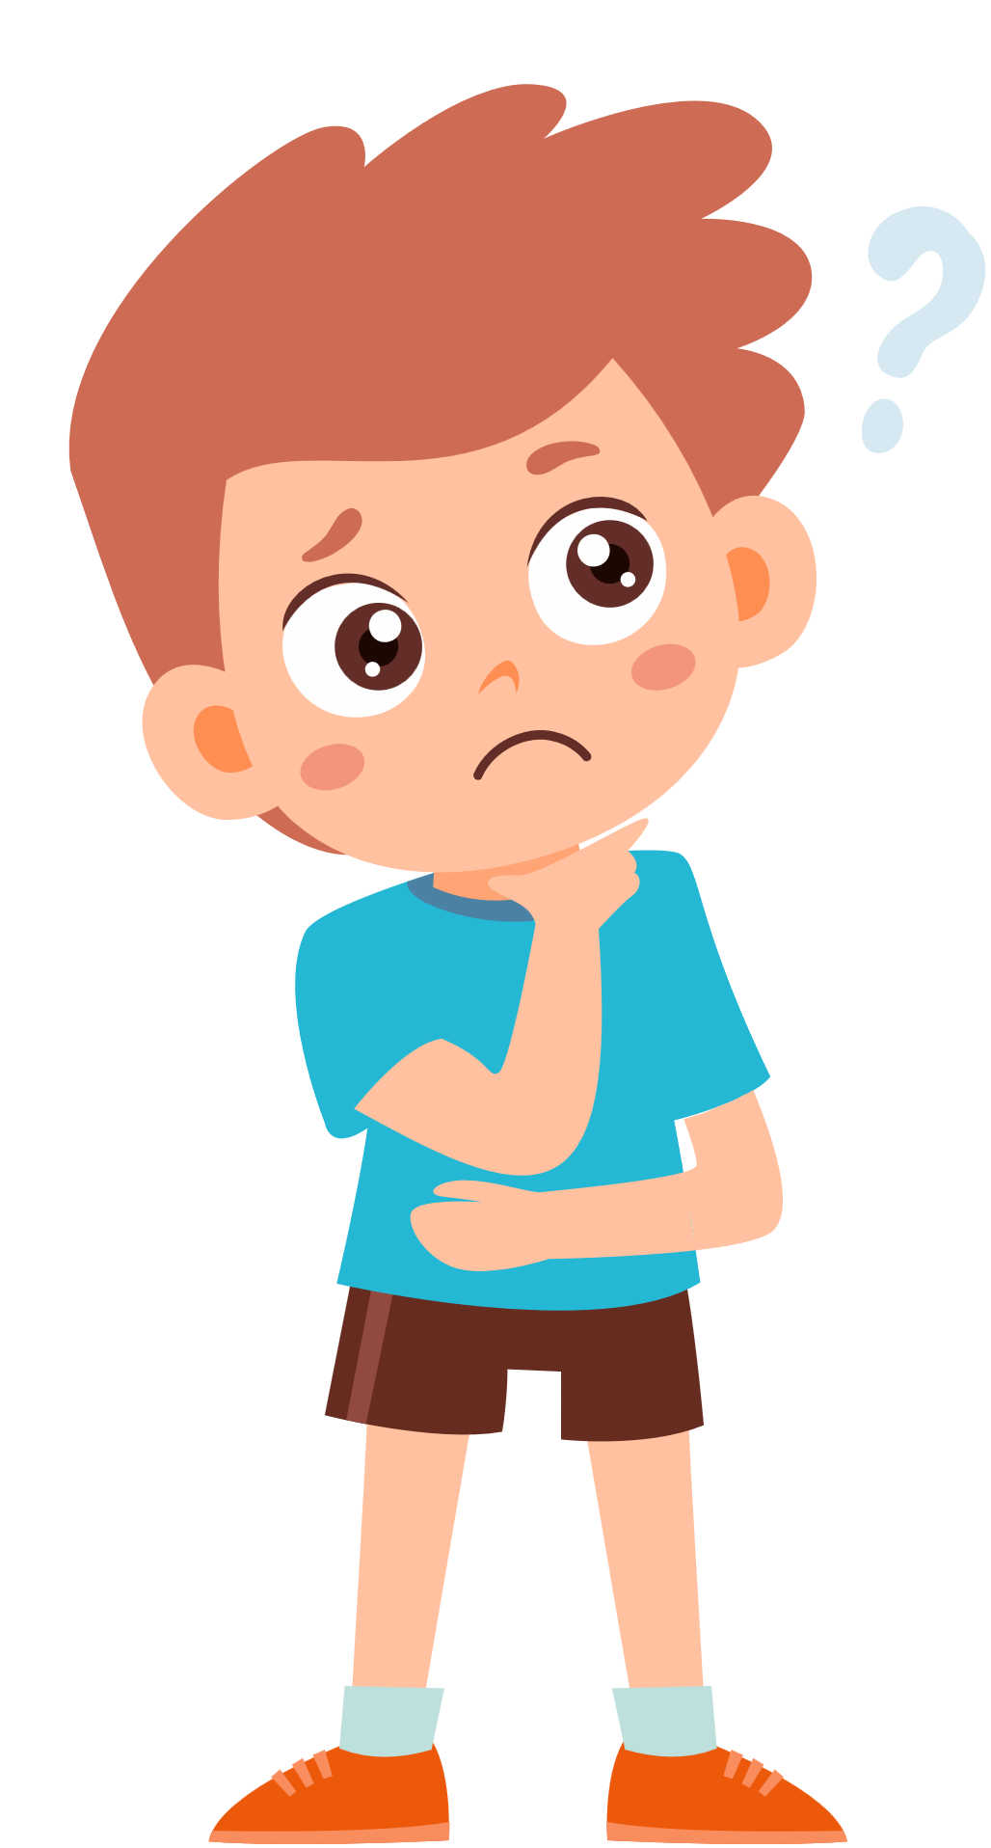
WARM UP
“ Who am I ?” Guessing Game
Notes:
Read the clues and guess what job it is before the time runs out.

Slide 4









1. I work in a restaurant.
Who am I ?
2. I cook food.
3. I am in charge of the kitchen.
5
4
3
2
1
Time’s Up
START

Slide 5
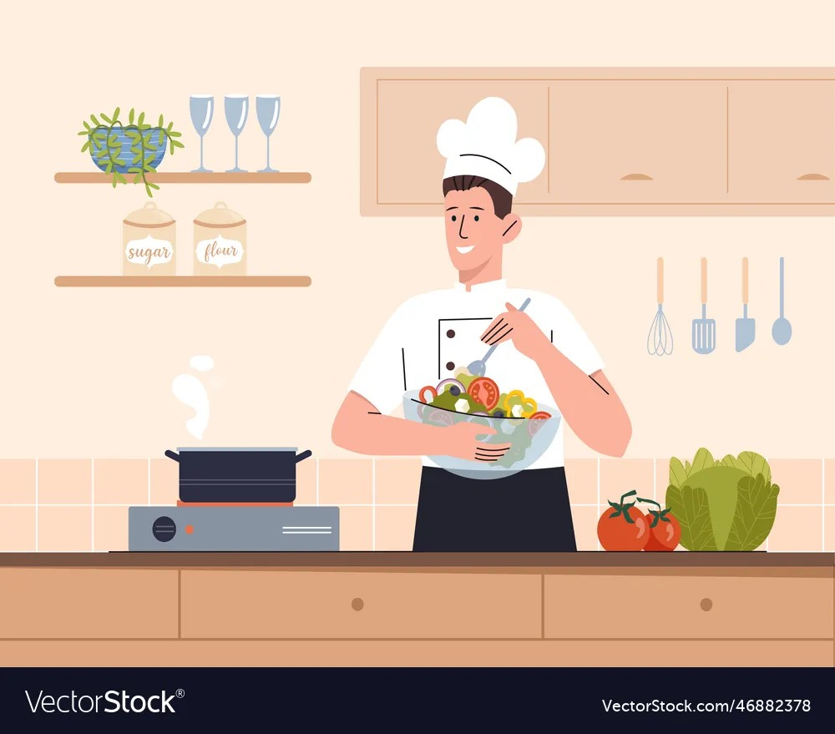

I am a chef.

Slide 6

1. I work at school.
Who am I ?
2. I help people learn.
3. I have many students.
5
4
3
2
1
Time’s Up
START

Slide 7
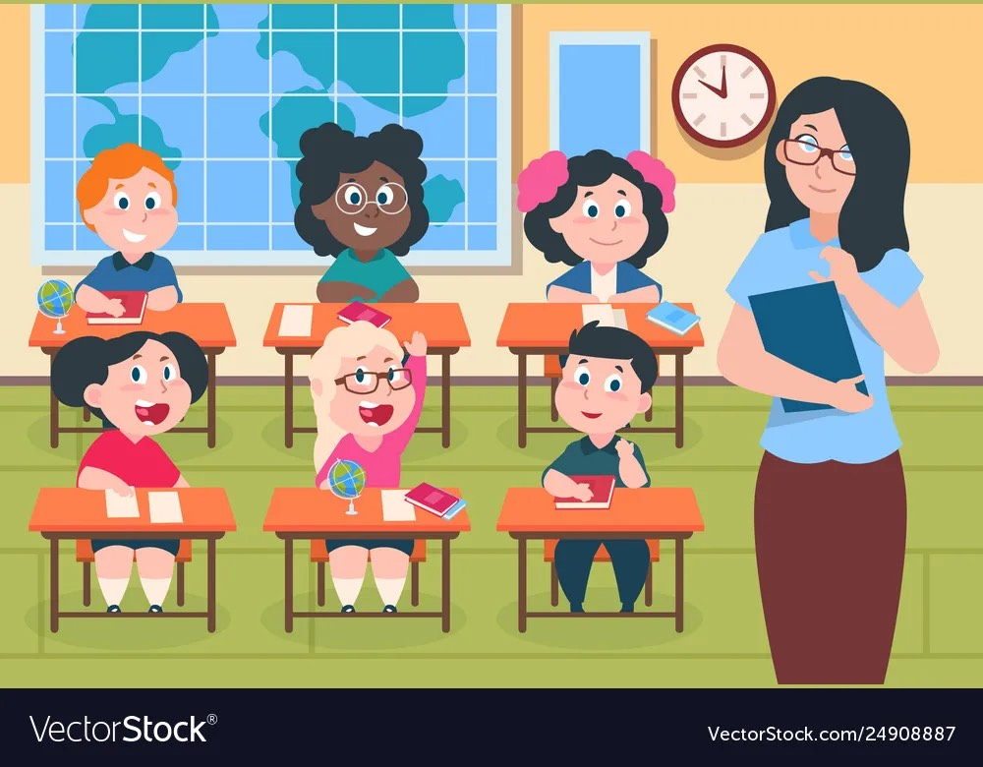

I am a teacher.

Slide 8

1. I work in a hospital.
Who am I ?
2. I help sick people.
5
4
3
2
1
Time’s Up
START

Slide 9


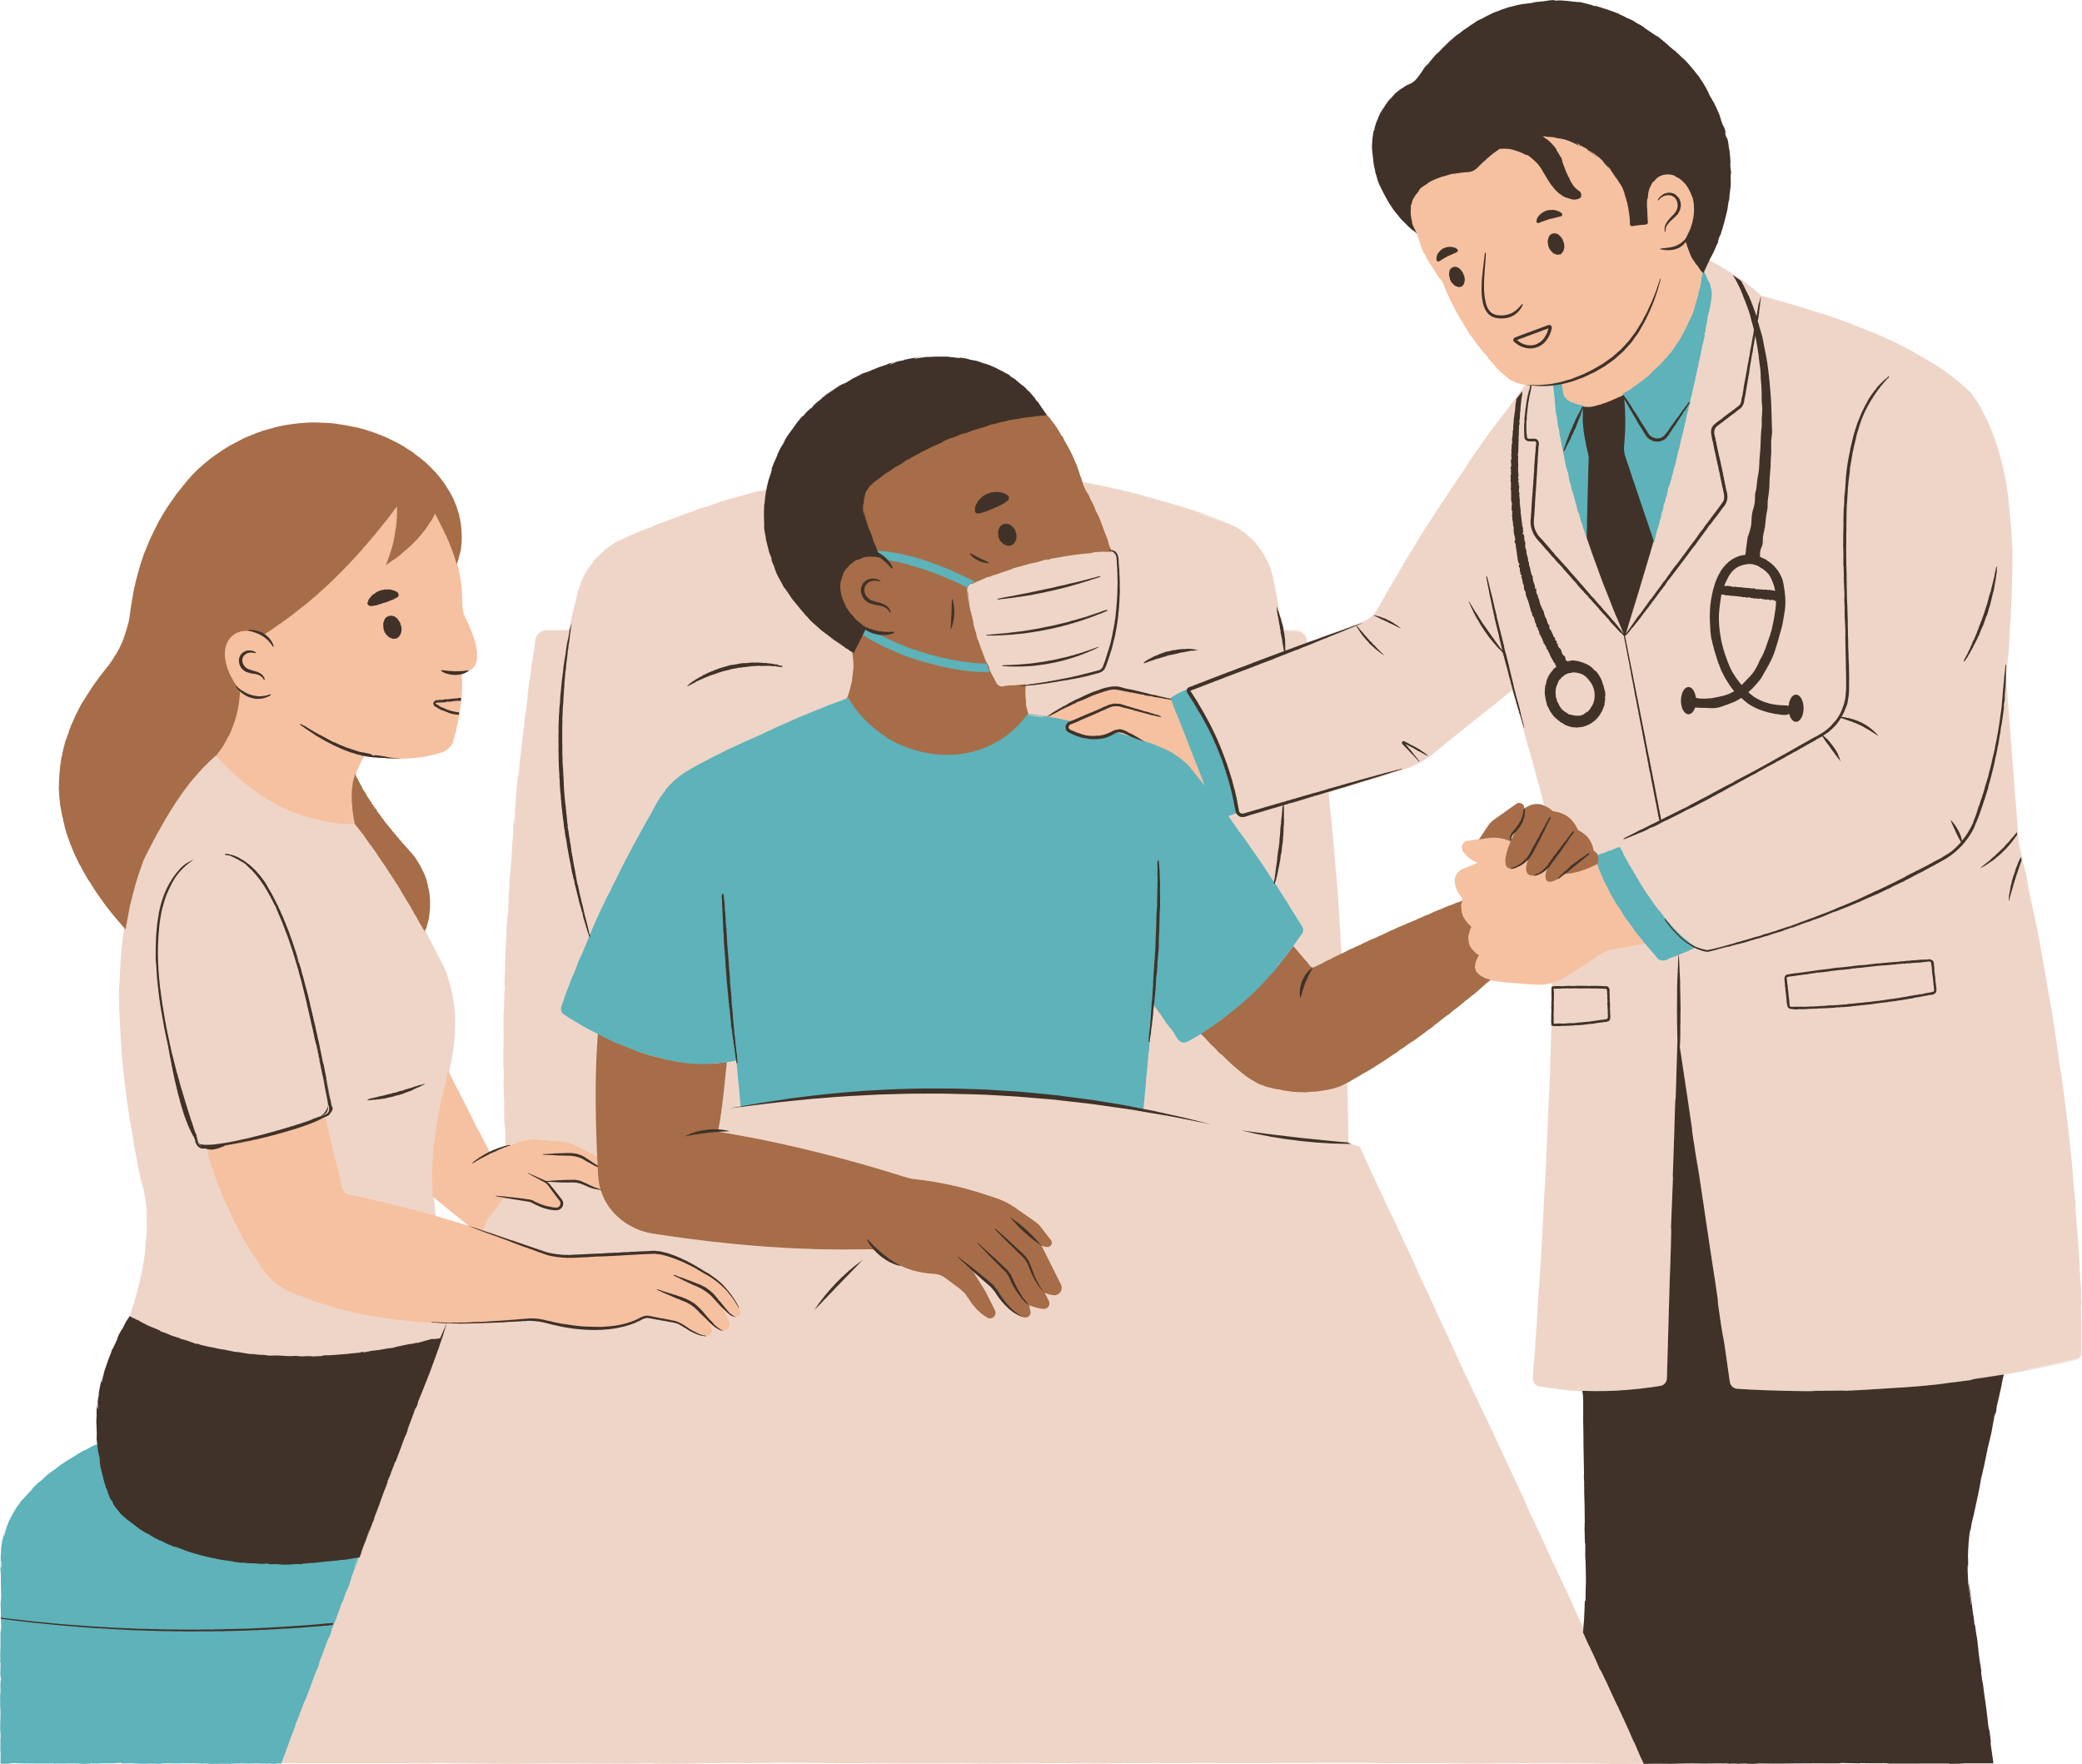


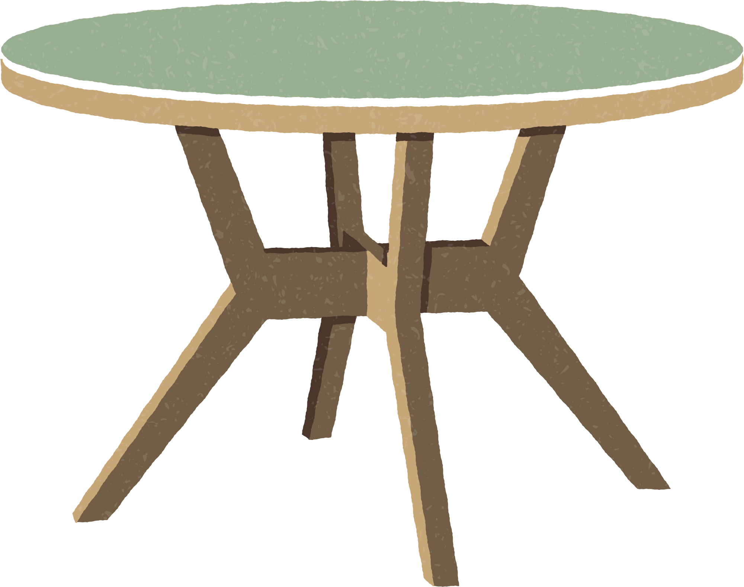
I am a doctor.

Slide 10



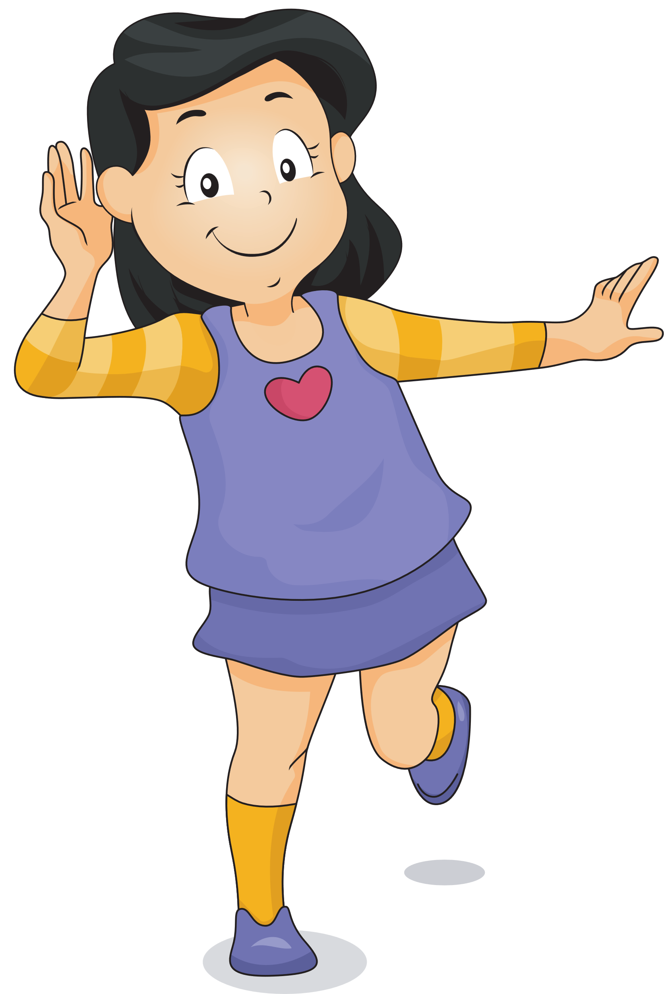
PRESENTATION
TASK 4. LISTEN AND REPEAT

Slide 11





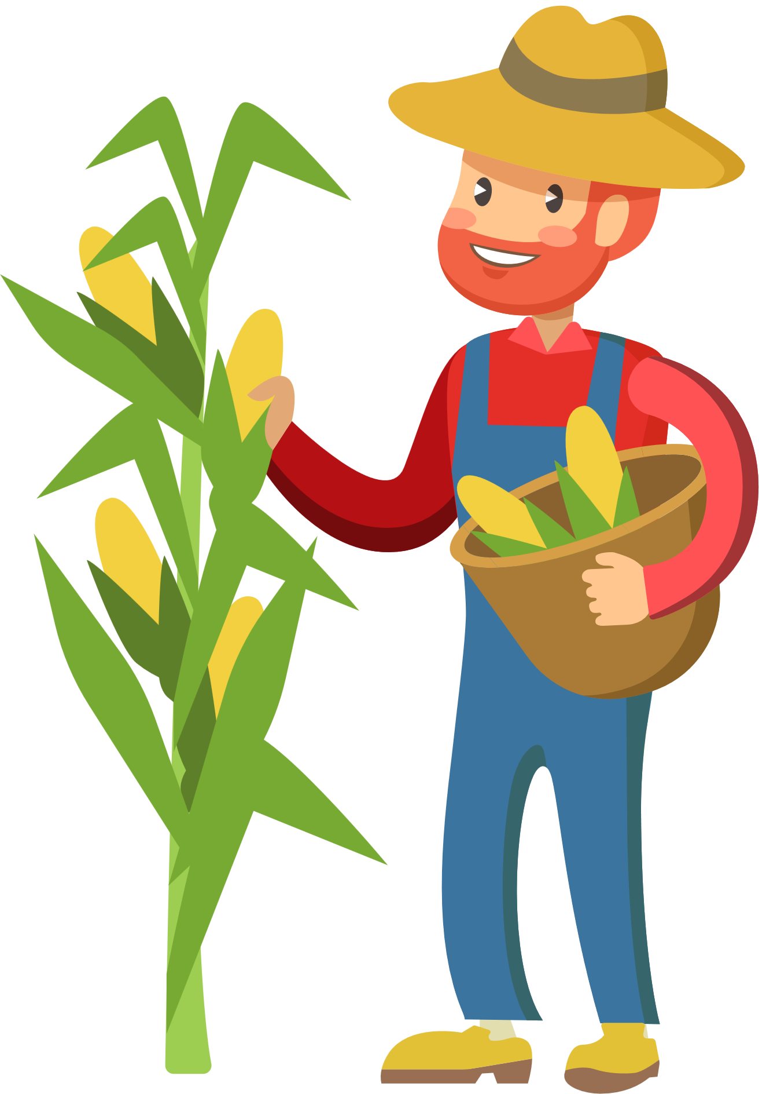
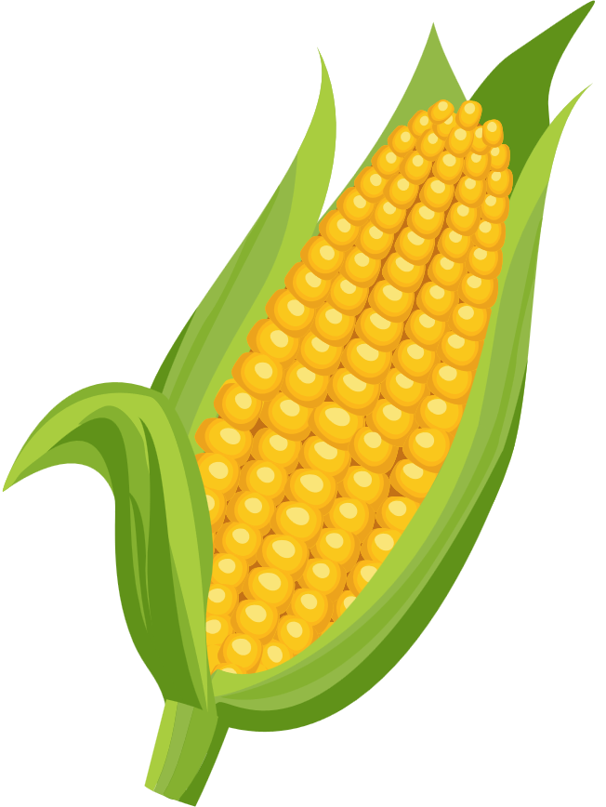

4 Listen and repeat
He's a farmer.
What does he do ?

Slide 12

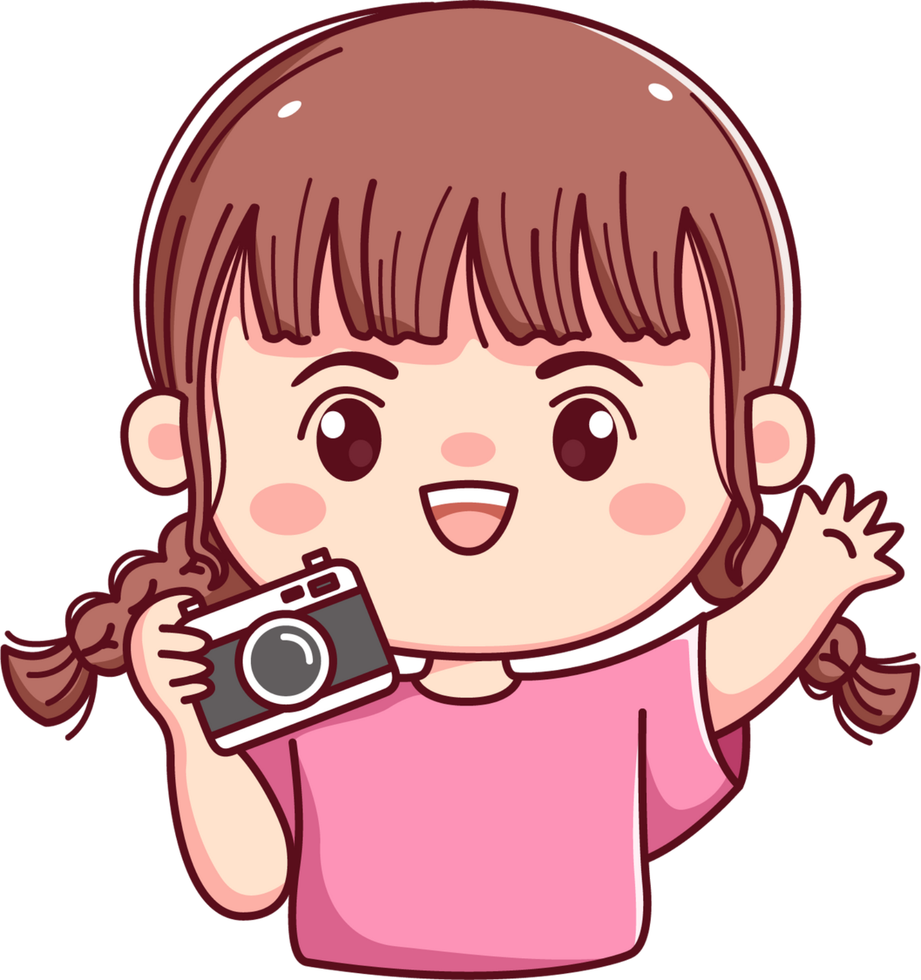

What does she do ?
She's a photographer.

Slide 13

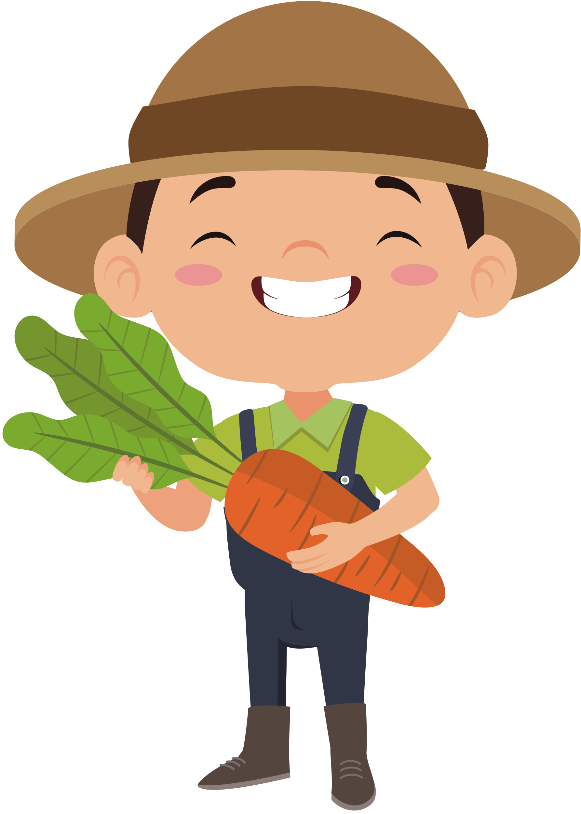


PRACTICE
HAPPY FARMER GAME

Slide 14



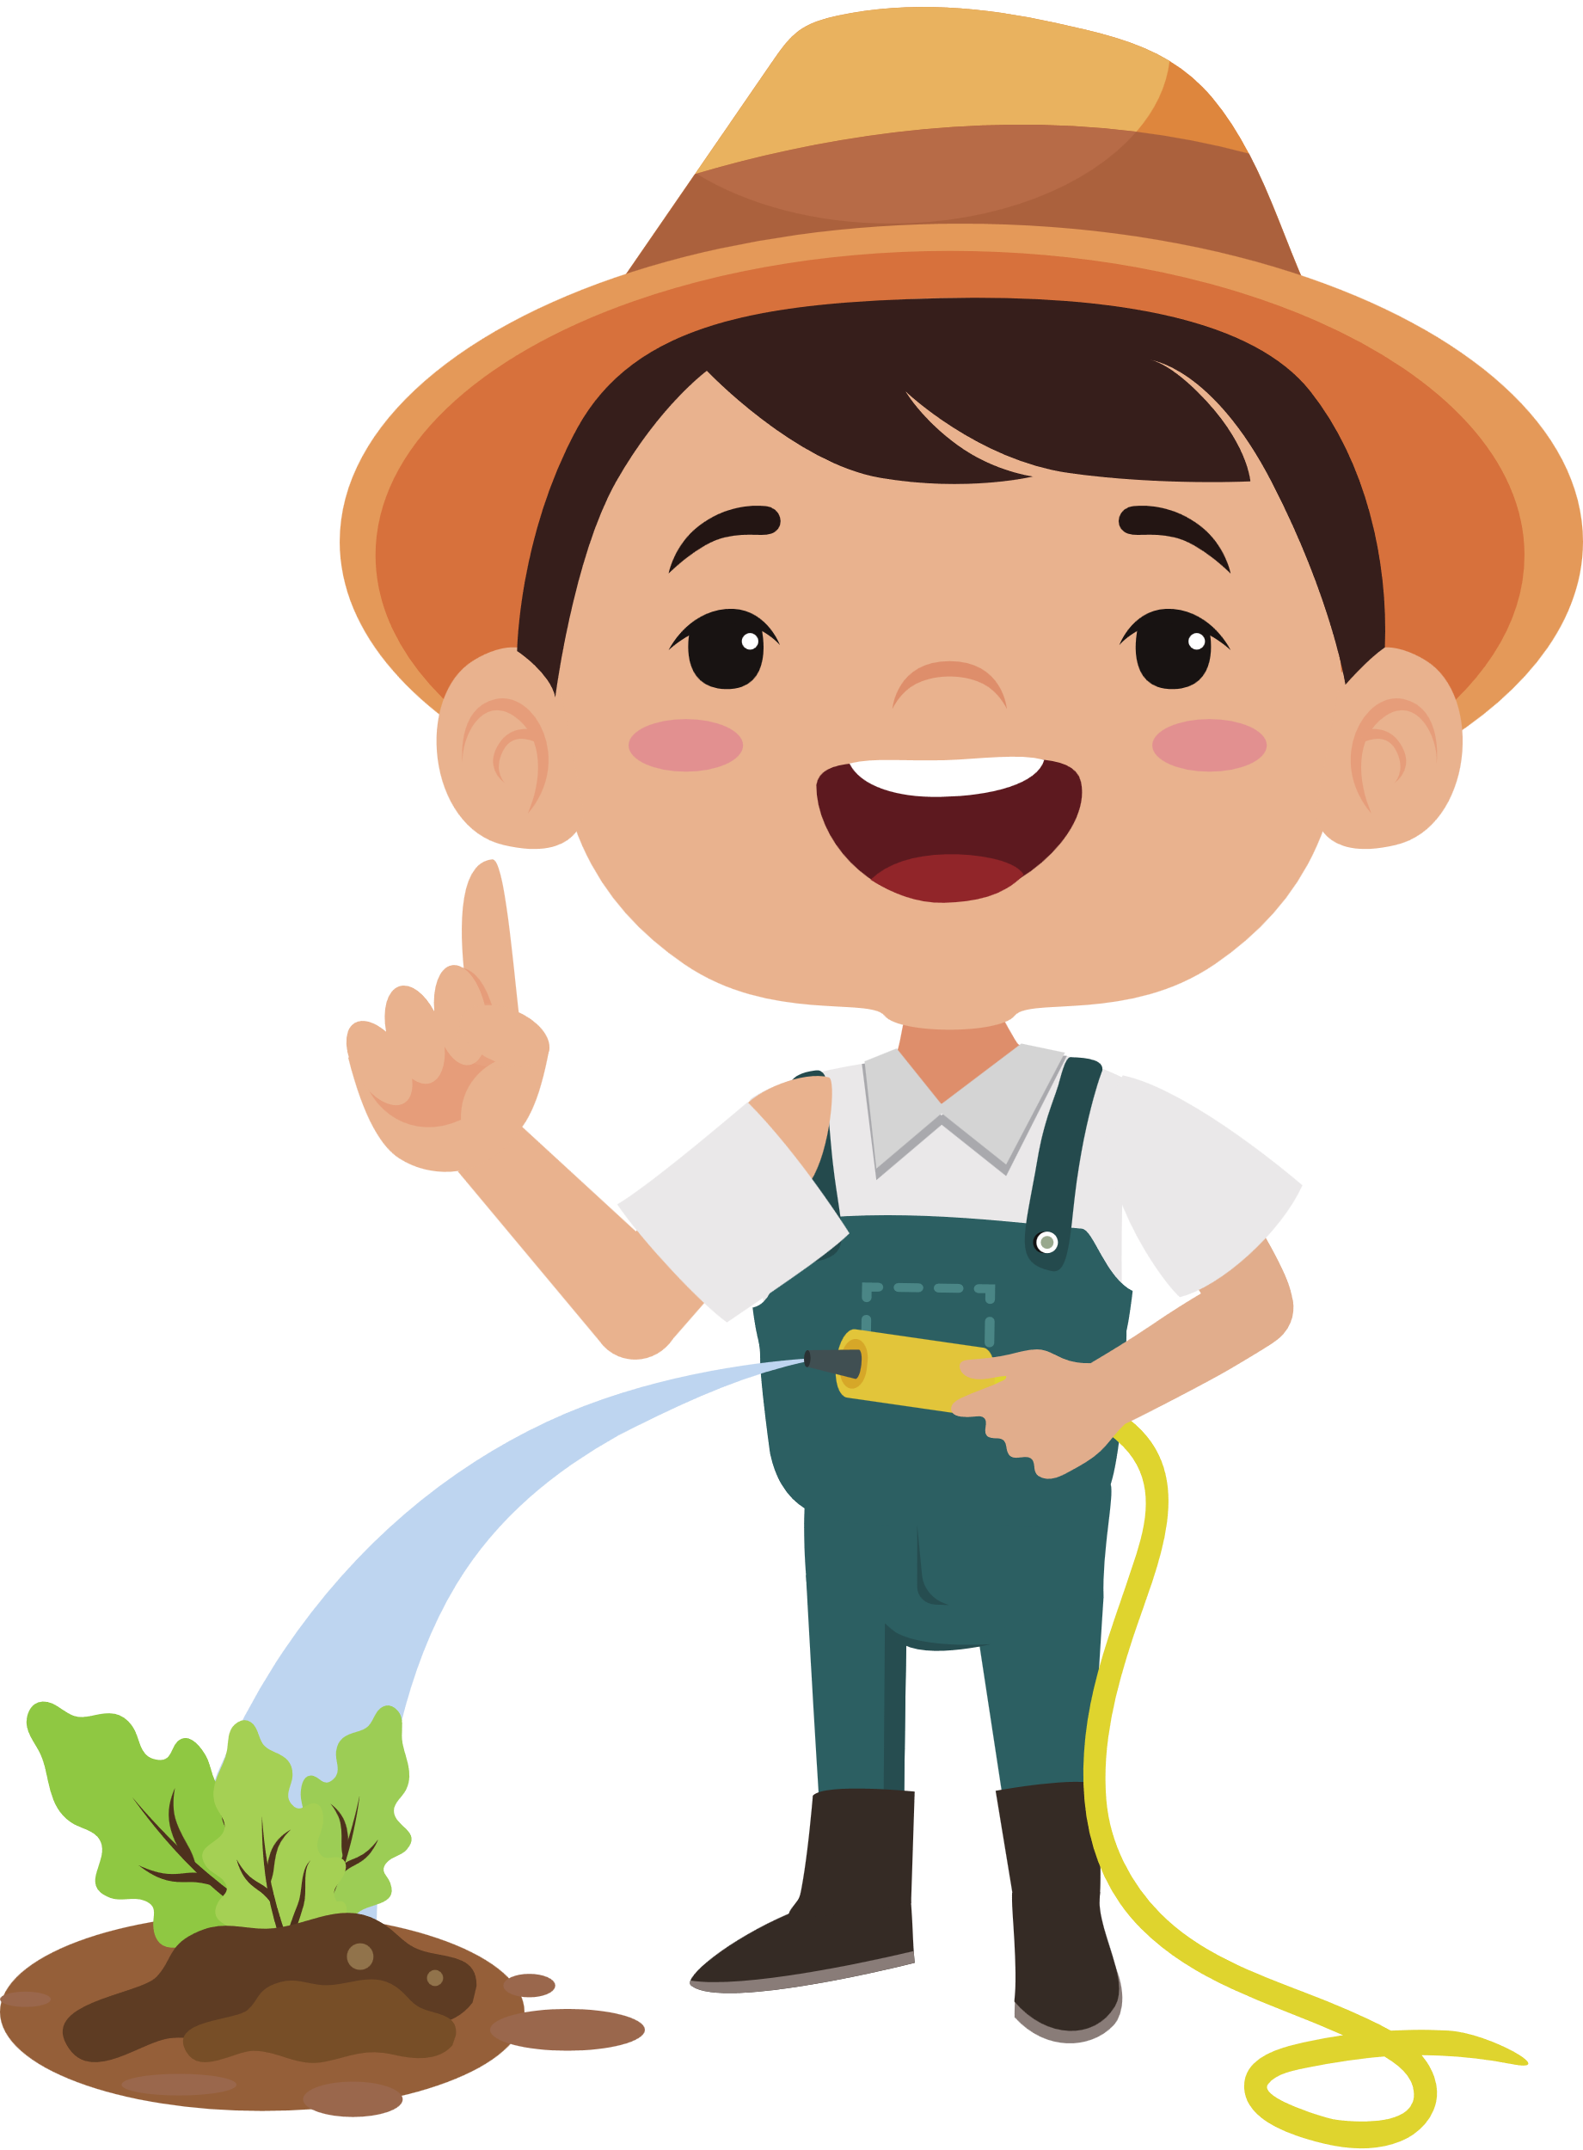

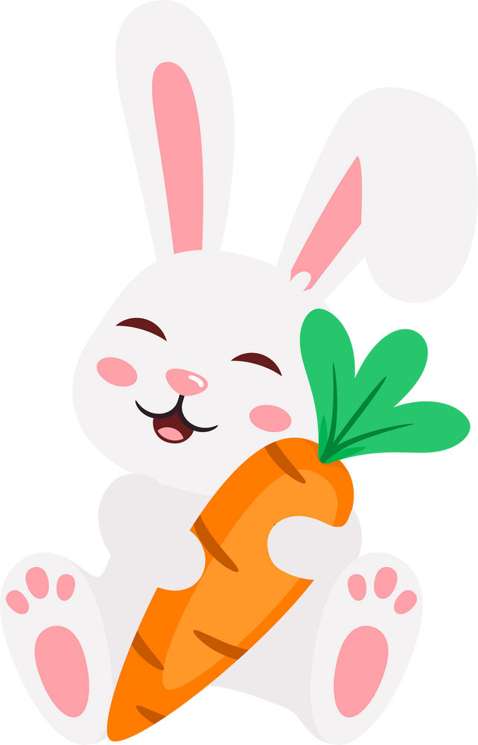



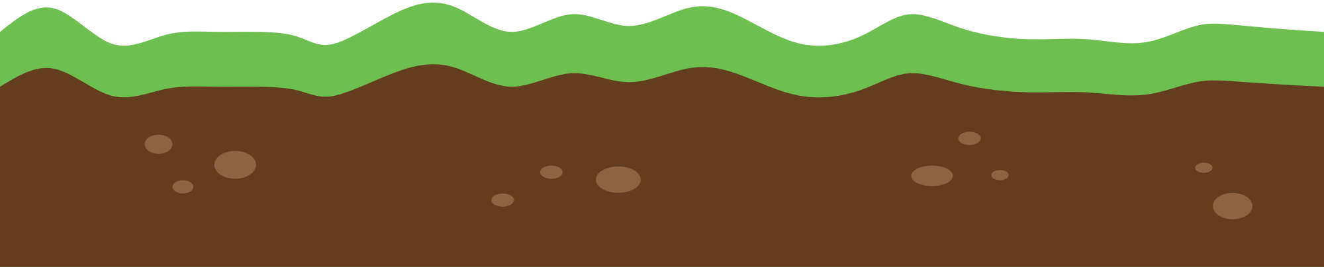

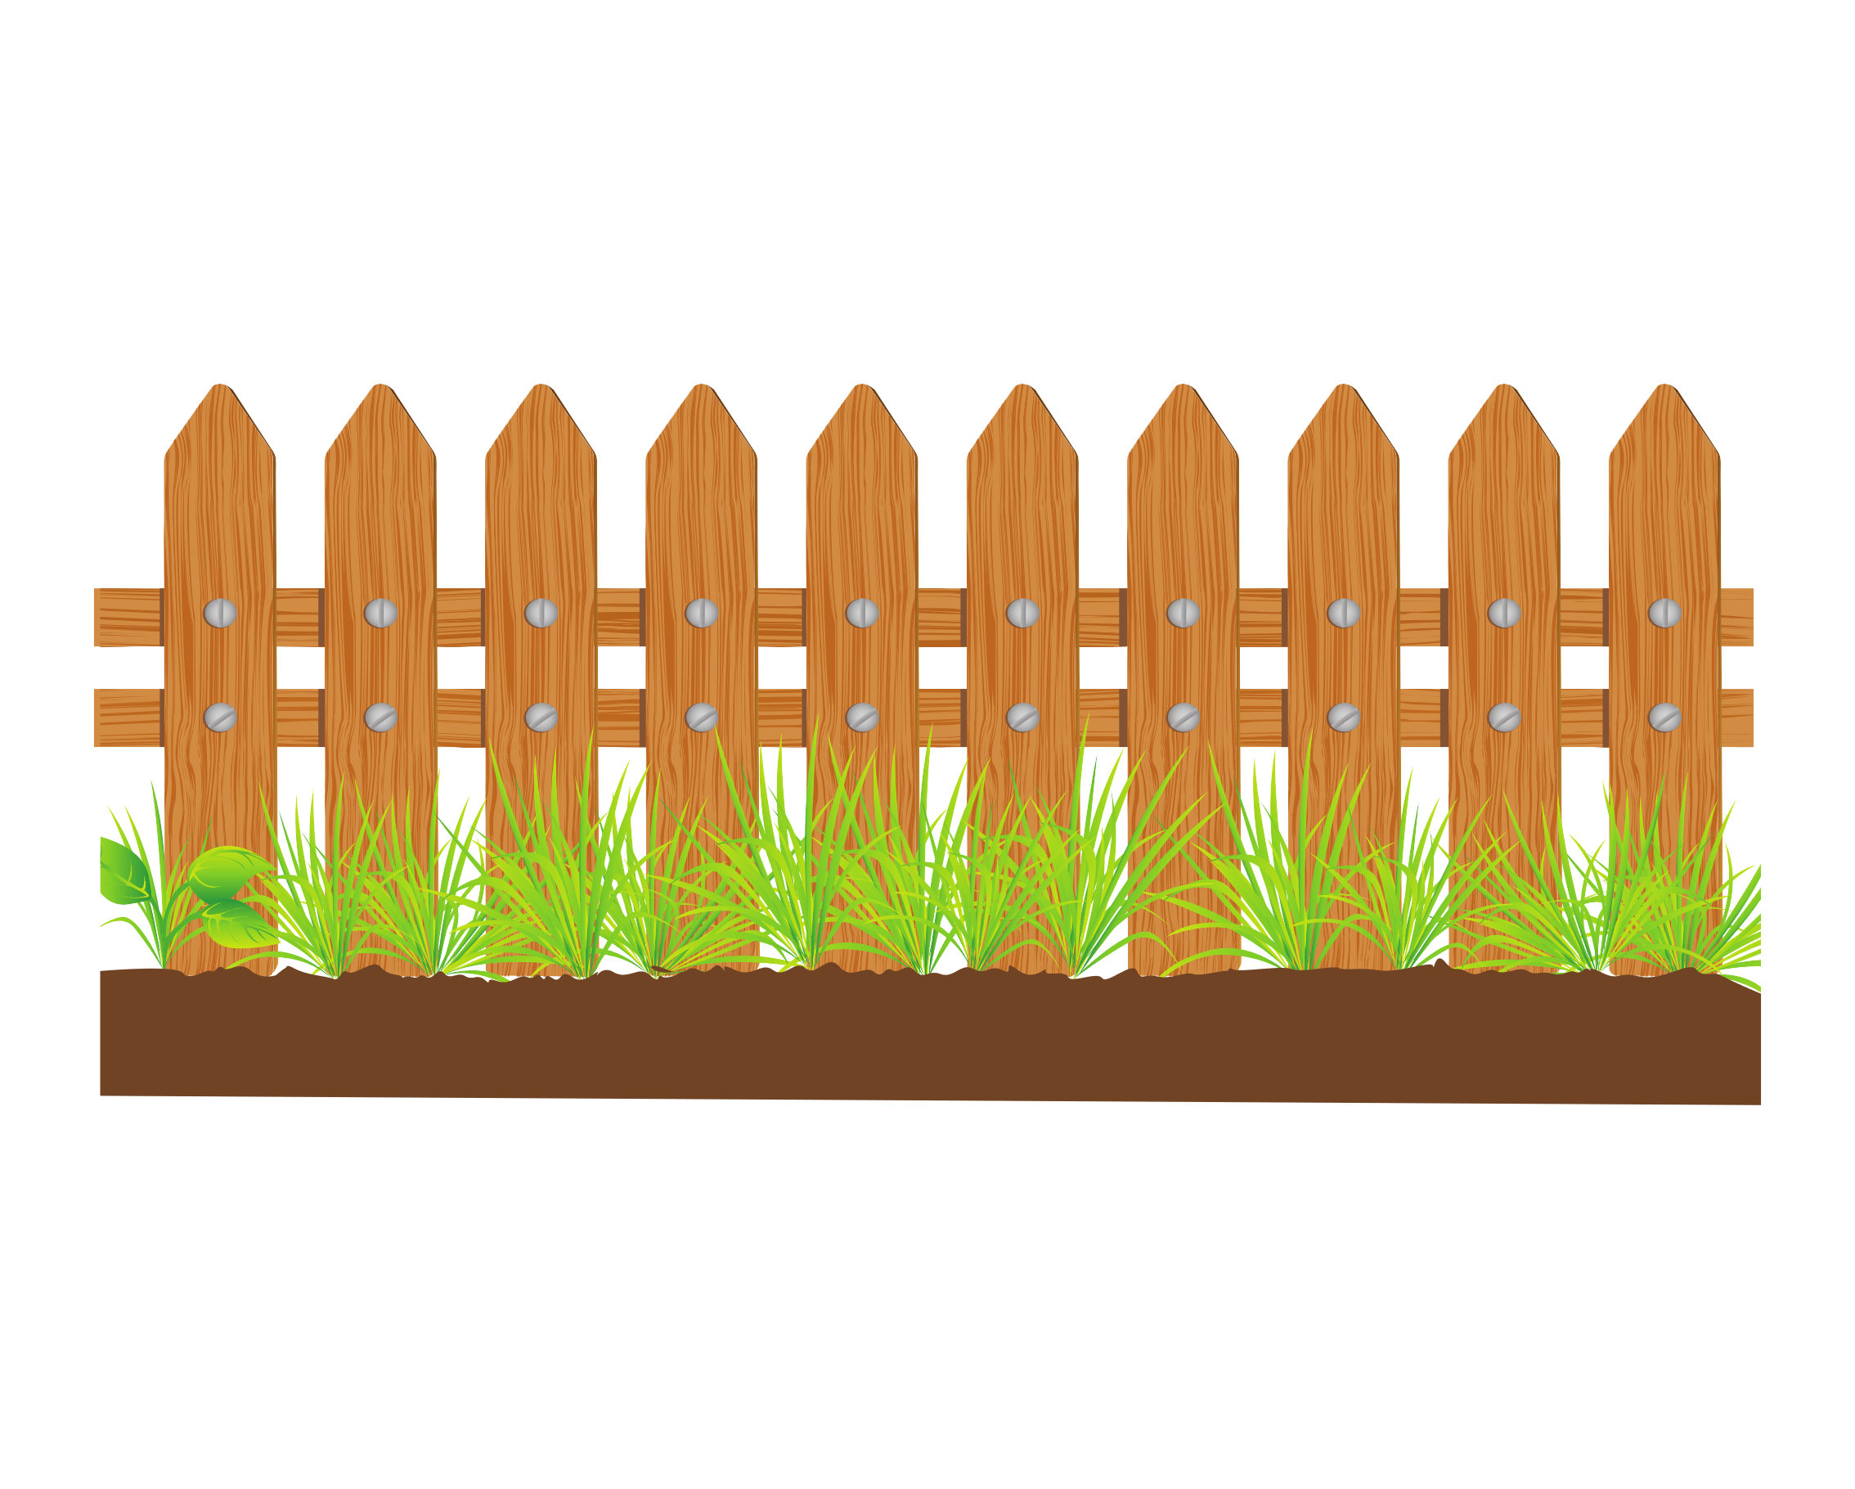


HAPPY FARMER

Slide 15


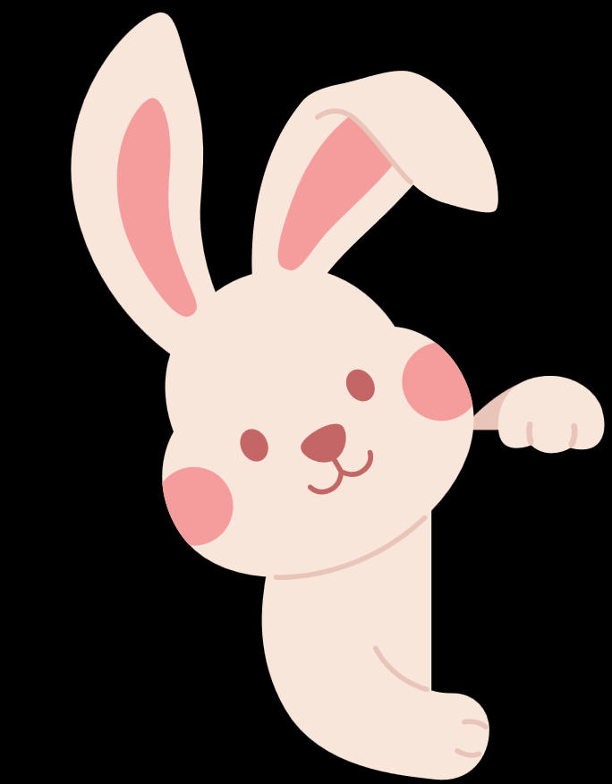
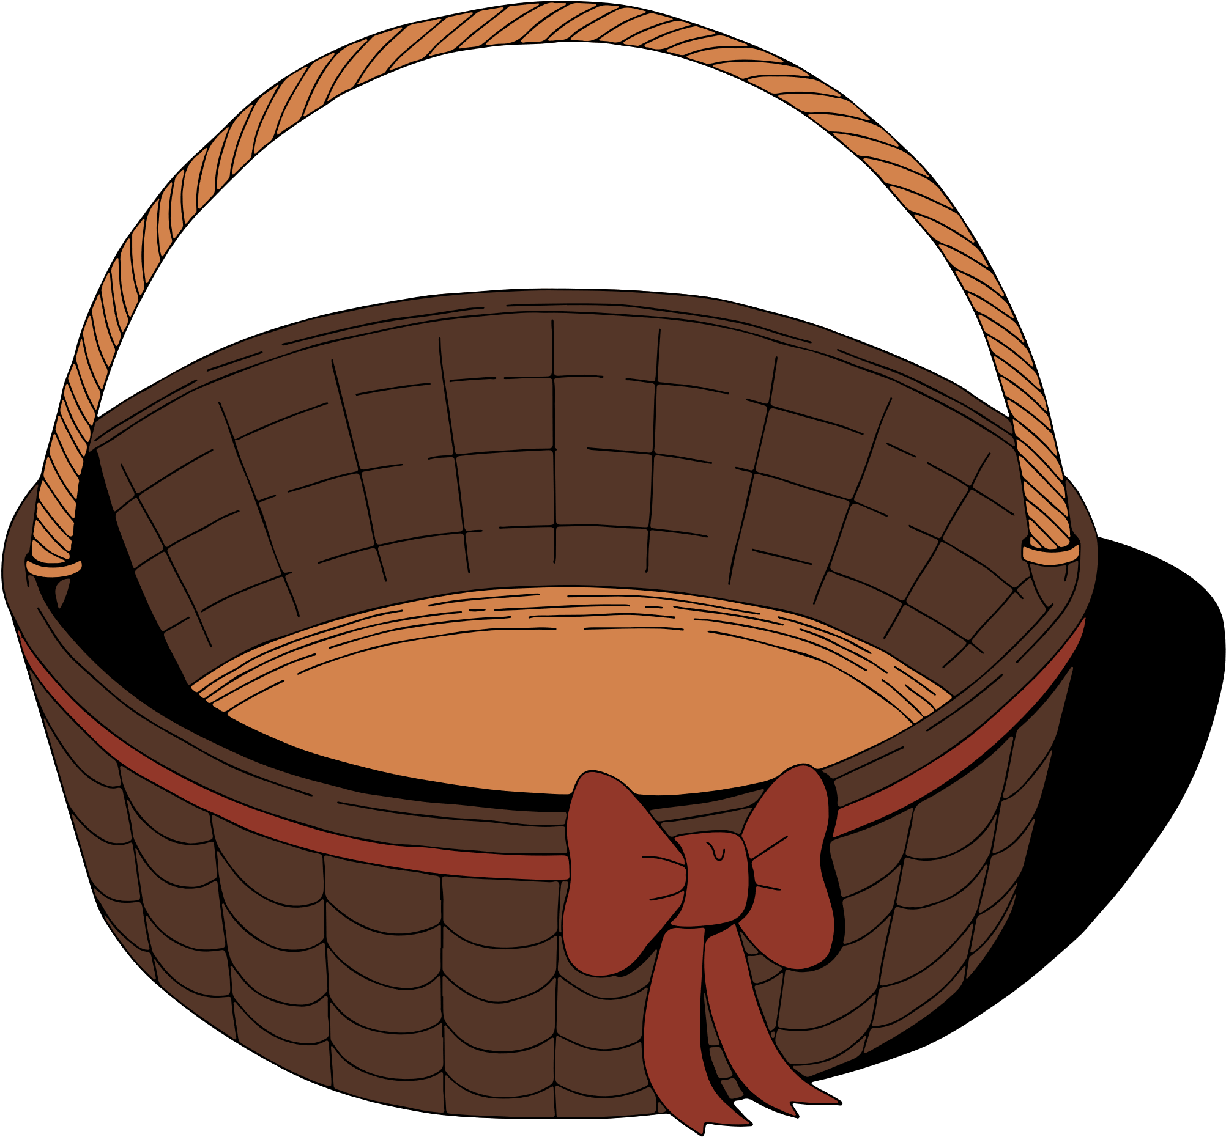

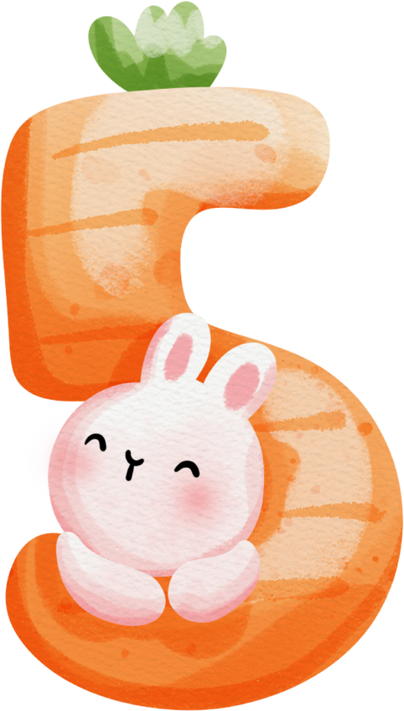



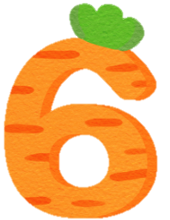
Choose the
number
Click me to get it.
NEXT
Notes:
Click the numbers to get the questions and click the farmer to get the carrot if the students can answer.
( nhấn vào số để chọn câu hỏi, sau đó quay trở lại và nhấn vào bác nông dân để lấy phần thưởng là cà rốt nhé !)

Slide 16


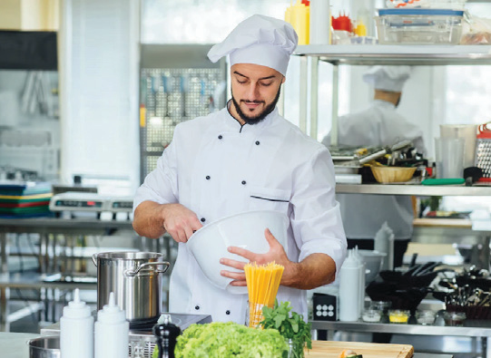
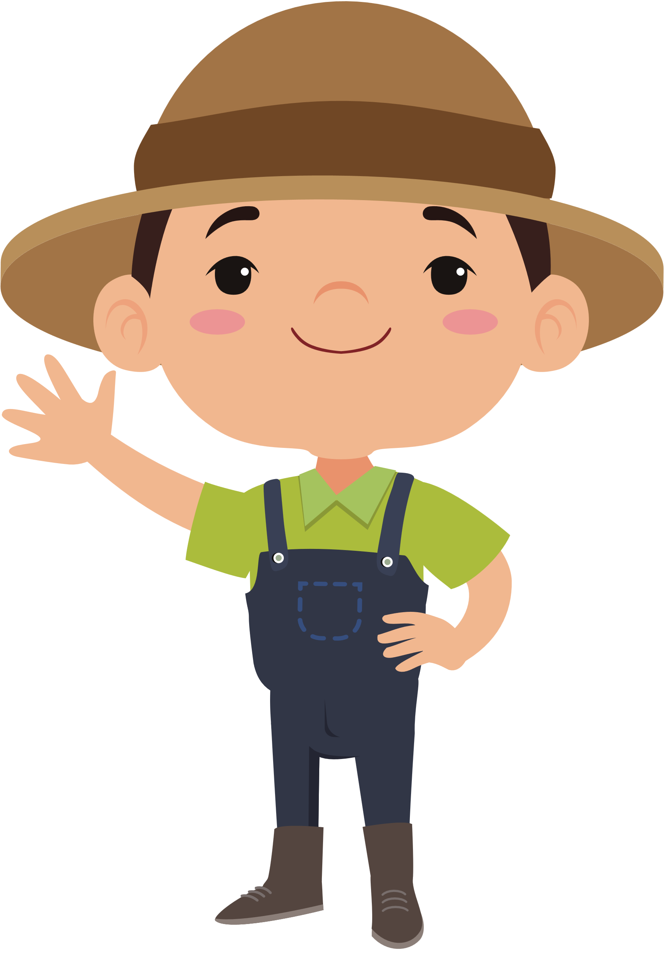
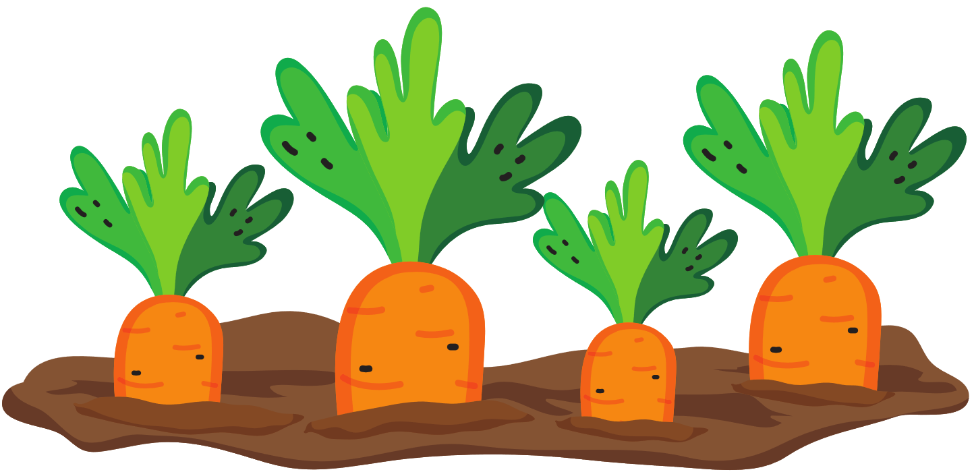
5 Look. Ask and answer
What does he do ?
He’s a chef.
Notes:
Click the rabbit to back and get the carrot. ( Nhấn chuột vào thỏ để quay trở lại)

Slide 17
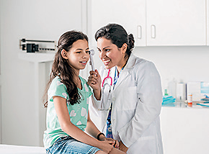
5 Look. Ask and answer
What does she do ?
She’s a doctor.
Notes:
Click the rabbit to back and get the carrot. ( Nhấn chuột vào thỏ để quay trở lại)

Slide 18
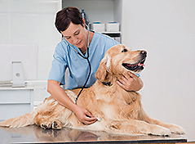
5 Look. Ask and answer
What does he do ?
He’s a vet.
Notes:
Click the rabbit to back and get the carrot. ( Nhấn chuột vào thỏ để quay trở lại)

Slide 19
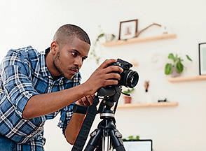
5 Look. Ask and answer
What does he do ?
He’s a photographer.
Notes:
Click the rabbit to back and get the carrot.
( Nhấn chuột vào thỏ để quay trở lại)

Slide 20



5 Look. Ask and answer
What does she do ?
She’s a teacher.
Notes:
Click the rabbit to back and get the carrot.
( Nhấn chuột vào thỏ để quay trở lại)

Slide 21


You’re lucky .
CLICK ME !

Slide 22

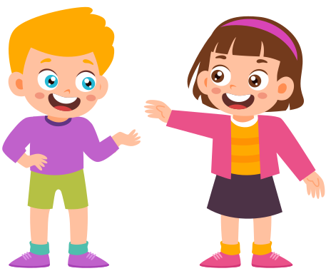

PRODUCTION

Slide 23



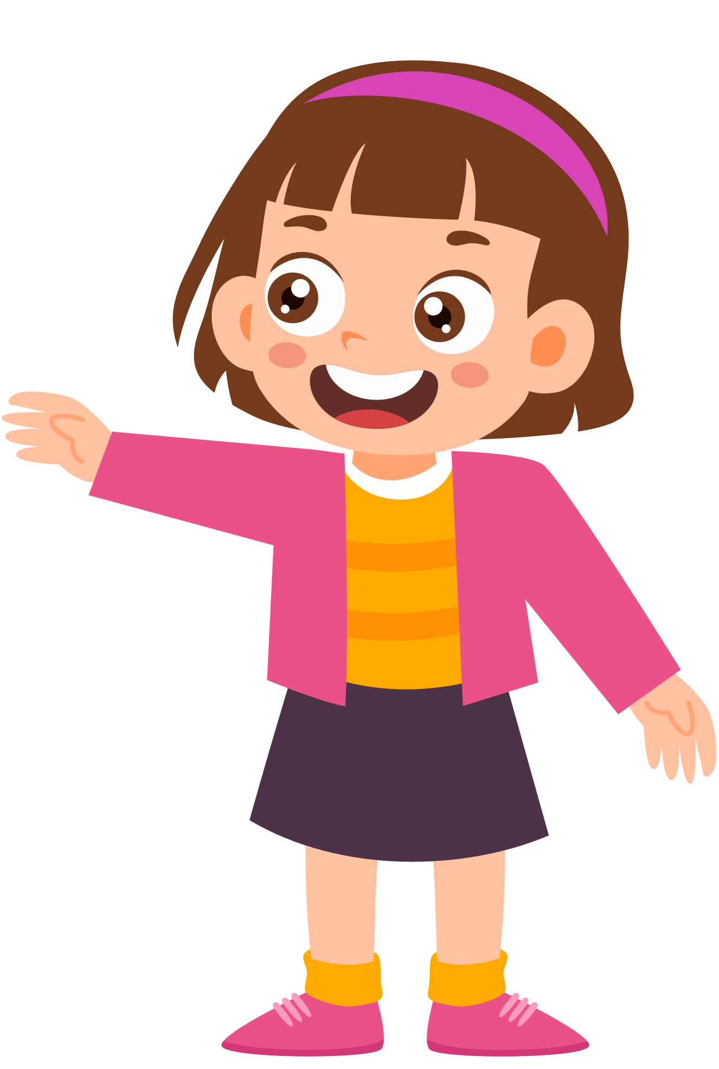
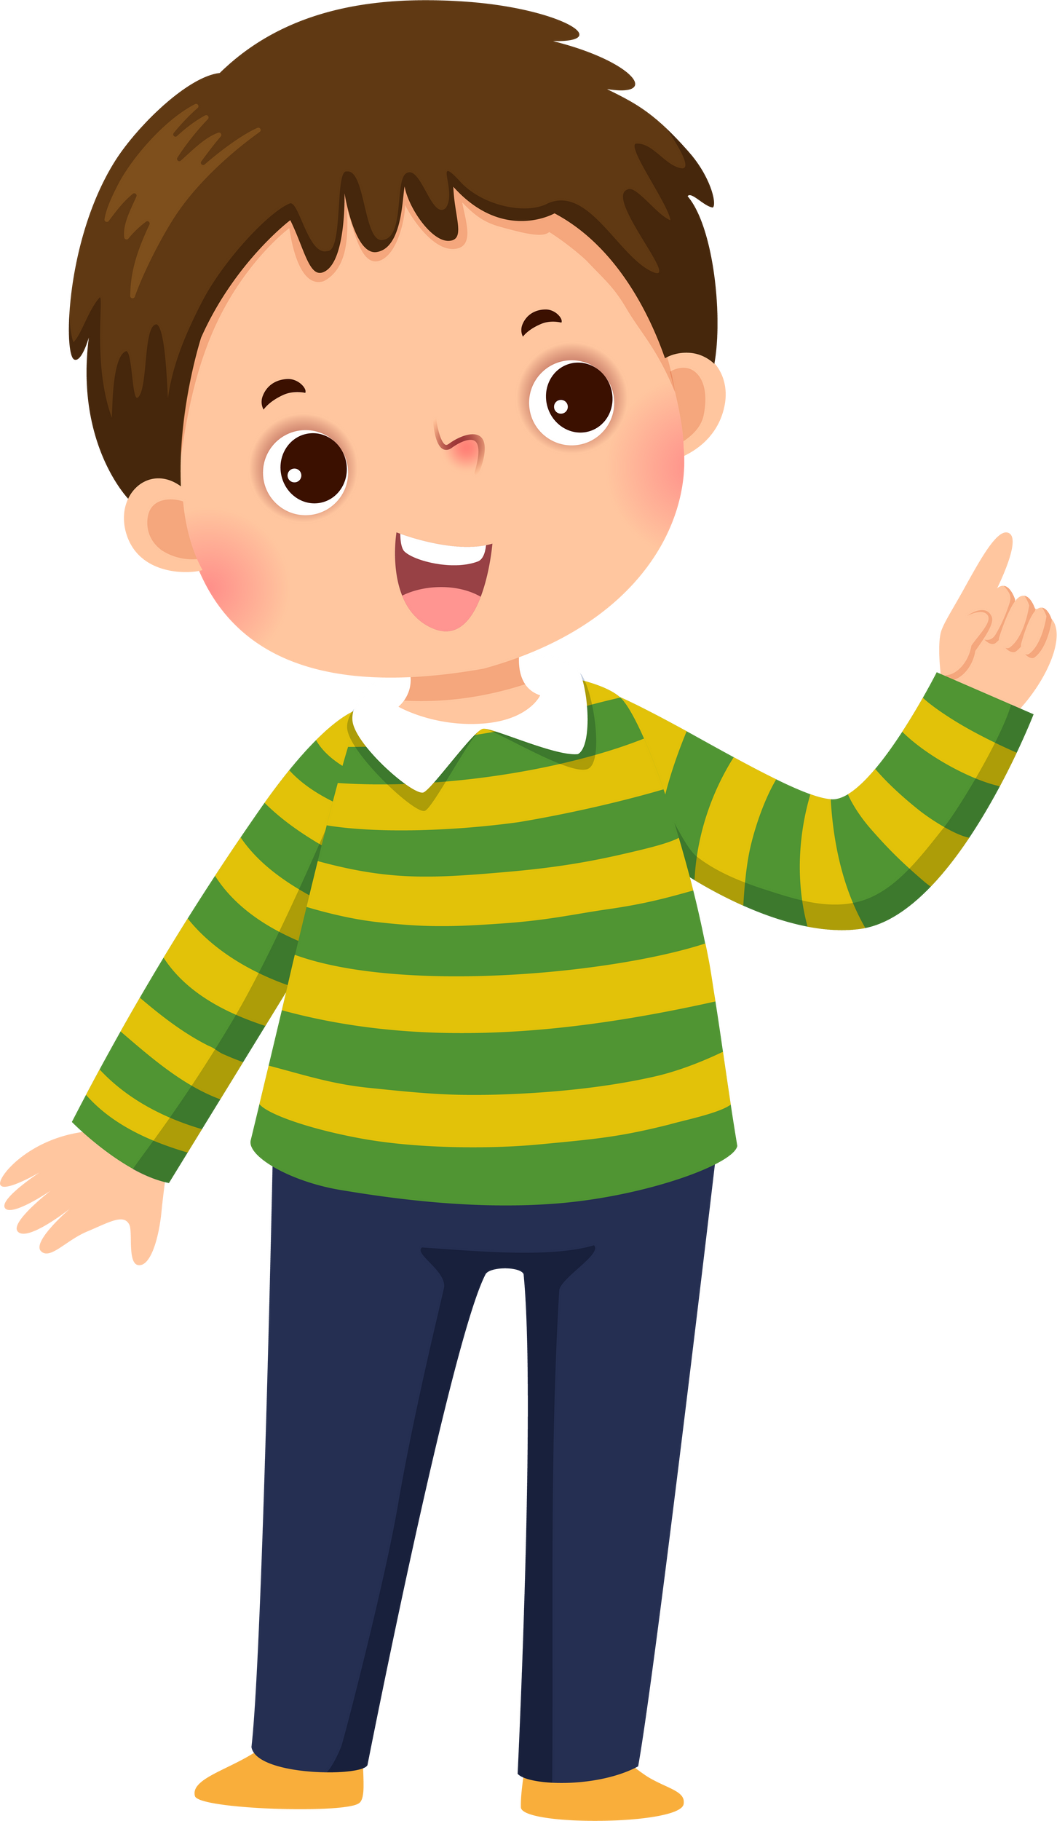


What does your mother do ?
She's a teacher.

Slide 24


ASSESSMENT

Slide 25



Read and circle
1. What do/ does your father do?
He / She is a doctor.
2. My sister is a doctor / teacher . She works in the hospital.
3. A vet/ farmer works in the field.
4.A doctor/chef cooks delicious food.
4.A vet helps pets / people.

Slide 26



VOCABULARY
STRUCTURE
Review Vocabulary:
chef, doctor, farmer, photographer,
vet.
What does he do? - He’s a farmer. What does she do? - She’s a photographer.

Slide 27







