Slide 1











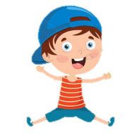





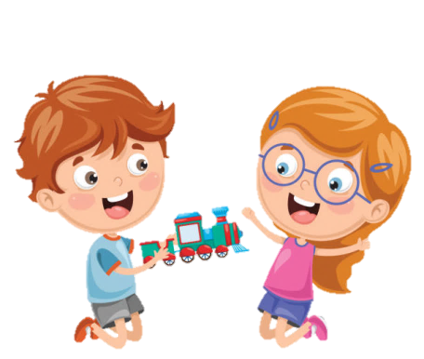





Slide 2
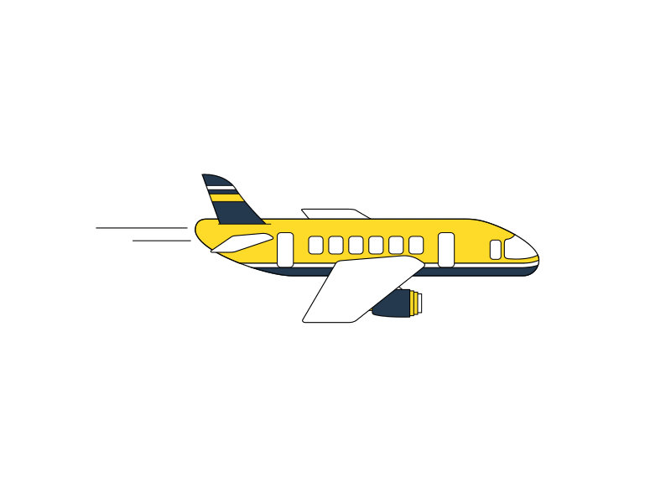


Unit 7: Jobs
Lesson 2
Task 4, 5, 6

Slide 3
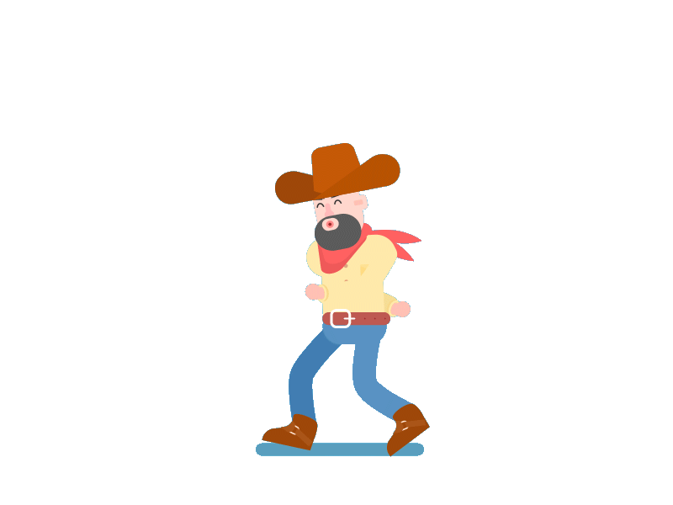
1. Warm up
Cowboy game

Slide 4
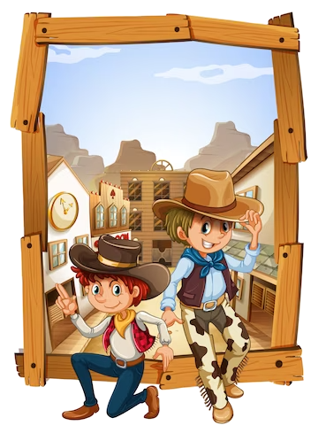
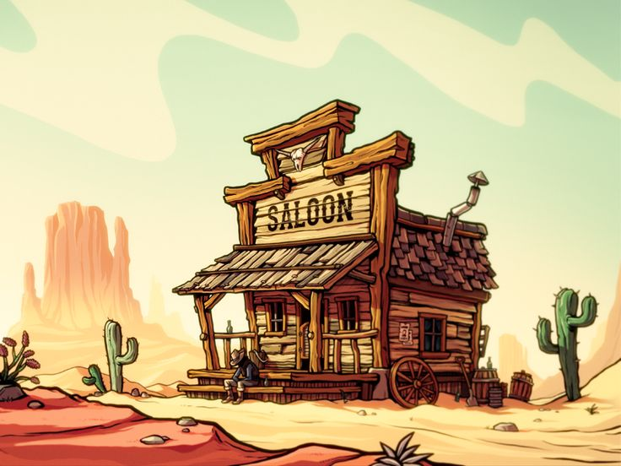
Cowboy game
Notes:
Cowboy game
Each turn will have two SS from each team. 2 SS stand, face their backs to each other. Each S will be given a picture.
When T counts 1,2,3, the two will turn back and look at the other’s picture and read that word aloud. Who read it correctly and faster will be the winner. –
The game will last for 7 rounds

Slide 5
2. Review

Slide 6
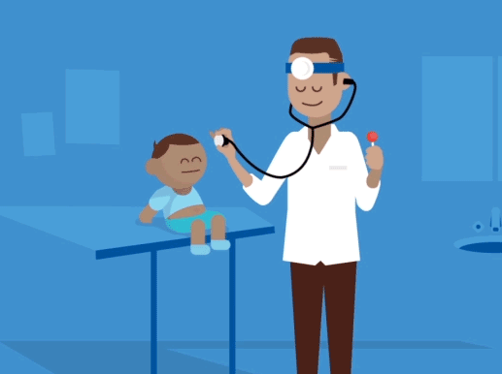
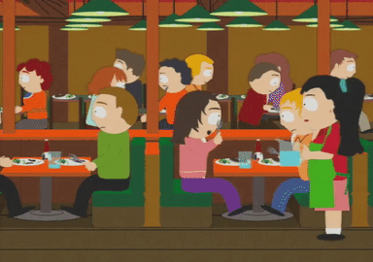



Listen and repeat.
in a clinic
in a restaurant
in a hospital
in a studio

Slide 7
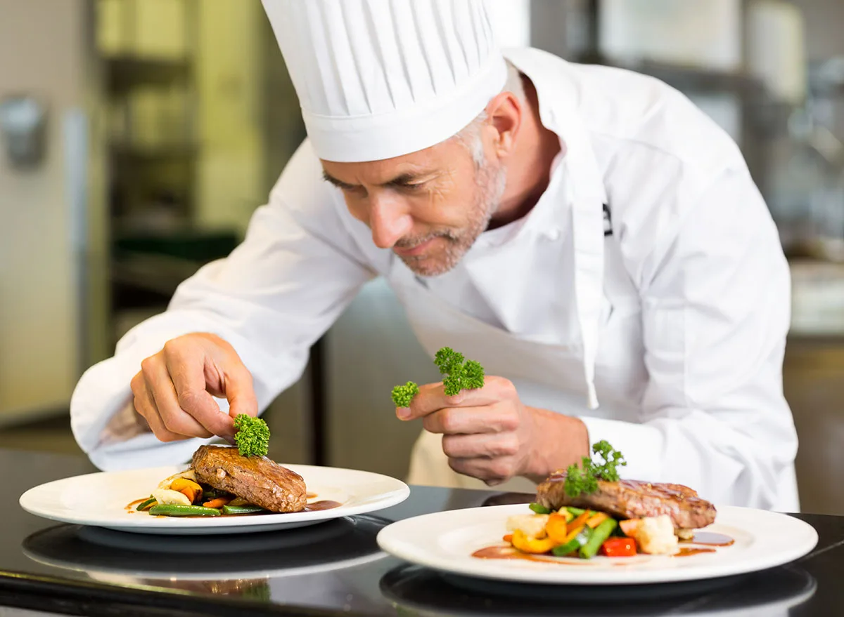
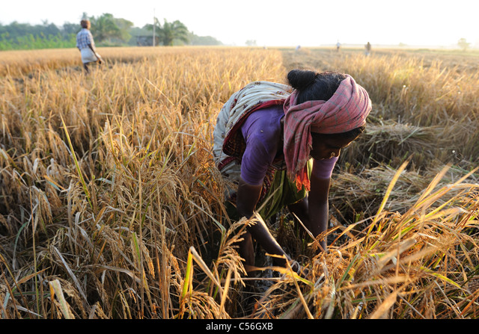
4. Listen and repeat.
Where does he work?
- He works in a restaurant.
2. Where does she work?
- She works in a field.

Slide 8
3. PRACTICE

Slide 9
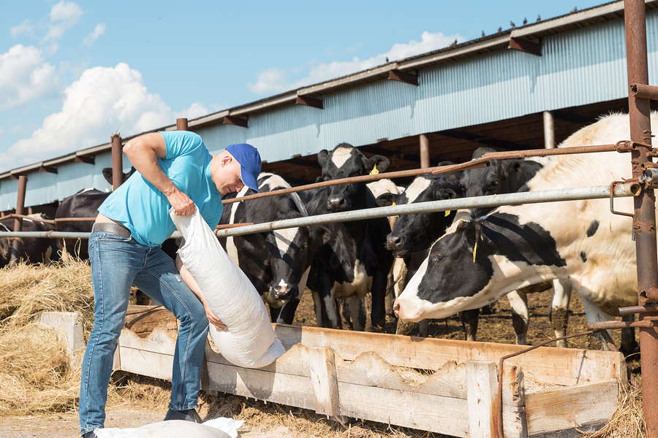
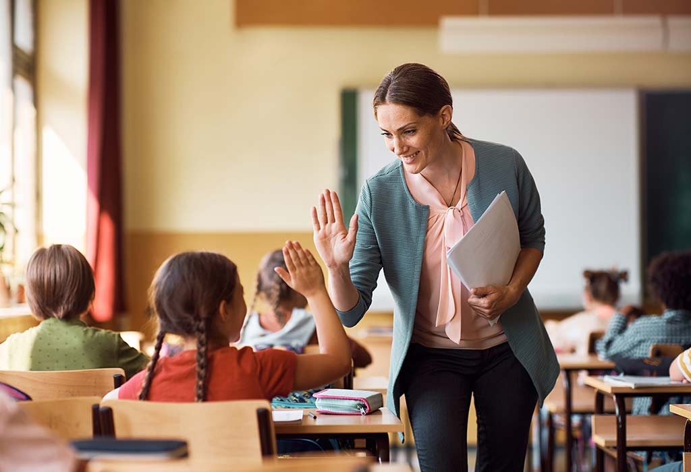
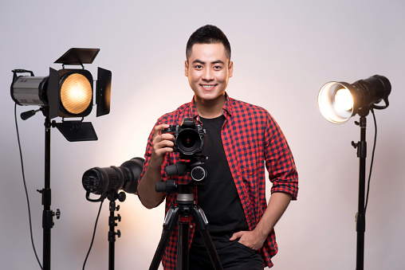

5. Look. Ask and answer.
Where does uncle Tom work?
He works on a farm.
1. uncle Tom/ on a farm
2. teacher Mai/ in a school
3. Mr. Lee/ in a studio
4. doctor Minh/ in a hospital

Slide 10
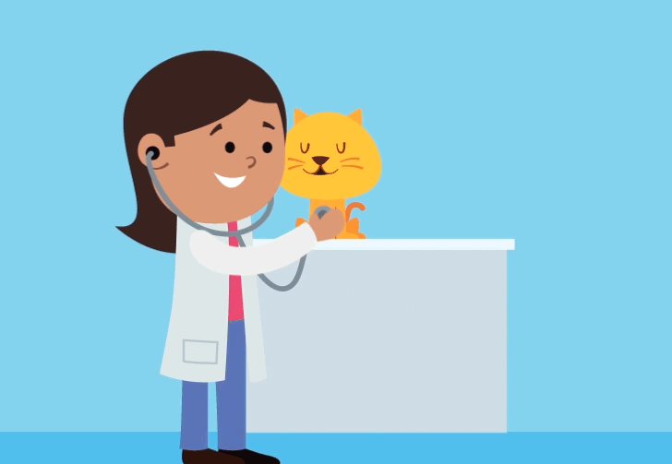
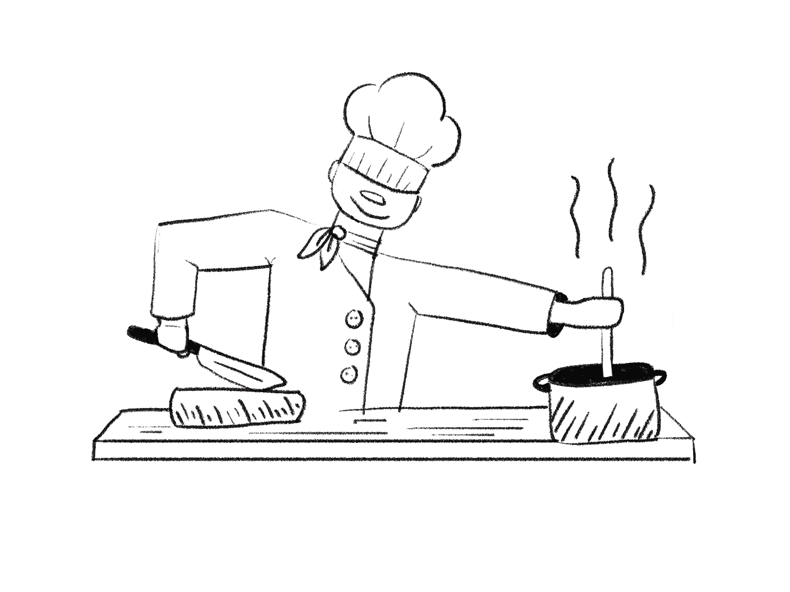
6. Listen and chant.
Vet, vet, vet
Clinic, clinic, clinic
A vet works in a clinic.
Chef, chef, chef
Restaurant, restaurant, restaurant
A chef works in a restaurant.

Slide 11
4. PRODUCTION

Slide 12



Football game
Notes:
Football game
T divides the class into 2 groups.
Each group will choose a name and play rock, scissors, paper to decide which group goes first. The two groups will take turns to choose a letter answer the corresponding questions.
If the answer is correct, T will click on the ball to make it move. If not, the chance is given to the other team.
The team bringing the ball to the goal first, or closer to the goal will win.

Slide 13
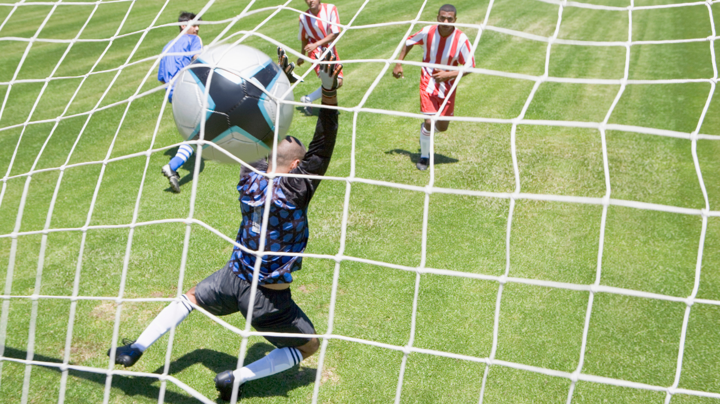
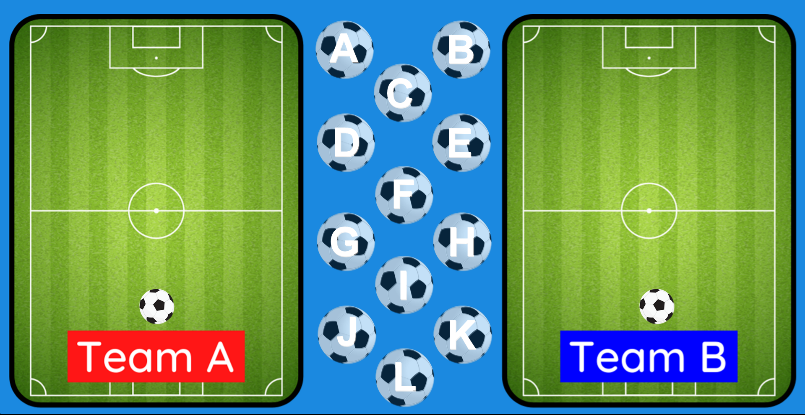
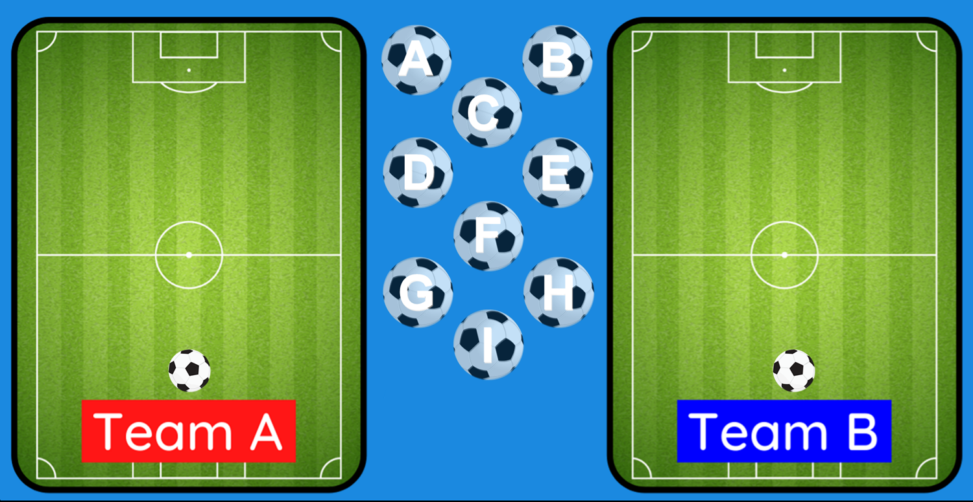


A
B
C
GOAL!!!!
GOAL!!!!
D
E
F
G
H
I
FINISH
Notes:
T clicks on the ball to make it move

Slide 14
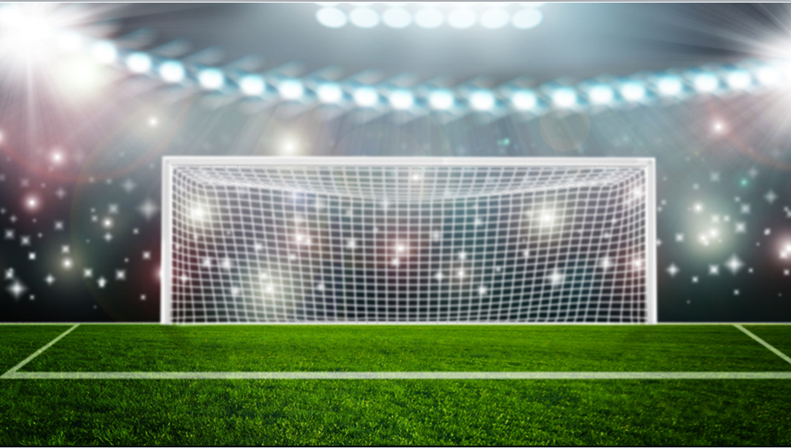
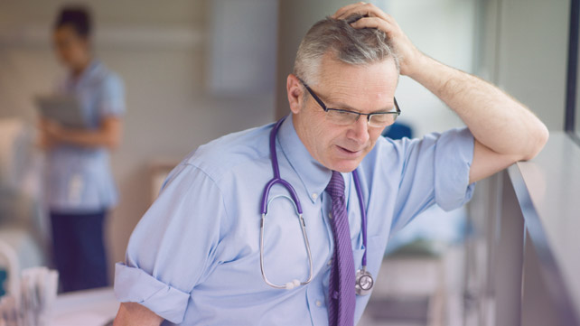
Where does he work?
He works in a hospital.

Slide 15
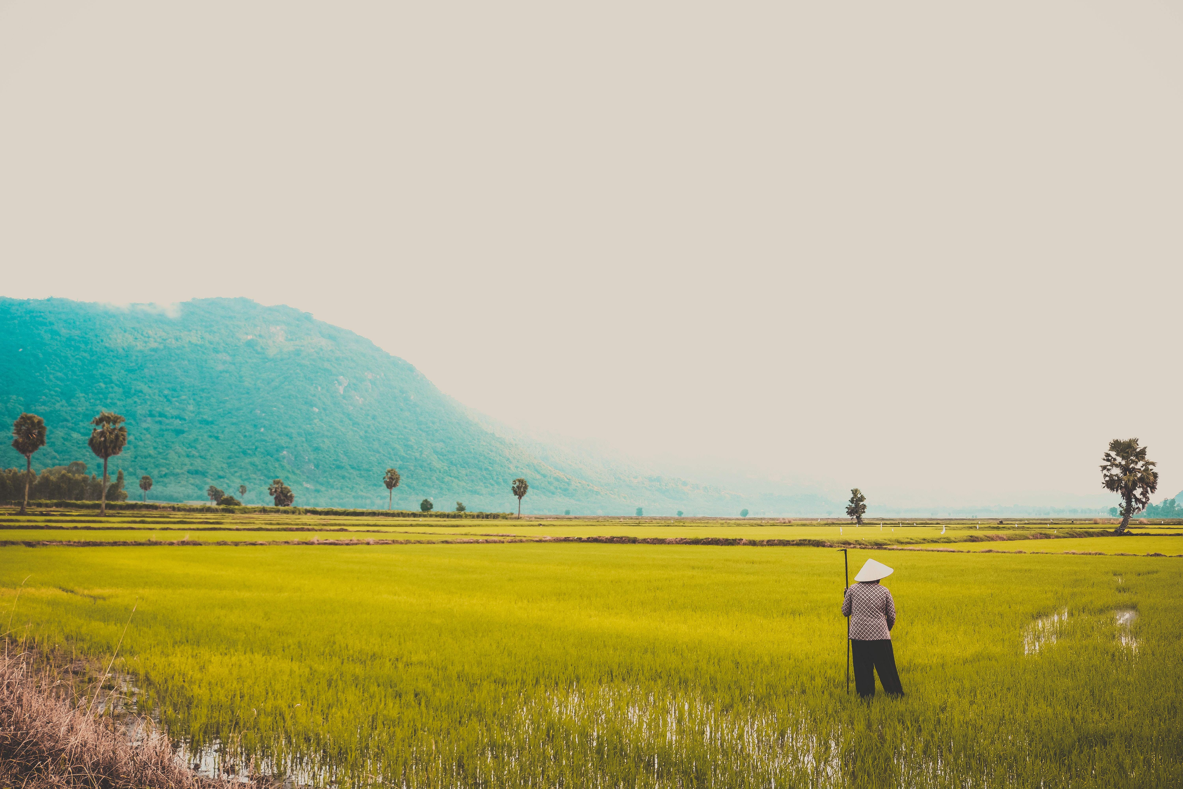
Where does she work?
She works in a field.

Slide 16
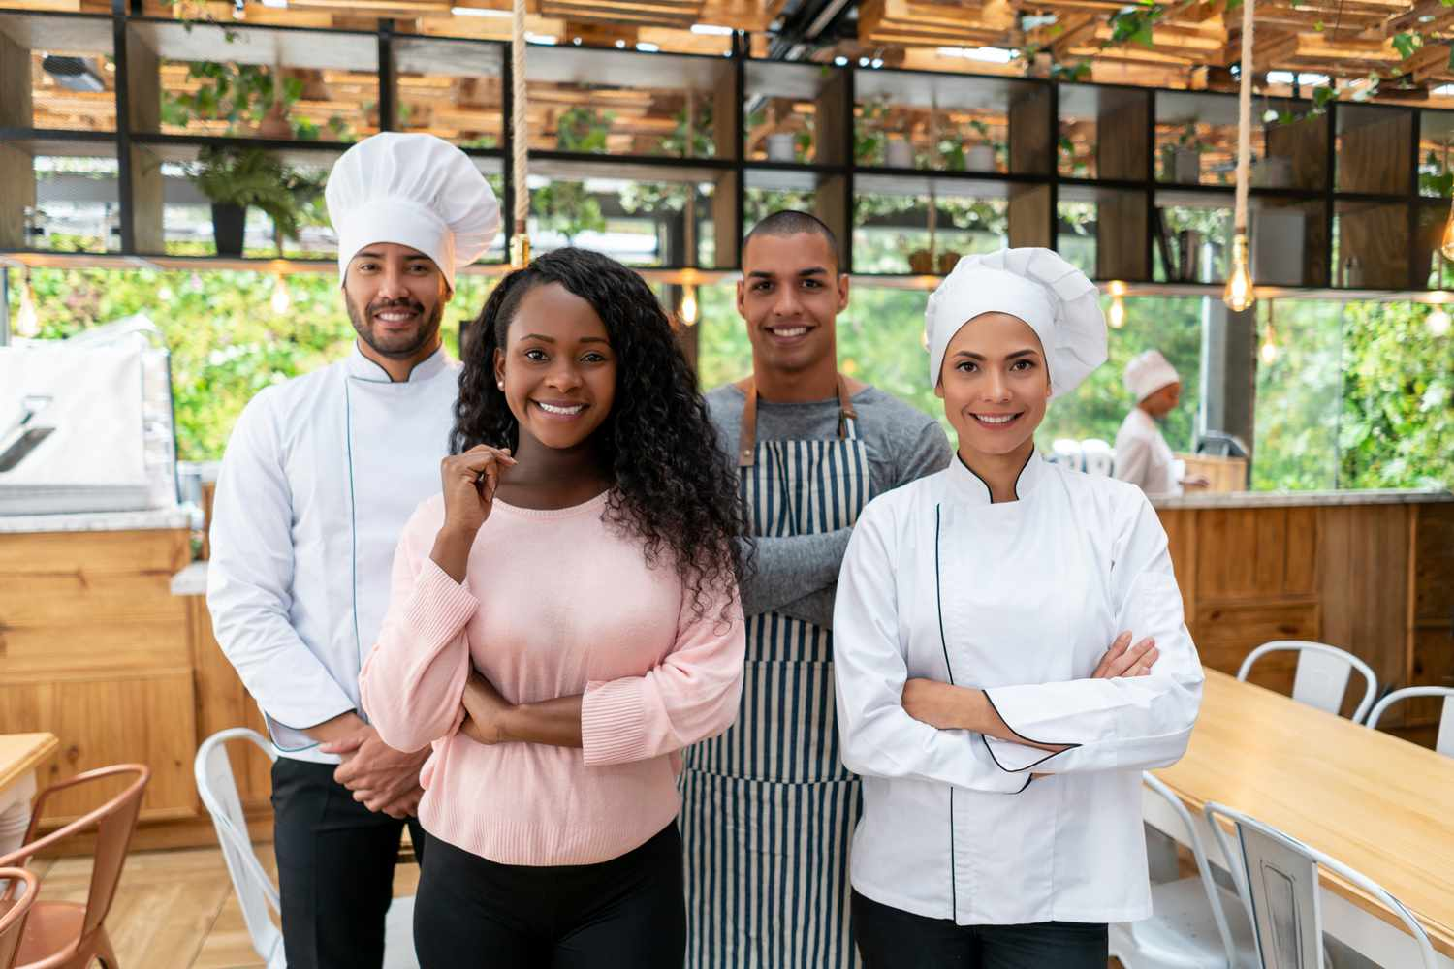
Where do they work?
They work in a restaurant.

Slide 17

Where does he work?
He works on a farm.

Slide 18
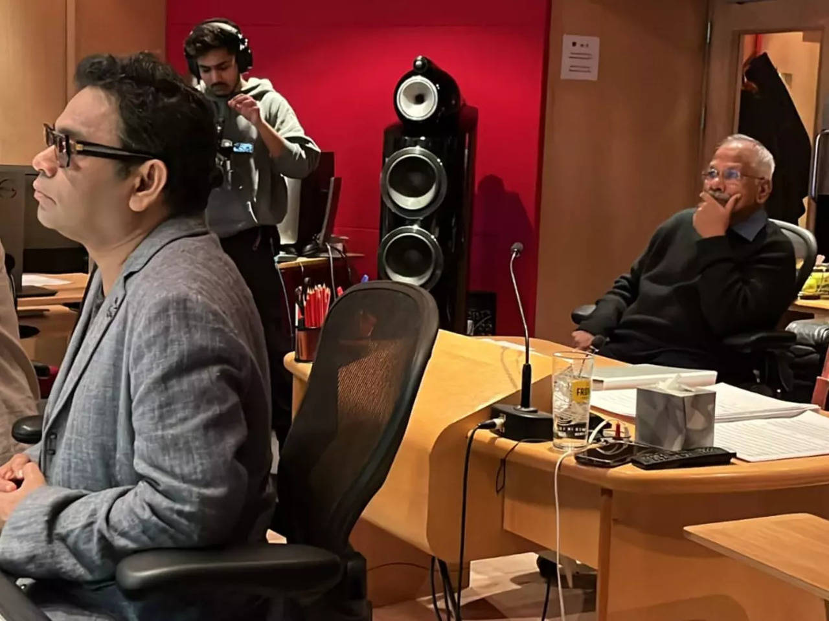
Where do they work?
They work in a studio.

Slide 19
Listen. What can you hear?
Teacher Mai works in a school.

Slide 20
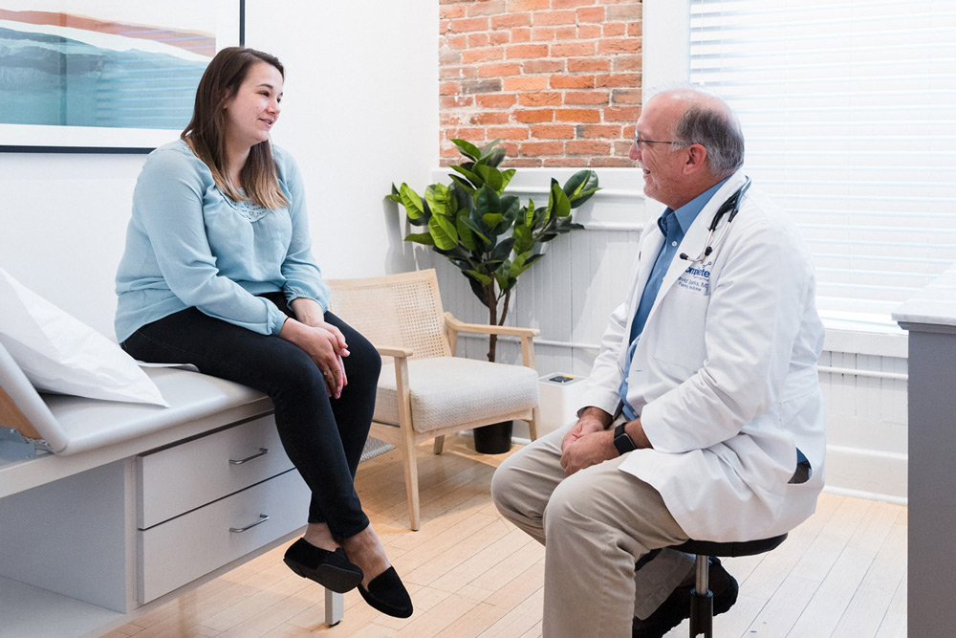
Where is she?
She is in a clinic.

Slide 21
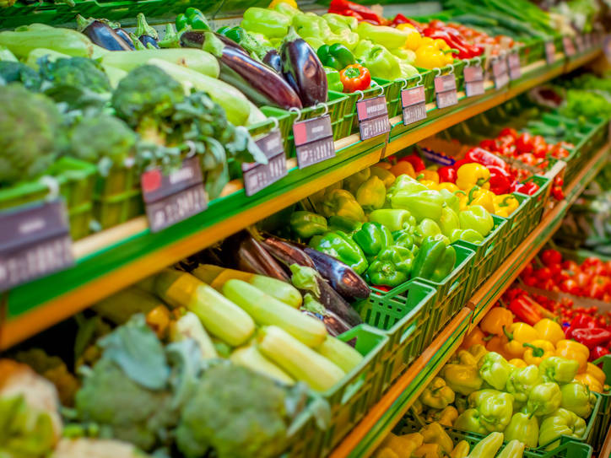
Where are they?
They are in a grocery store.

Slide 22
Listen. What can you hear?
A chef works
in a restaurant.

Slide 23
5. ASSESSMENT

Slide 24
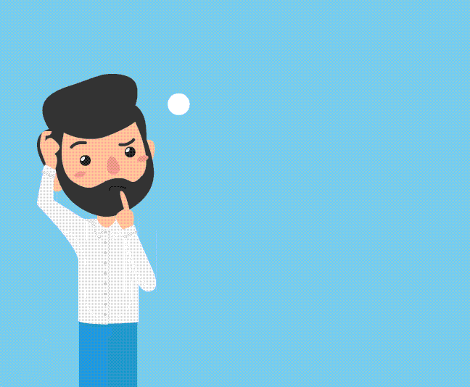
Look and write.
He’s a farmer. He works ________________.
Ms. Jane is a doctor. She works ________________.
His father is a chef. He works ________________.
Her brothers are photographers. They work ________________.
Their mother is a vet. She works ________________.
on a farm
in a hospital
in a restaurant
in a studio
in a clinic

Slide 25
UNIT 7: JOBS
LESSON 2: PERIOD 2
What we learnt today:
Review vocabulary:
- in a hospital, in a restaurant, in a studio, in a clinic
Structure:
Where does he work?
He works in a restaurant.

Slide 26




Thank you & goodbye!

