Slide 1


Slide 2

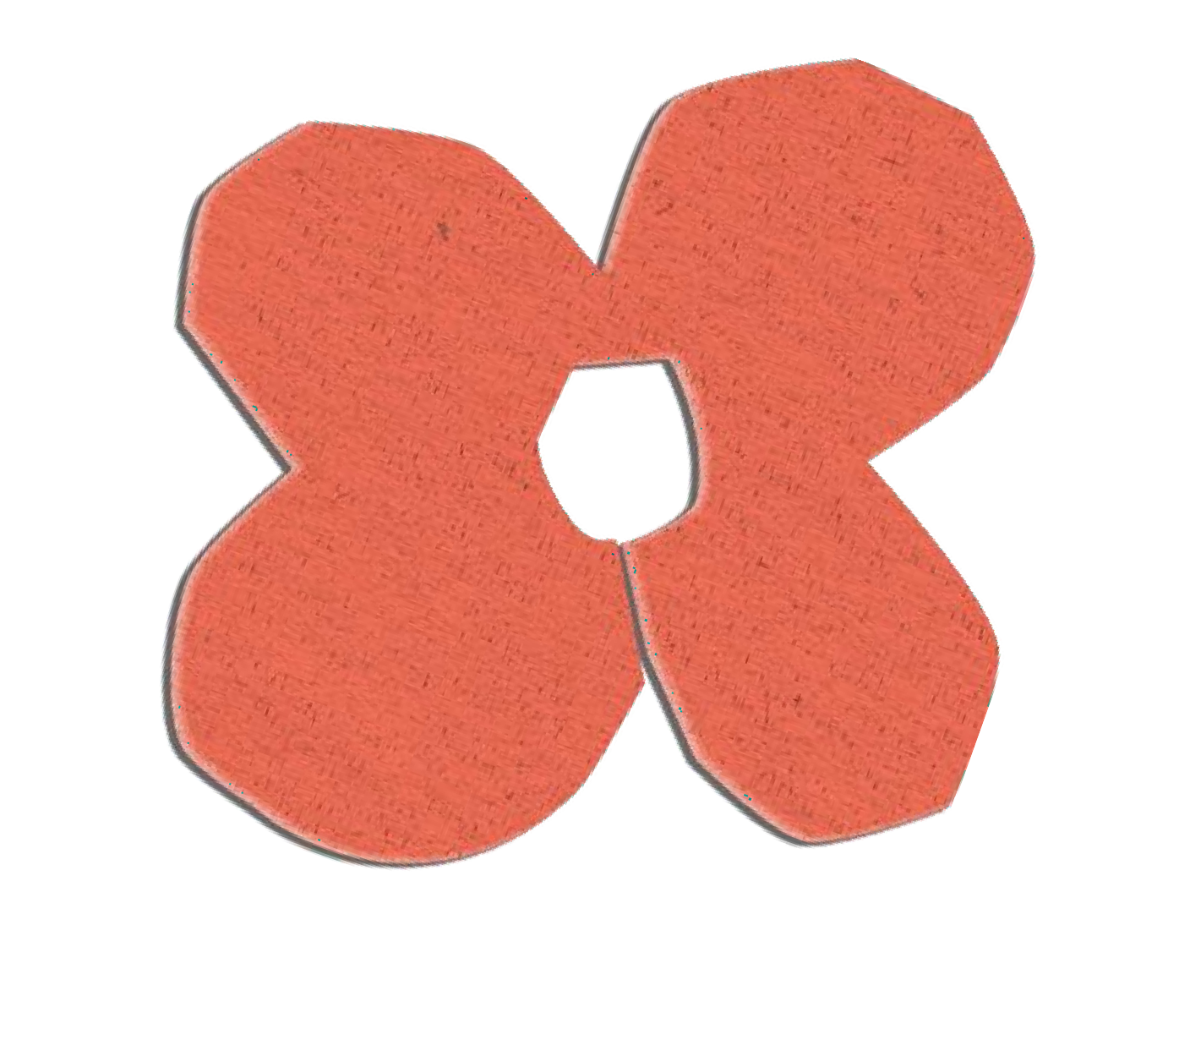



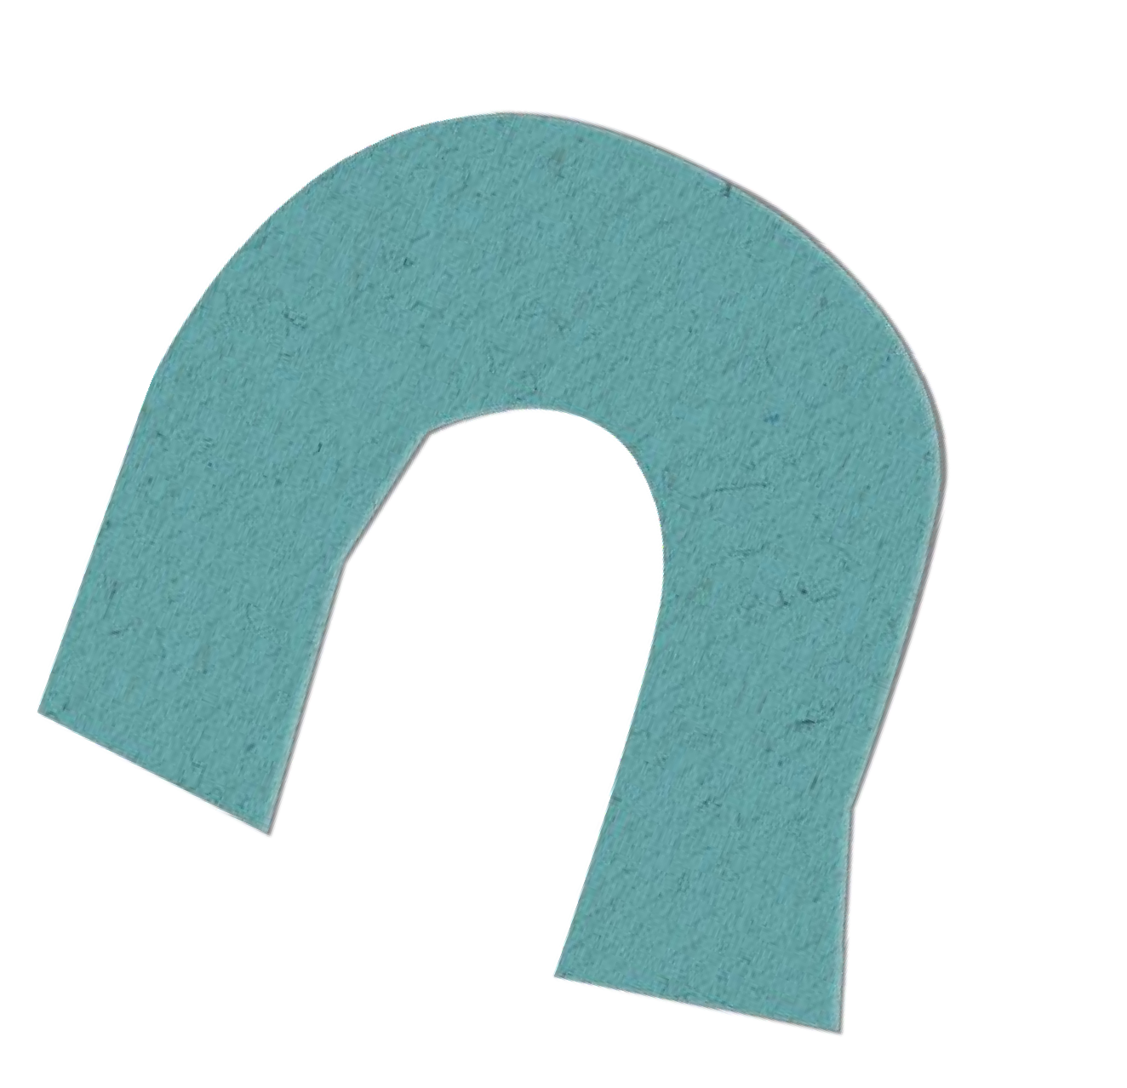



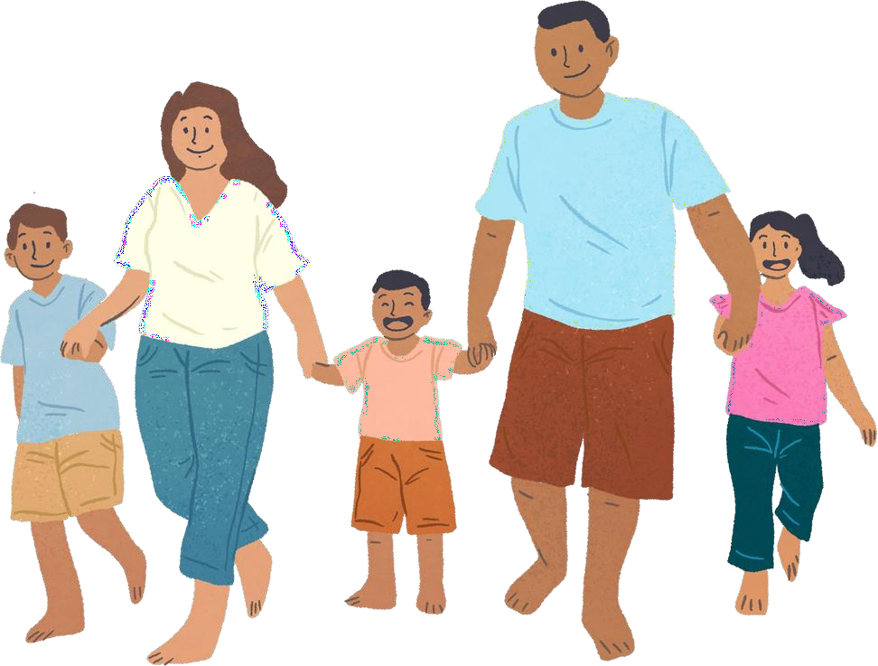

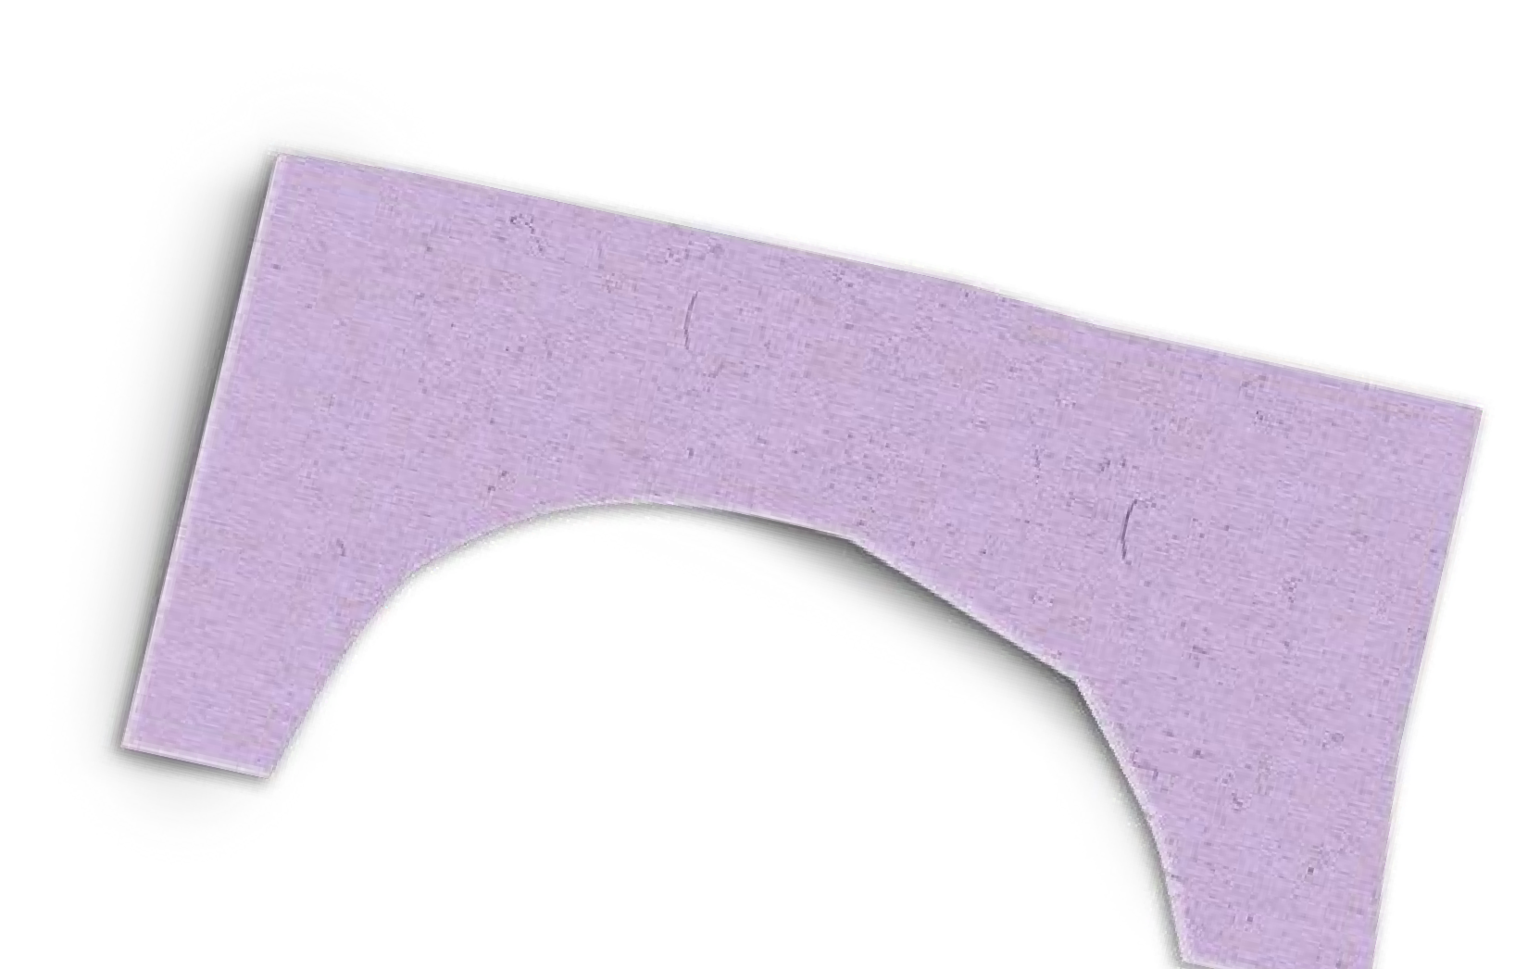
Unit 11: FAMILY TIME

Slide 3







Table of contents
Warm-up and Review.
Activity 1: Look, listen and repeat. Activity 2: Listen, point and say.
Activity 3: Let’s talk. Fun corner and Wrap-up.

Slide 4


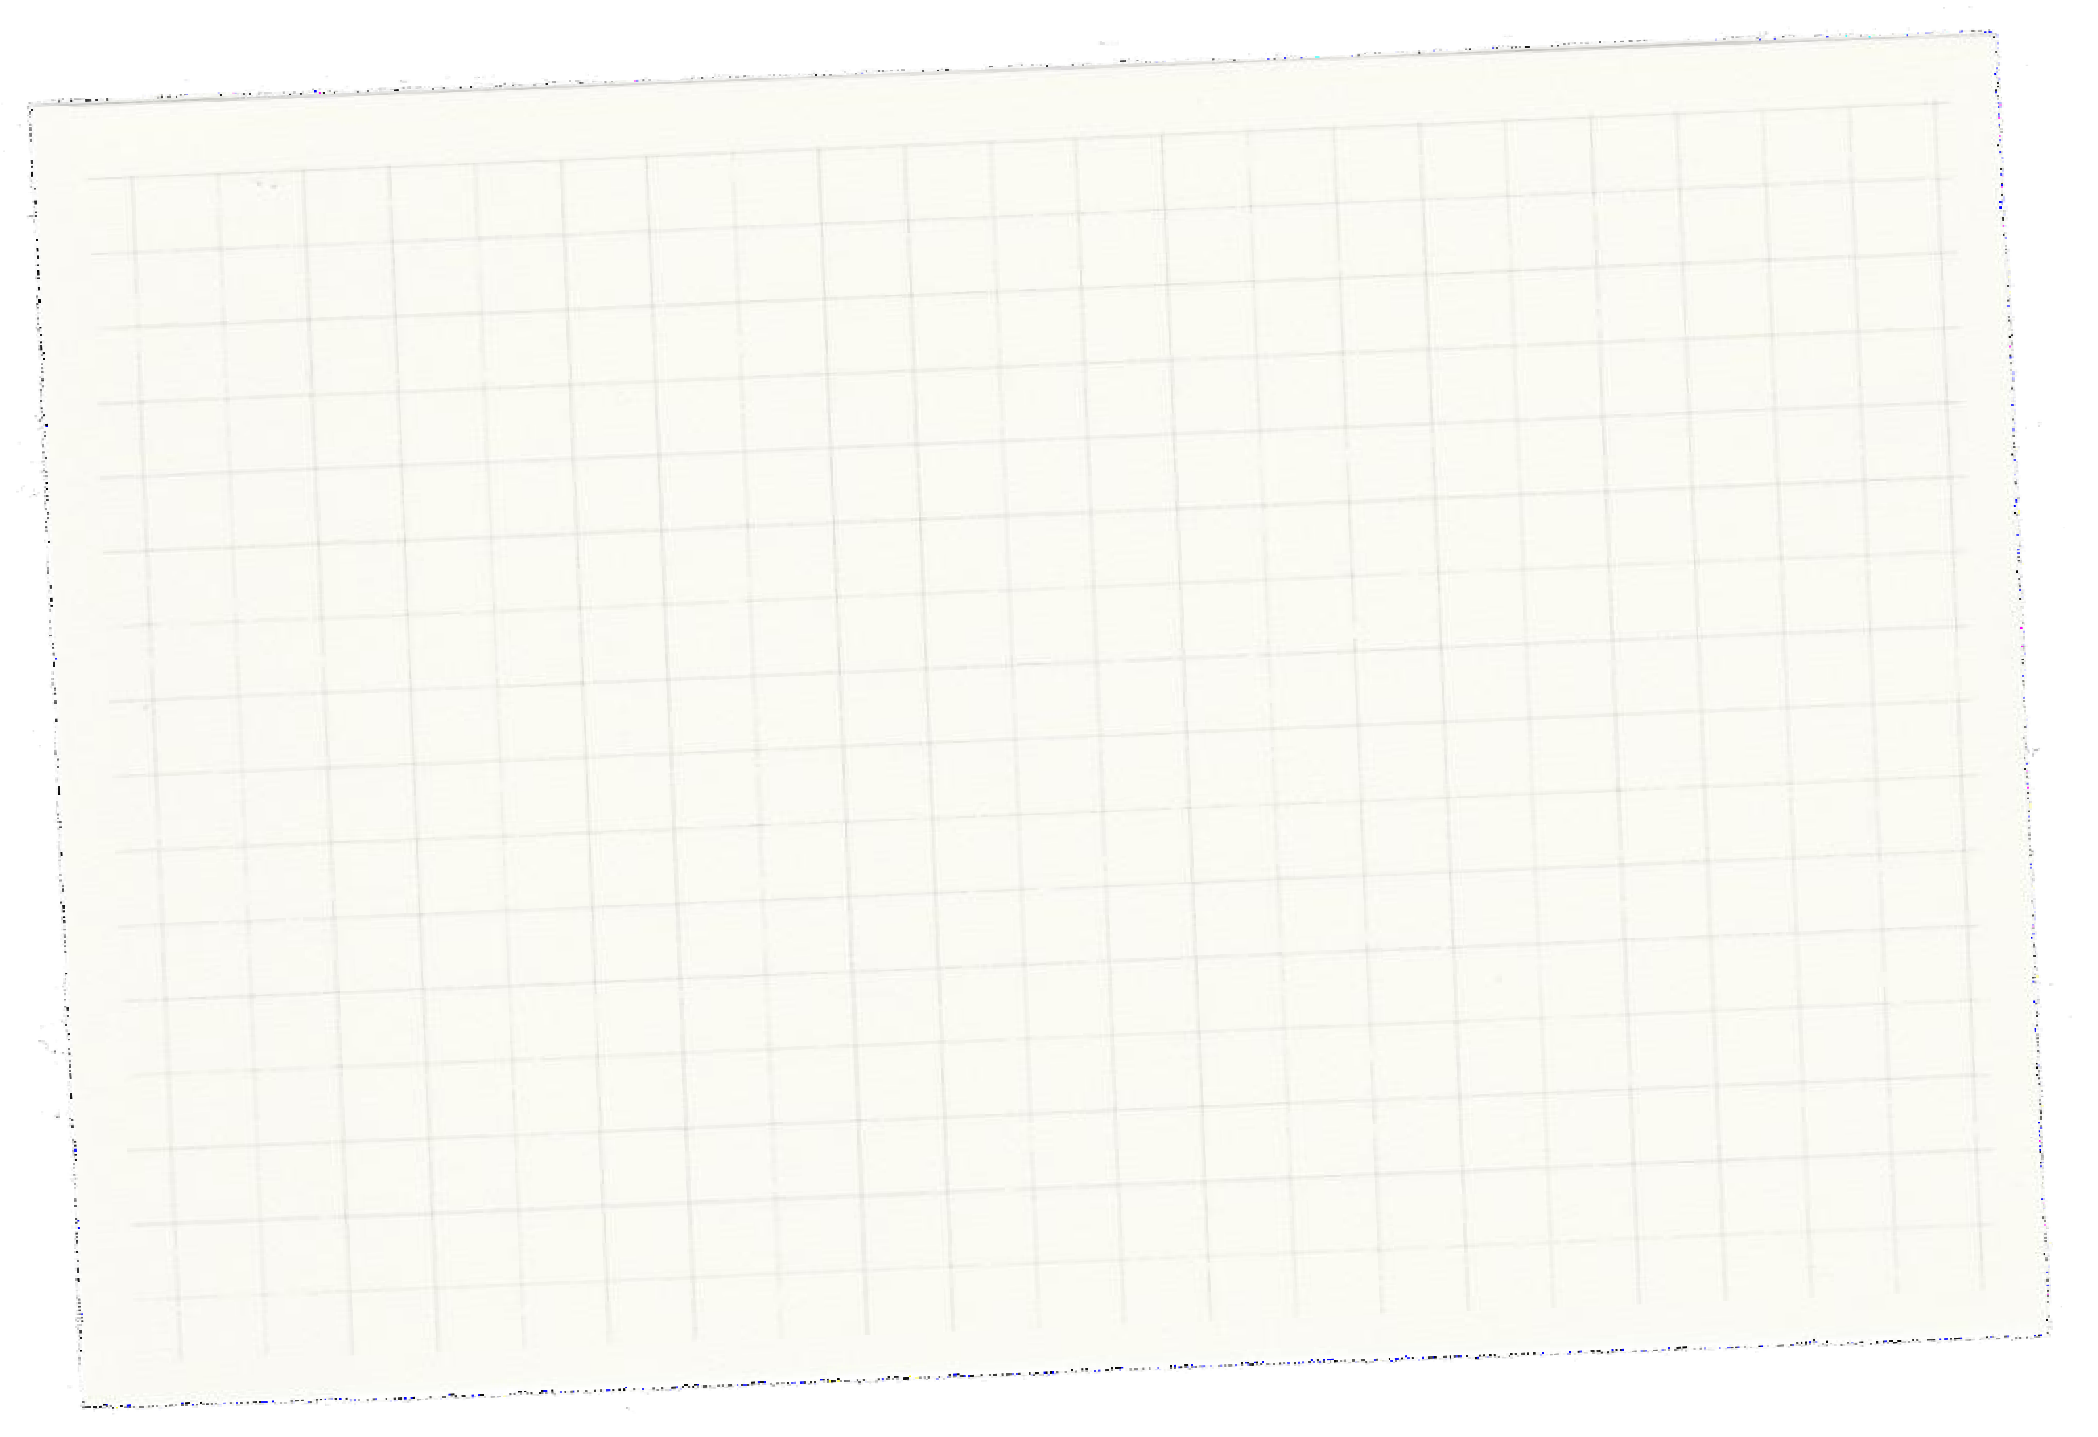






Warm-up and Review.
01

Slide 5
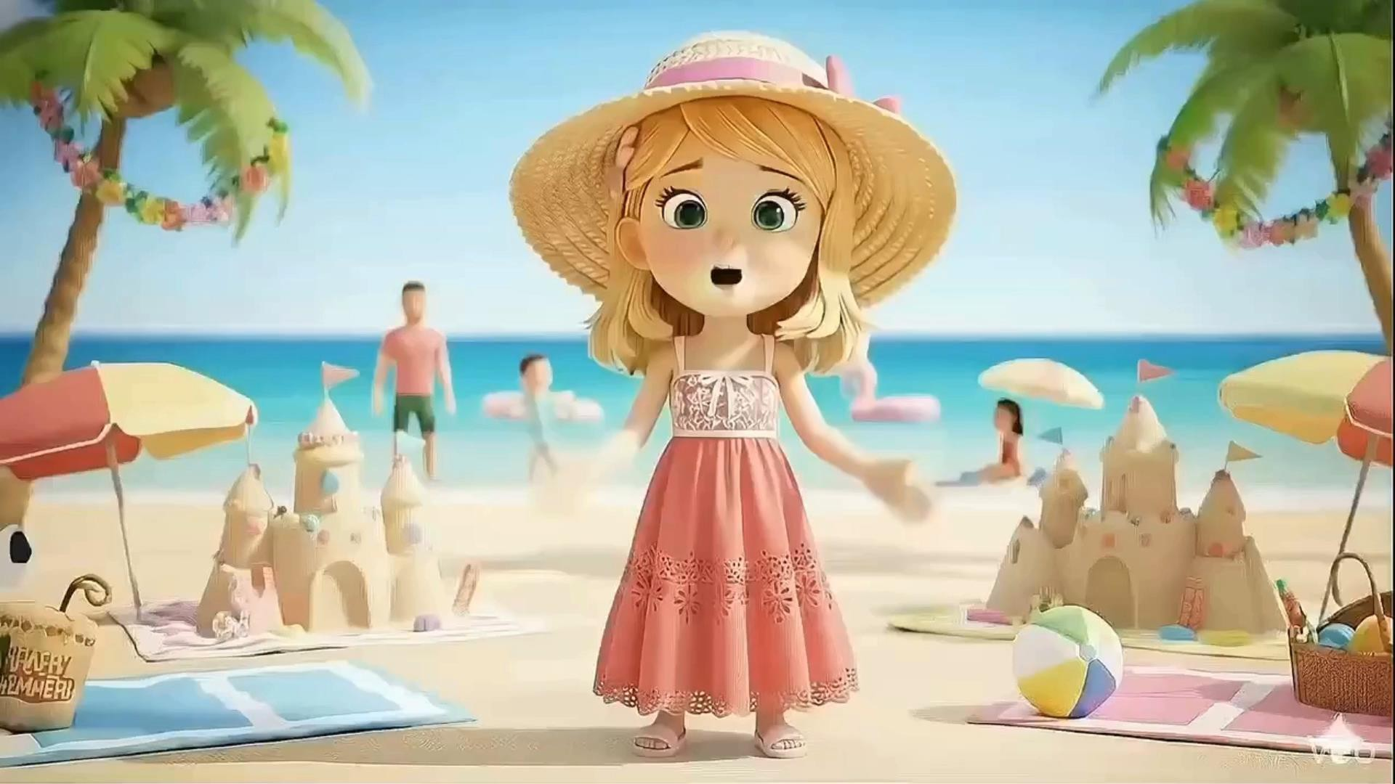

Slide 6
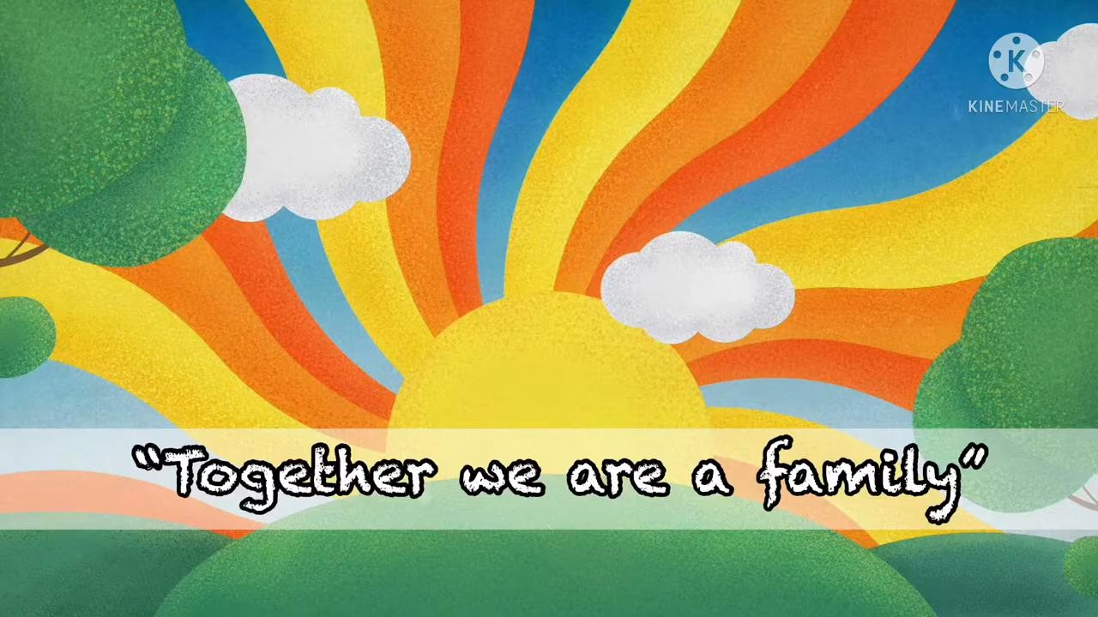

Slide 7
Game
HOT SEAT

Slide 9
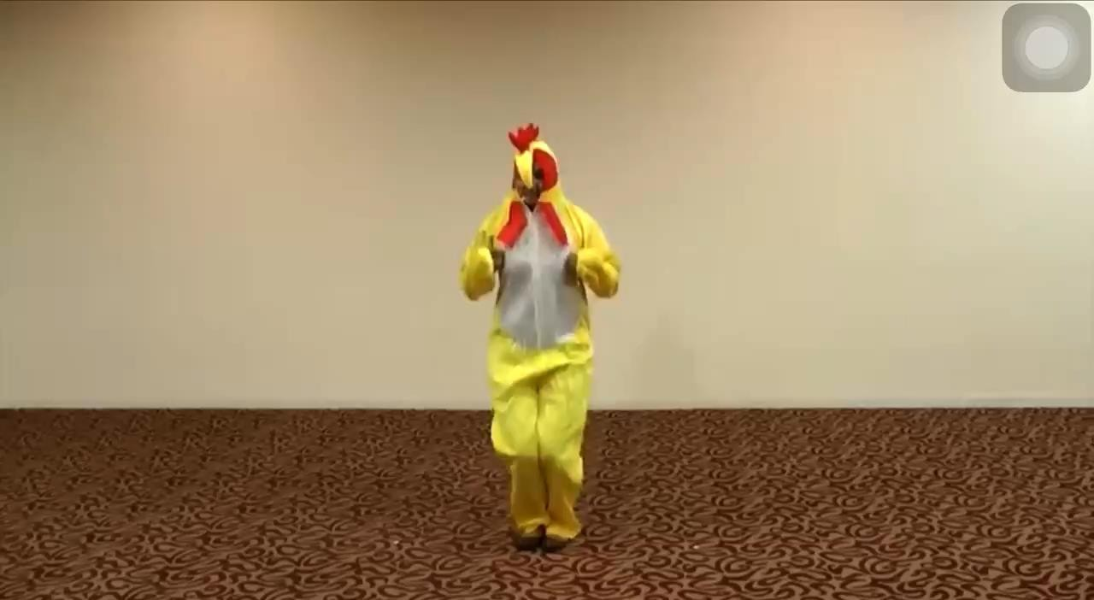

Slide 10
Question 1: How many people are there in your family?
- There are four people in my family.

Slide 12
Question 2: What do you do with your family?
- We watch TV.

Slide 13
02
ACTIVITY 1
Look, listen and repeat.

Slide 14

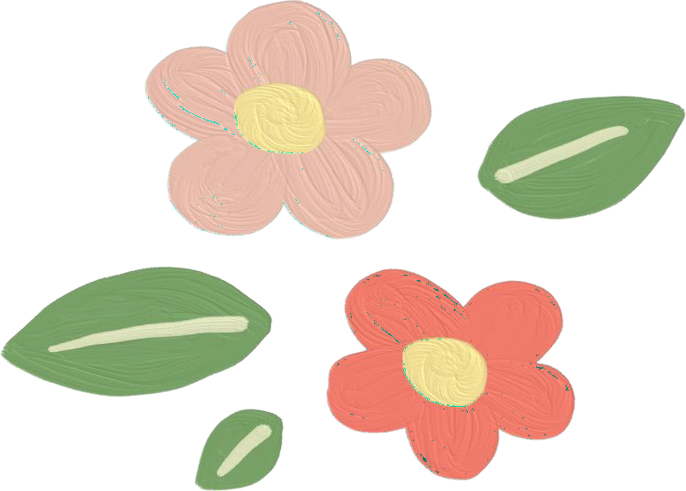

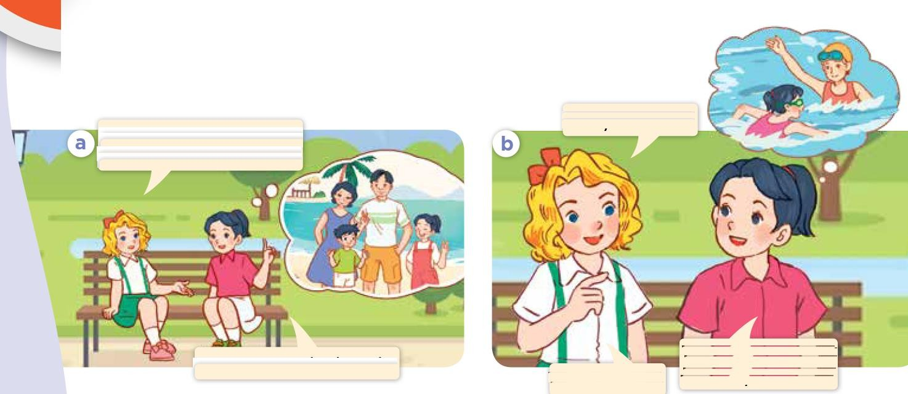







Look and say.

Slide 15
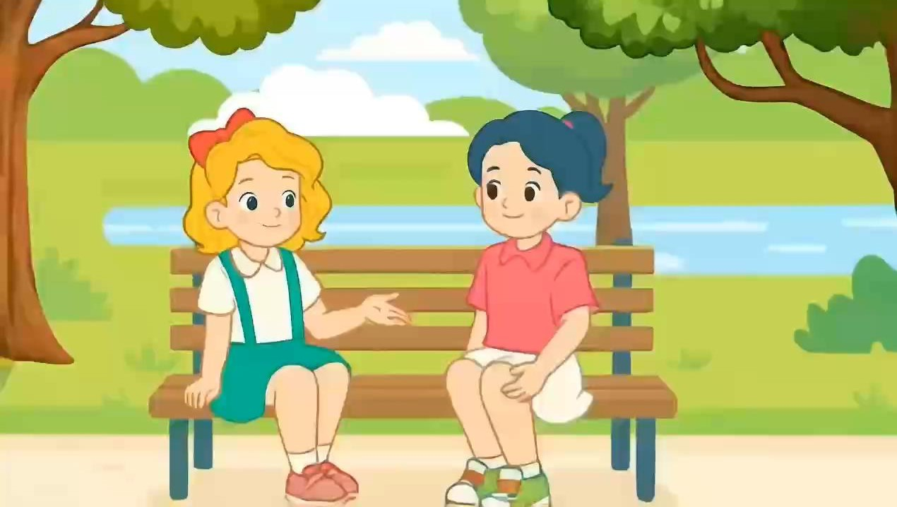

Slide 16
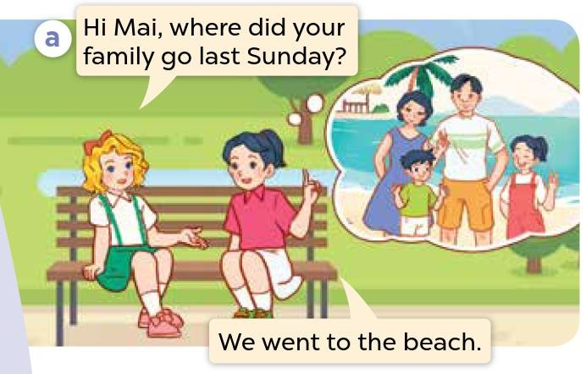


Look, listen and repeat.

Slide 17
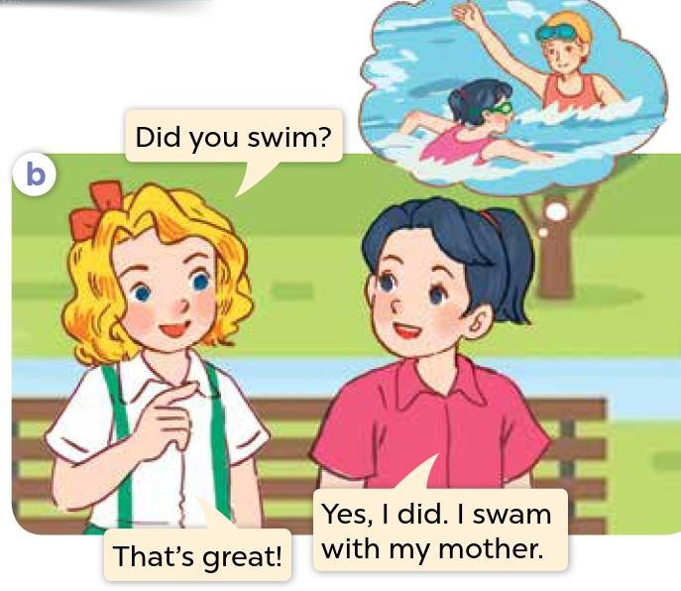
Look, listen and repeat.

Slide 18
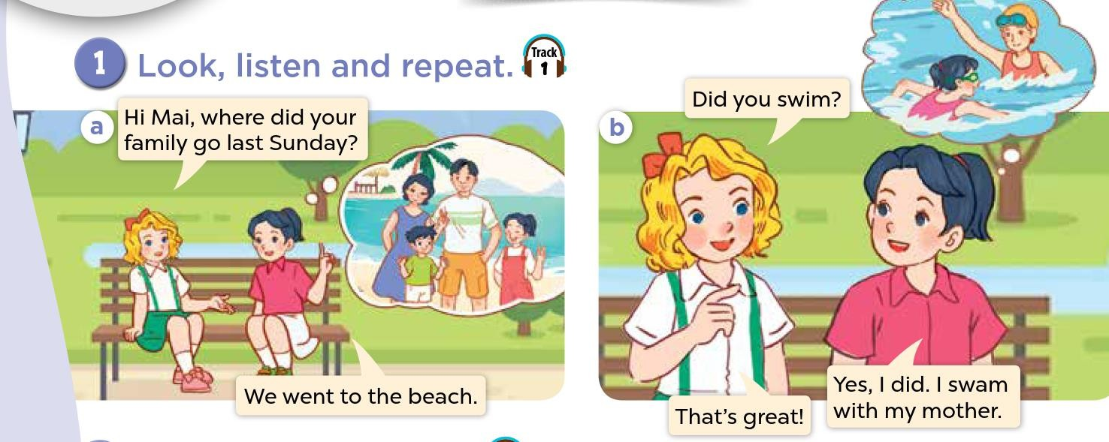
Look, listen and repeat.

Slide 19
03
ACTIVITY 2
Listen, point and say.

Slide 20

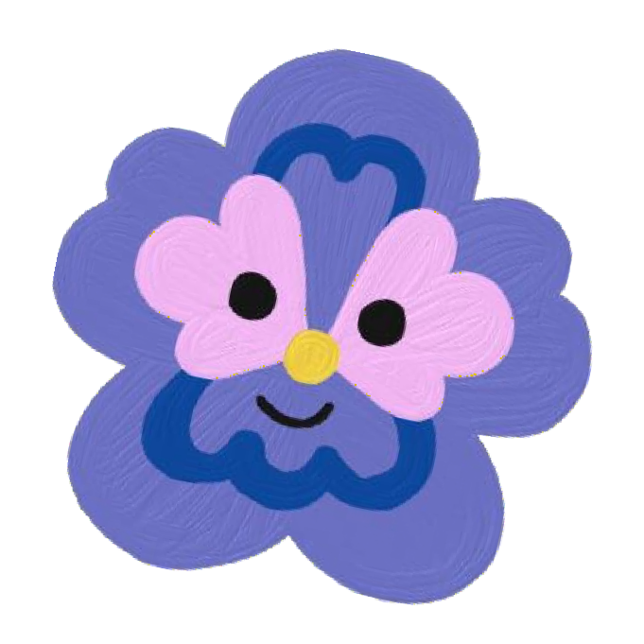


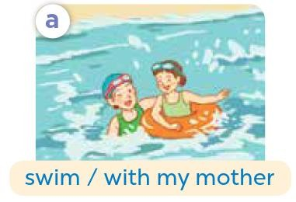
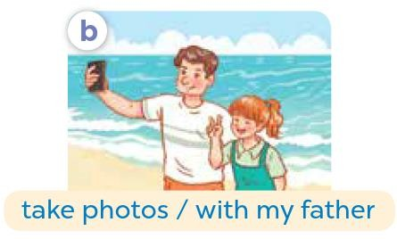

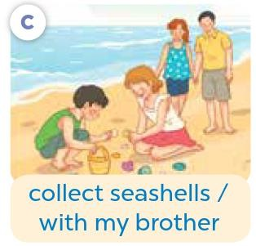
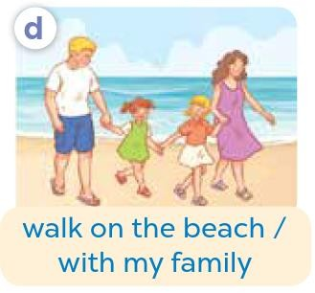


Listen, point and say.

Slide 21

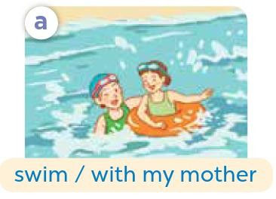

Listen, point and say.

Slide 22
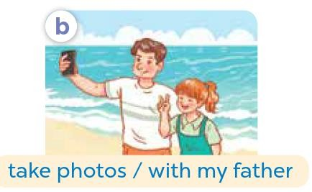
Listen, point and say.

Slide 23
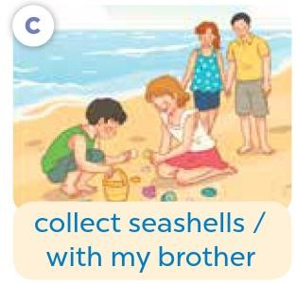
Listen, point and say.

Slide 24
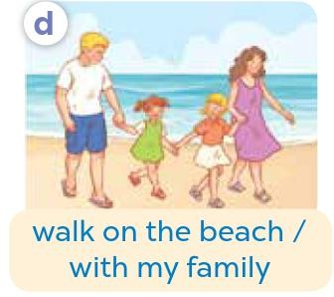
Listen, point and say.

Slide 25


Slide 26
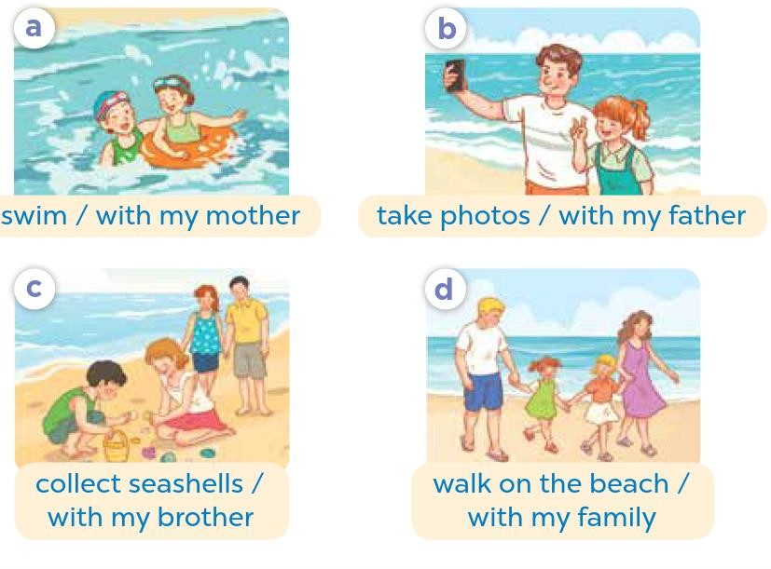


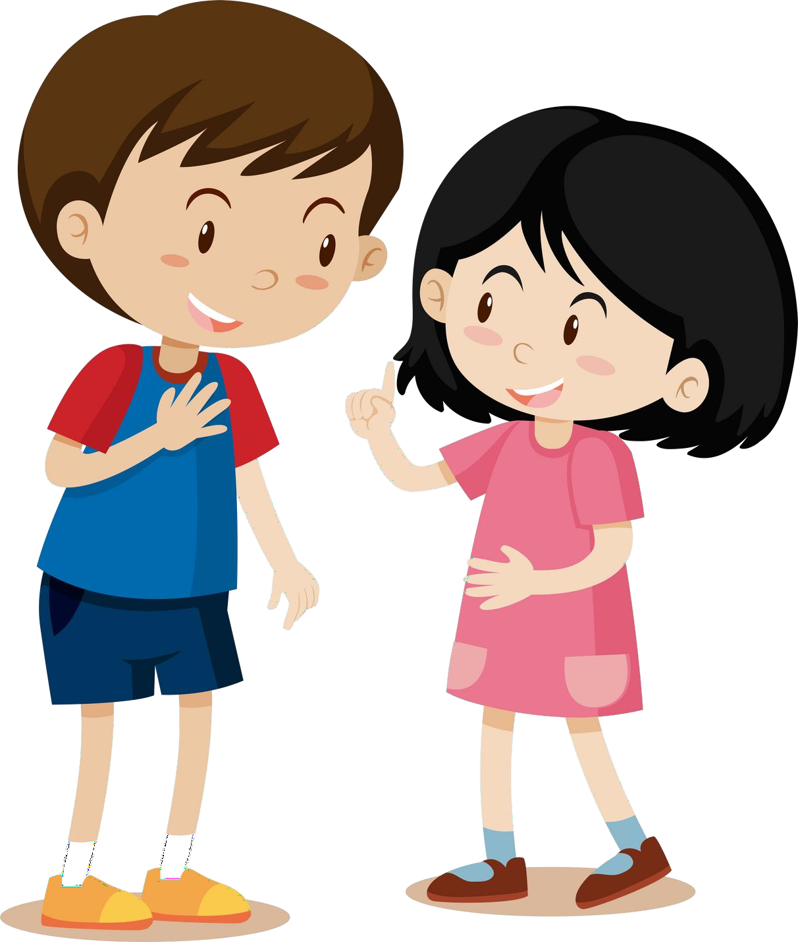
Work in pairs.
Did you ?
Yes, I . I .

Slide 27
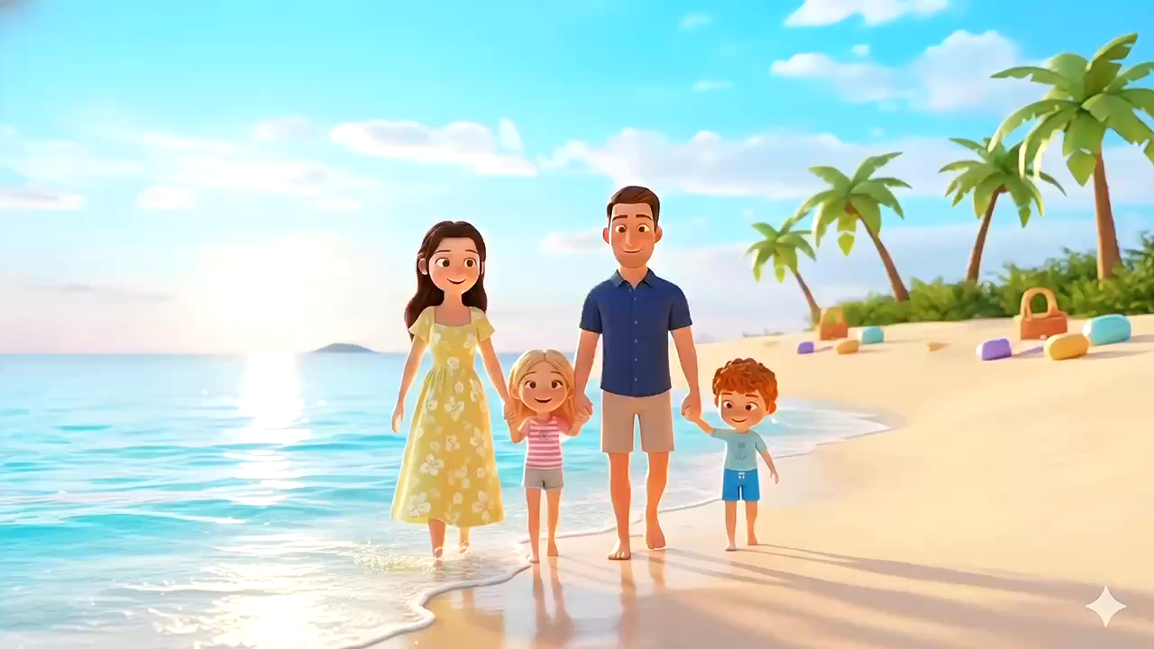

Slide 28








Work in pairs.
Did you swim?
Yes, I did. I swam with my mother.
swim / with my mother

Slide 29

Work in pairs.
Did you take photo?
Yes, I did. I took photo with my father.
take photo / with my father

Slide 30
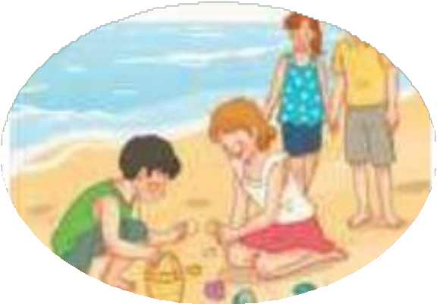
Work in pairs.
Did you collect seashells?
Yes, I did. I collected seashells with my brother.
collect seashells / with my brother

Slide 31

Work in pairs.
Did you walk on the beach?
Yes, I did. I walked on the beach with my family.
walk on the beach / with my family

Slide 32



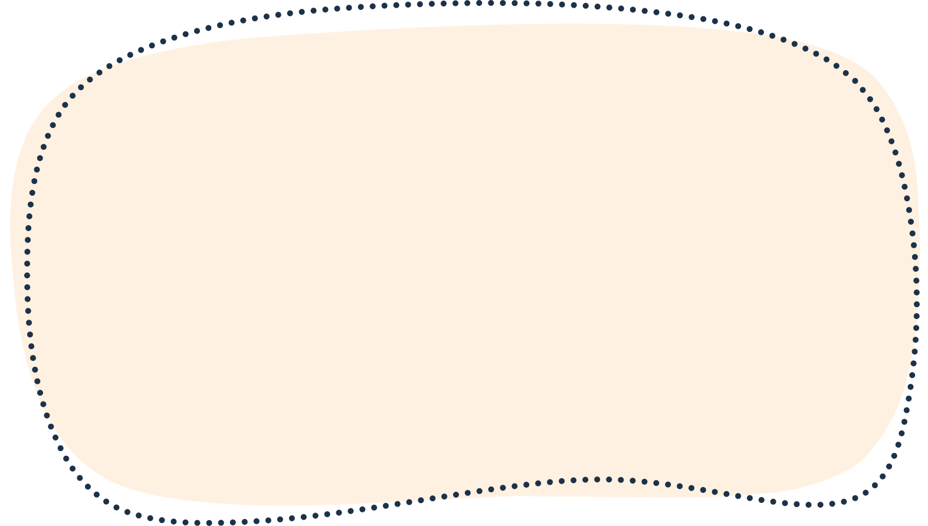


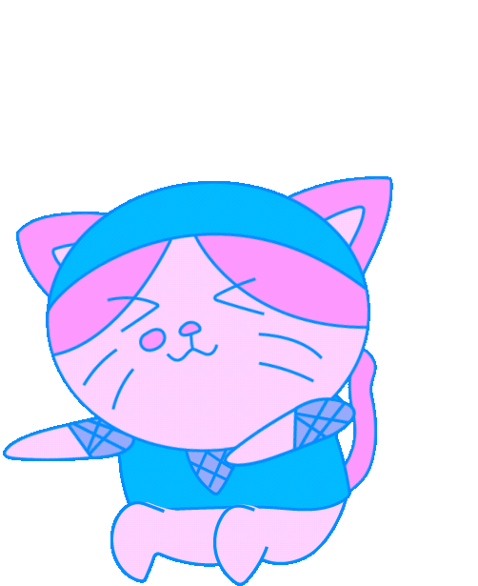




Slide 33
04
ACTIVITY 3
Let’s talk.

Slide 34





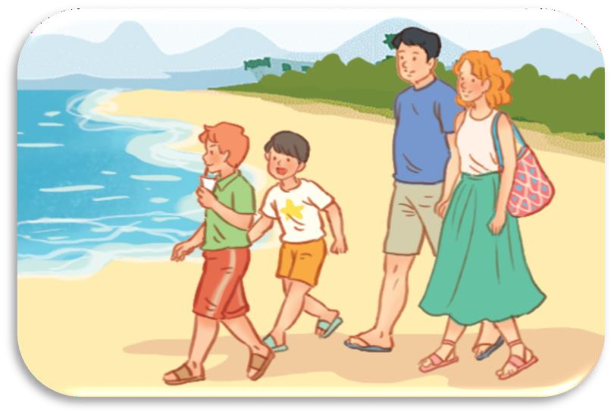

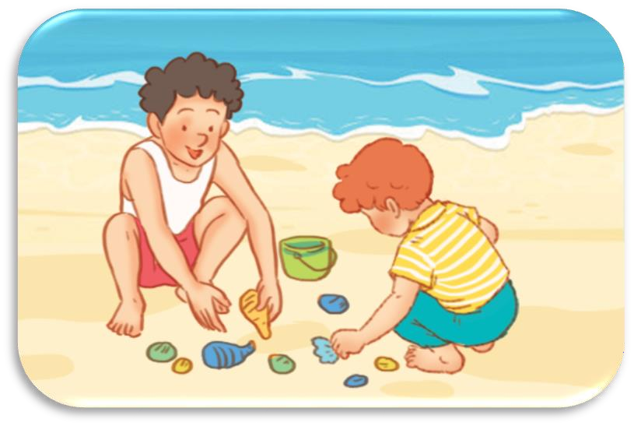
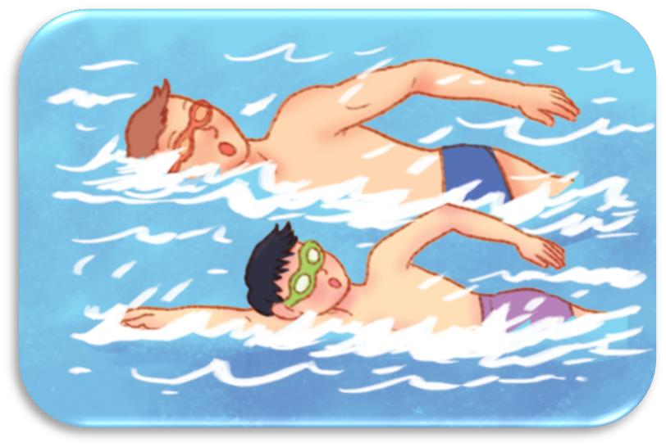
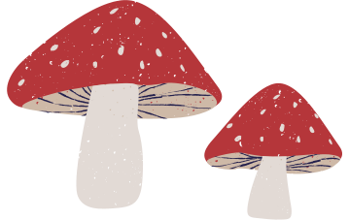


Let’s talk.
Did you ?
.

Slide 35
Work in pairs.
Did you ?
.

Slide 36




Let’s talk.
Did you take photoo
Yes, I did. I took photo with my mother.

Slide 37

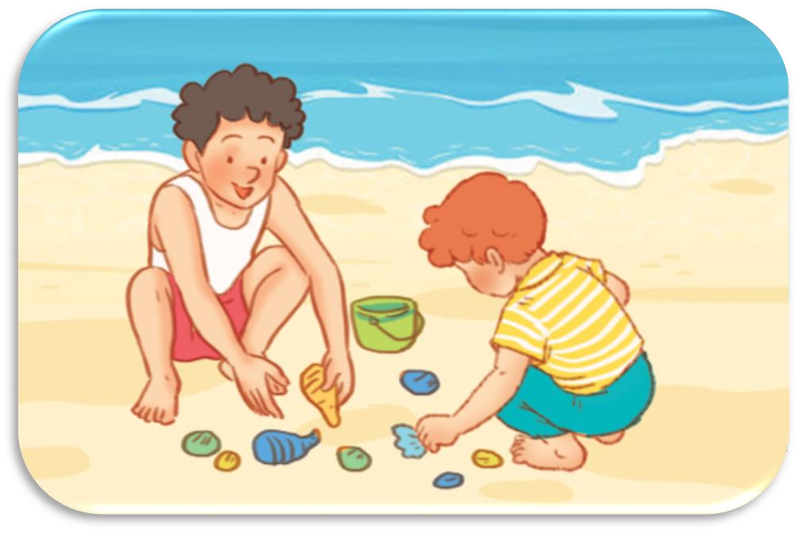


Let’s talk.
Did you collect seashellso
Yes, I did. I collected seashells with my brother.

Slide 38

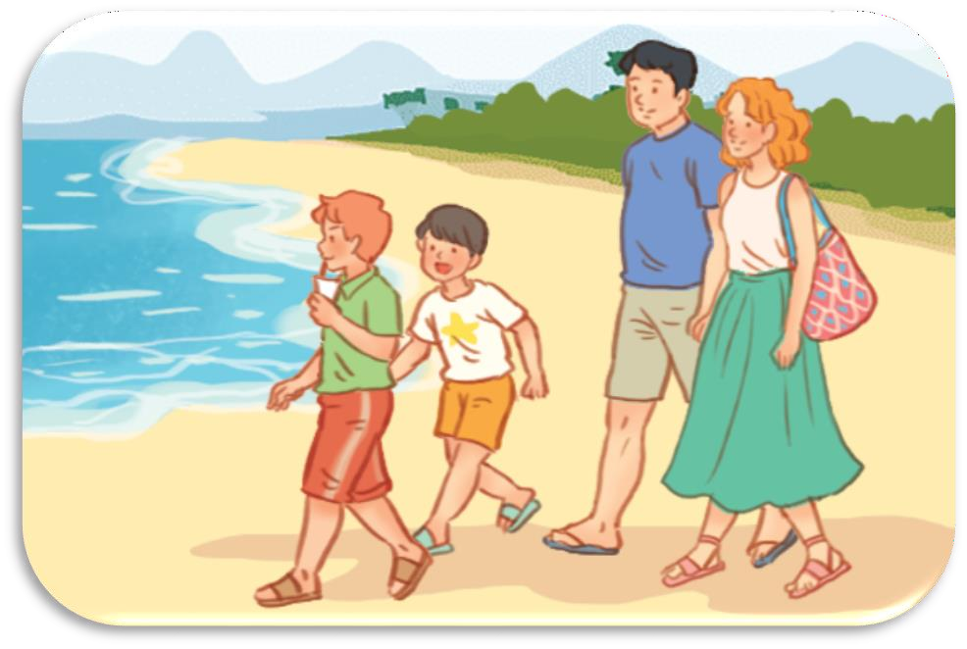


Let’s talk.
Did you walk on the beacho
Yes, I did. I walked
on the beach with my family.

Slide 39

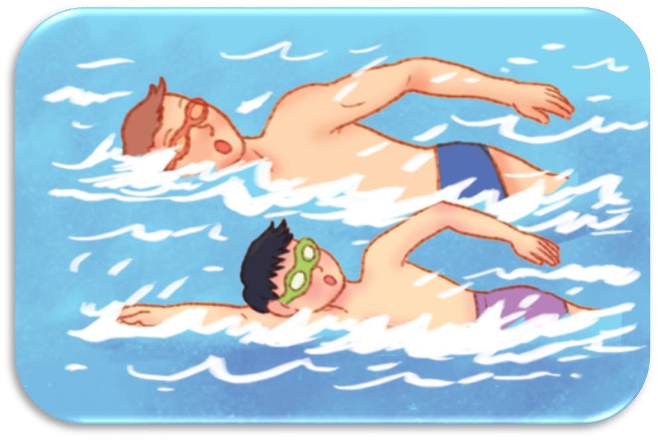


Let’s talk.
Did you swimo
Yes, I did. I swam with my father.

Slide 40
Fun corner and wrap-up.
05

Slide 41


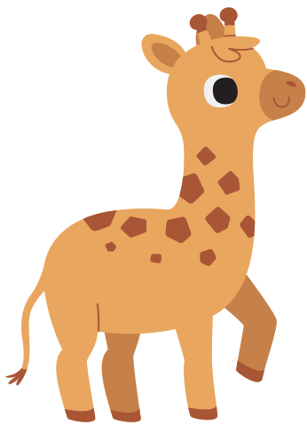


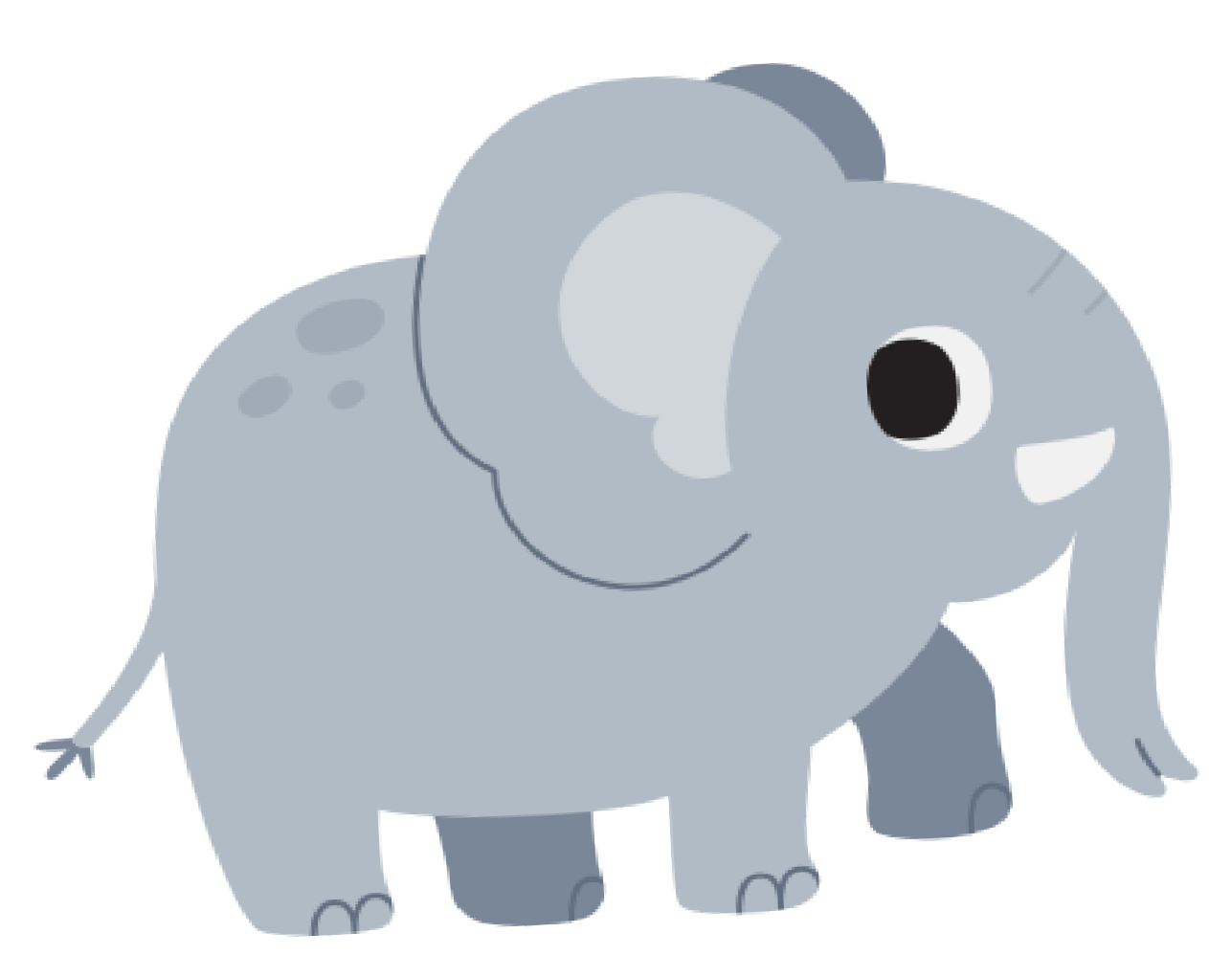
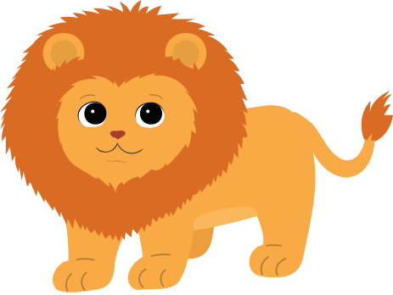
LUCKY ANIMALS

Slide 42


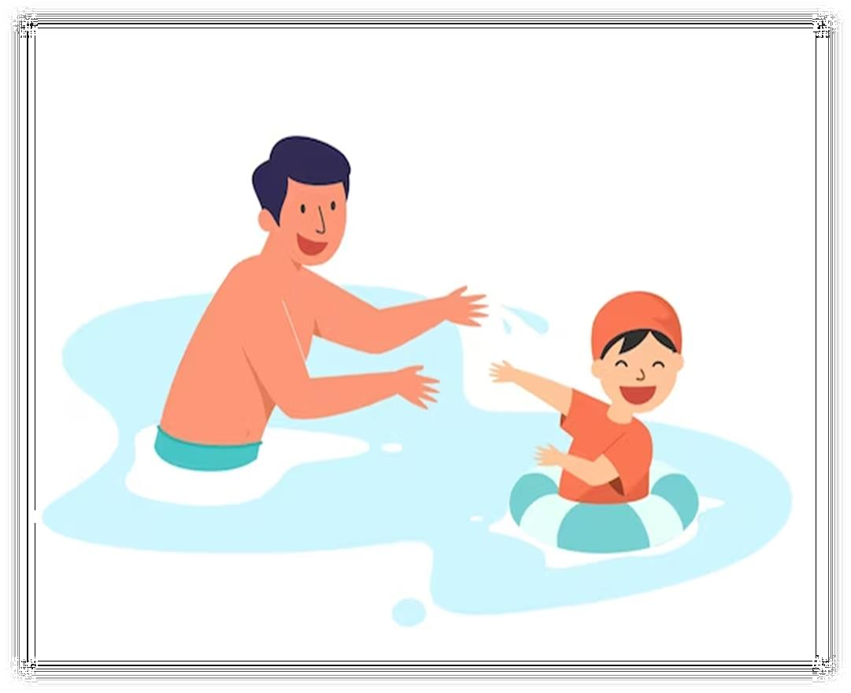




Yes, I did. I swam withmy father.
Didyouswim?
+ 1

Slide 43

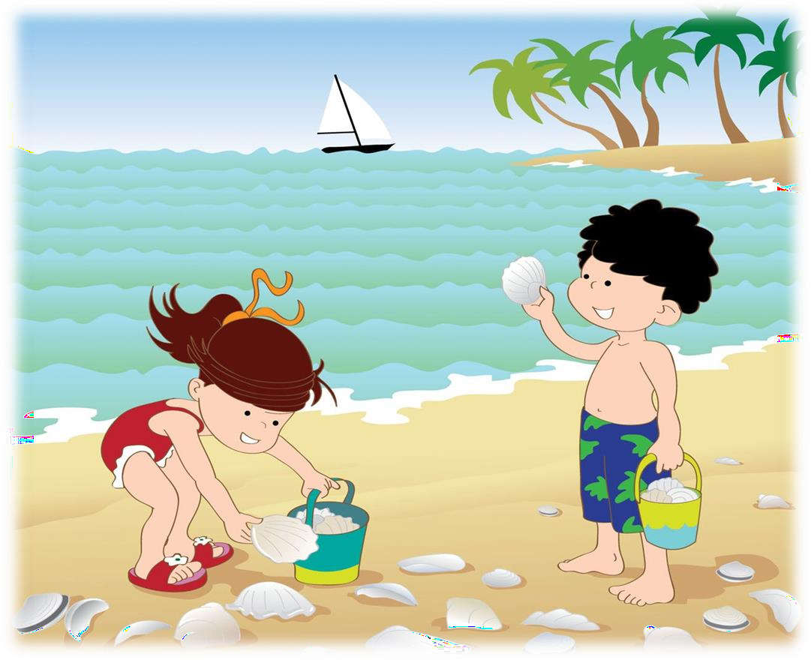


Yes, I did. I collected seashellswithmy brother.
Didyou collect seashells?
+ 3

Slide 44
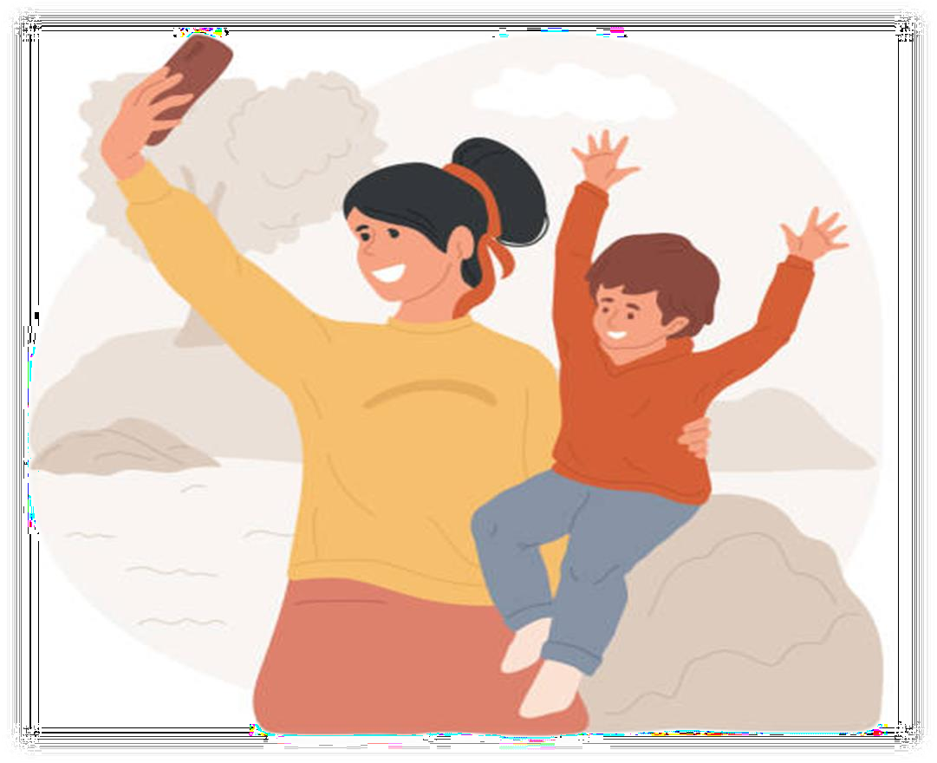


Yes, I did. I took photoswithmy mother.
Didyoutakephotos?
+ 2

Slide 45
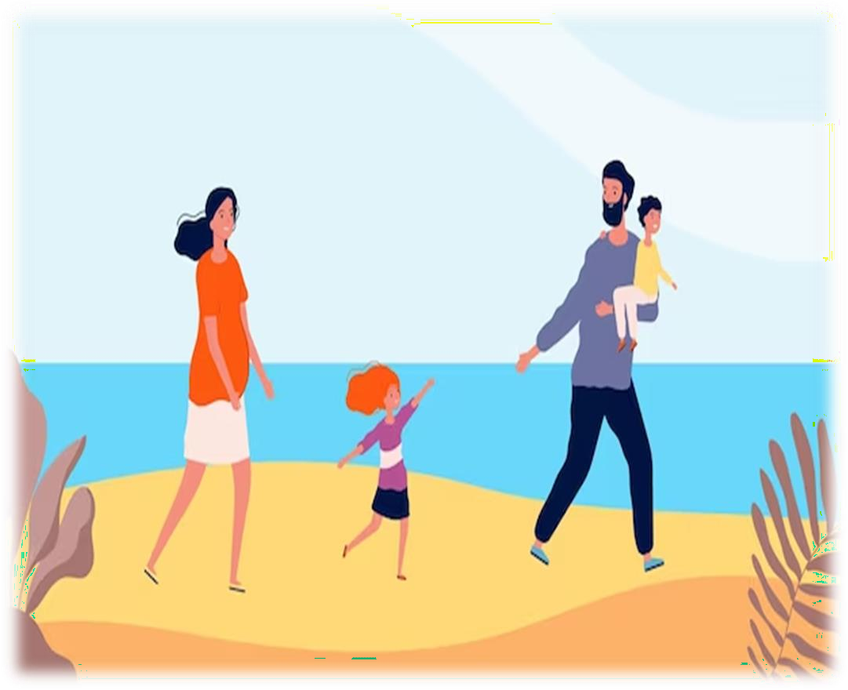



Yes, I did. I walked onthebeach withmy family.
Didyou
walk onthebeach?
+ 3

Slide 46


+ 3

Slide 47


Scoreboard
TEAM A TEAM B

Slide 48



Slide 49

Website: hoclieu.vn
Fanpage: https://www.facebook.com/tienganhglobalsuccess.vn/

