Slide 2









Our home
Lesson 1 - Period 1

Slide 3

Table of contents
01
02
03
Look, listen and repeat.
Listen, point and say.
Warm-up and review
04
05
Let's talk.
Fun corner and wrap-up

Slide 4







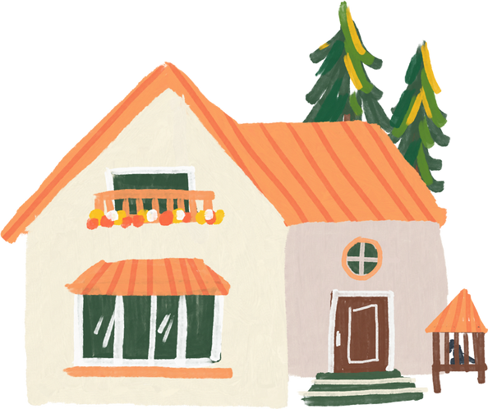
01
Warm-up and review

Slide 5
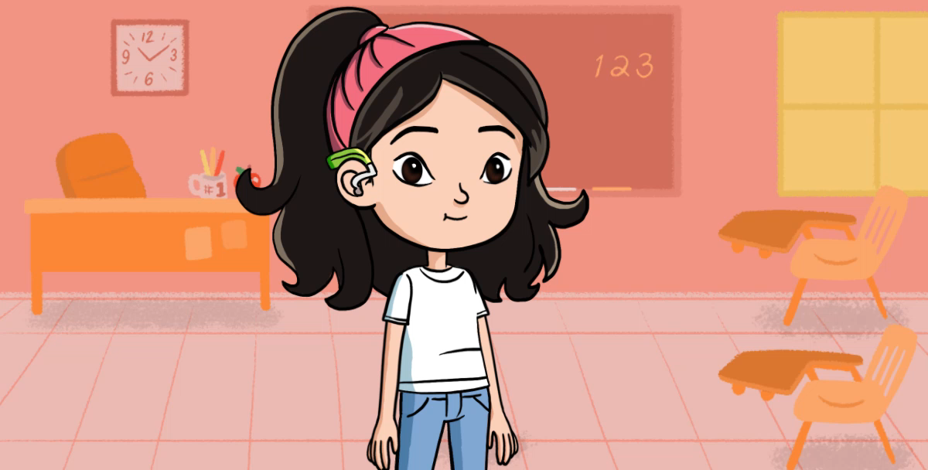

Slide 6



Slide 7



Slide 8



Slide 9

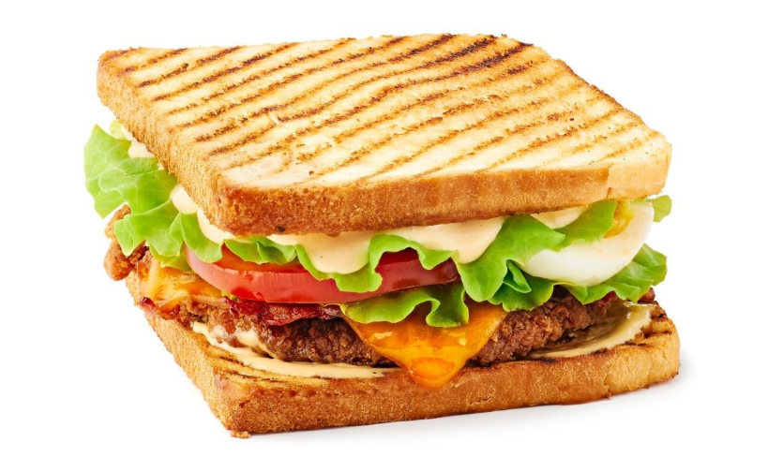

Slide 10
02
Look, listen and repeat.

Slide 11
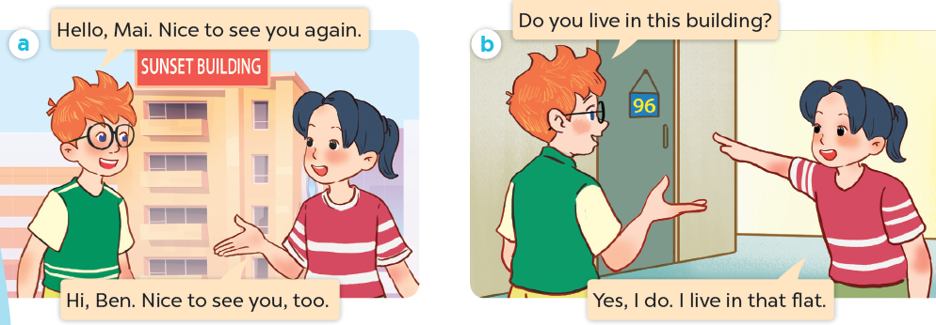
What are they talking about?
Where are they?
Who are they?

Slide 12

Look, listen and repeat.

Slide 13
Look, listen and repeat.

Slide 14
Look, listen and repeat.

Slide 15
03
Listen, point and say.

Slide 16
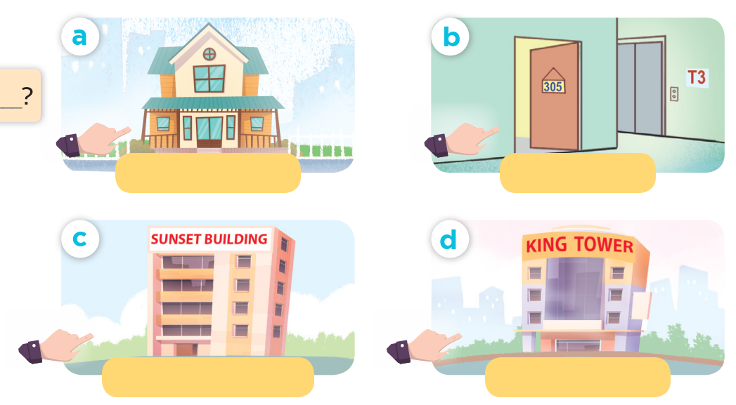
Look and say.

Slide 17
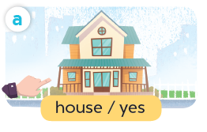
Listen, point and say.
house / yes

Slide 18
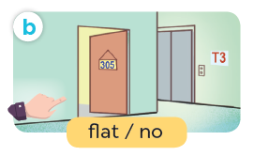
Listen, point and say.
flat / no

Slide 19
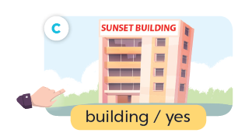
Listen, point and say.
building / yes

Slide 20
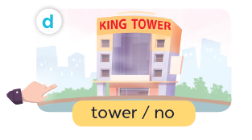
Listen, point and say.
tower / no

Slide 21
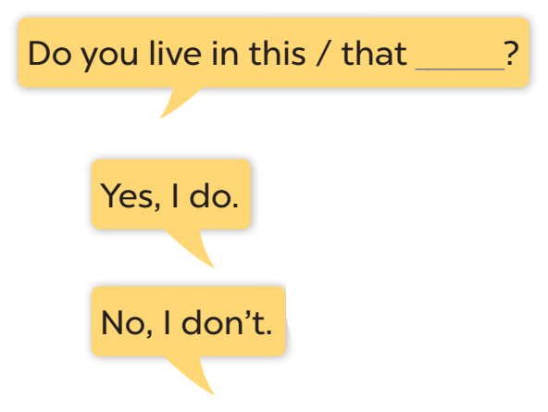




Slide 22
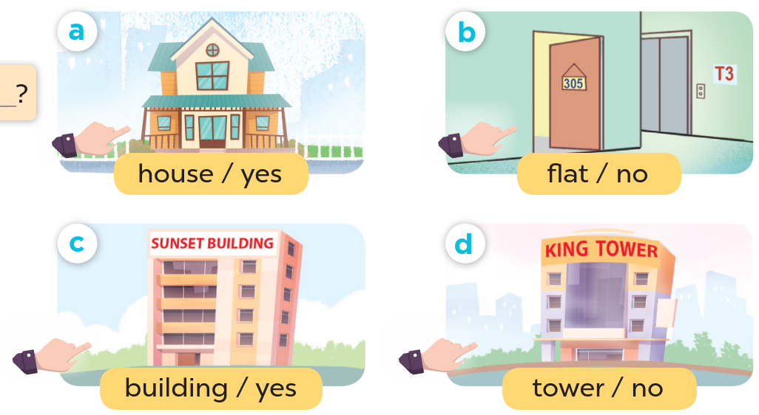
Look at the hands.

Slide 23
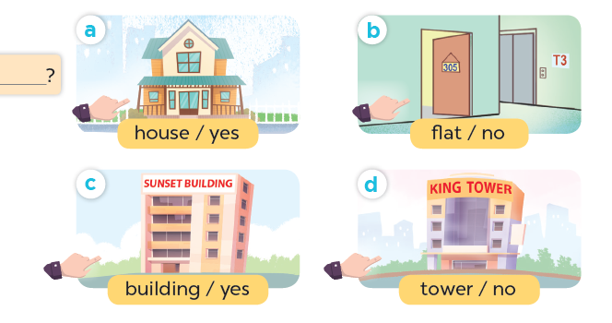
Listen, point and say.
Do you live in this house?
Yes, I do.
house / yes

Slide 24
Listen, point and say.
Do you live in this flat?
No, I don't.
flat / no

Slide 25
Listen, point and say.
Do you live in that building?
Yes, I do.
building / yes

Slide 26
Listen, point and say.
Do you live in that tower?
No, I don't.
tower / no

Slide 27
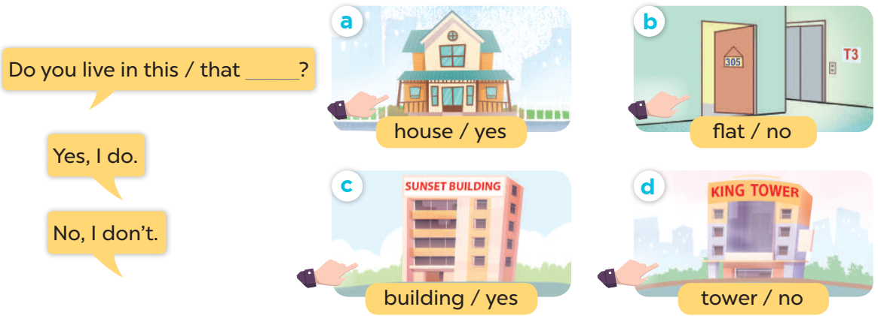
Work in pairs. Ask and answer.

Slide 28
04
Let's talk.

Slide 29
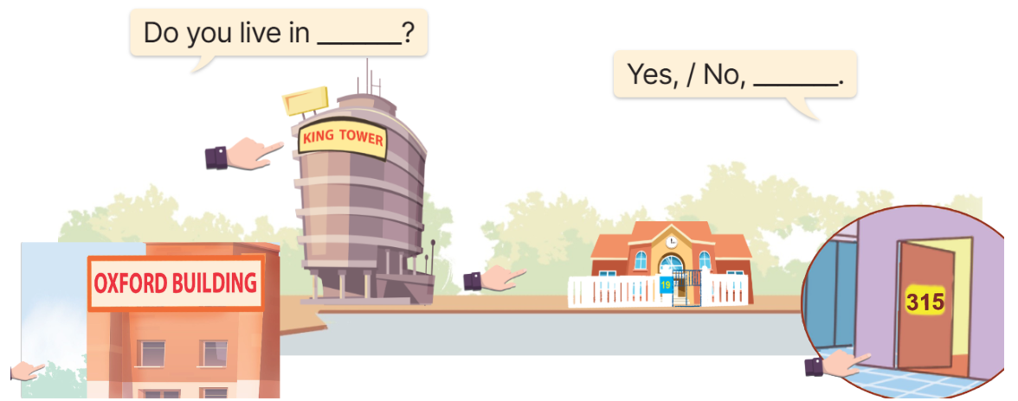

Slide 30
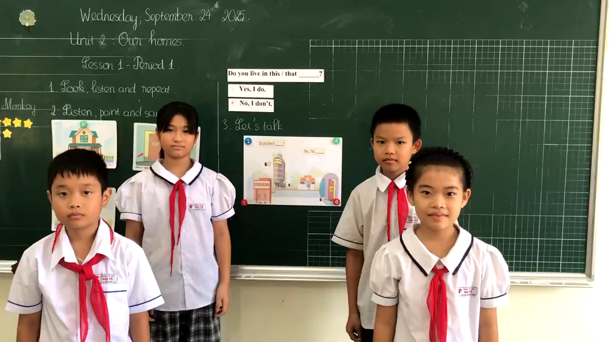

Slide 31
05
Fun corner and wrap-up
Lucky letter

Slide 32
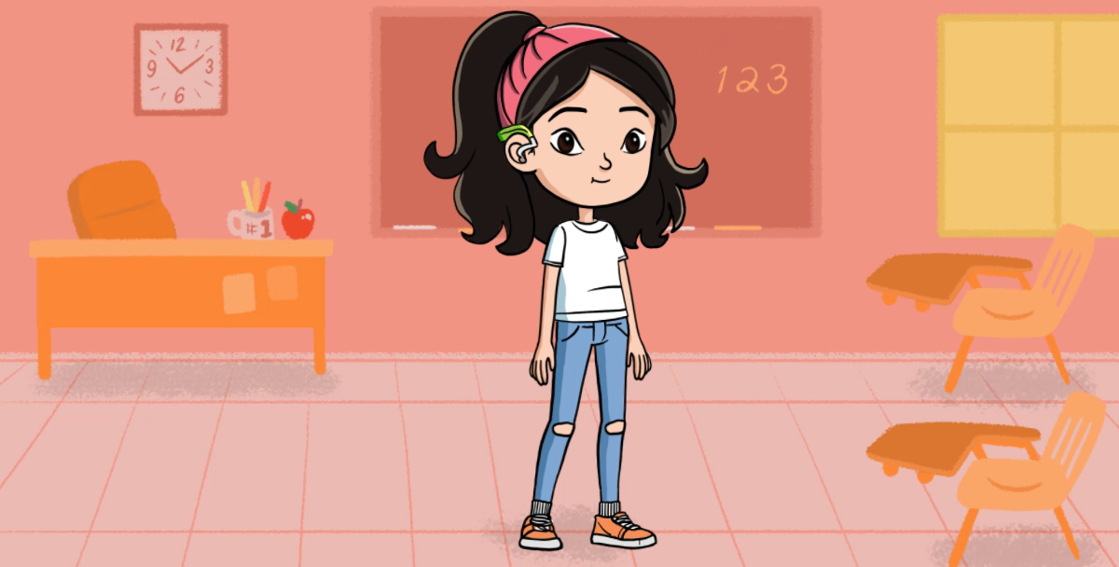

Slide 33

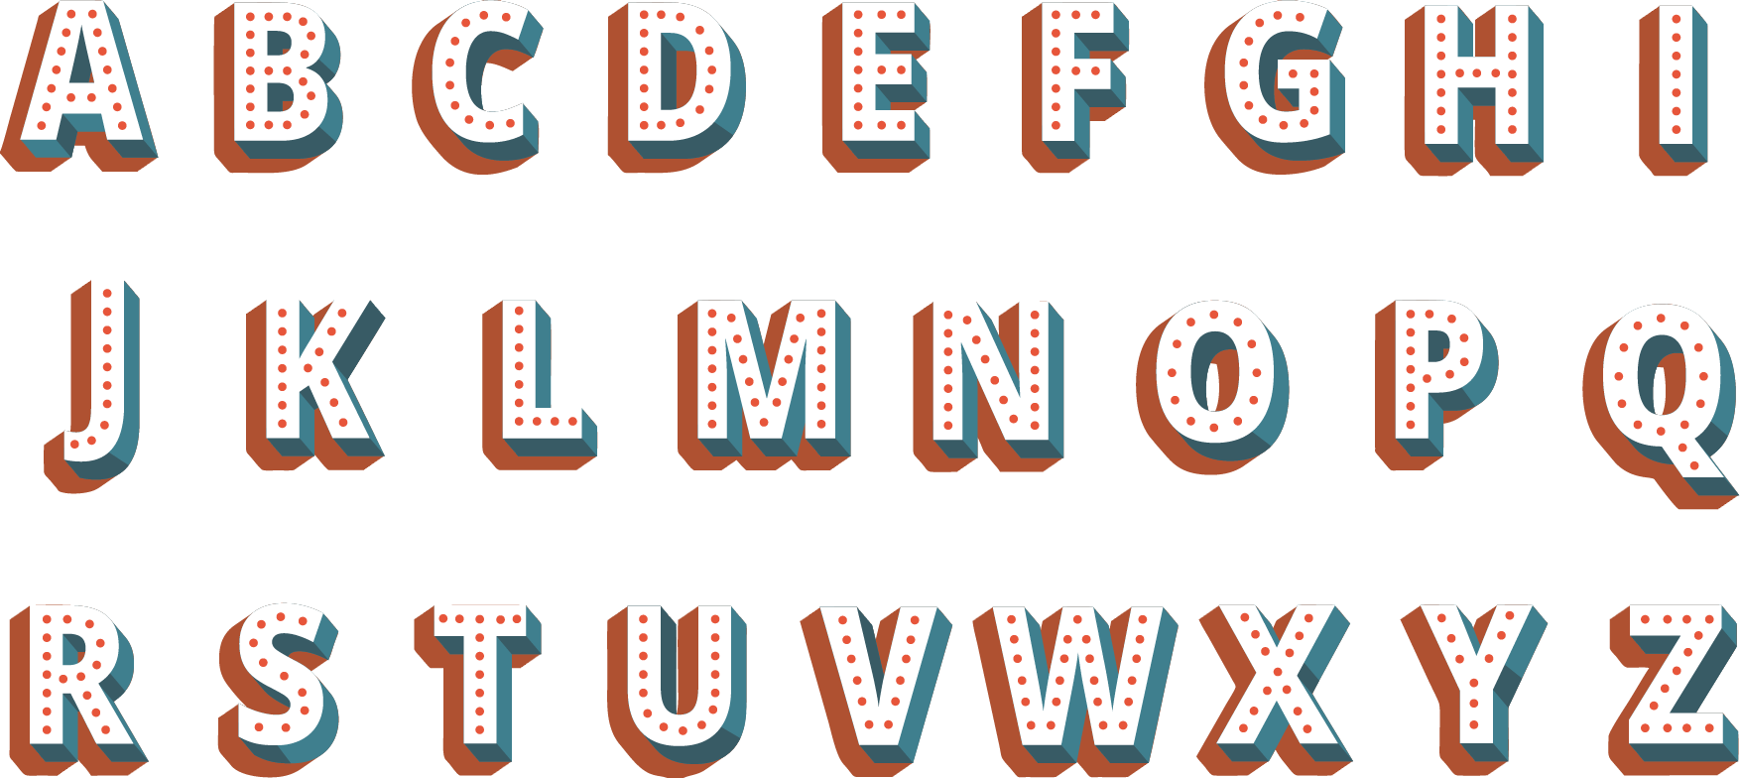
1
4
2
1
3
5

Slide 34




Yes, I do.

Slide 35



Do you live in that house?
No, I don’t.

Slide 36
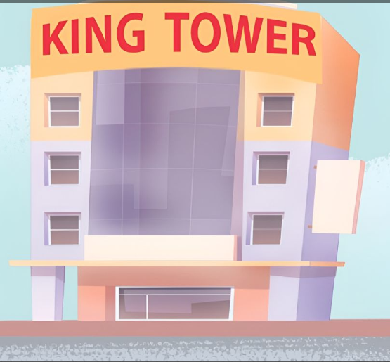

No, I don't.

Slide 37
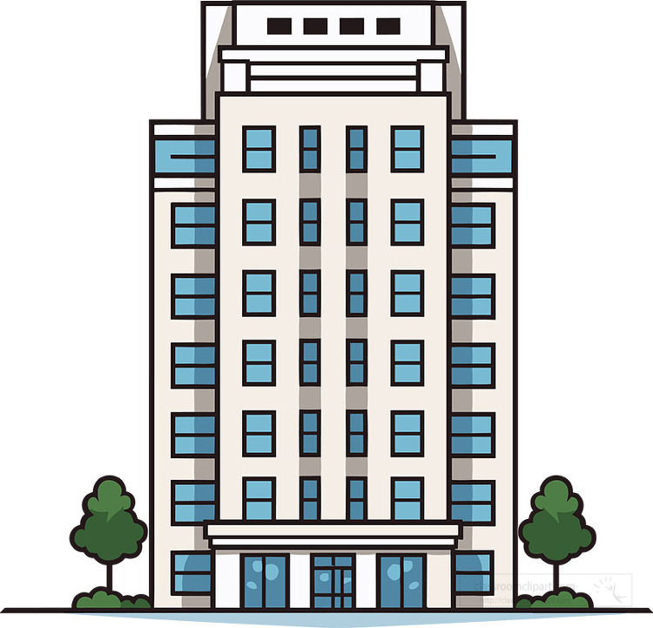
Moon Building
Do you live in that building?
No, I don't.

Slide 38

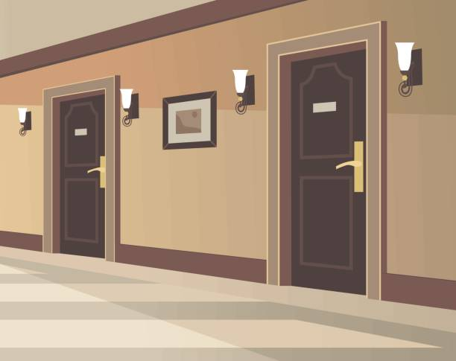


Yes, I do.

Slide 39

Lucky Letter
+ 5 points

Slide 40
Website: hoclieu.vn
Fanpage: facebook.com/www.tienganhglobalsuccess.vn

