Slide 1

Unit 9: Classroom activities
Lesson 2.1: Vocabulary & Phonics
Page: 60

Slide 2
Lesson Outline
Warm-up
Phonics
Practice
Consolidation
Wrap-up

Slide 3
Objectives
By the end of this lesson, students will be able to gain the following:
Phonics: /z/
Vocabulary:
zebra, zoo
Sentence pattern:
“This is a (zebra)”.
Skills:
Identify the letter Z/z and the /z/ sound. Practice language skills – the structure “This is a (zebra)”.

Slide 4

WARM UP

Slide 5




Slide 6

What is it?
It’s a pencil case.

Slide 7

What is it?
It’s a crayon.

Slide 8

What is it?
It’s an eraser.

Slide 9

What is it?
It’s a ruler.

Slide 10

It’s time to learn …

Slide 11

Phonics
/z/

Slide 12

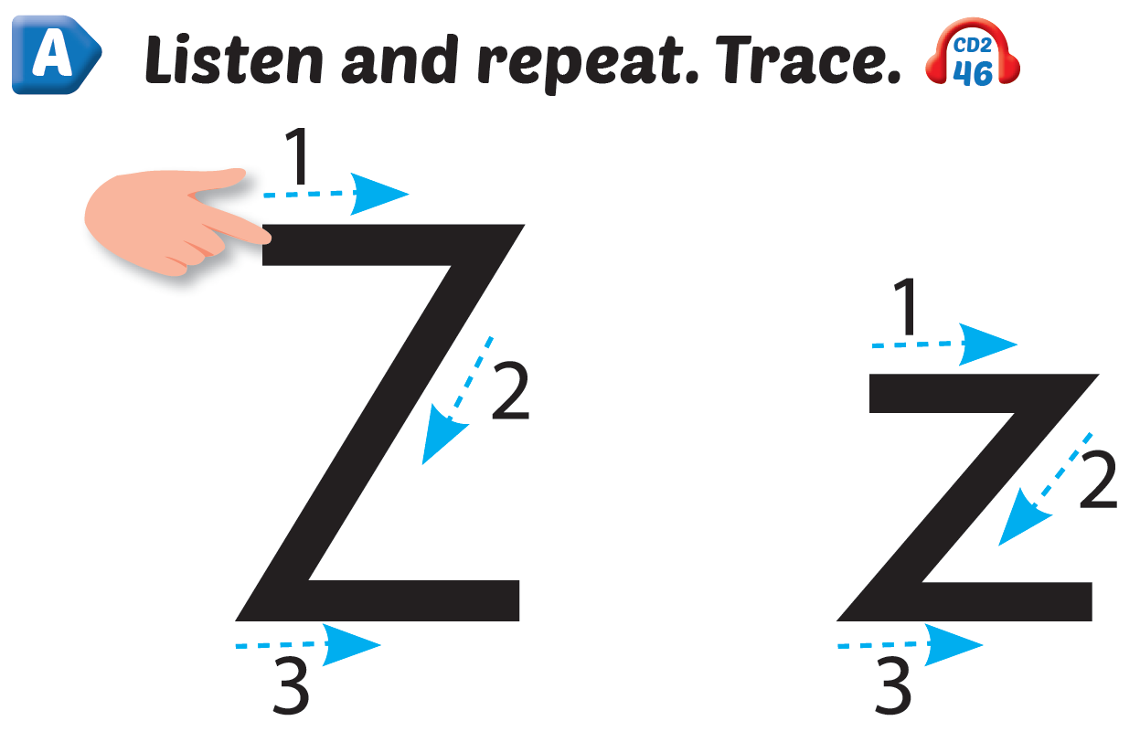
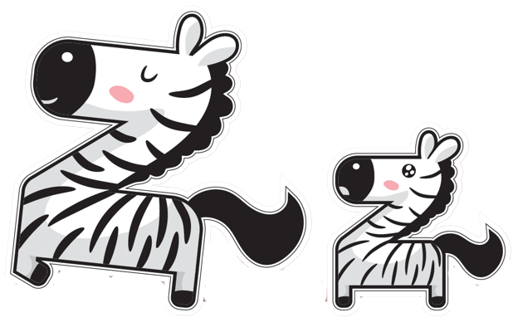
Click Alphabet to hear the sound
Click the icon to hear the sound

Slide 13

New words
zebra, zoo

Slide 14
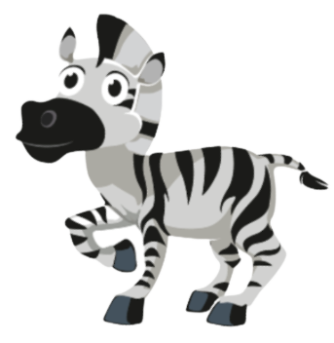

Click the icon to hear the sound
/ˈziːbrə/
con ngựa vằn
Notes:
Click vào hình để nghe audio

Slide 15


Click the icon to hear the sound
/zuː/
sở thú
Notes:
Click vào hình để nghe audio

Slide 16
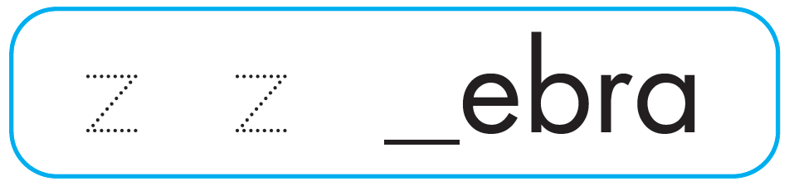
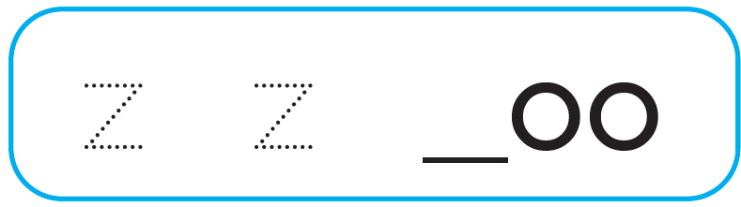
Click Alphabet to hear the sound
Click on each icon to hear the sound
z
z

Slide 17
It’s time to play …

Slide 18
What sound is this?
“z”

Slide 19
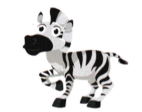
Letter Z is for….
zebra

Slide 20
Letter Z is for….
zoo

Slide 21

Practice

Slide 22


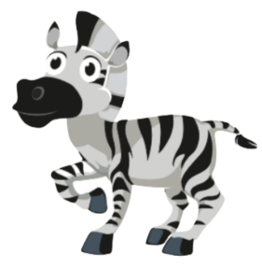
This is a ,
Click the icon to hear the sound
z, z, .
This is a ,
z, z, z.

Slide 23


Click the icon to hear the sound

Slide 24

Further Practice

Slide 25

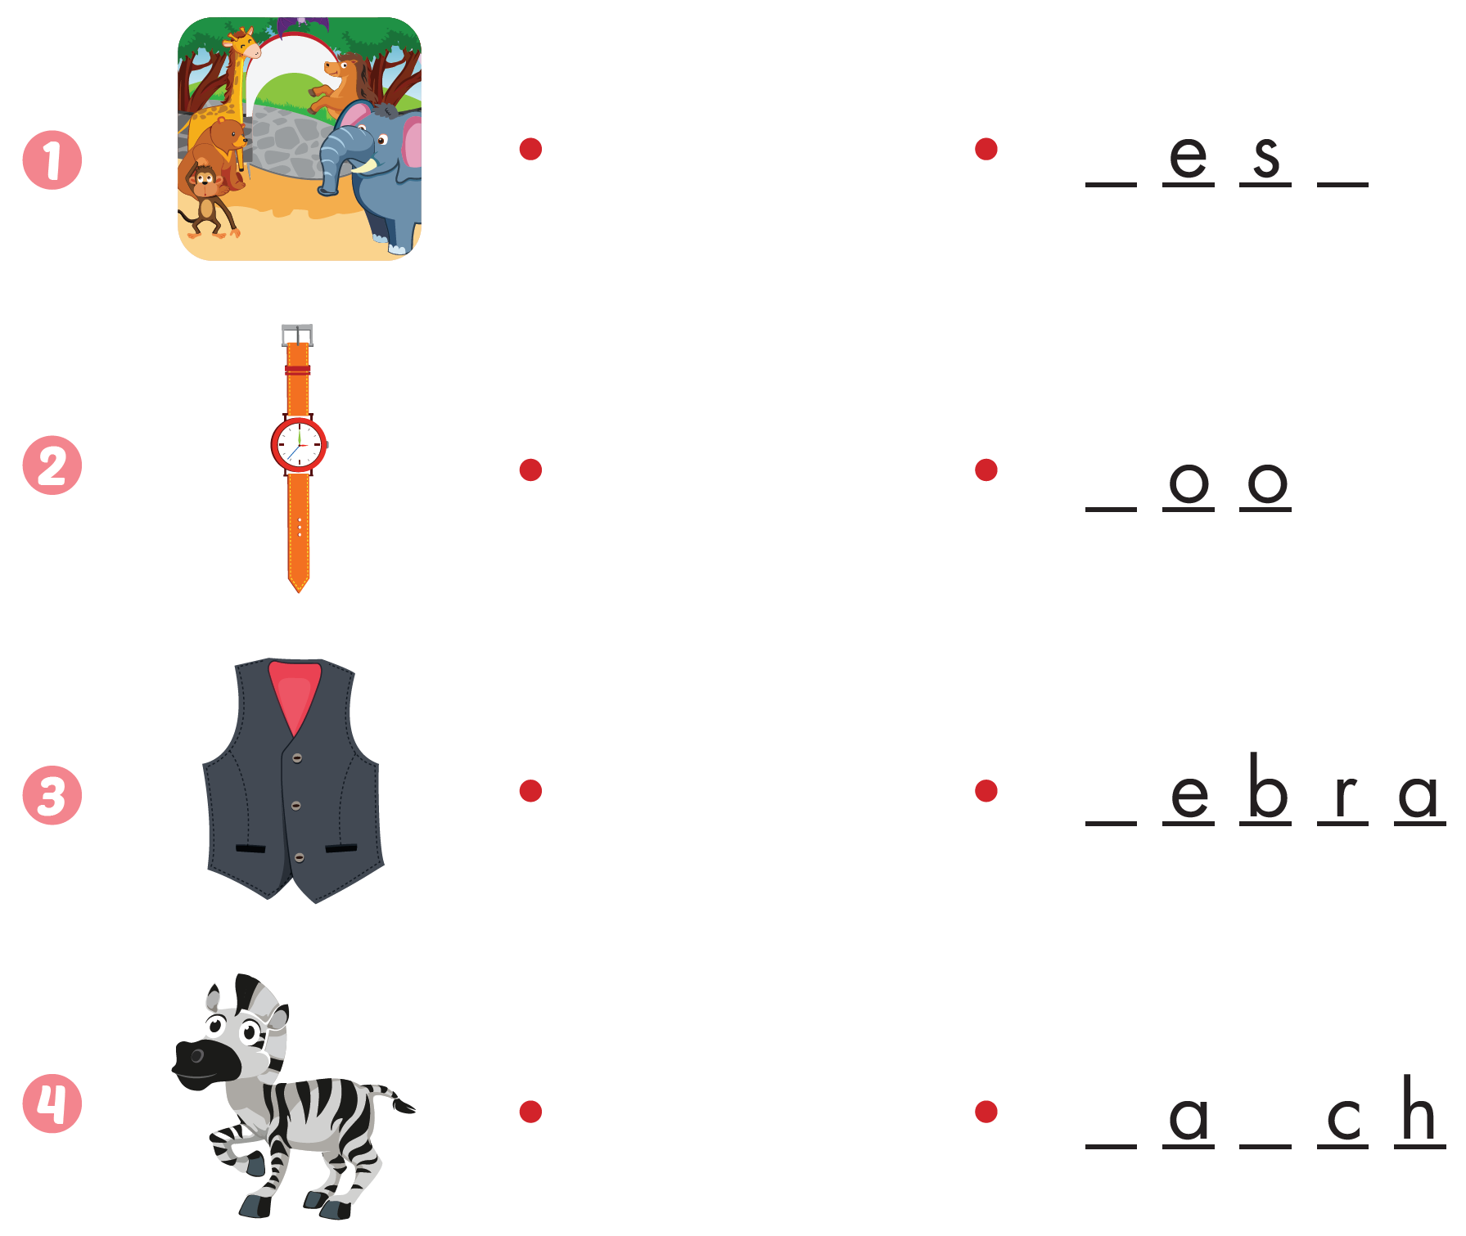
Workbook - Page 58
z
z

Slide 26

CONSOLIDATION

Slide 27
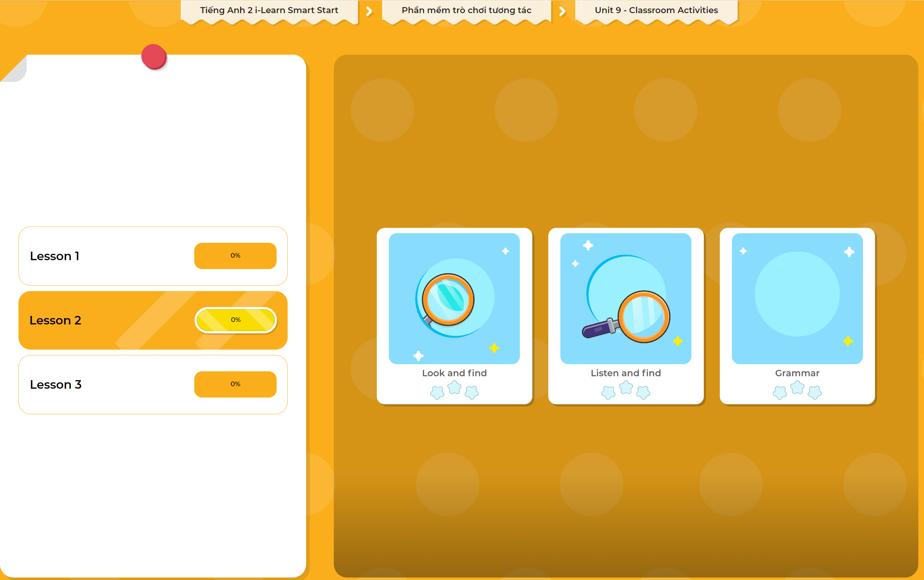
Extra Practice
DHA App
LET’S PLAY!
Click here to play the games

Slide 28

WRAP-UP

Slide 29
Today’s lesson
Structures/ Sentence patterns
This is a (zebra).
Vocabulary
zebra, zoo

Slide 30
Homework
Practice vocabularies and phonics. Make sentences using them.
Practice the vocabulary and phonics in Tiếng Anh 2 i-Learn Smart Start Notebook (page 58)
Do the exercises in Tiếng Anh 2 i-Learn Smart Start Workbook (page 58)
Play the consolidation games in Tiếng Anh 2 i-Learn Smart Start DHA App on www.eduhome.com.vn
Prepare the next lesson (page 61)

Slide 31

Enjoy your day!

