Slide 1







Teacher: Dinh Thi Khanh

Slide 2


Slide 3













Our school rooms
Lesson 2 - Period 3

Slide 4







₀₄ Let's talk.
Table of contents
01 Warm-up & Review
₀₂ Look, listen
05
Fun corner & Wrap-up
and repeat.
03 Listen, point and say.

Slide 5









Warm-up & Review
01

Slide 6


Slide 7
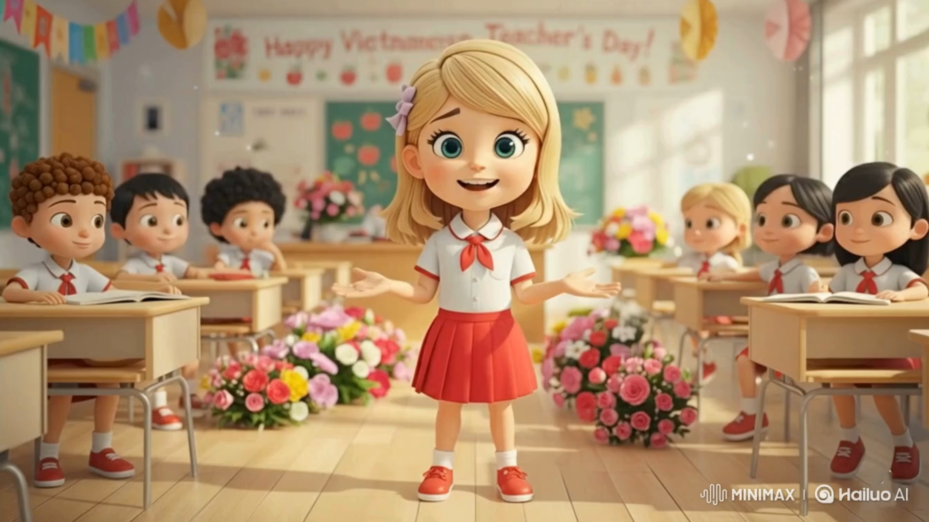

Slide 8
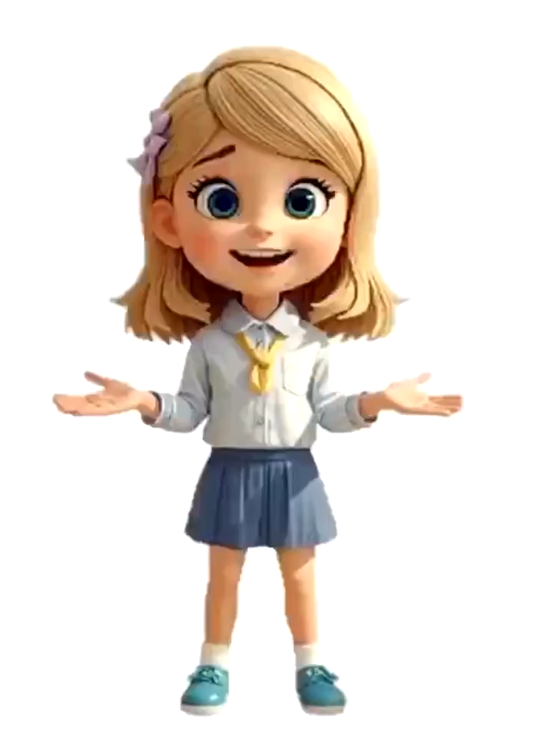

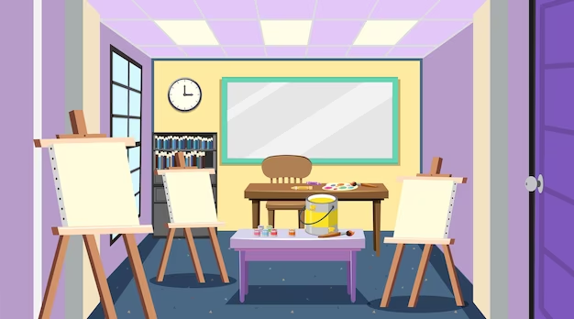

Slide 9
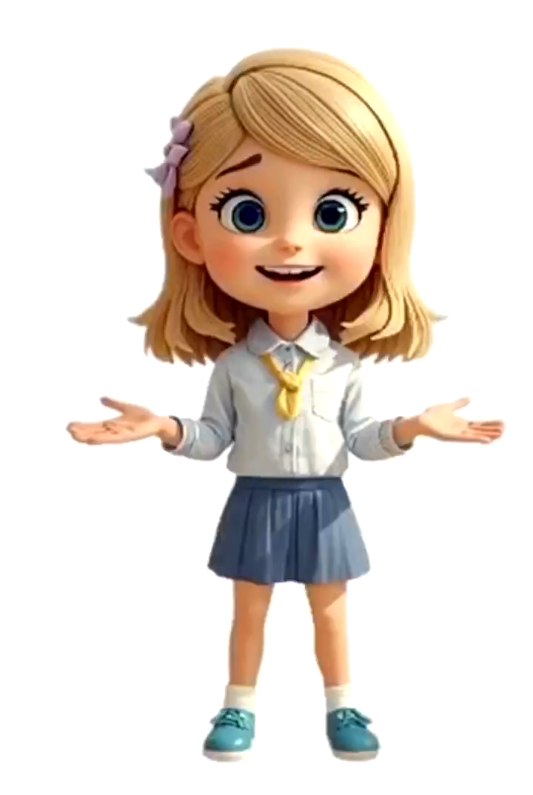


Slide 10
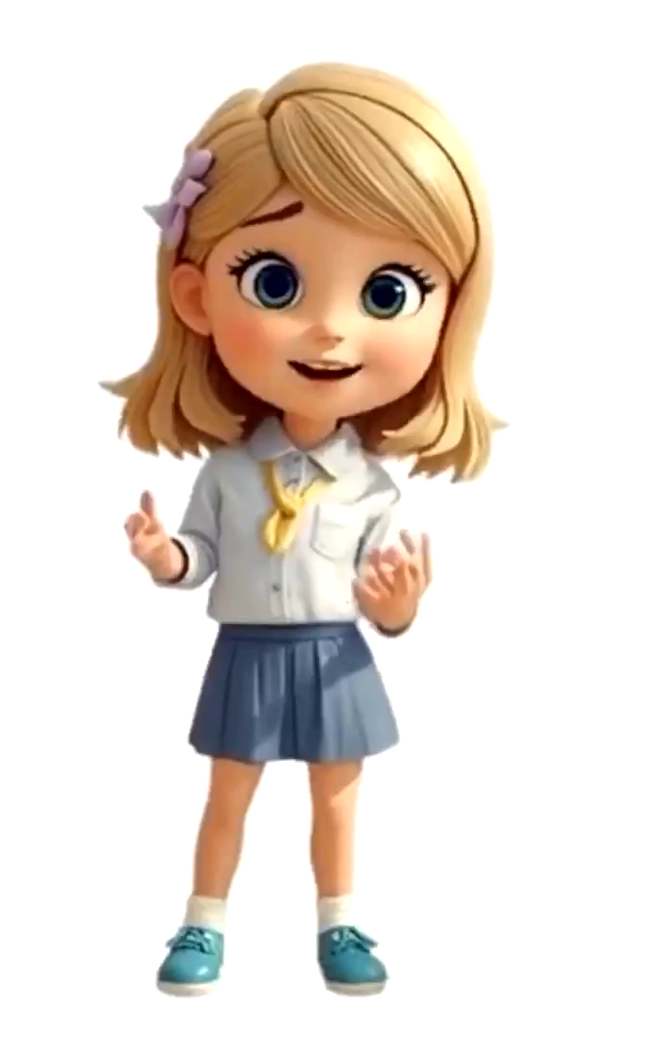


Slide 11

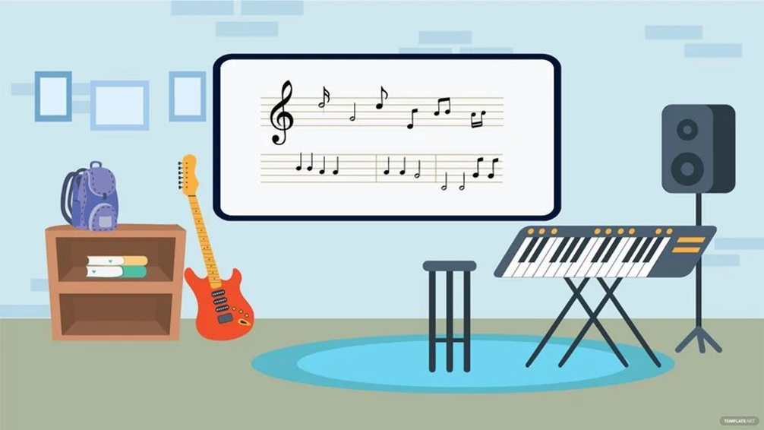

Slide 12












02
Listen, point and say.

Slide 13












Vocabulary

Slide 14





go upstairs

Slide 15

go downstairs

Slide 16
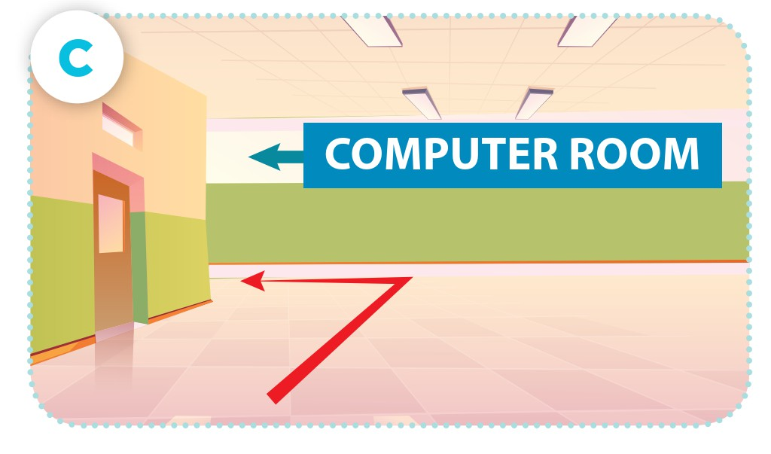
go along the corridor and turn left

Slide 17

go past the library and turn right

Slide 18

go upstairs
go downstairs
go along the corridor and turn left
go past the library and turn right

Slide 19
Structure

Slide 20




Could you tell me the way to the computer room, please?
Go upstairs.

Slide 21


Could you tell me the way to the computer room, please?
Go downstairs.

Slide 22
Could you tell me the way to the computer room, please?
Go along the corridor and turn left.

Slide 23


Could you tell me the way to the computer room, please?
Go past the library and turn right.

Slide 24

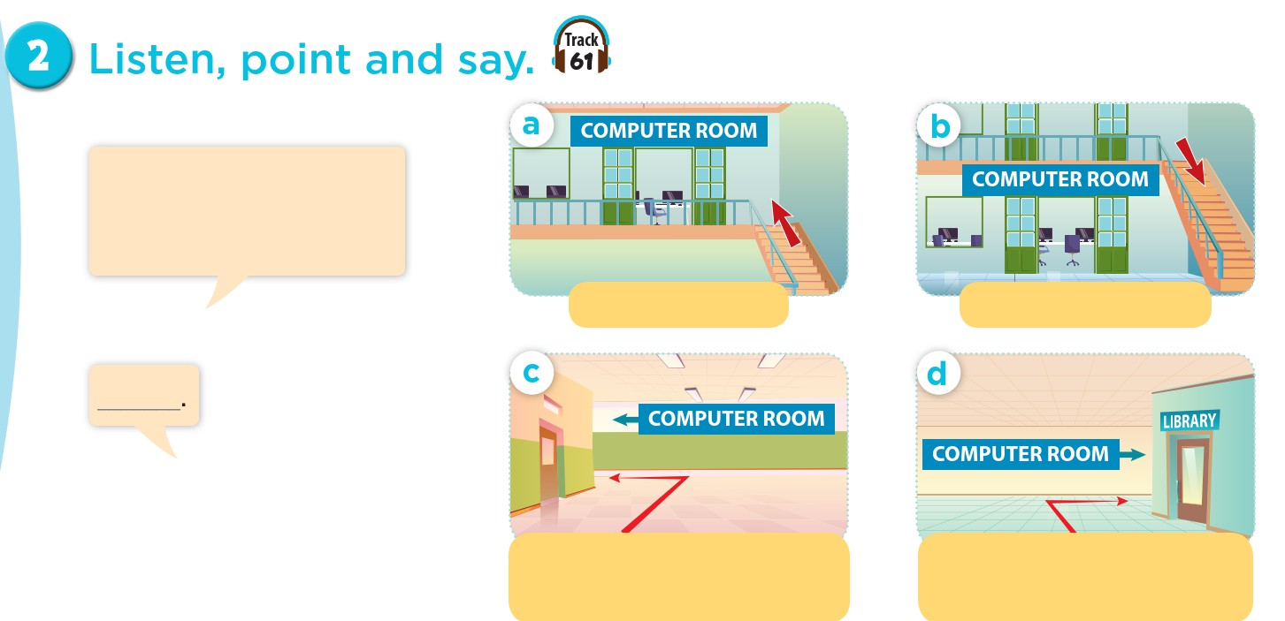
Work in pair
Could you tell me the way to the computer room, please?
go upstairs
go downstairs
go along the
corridor and turn left
go past the library
and turn right

Slide 25
Act it out.
Could you tell me the way to the computer room, please?
go upstairs
go downstairs
go along the
corridor and turn left
go past the library
and turn right

Slide 26

PASSING GAME

Slide 28
PASS STTOH E PB A!L L!

Slide 29
PASS STTOH E PB A!L L!

Slide 30
03
Look, listen and repeat.

Slide 31
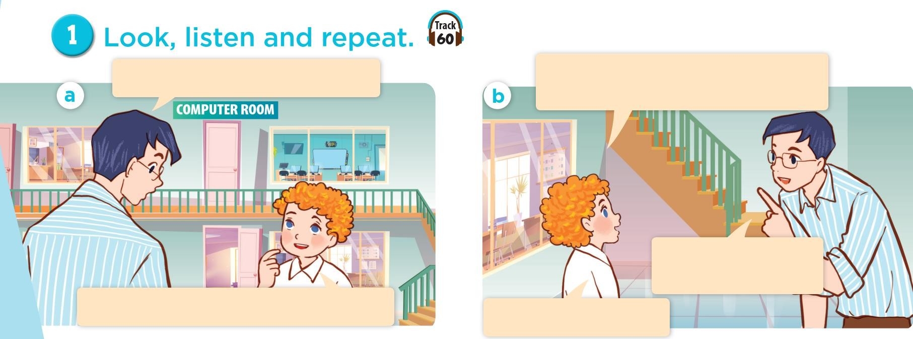

WWhheoreaarereththeey?y?

Slide 32
Look, listen and repeat.
Could you tell me the way to the
computer room, please?
What are you looking for, Bill?
Go upstairs. It’s
on the first floor.
I’m looking for the computer room.
Thank you, Mr Long.

Slide 33
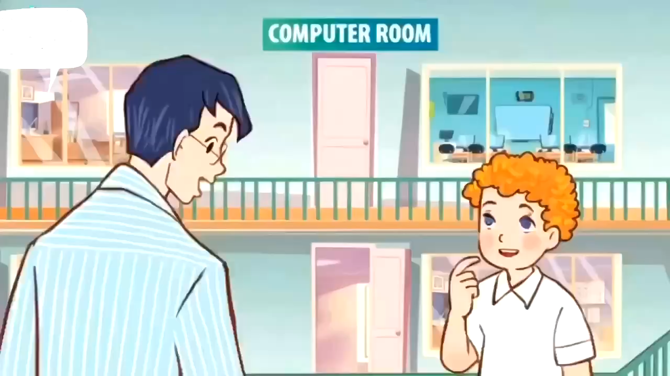

Slide 34
Look, listen and repeat.
Could you tell me the way to the
computer room, please?
What are you looking for, Bill?
Go upstairs. It’s
on the first floor.
I’m looking for the computer room.
Thank you, Mr Long.

Slide 35

Practice in pairs
Could you tell me the way to the
computer room, please?
What are you looking for, Bill?
Go upstairs. It’s
on the first floor.
I’m looking for the computer room.
Thank you, Mr Long.

Slide 36
Let’s talk.
04

Slide 37
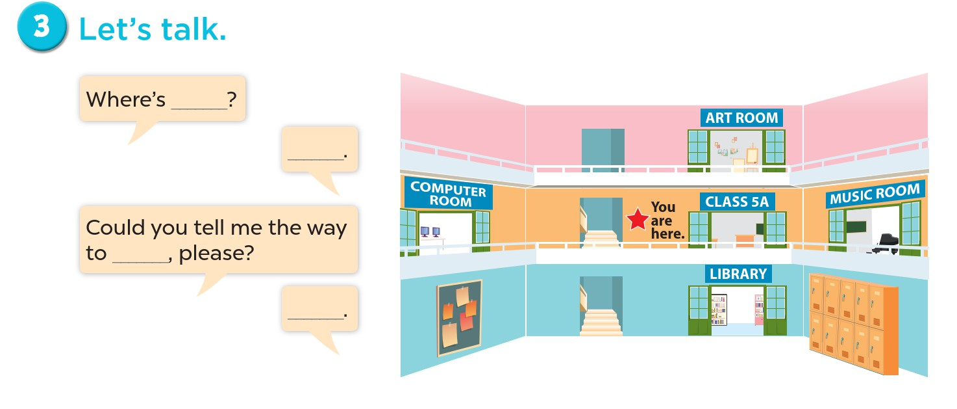

Slide 38
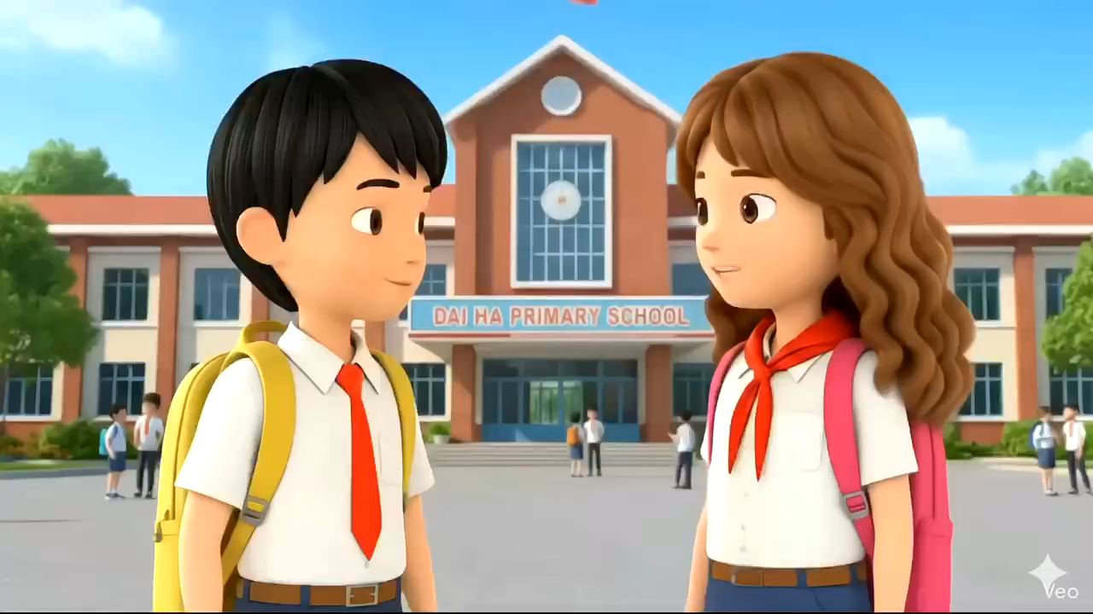

Slide 39
Work in group

Slide 40
05
Fun corner & Wrap-up

Slide 41
Madagasca Game

Slide 42
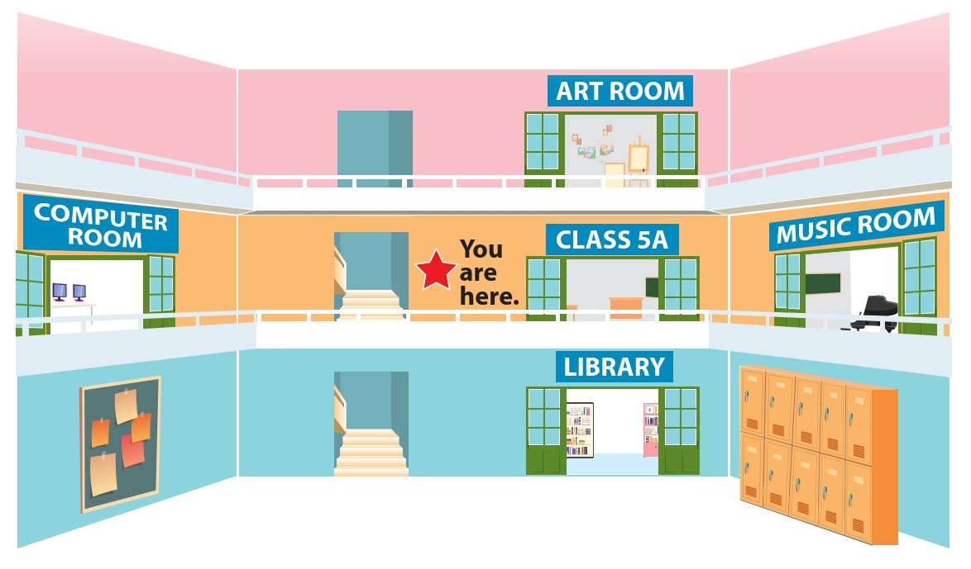


Could you tell me the way to the computer room, please?
Go along the corridor and turn left.

Slide 43




Pick a crate!

Slide 44
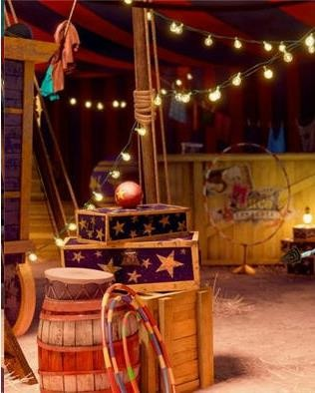
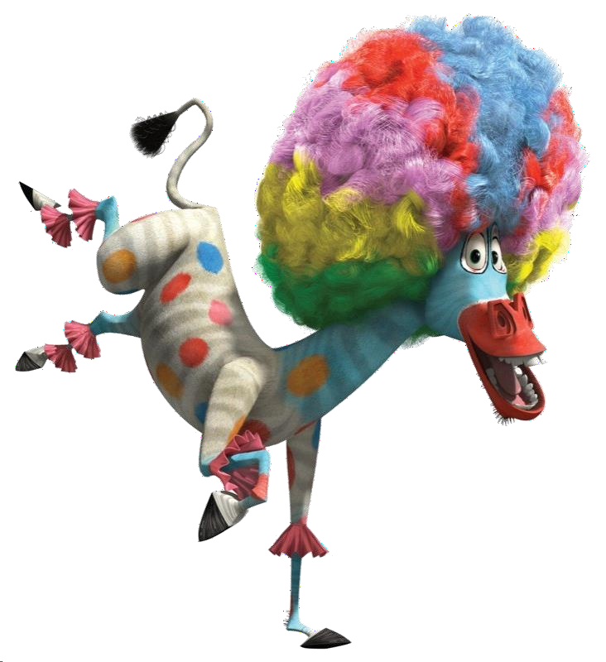

add 5 points

Slide 45


Steal 3 points.

Slide 46

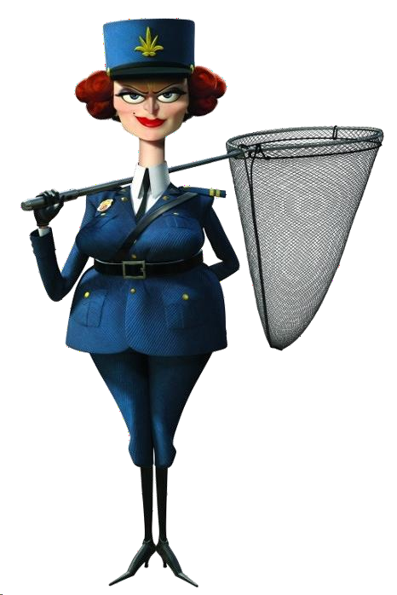
Everyone lose 5 points

Slide 47

Could you tell me the way to the library, please?
Go downstairs and turn left.

Slide 48
Pick a crate!

Slide 49
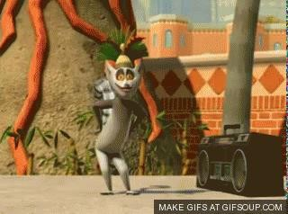
You l1ik0eptooinmtosve it!

Slide 50

6 points

Slide 51
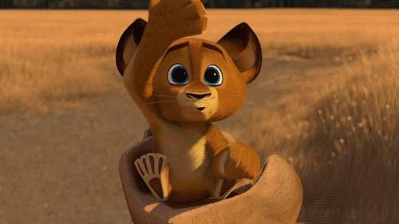
Steal 3 points.

Slide 52


Could you tell me the way to the
music room, please?
Go past Class 5A and turn right.

Slide 53
Pick a crate!

Slide 54

Lose 5 points.

Slide 55

2 points

Slide 56
You li5kepotoinmtsove it!

Slide 57


Could you tell me the way to the art room, please?
Go upstairs and turn left.

Slide 58
Pick a crate!

Slide 59
Lose 2 points.

Slide 60

5 points

Slide 61
Steal 3 points.

Slide 62


Could you tell me the way to Class 5B, please?
CLASS 5B
Go downstairs and turn right.

Slide 63
Pick a crate!

Slide 64
Lose 5 points.

Slide 65
Steal 3 points.

Slide 66

4 points

Slide 68


Slide 69

Website: hoclieu.vn
Fanpage: https://www.facebook.com/tienganhglobalsuccess.vn/

