Slide 1

WELCOME TO
OUR ENGLISH CLASS
Teacher: Ms My
Class : 4C

Slide 2
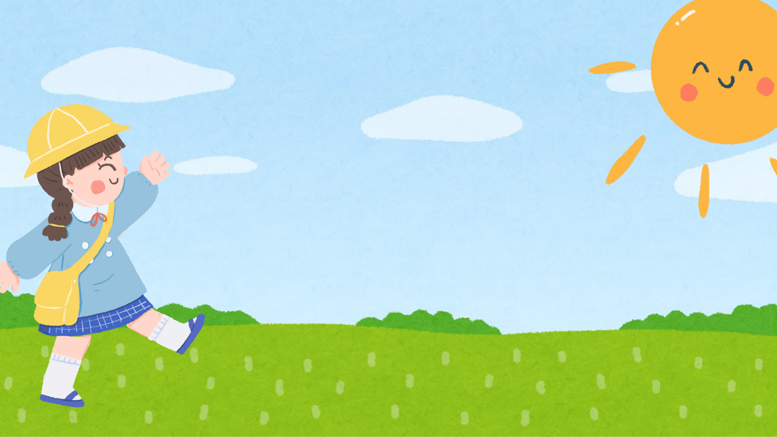
Warm-up:

Slide 3
https://youtu.be/XcW9Ct000yY?si=stfo_C8qTkWeRPiK

Slide 4
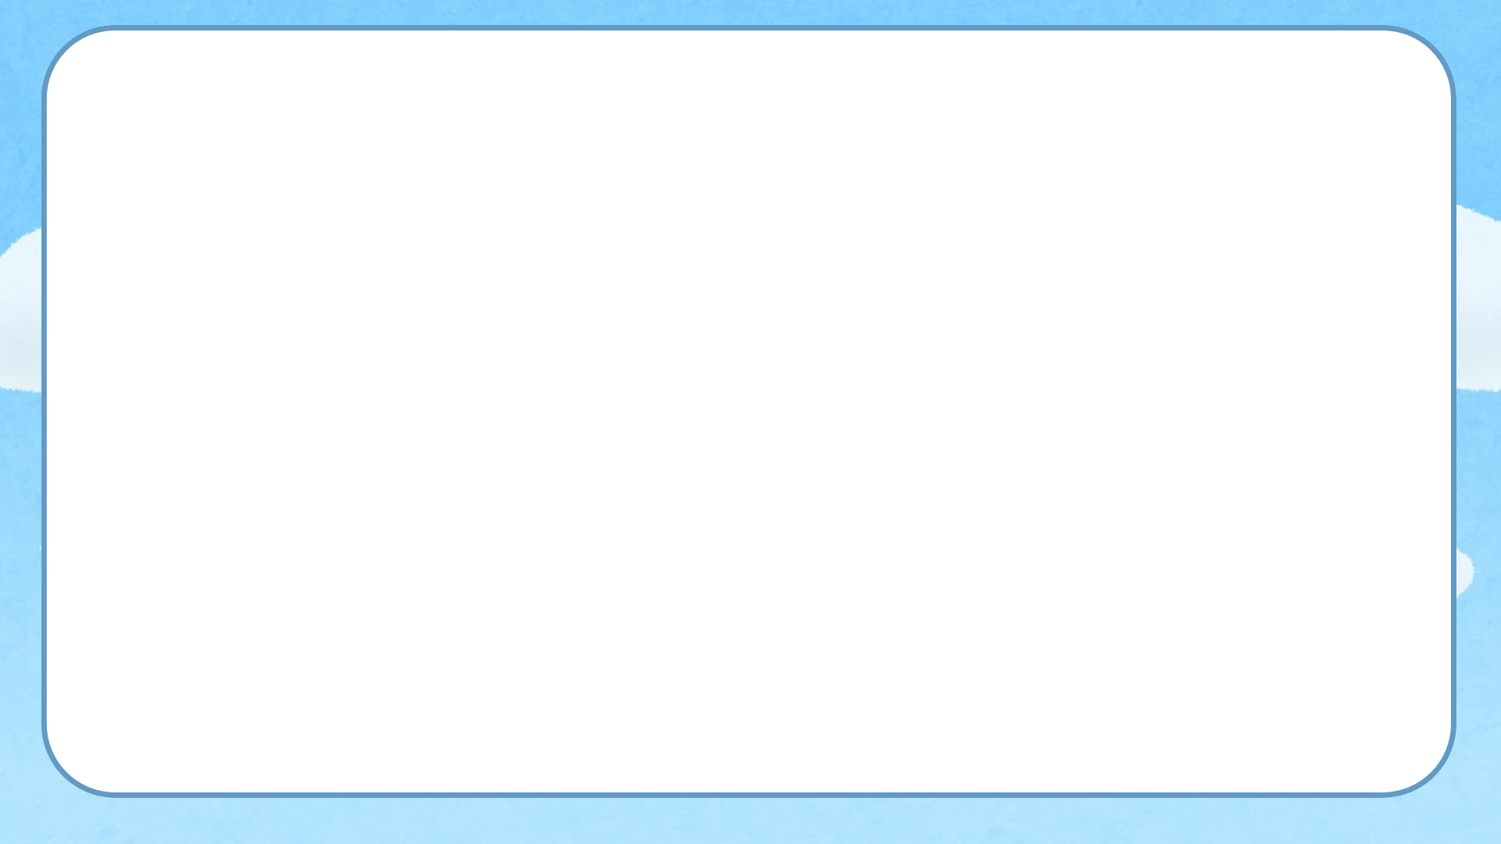


weather
/ˈweðə/

Slide 5
Unit 16:
Weather
Lesson 1 – Part 1,2,3

Slide 6
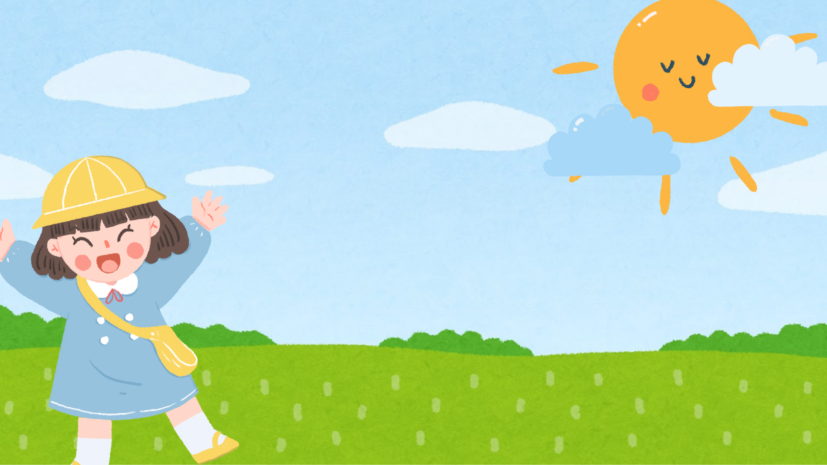
Activity 1:
Look, listen
and repeat

Slide 7
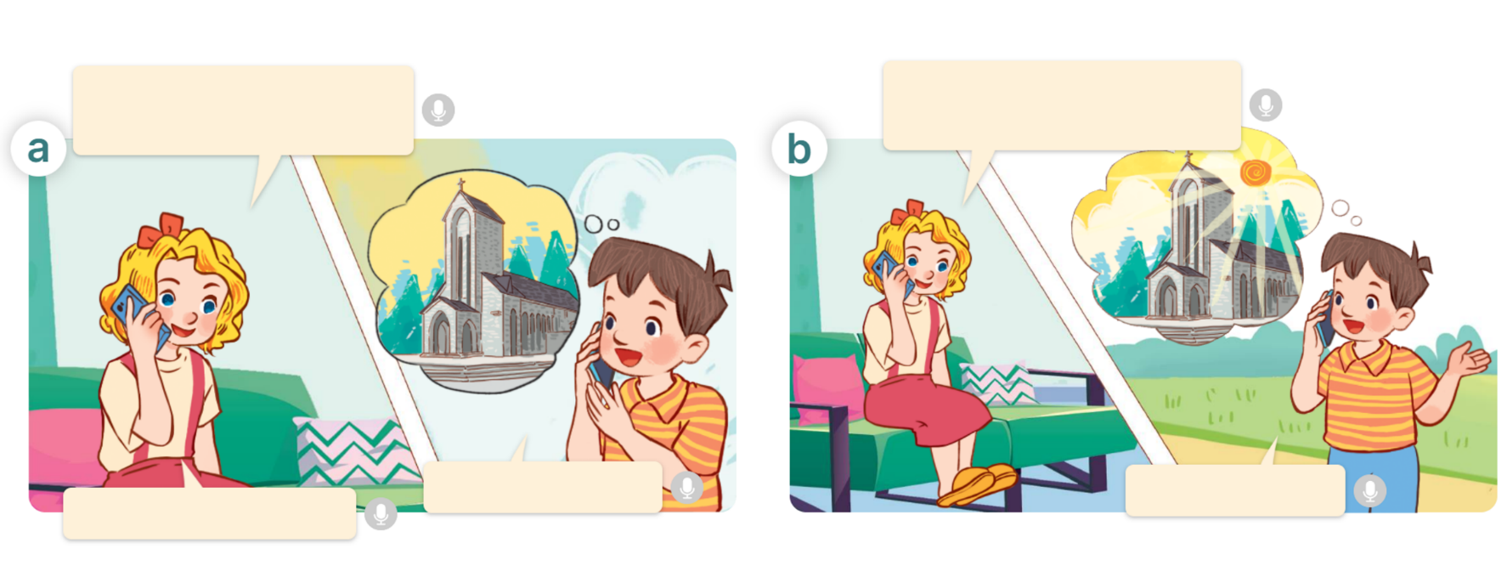

Slide 8

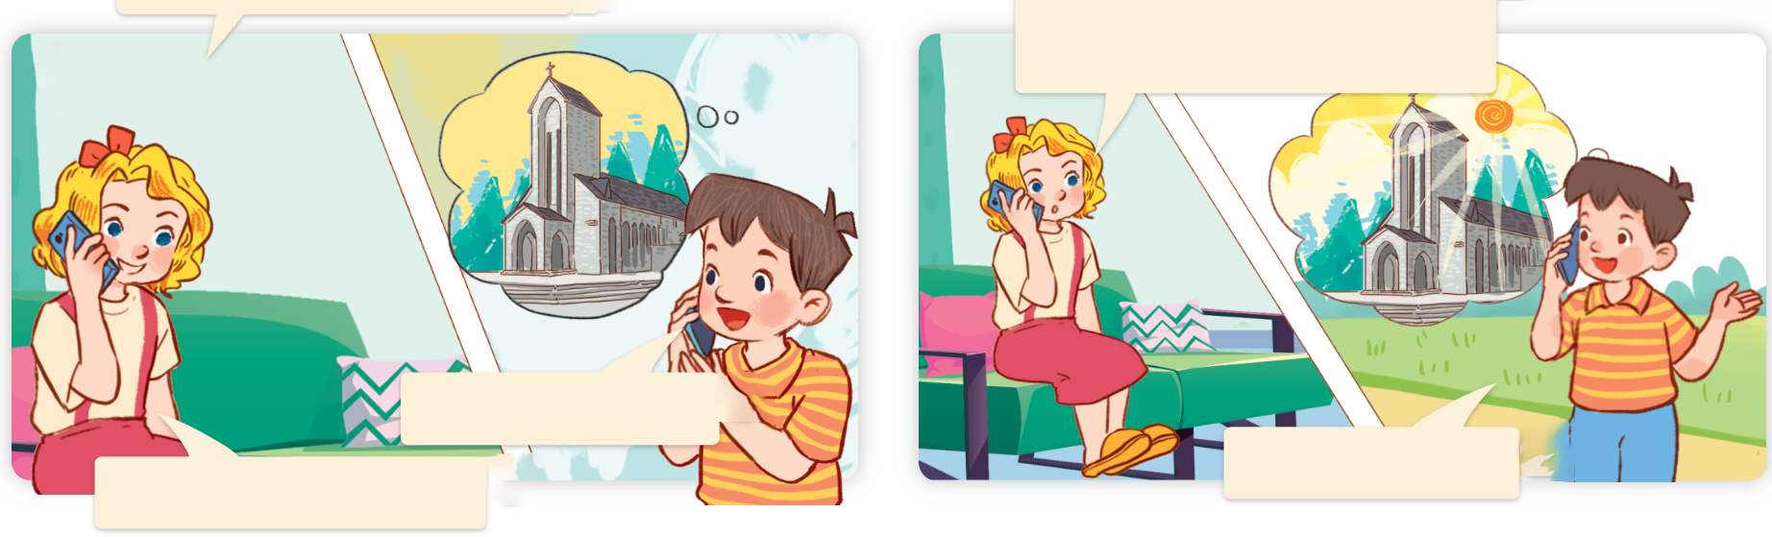
Hi, Minh. Where were you last weekend?
a
b
What was the weather like in Sa Pa?
I was in Sa Pa.
It was sunny.
Great! I like Sa Pa.

Slide 9


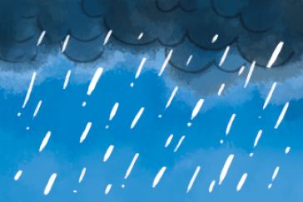

Model sentences:
Cách hỏi thời tiết cuối tuần trước như thế nào.
What was the weather like last weekend/ yesterday?
( Thời tiết cuối tuần trước như thế nào?)
It was + adj ( tình từ chỉ thời tiết)
( Trời ________.)
Example:
What was the weather like last weekend?
It was rainy.

Slide 10
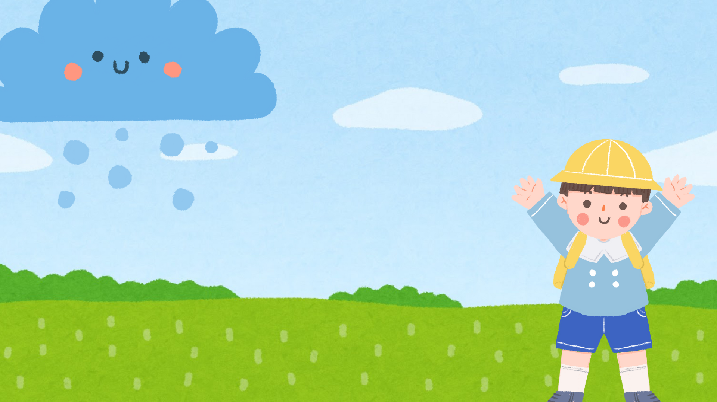
Activity 2:
Listen, point
and say

Slide 11
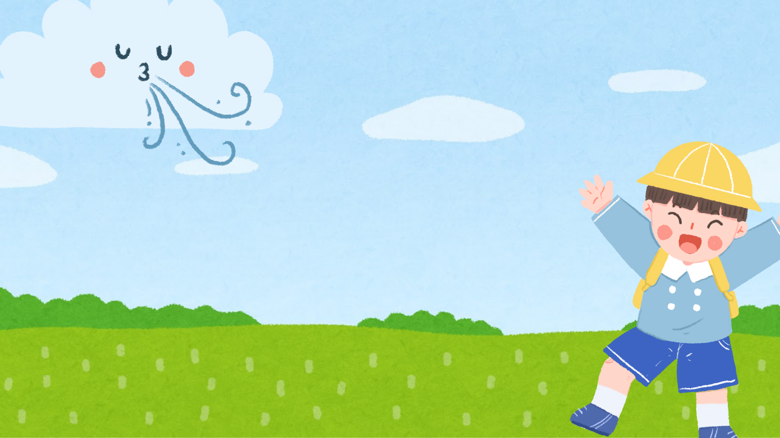
NEW WORDS:

Slide 12

sunny

Slide 13
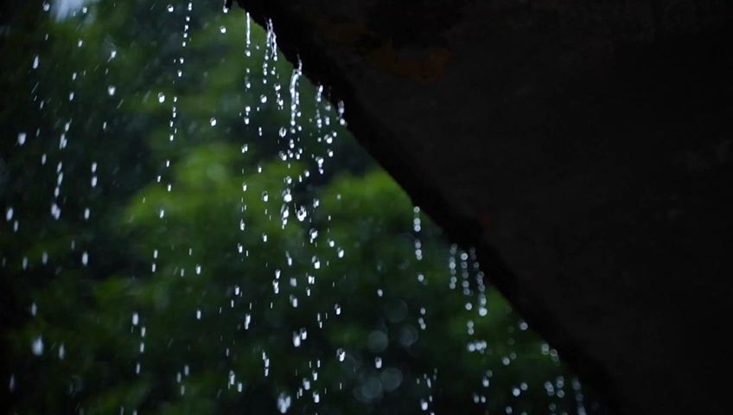
rainy

Slide 14
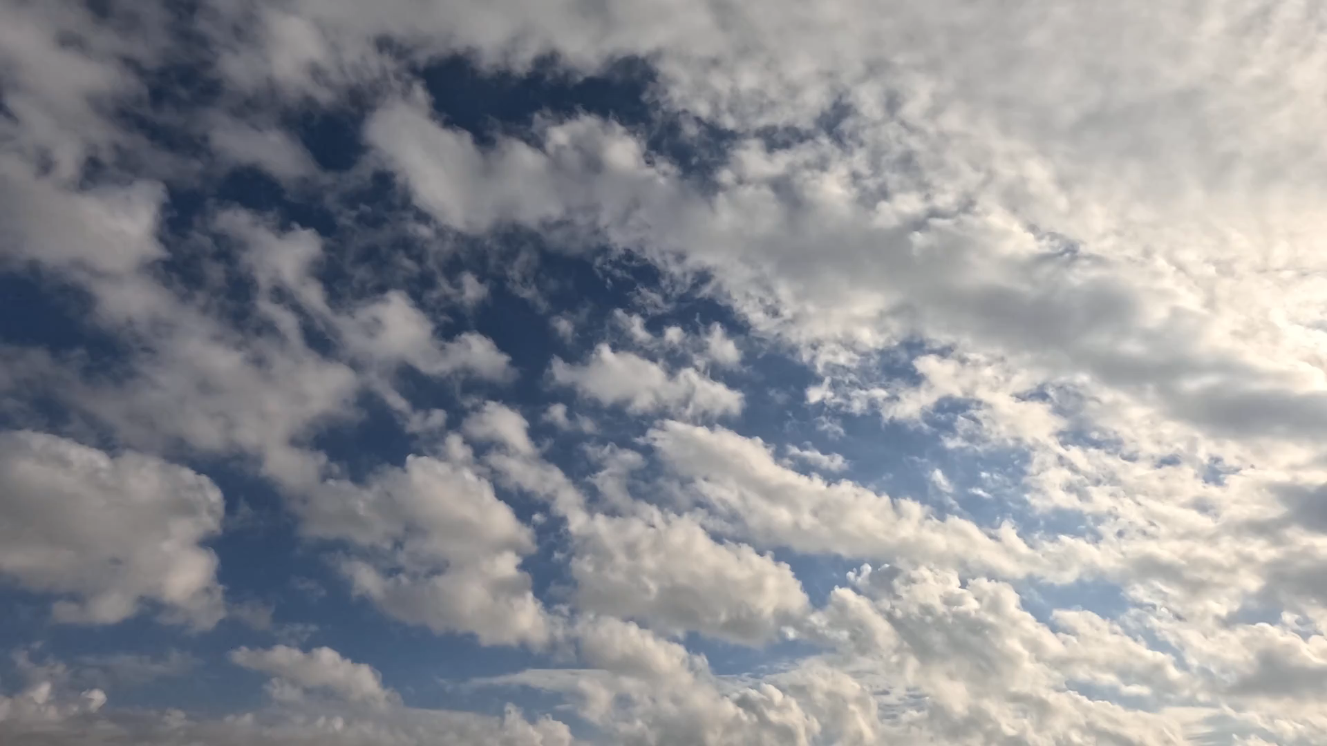
cloudy

Slide 15
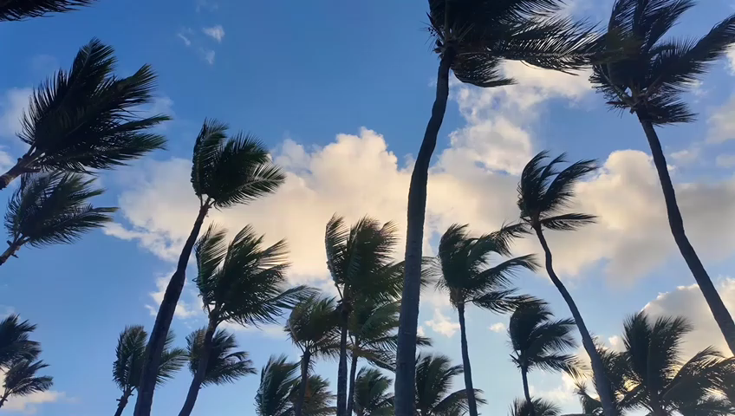
windy

Slide 16





sunny
rainy
cloudy
windy
weather
/ˈsʌnɪ/
/ˈreɪnɪ/
/ˈklaʊdɪ/
/ˈwɪndɪ/
/ˈweðə/

Slide 17

MISSING GAME

Slide 18
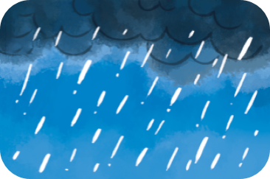



a
b
rainy
windy
c
d
sunny
cloudy

Slide 19
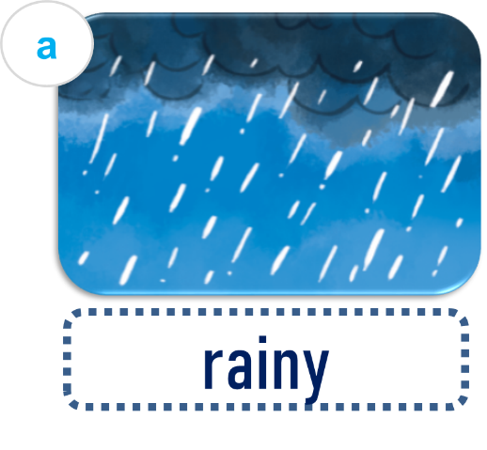

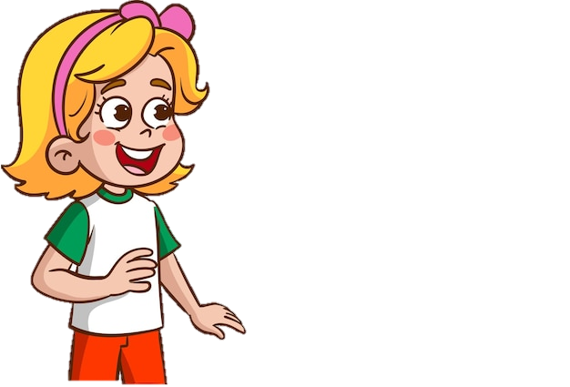
What was the weather like
last weekend?
It was …………….
rainy

Slide 20
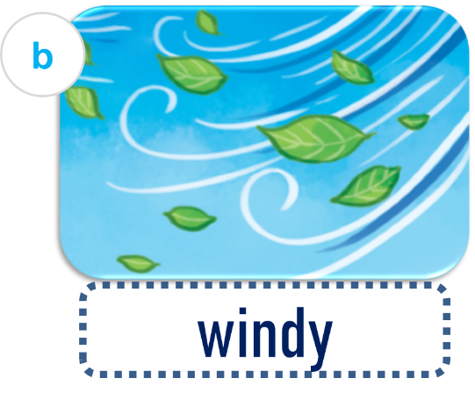
What was the weather like
last weekend?
It was …………….
windy

Slide 21
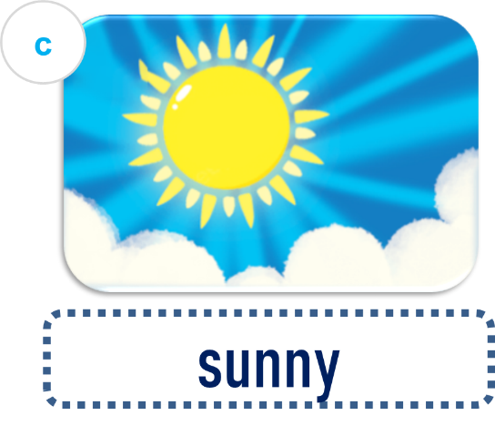
What was the weather like
last weekend?
It was …………….
sunny

Slide 22
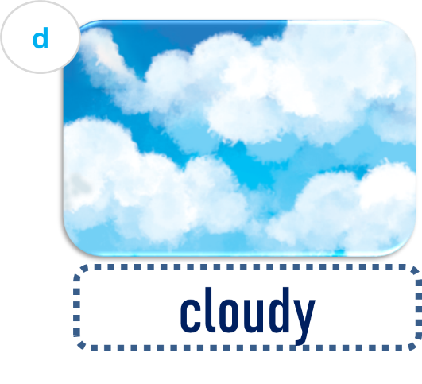
What was the weather like
last weekend?
It was …………….
cloudy

Slide 23
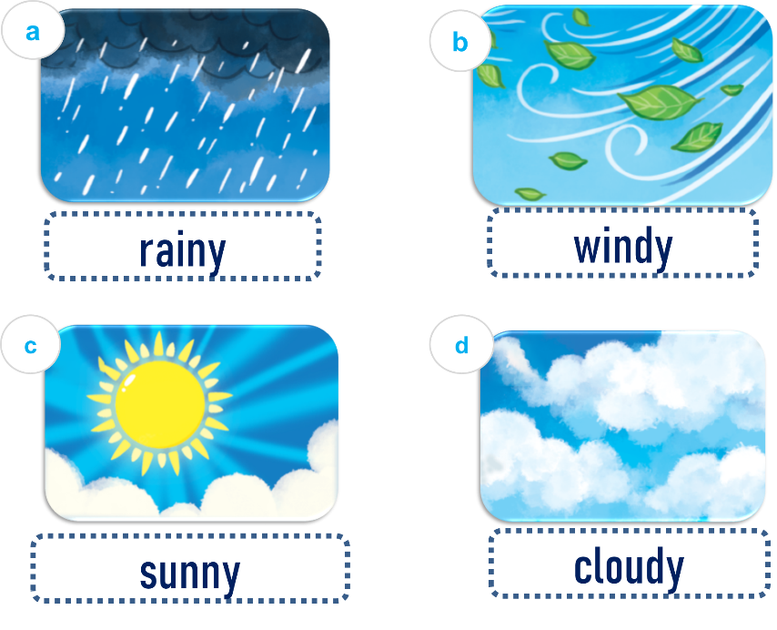

Work in pairs:
What was the weather like
last weekend?
It was …………….

Slide 24
Activity 3:
Let’s talk

Slide 25
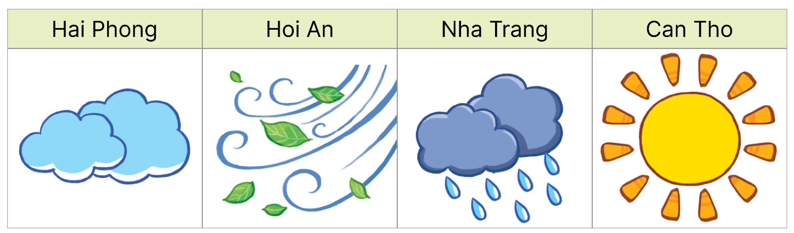
What was the weather
like yesterday?
It was _____.

Slide 26
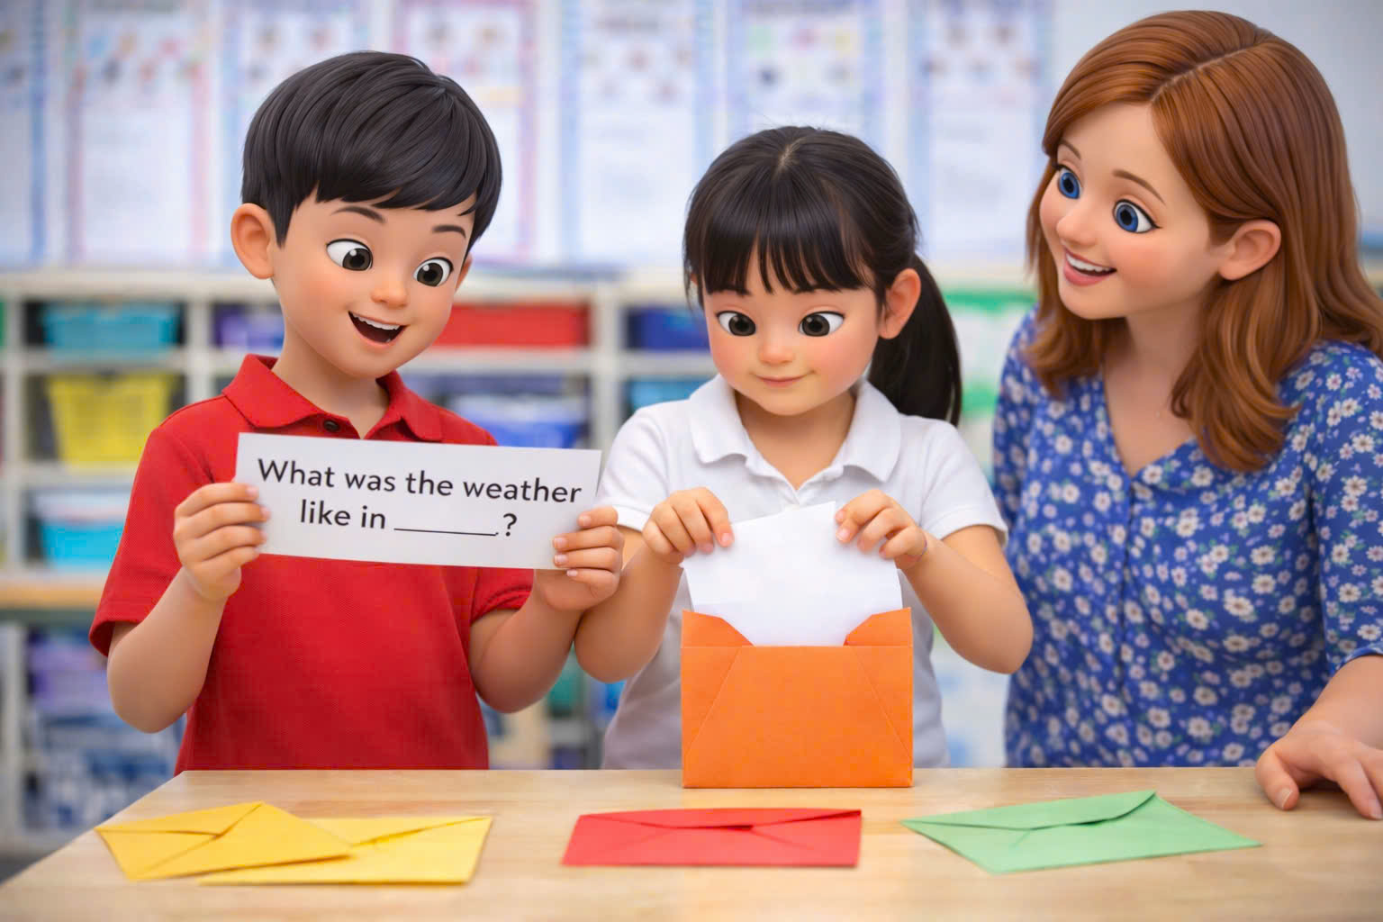

Slide 27
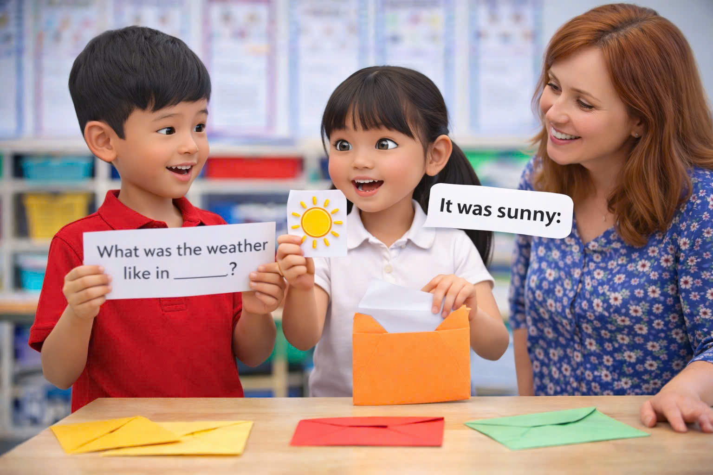

Slide 28

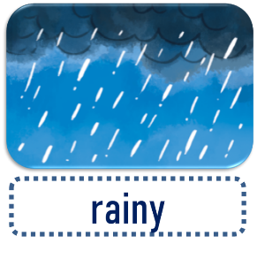

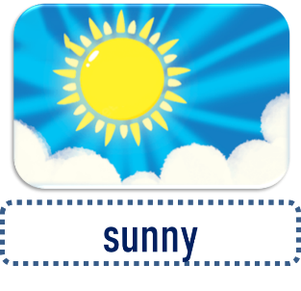
Wrap-up:
UNIT 16:
Weather
Lesson 1: Part 1-2-3
What was the weather like
last weekend?
It was …………….

Slide 29
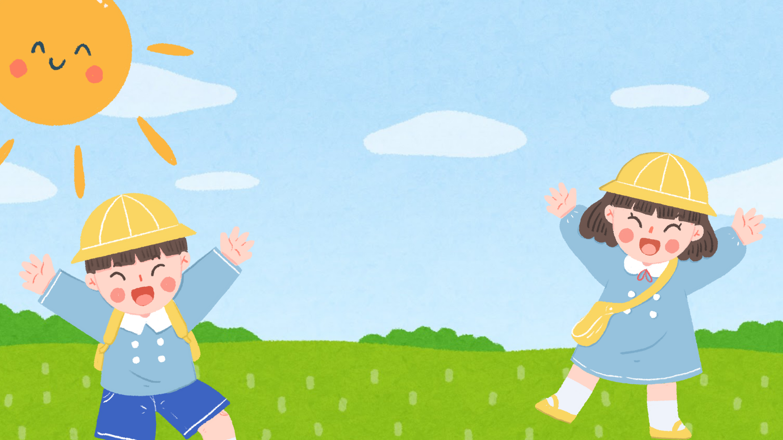
Mini game:
Ring the
golden bell

Slide 30








A: What was the _______ like last Sunday?
B: It was rainy.
weather
cinema
face

Slide 31







What was the weather like last weekend?
It was cloudy.
It was sunny.
It was windy.

Slide 32




A: ___________.
B: It was rainy.
What do you do in the morning?
Where does he go on Saturdays?
What was the weather like yesterday?

Slide 33
THANKS FOR
YOUR ATTENTION!

