Slide 1



DAI HA PRIMARY SCHOOL
Welcome teachers to our class 4A
Teacher: Ms My

Slide 2
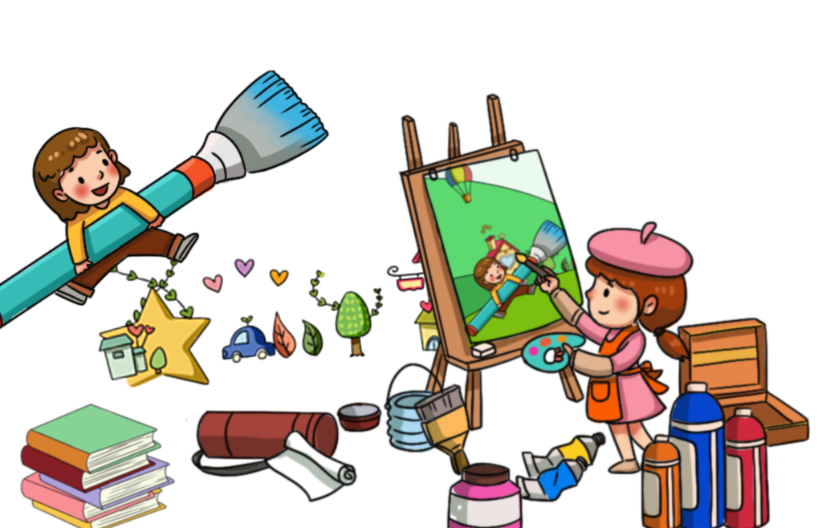
Warm-up

Slide 3

Friday, November 14th, 2025
Unit 6: Our school facilities
Lesson 2 – Period 3

Slide 4
New words

Slide 5
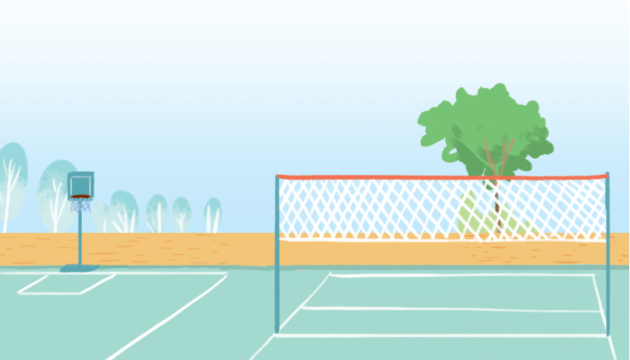
playground
/ˈpleɪɡraʊnd/
Sân chơi

Slide 6
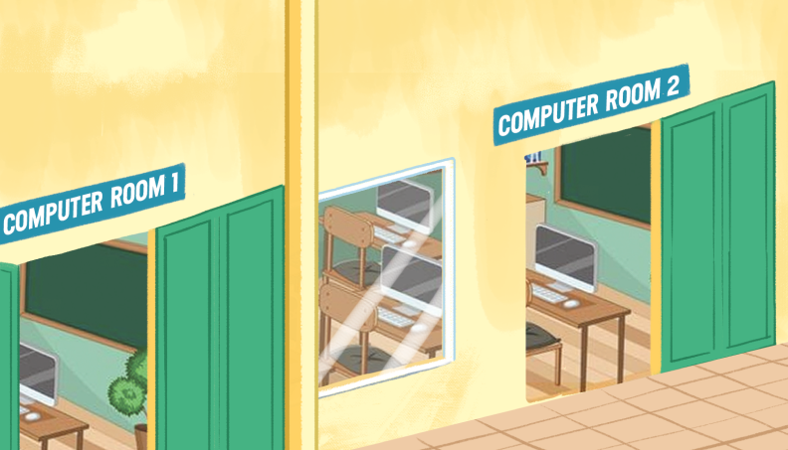
computer room
/kəmˈpjuːtə ruːm
Phòng máy tính

Slide 7
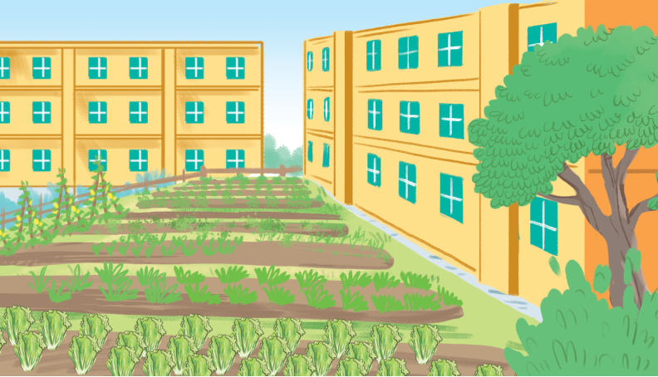
garden
/ˈɡɑːdn/
Vườn

Slide 8
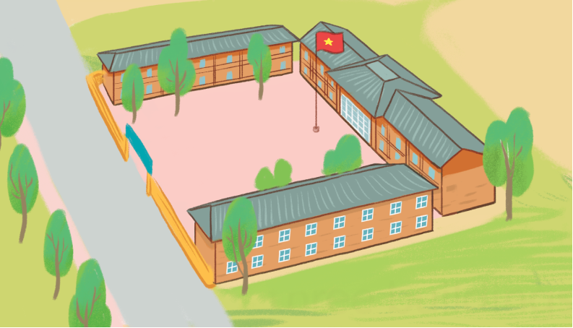
building
/ˈbɪldɪŋ/
Tòa nhà

Slide 9
New words
computer room
: Phòng máy tính
garden
: Vườn
playground
: Sân chơi
building
: Tòa nhà

Slide 10
Guessing game

Slide 11
Playground

Slide 12

building

Slide 13

Computer room

Slide 14

garden

Slide 15
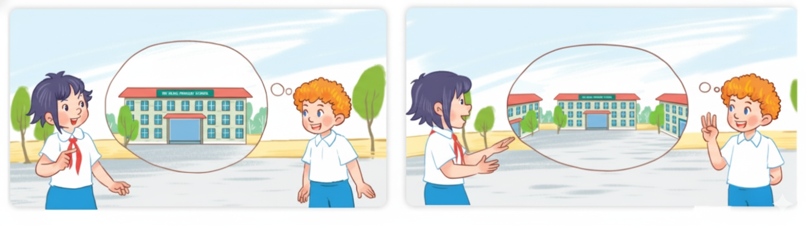
1.
Look, listen and repeat.

Slide 16
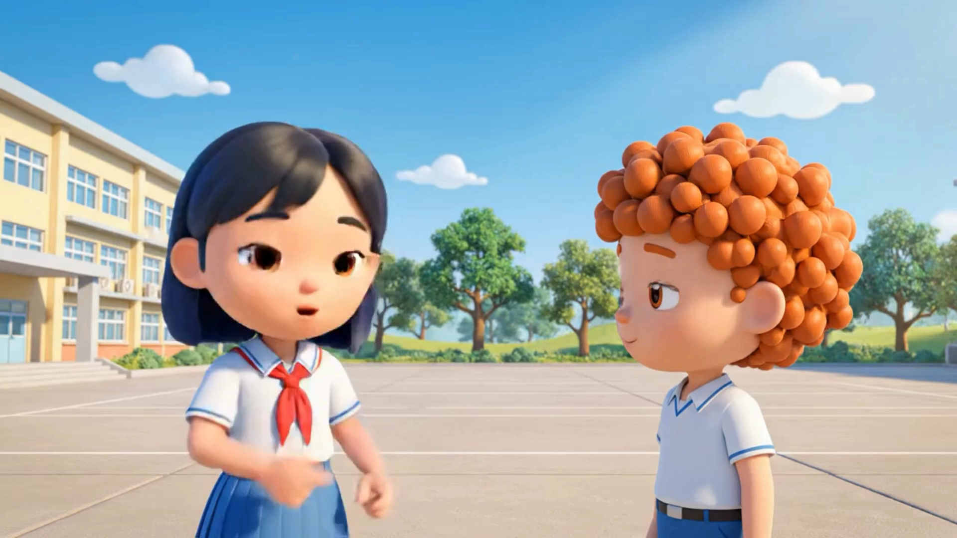
1.
Look, listen and repeat.

Slide 17
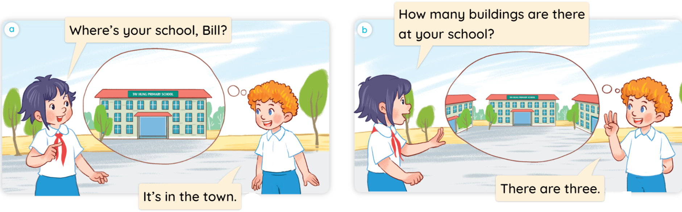

1.
Look, listen and repeat.

Slide 18
Structure

Slide 19
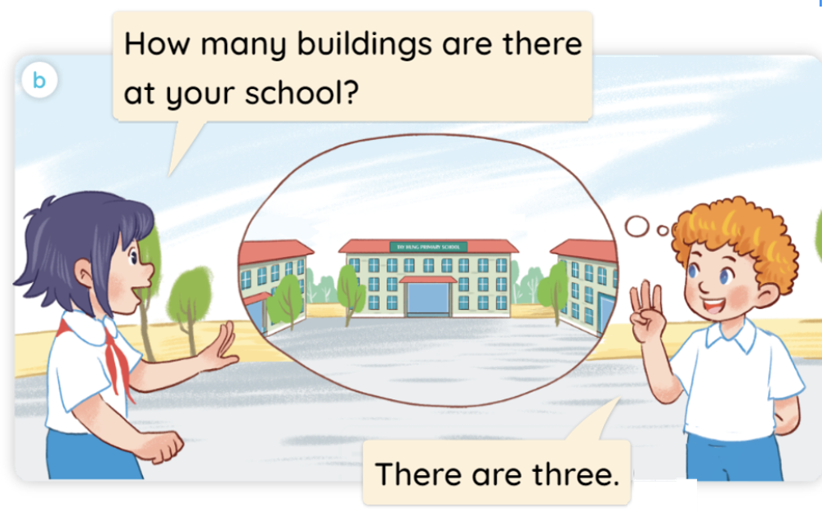

Structure
Ex:
Hỏi và trả lời về số lượng:
How many _____ are there at your school?
(Có bao nhiêu _________?)
There is one.
(Có một.)
There are ____.
(Có ___.)

Slide 20
2. Listen, point and say.

Slide 21
2.
Listen, point and say.
a
b
playgrounds
computer rooms
c
d
gardens
buildings

Slide 22


2.
Listen, point and say.
a
Playgrounds / one
How many playgrounds are there at your school?
There is one.

Slide 23
2.
Listen, point and say.
b
computer rooms / two
How many computer rooms are there at your school?
There are two.

Slide 24

2.
Listen, point and say.
c
Gardens / one
How many gardens are there at your school?
There is one.

Slide 25

2.
Listen, point and say.
d
Buildings / three
How many buildings are there at your school?
There are three.

Slide 26
Let’s talk

Slide 27
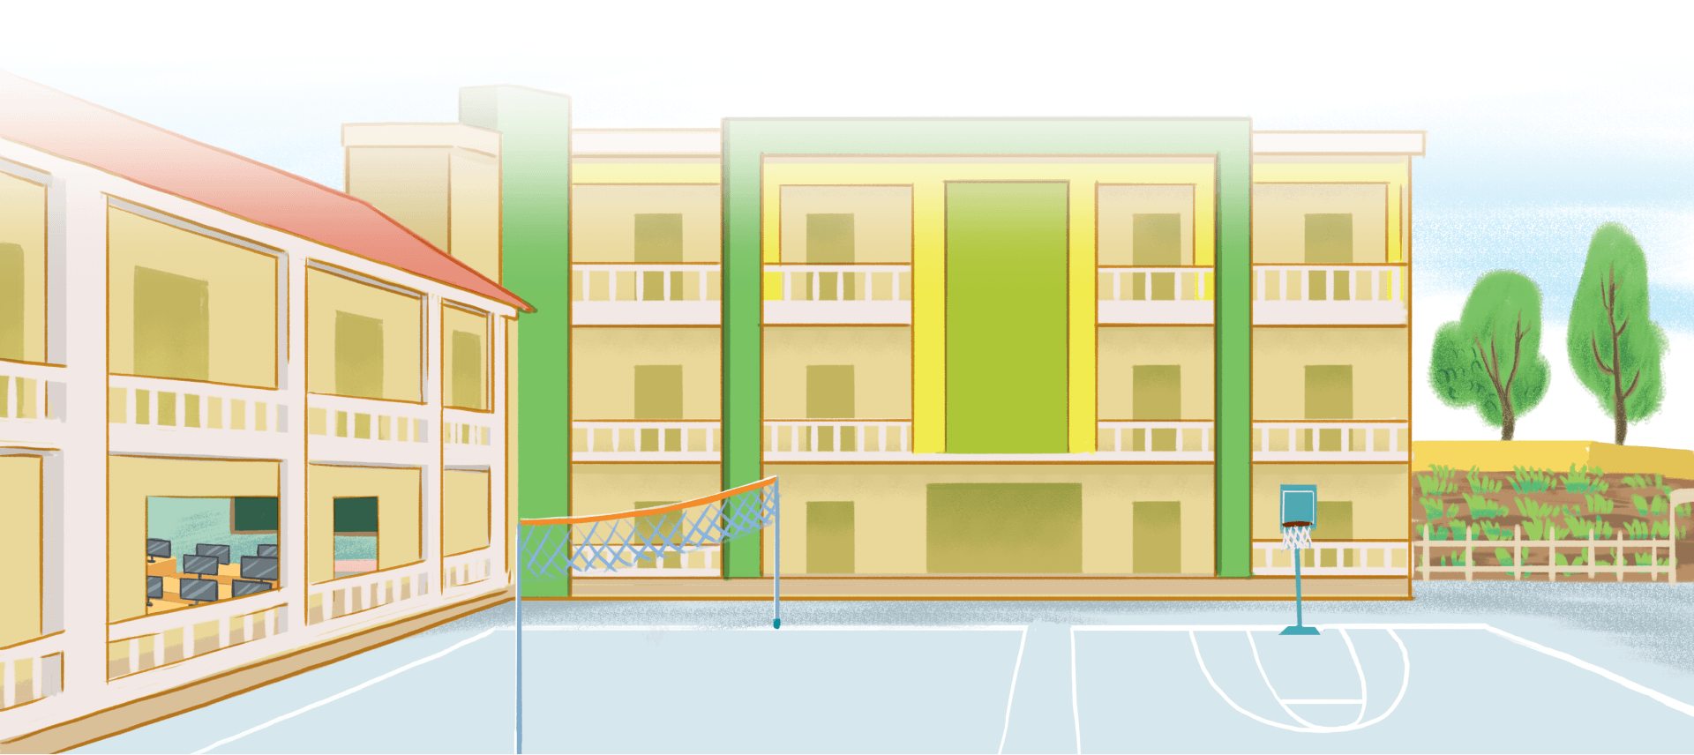
3.
Let’s talk.

Slide 28
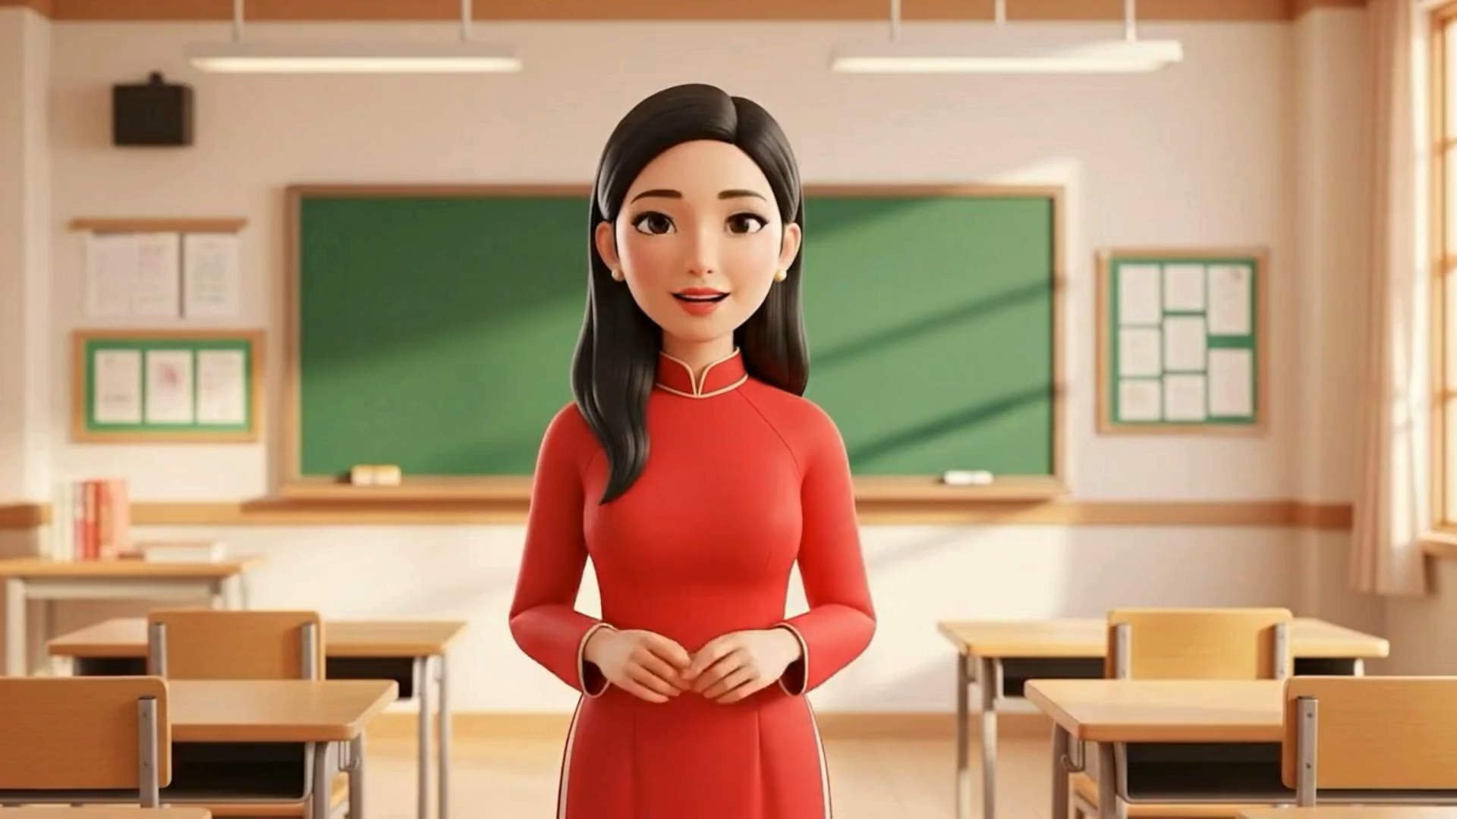
3.
Let’s talk.

Slide 29
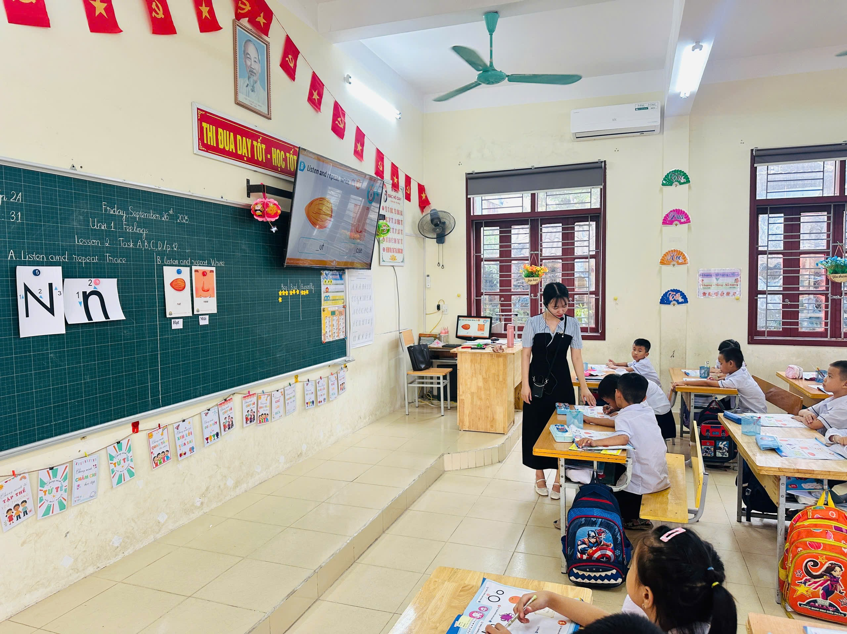
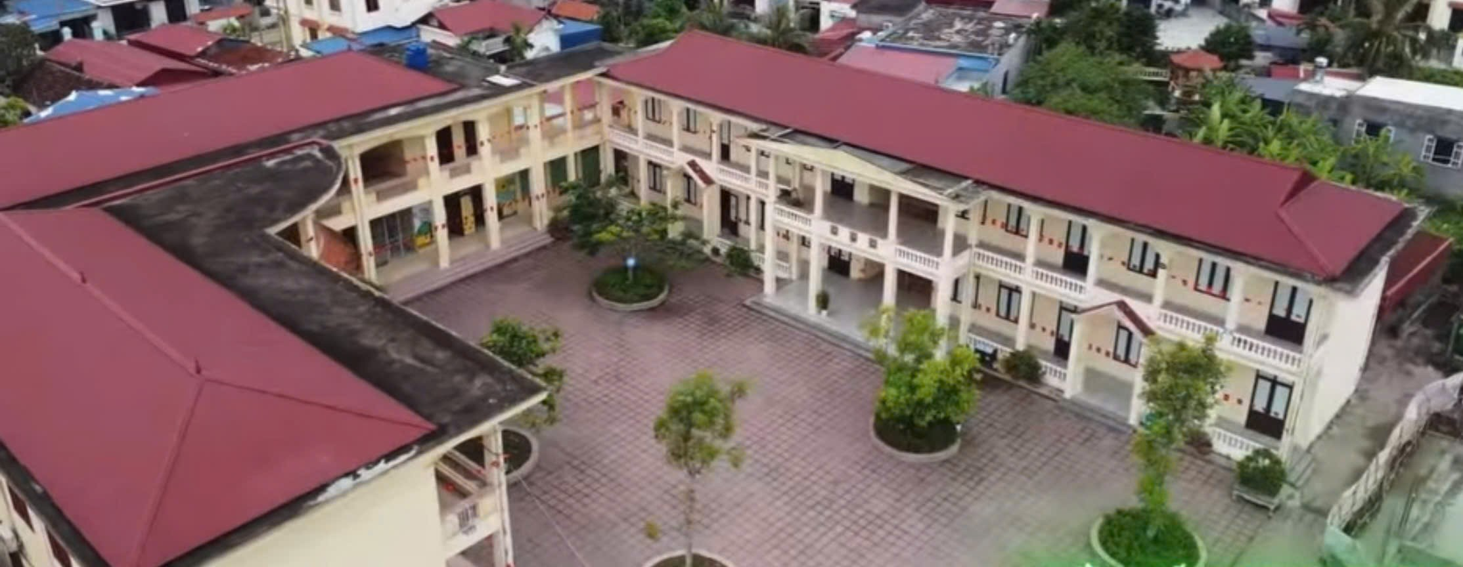
3.
Let’s talk.
How many _________ are there at your school?
There is/are ______.
BUILDINGS
ENGLISH ROOMS

Slide 30

How many___ are there at your school?
There is_____.
There are____.

Slide 31
Fun corner and Wrap up

Slide 32











Notes:
Ms Huyền Phạm - 0936.082.789 – YOUTUBE: MsPham. Facebook: Dạy và học cùng công nghệ.

Slide 33
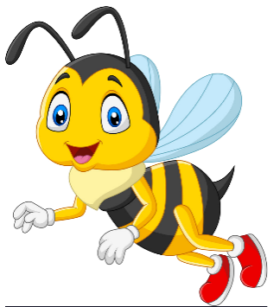





How many _________
are there at your school?
Next
buildings
gardens
computer rooms
playgrounds
Notes:
Ms Huyền Phạm - 0936.082.789 – YOUTUBE: MsPham. Facebook: Dạy và học cùng công nghệ.

Slide 34
How many _________
are there at your school?
Next
playgrounds
buildings
computer rooms
gardens
Notes:
Ms Huyền Phạm - 0936.082.789 – YOUTUBE: MsPham. Facebook: Dạy và học cùng công nghệ.

Slide 35
How many _________
are there at your school?
Next
gardens
playgrounds
buildings
computer rooms
Notes:
Ms Huyền Phạm - 0936.082.789 – YOUTUBE: MsPham. Facebook: Dạy và học cùng công nghệ.

Slide 36
How many _________
are there at your school?
Next
gardens
playgrounds
computer rooms
buildings
Notes:
Ms Huyền Phạm - 0936.082.789 – YOUTUBE: MsPham. Facebook: Dạy và học cùng công nghệ.

Slide 37
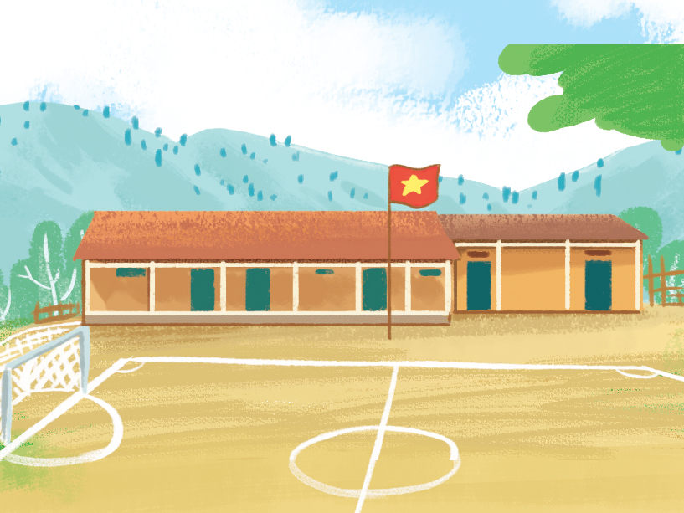
How many playgrounds
are there at your school?
Next
There is
three.
There are three.
There are two.
There is
one.
Notes:
Ms Huyền Phạm - 0936.082.789 – YOUTUBE: MsPham. Facebook: Dạy và học cùng công nghệ.

Slide 38
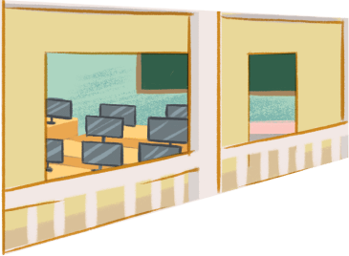
How many computer rooms
are there at your school?
Next
There is
one.
There is
two.
There are
two.
There are
one.
Notes:
Ms Huyền Phạm - 0936.082.789 – YOUTUBE: MsPham. Facebook: Dạy và học cùng công nghệ.

Slide 39
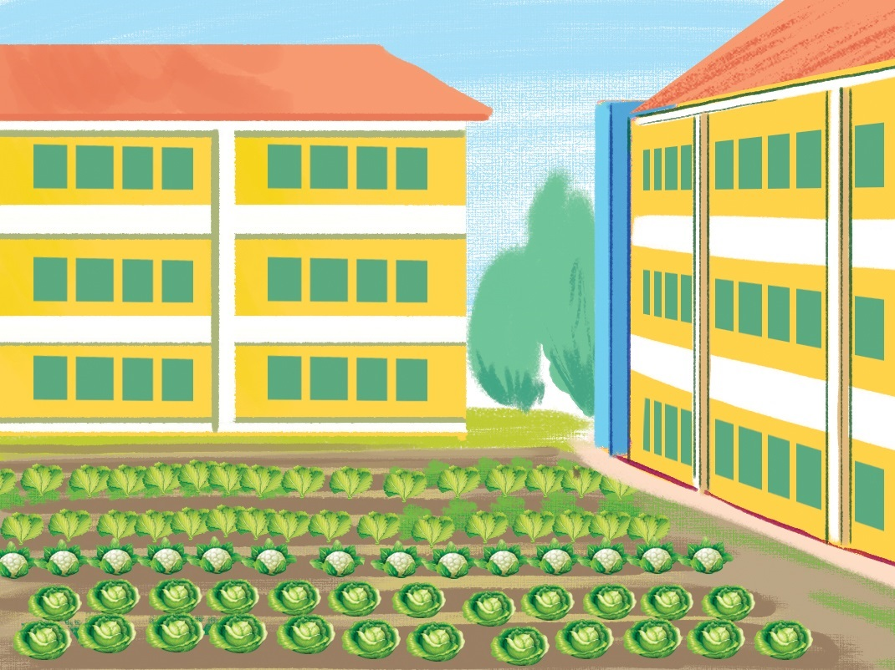
How many gardens
are there at your school?
Next
There is
one.
There are
three.
There are
two.
There are
four.
Notes:
Ms Huyền Phạm - 0936.082.789 – YOUTUBE: MsPham. Facebook: Dạy và học cùng công nghệ.

Slide 40








Notes:
Ms Huyền Phạm - 0936.082.789 – YOUTUBE: MsPham. Facebook: Dạy và học cùng công nghệ.

Slide 41
THANK YOU

