Slide 1




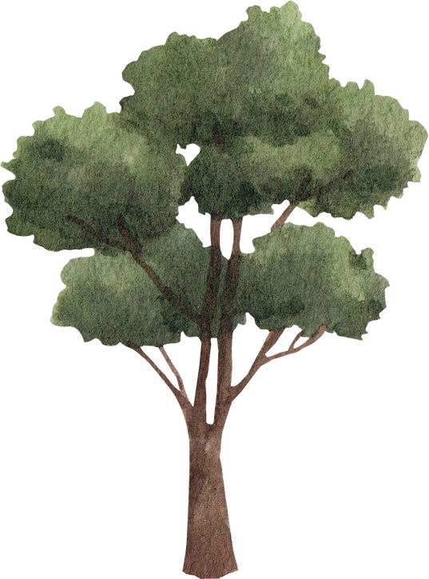

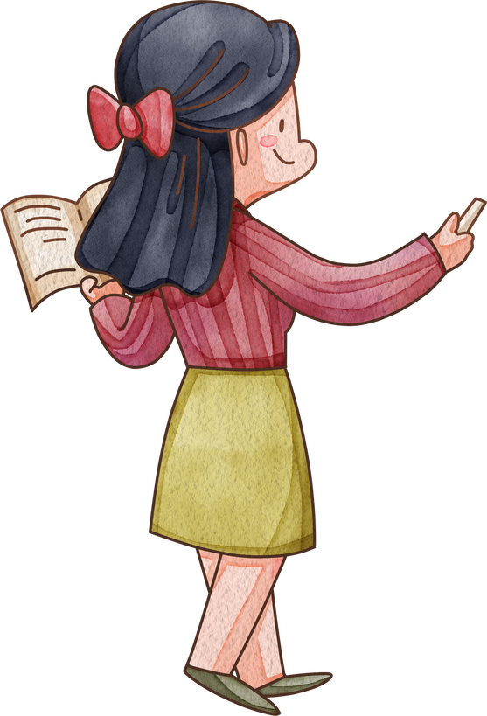
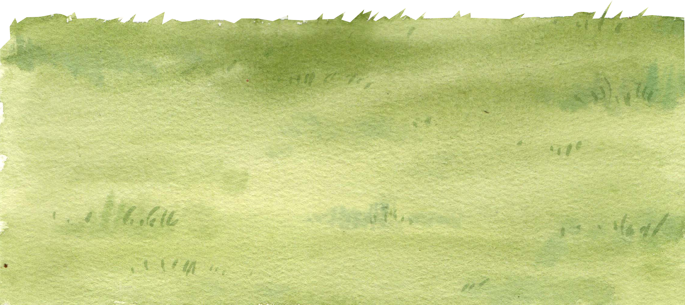
Hello!
Welcome to Ms.Chi English class

Slide 2
Warm-up and review

Slide 3




Picking coconut
Notes:
Step 1: Divide the class into 4 teams.
Step 2: Invite one pupil from each team to the front, listen to the recording and choose the right answer.
Step 3: Encourage pupils to join in the game.
Step 4: Give points to pupils.

Slide 4





Look and click on the right coconut!
farmer
driver
doctor
We did it!
driver

Slide 5



Look and click on the right coconut!
nurse
farmer
teacher
We did it!
farmer

Slide 6

Look and click on the right coconut!
singer
doctor
worker
We did it!
doctor

Slide 7




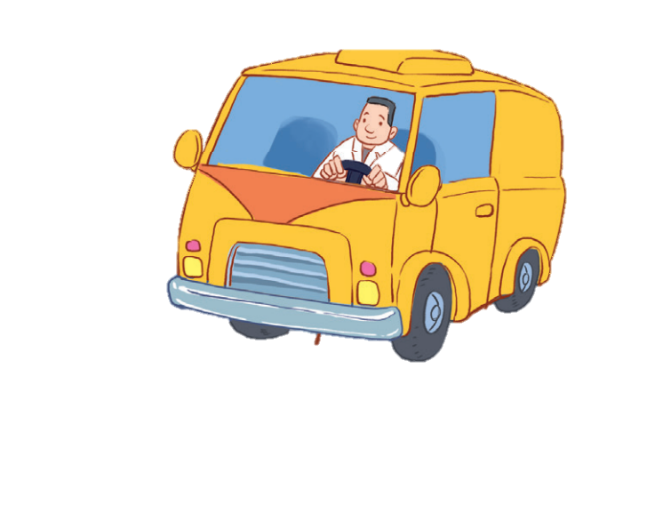

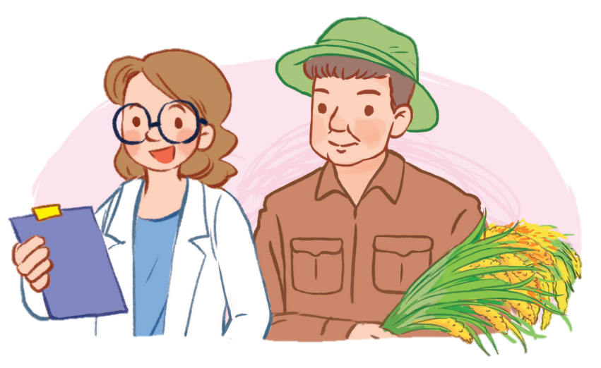
12
LESSON 3 – Act 1,2,3

Slide 8
1
Listen and repeat.

Slide 9
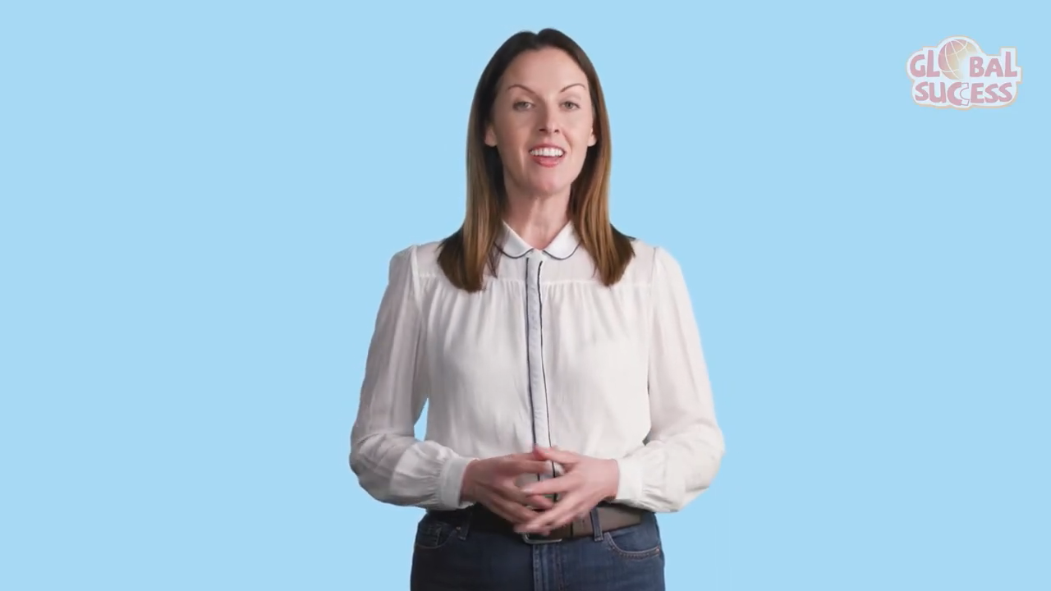

Slide 10


Slide 11
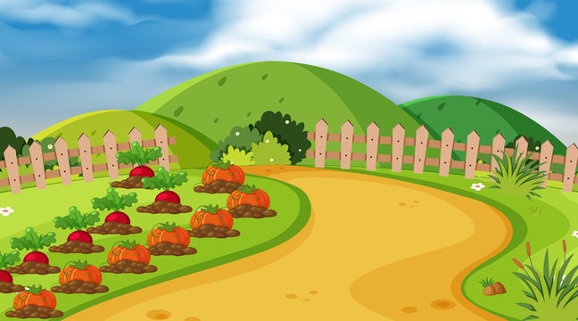

Listen and choose.
mother
or
er
doctor
Notes:
Game: Listen and choose.
Divide the class into 2 groups. Let the pupils listen to the recording, then choose the correct word.

Slide 12
Listen and choose.
or
mother
doctor
ch

Slide 13
Listen and choose.
th
or
mother
doctor

Slide 14
Listen and choose.
er
m
doctor
mother

Slide 15
2
Listen and circle.

Slide 16
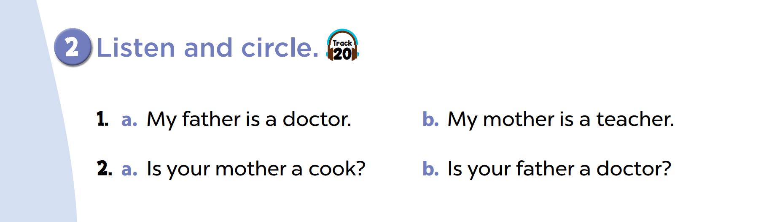

Slide 18

Whisper game
Notes:
Step 1: Divide the class into four teams.
Step 2: Invite 5 pupils from each team to line up. The first pupil gets a card/ listens to the teacher’s whisper. Pupils whisper sentences to the next friends in their lines. The last pupils say the sentence aloud.
Step 3: Encourage pupils to join in the game.
Step 4: Give points to teams.

Slide 19

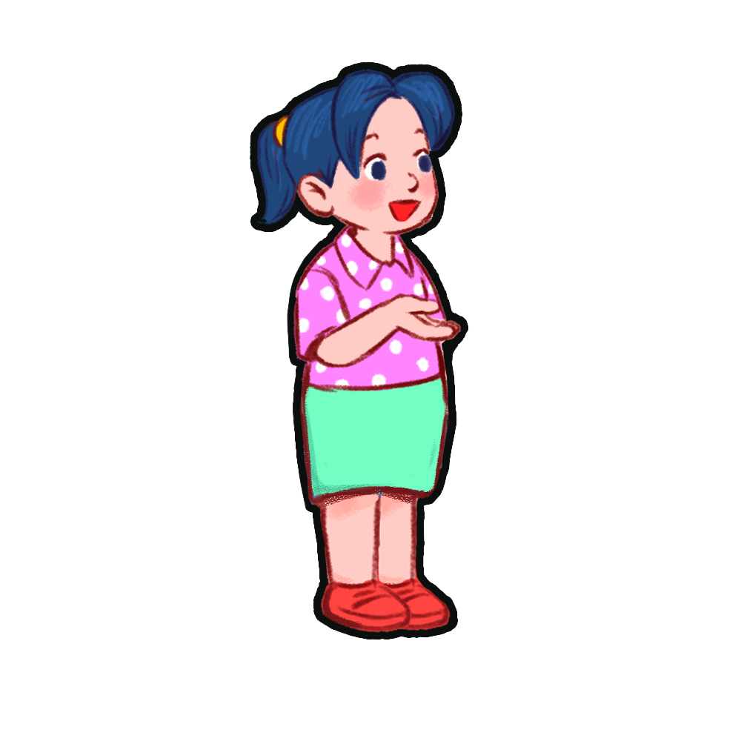



My mother is a teacher.
My mother is a teacher.
My mother is a teacher.
My mother is a teacher.
My mother is a teacher.

Slide 20
My father is a singer.
My father is a singer.
My father is a singer.
My father is a singer.
My father is a singer.

Slide 21
My sister is a doctor.
My sister is a doctor.
My sister is a doctor.
My sister is a doctor.
My sister is a doctor.

Slide 22
4
Let’s chant.

Slide 23


Brother, brother
That's my brother
Driver, Driver
My brother is a driver
Sister, Sister
That's my sister
Singer, singer
My sister is a singer

Slide 24
Brother, brother
That's my brother
Driver, Driver
My brother is a driver
Sister, Sister
That's my sister
Singer, singer
My sister is a singer

Slide 25
5
Fun corner and wrap-up

Slide 26








Game time: Guessing
1
2
3
4
5
6
7
8
points
Notes:
Step 1: Divide the class into 4 teams.
Step 2: Look at the cards (1-8), there are pictures behind them. Let pupils guess the jobs in the pictures. (Spin the lucky wheel to get points.)
Step 3: Encourage pupils to take part in the game and practice speaking English.
Step 4: Give points to pupils.

