Slide 1




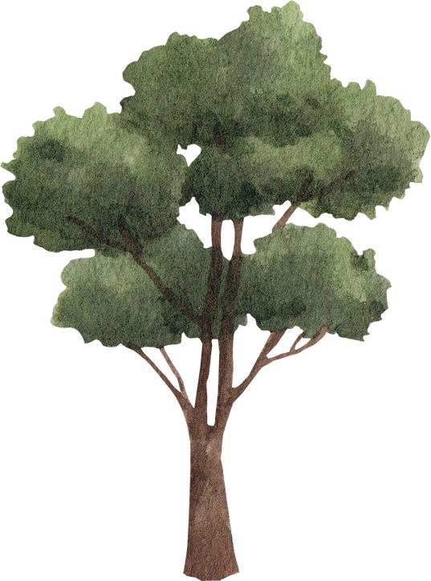
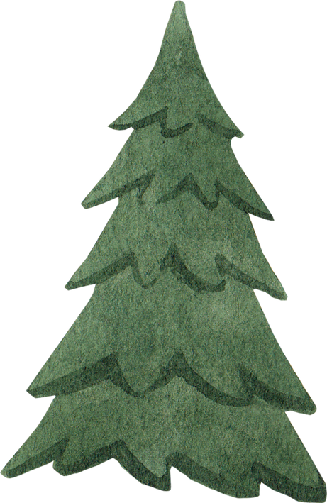
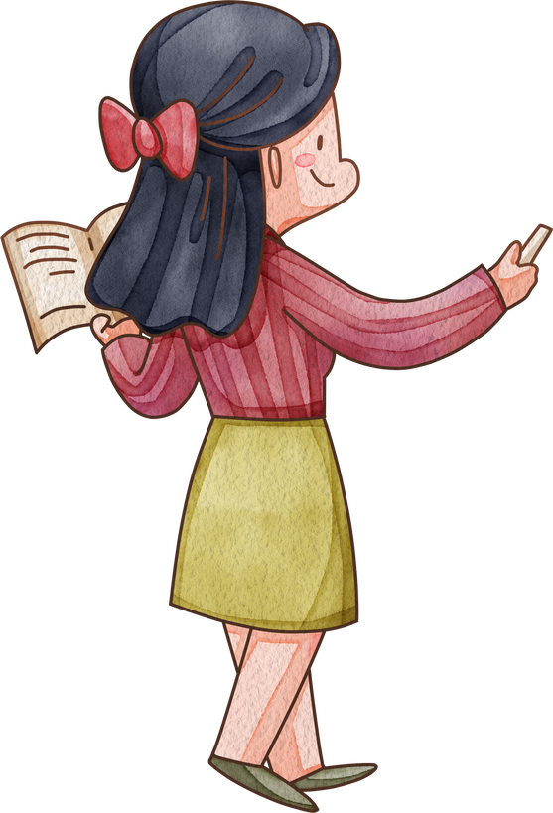
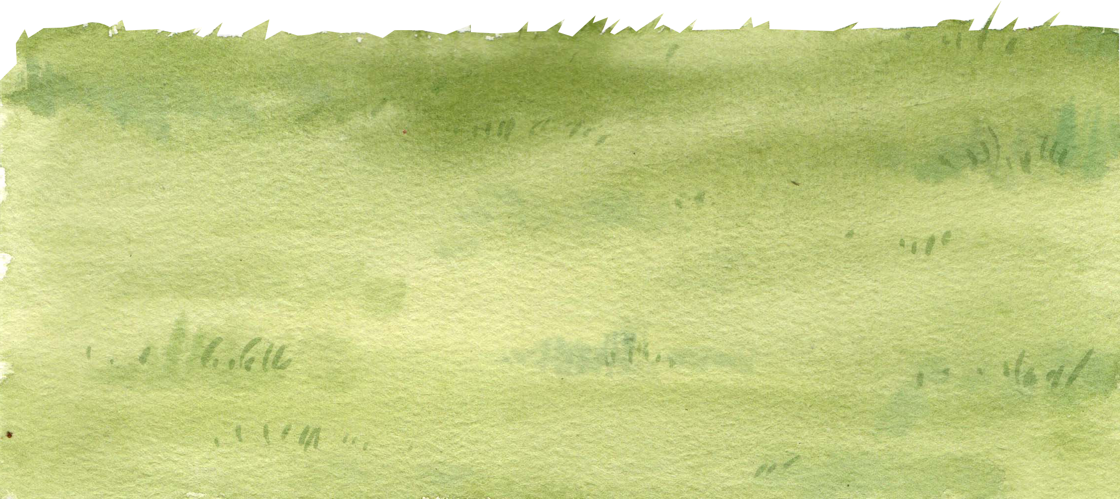
Hello!
Welcome to Ms.Chi English class

Slide 2


Unit 5: Animals
Lesson 1.1
Page 32

Slide 3

WARM-UP

Slide 4
Let’s play!
Simon says Game

Slide 5

It’s time to learn …

Slide 6

New words
Dog,
Cat,
Bird.

Slide 7

Presentation

Slide 8

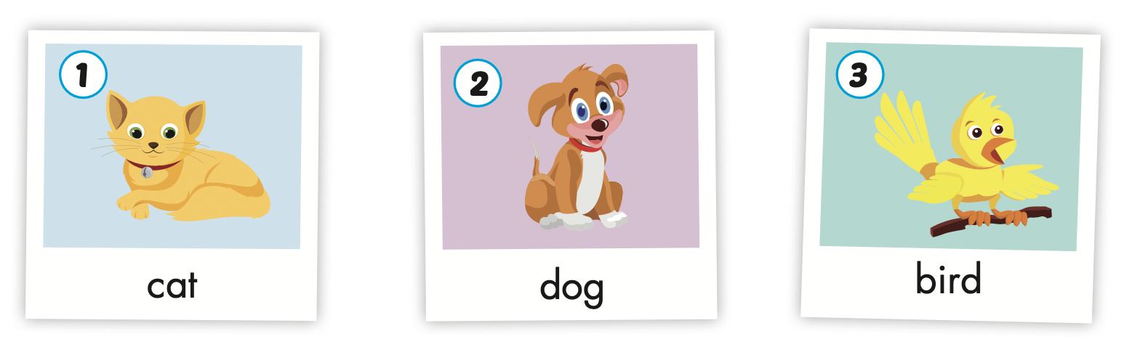

Slide 9
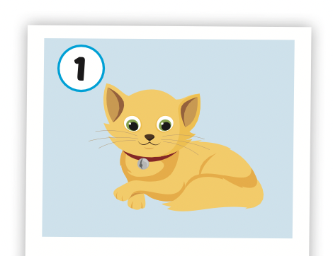
Click on the picture to hear the sound
cat
/kæt/
con mèo

Slide 10
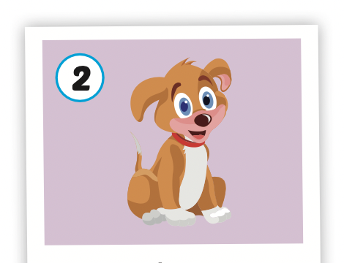
Click on the picture to hear the sound
dog
/dɔːɡ/
con chó

Slide 11
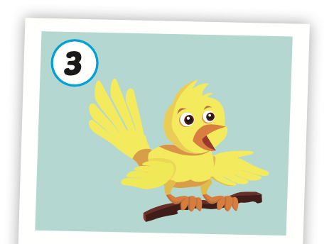
Click on the picture to hear the sound
bird
/bɝːrd/
con chim

Slide 12
Structures
I like (cats).

Slide 13

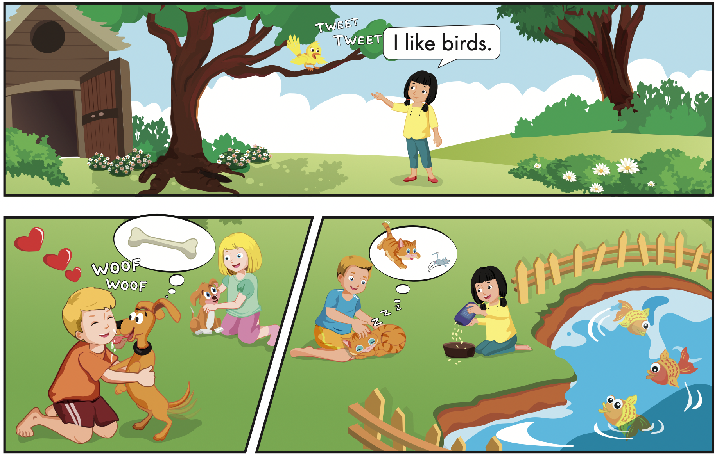
Click B to hear the sound

Slide 14

Speaking

Slide 15
Let’s say!
It’s a cat.
I like cats.

Slide 16
Let’s say!
It’s a dog.
I like dogs.

Slide 17
Let’s say!
It’s a bird.
I like birds.

Slide 18



Slide 20

Production

Slide 21
Let’s play!
Listen, look and say
I like……..

Slide 22




I like dogs.

Slide 23


I like birds.

Slide 24

I like cats.

Slide 25


Slide 26

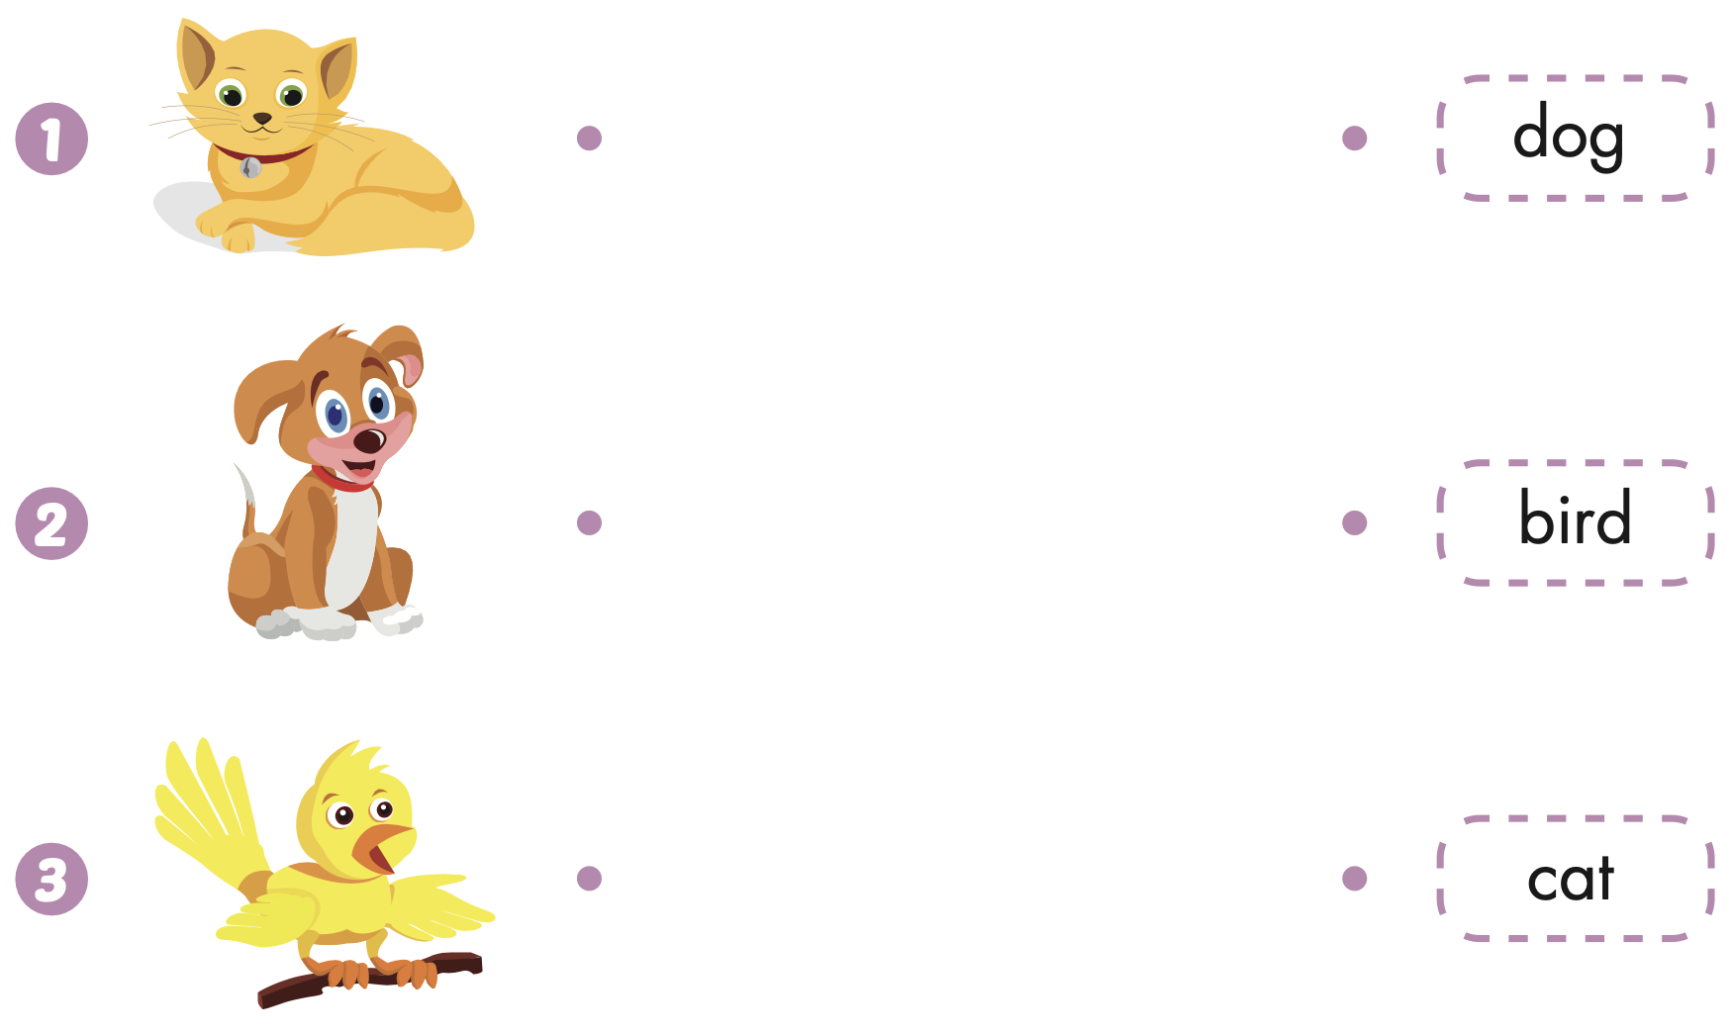
Extra Practice
WB, page 30

Slide 27

CONSOLIDATION

Slide 28

Let’s play!
Telephone Game

Slide 29

WRAP-UP

Slide 30
Today’s lesson
Vocabularies
Dog,
Cat,
Bird.
Structures/ Sentence patterns
I like(cats).

Slide 31
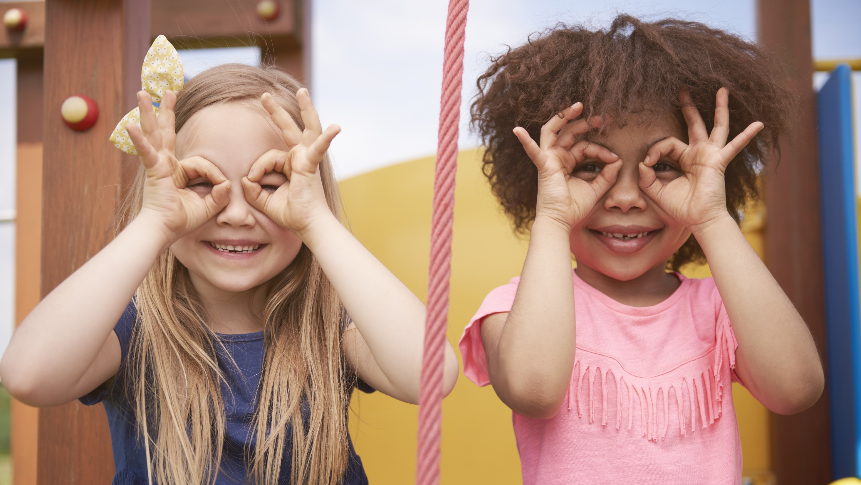
Enjoy your day!

