Slide 1


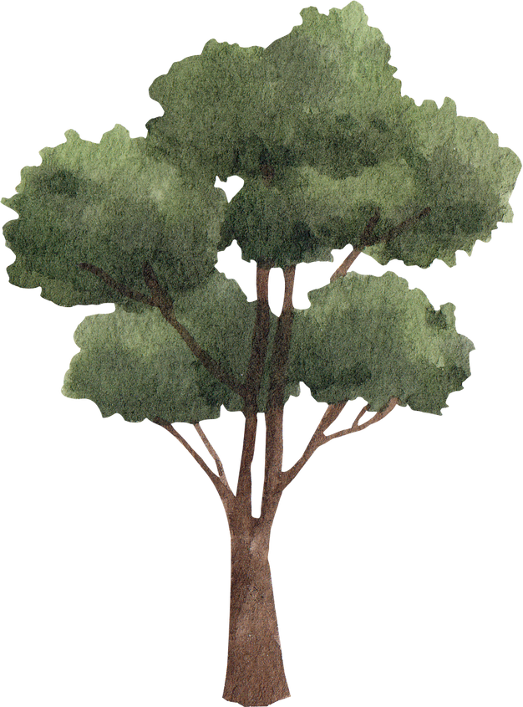



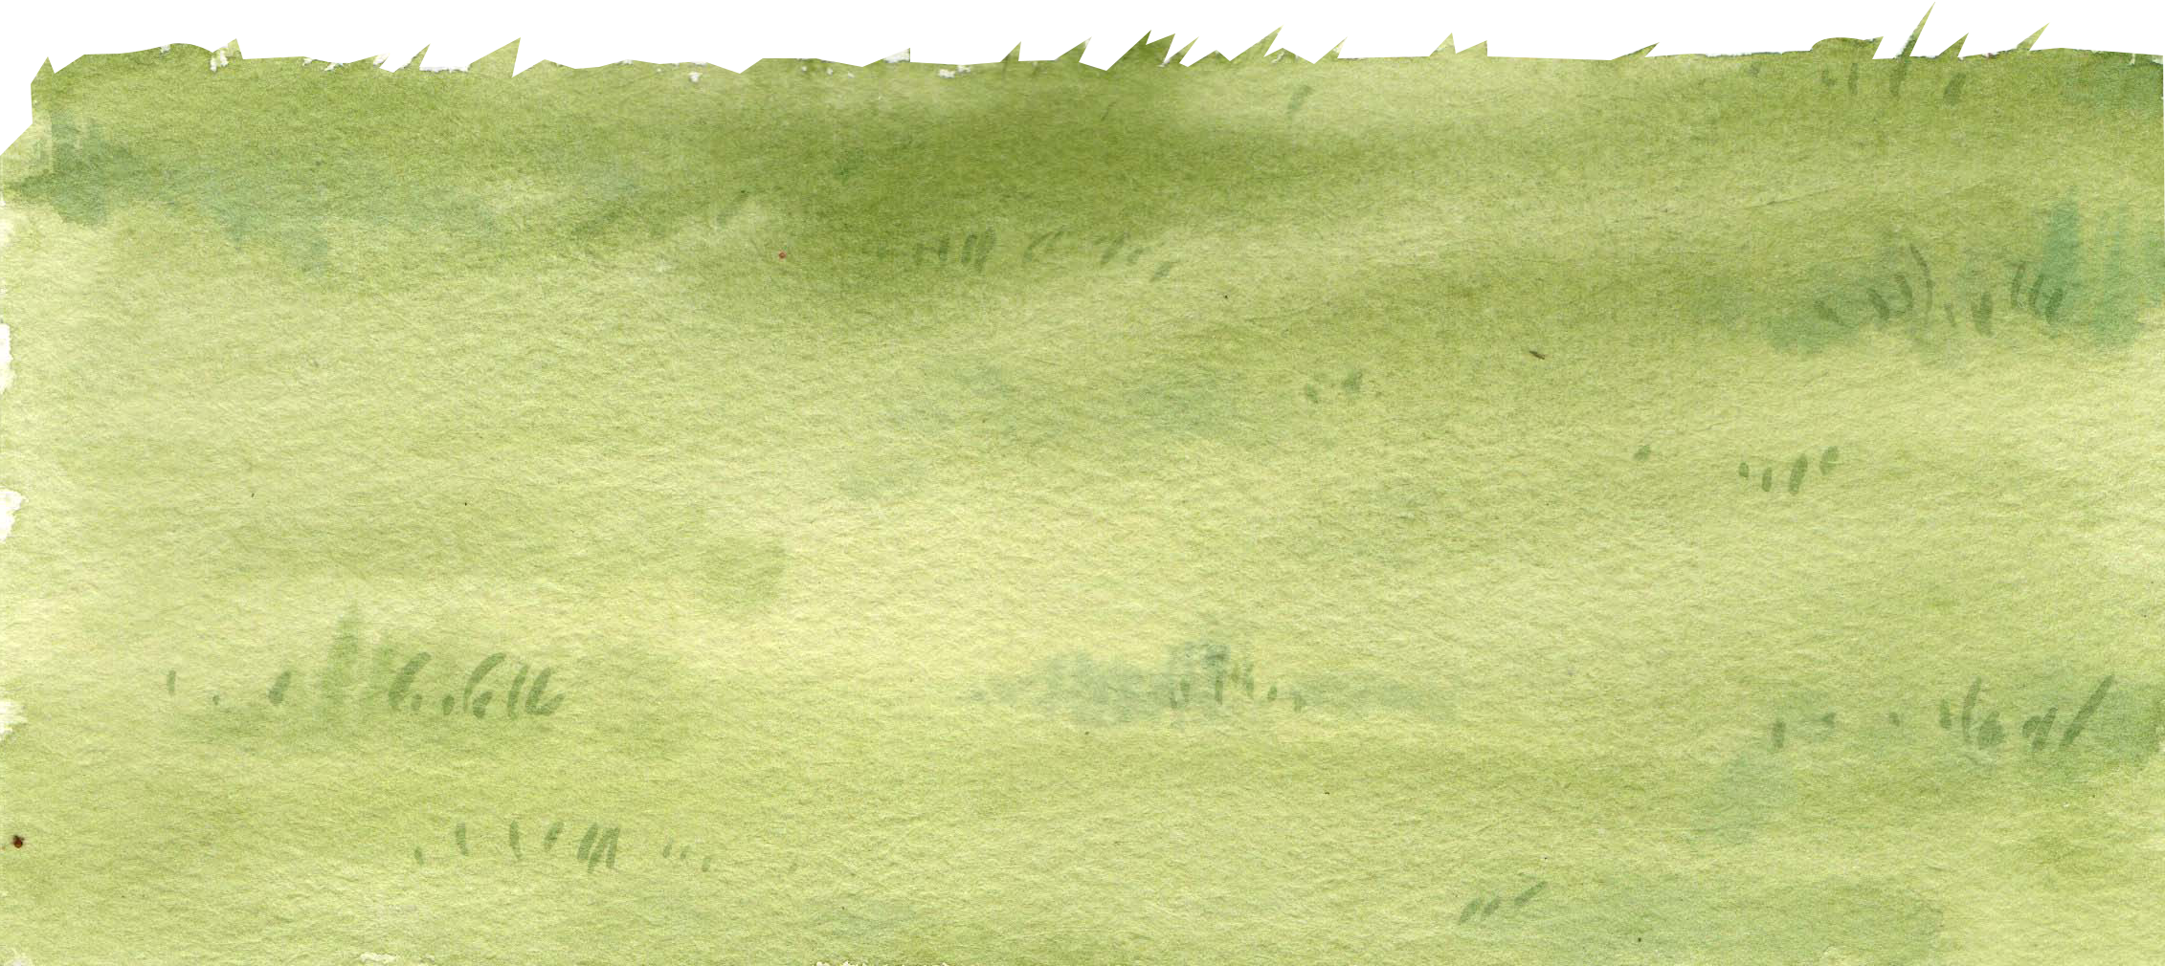
🌈 Welcome to Our Happy English Class!

Slide 2



6
Our school
LESSON 1 PERIOD 1

Slide 3
Warm-up

Slide 4

Look, listen and repeat.

Slide 5
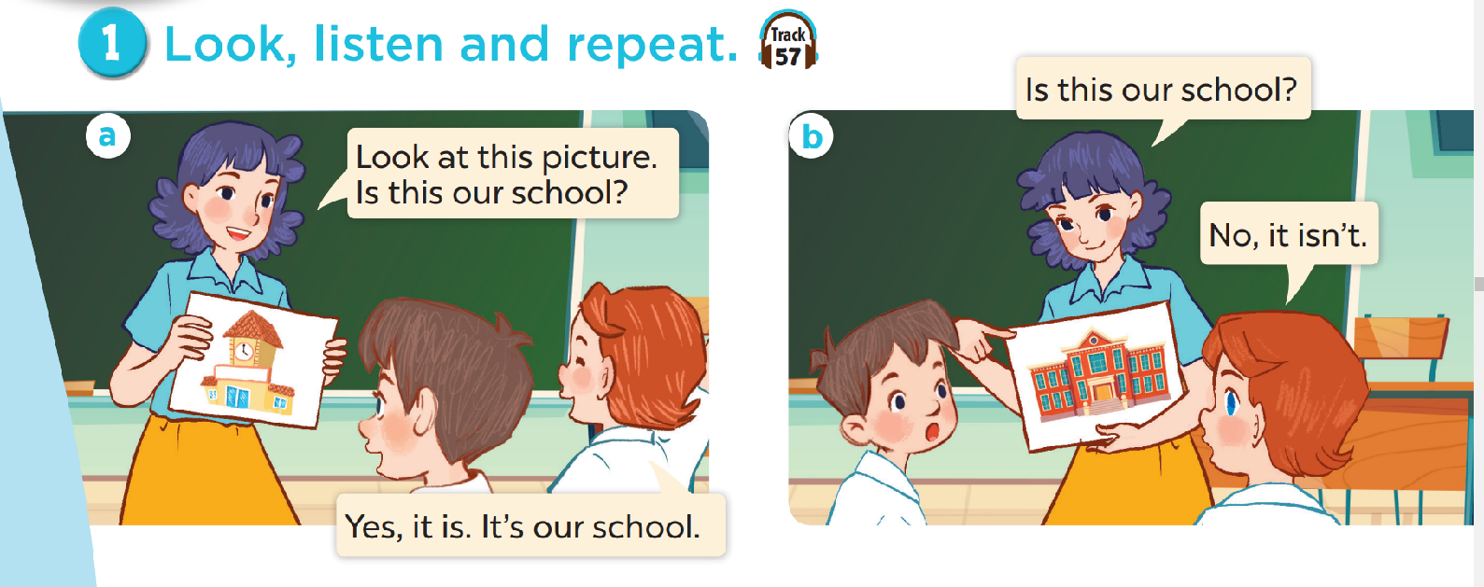
Look and answer the questions.
Where are they?
Who are they?
What are they doing?

Slide 6
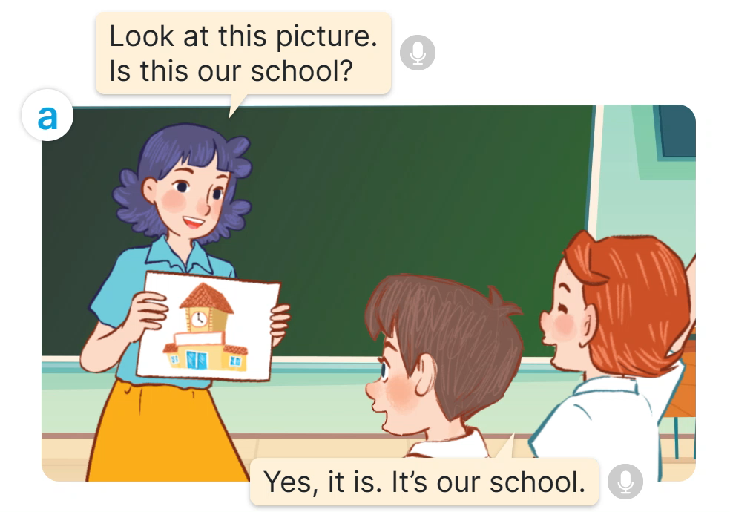

Slide 7
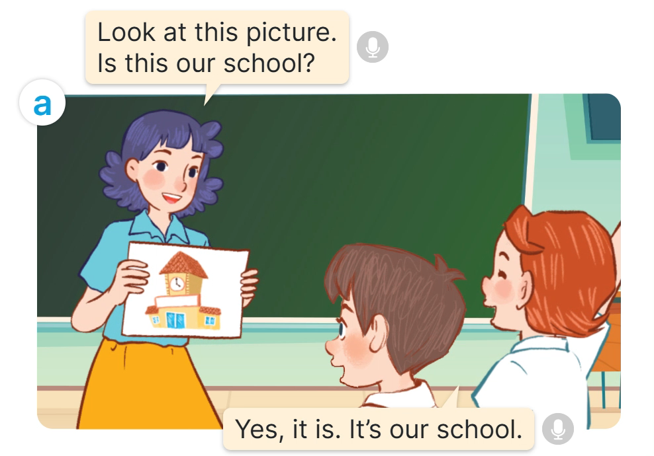

Slide 8
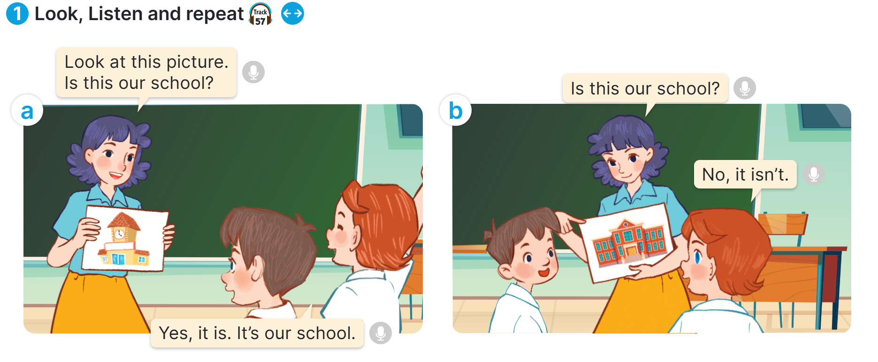
Listen and repeat

Slide 9


Slide 10


Slide 11

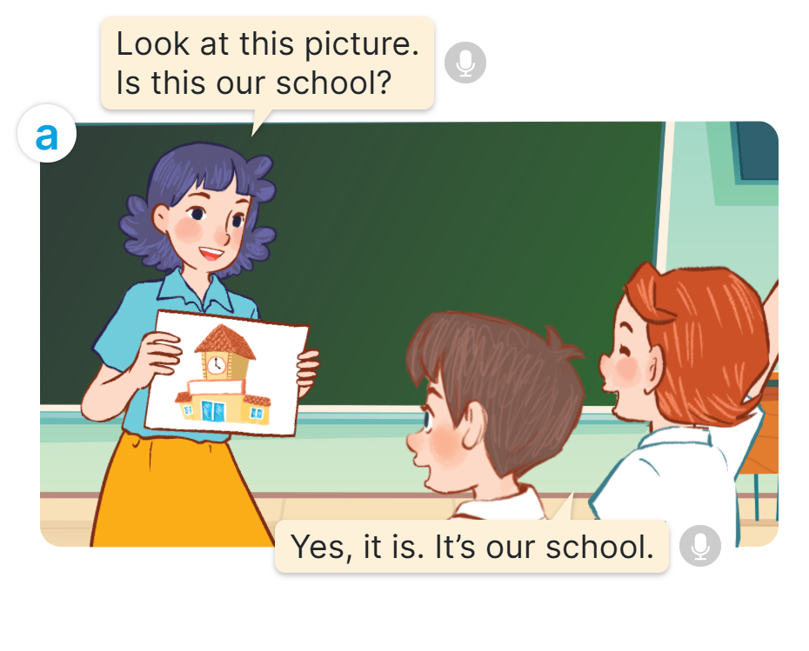

Slide 12

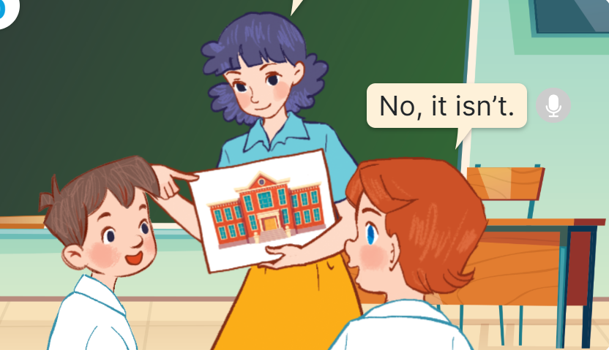

Slide 13

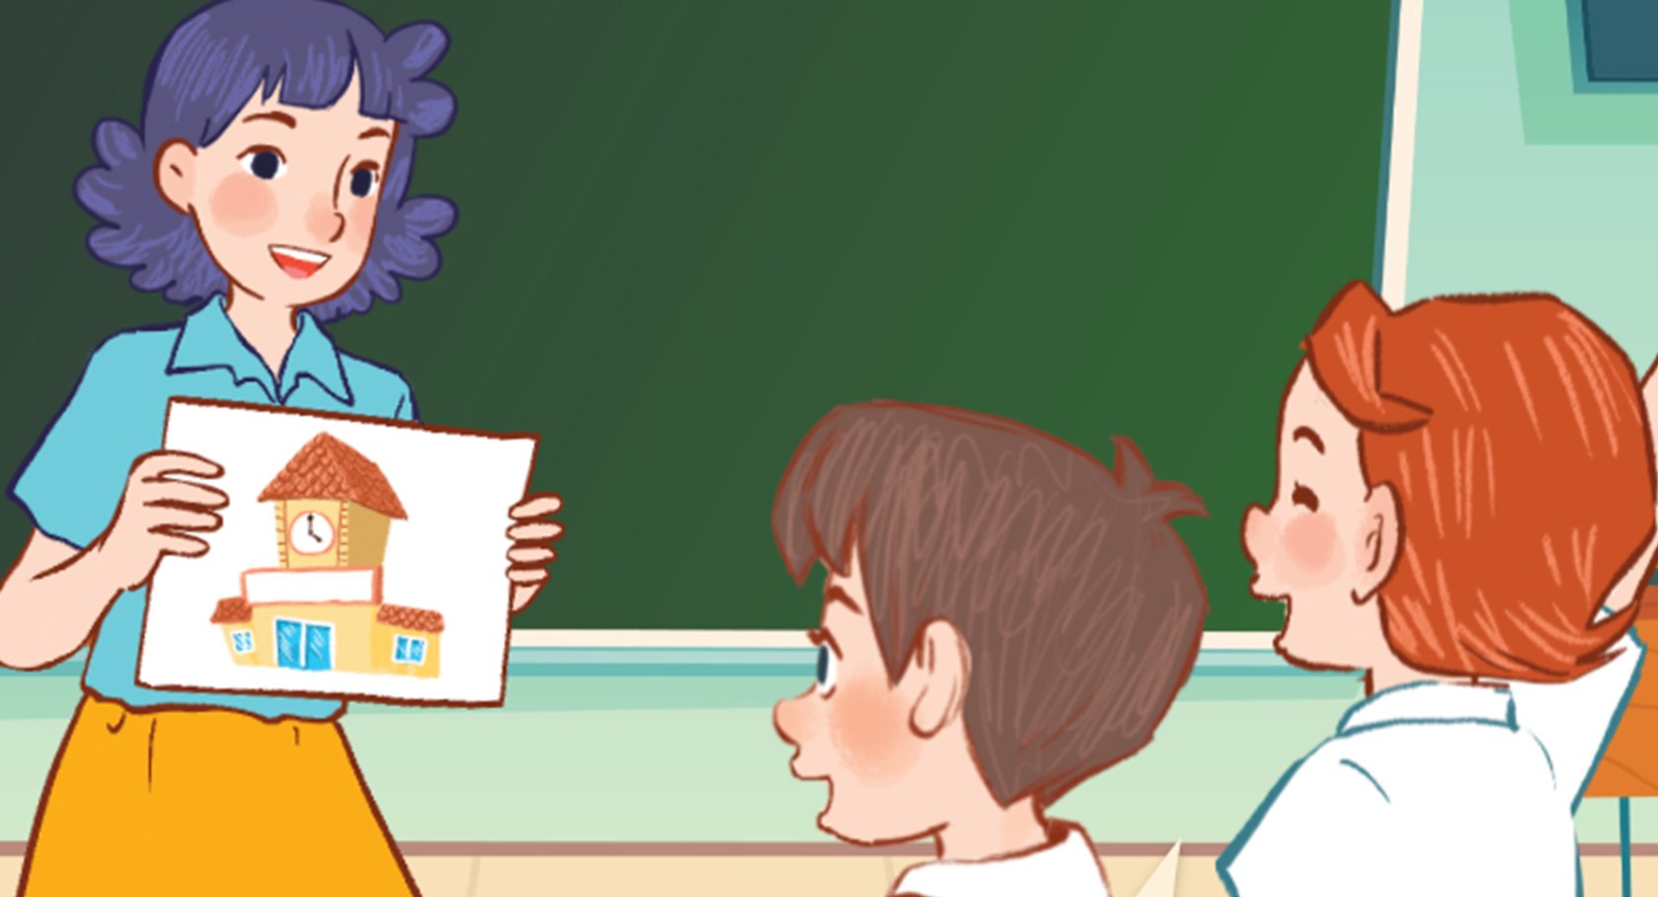

Slide 14


Slide 15


Slide 16


Slide 17
Work in pairs

Slide 18

Listen, point and say.

Slide 19
New words

Slide 20
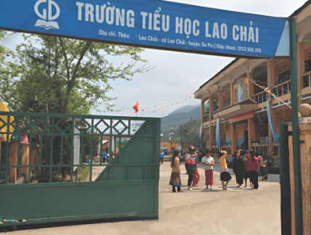
School
/skuːl/

Slide 21
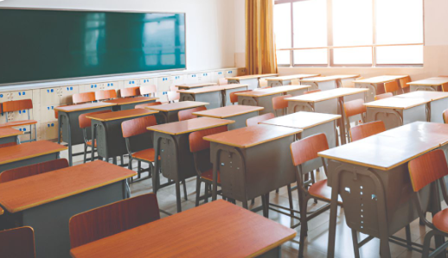
Classroom
/ˈklɑːsruːm/

Slide 22
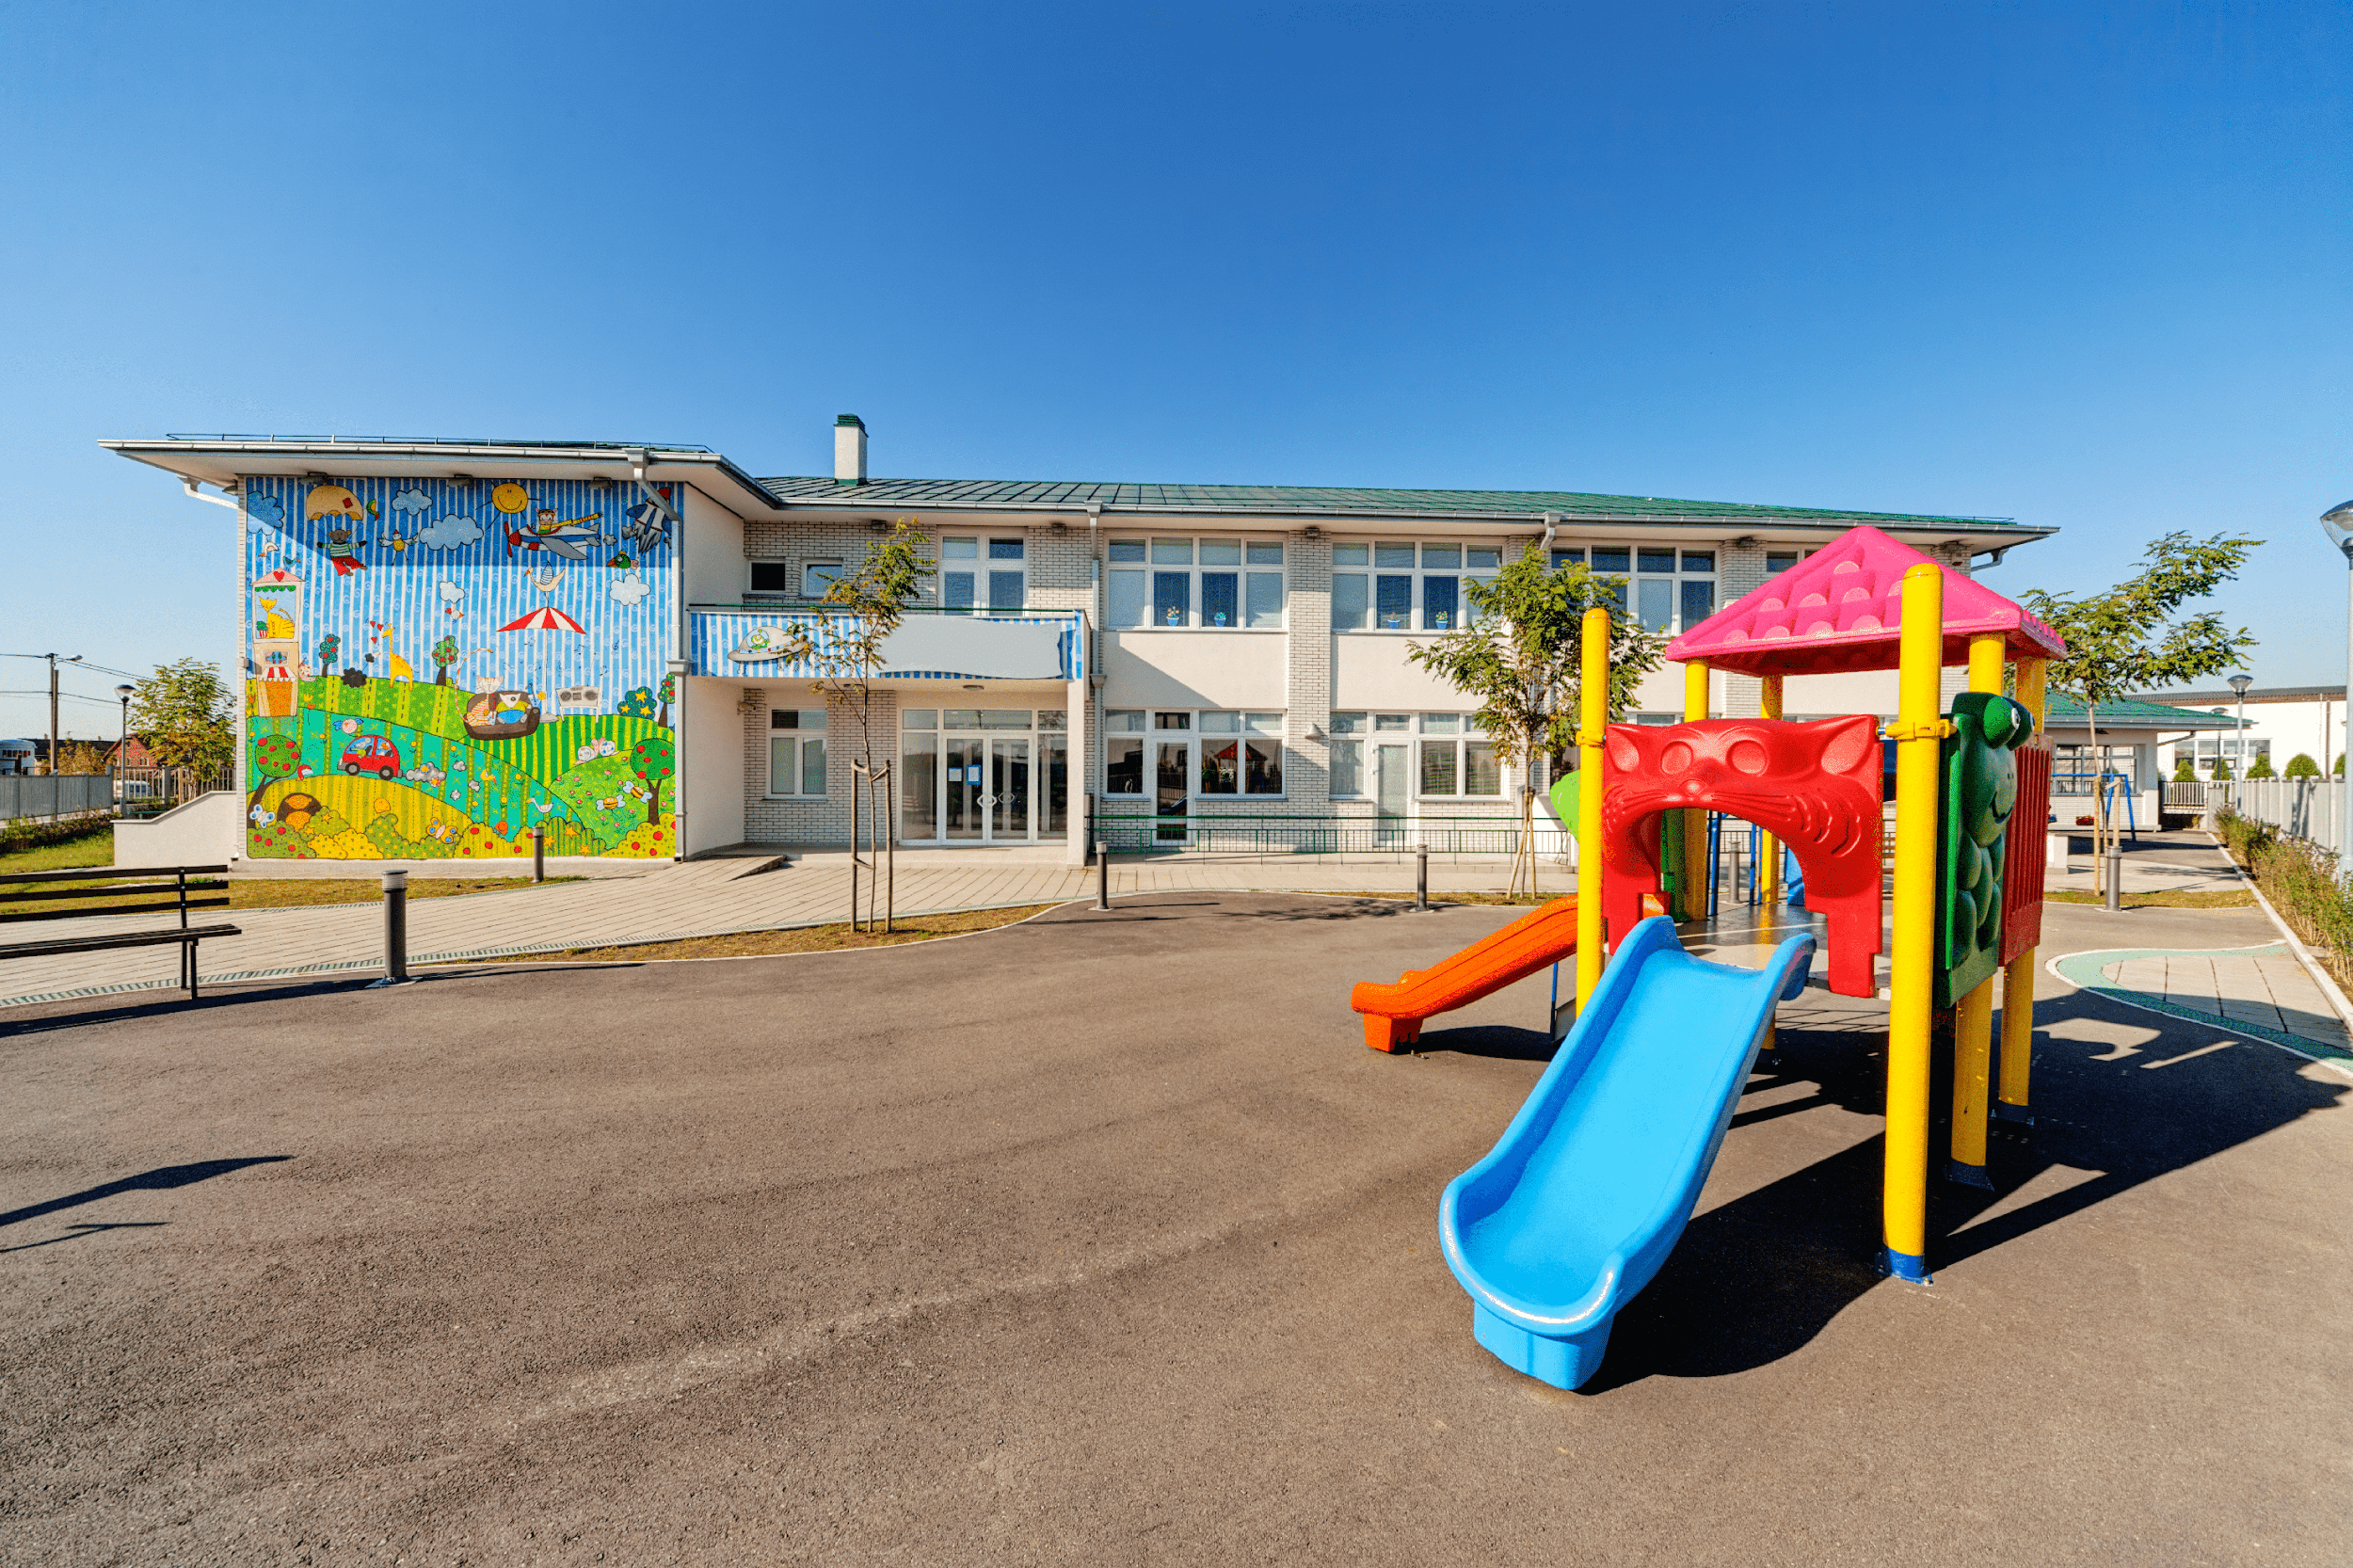
Playground
/ˈpleɪɡraʊnd/

Slide 23
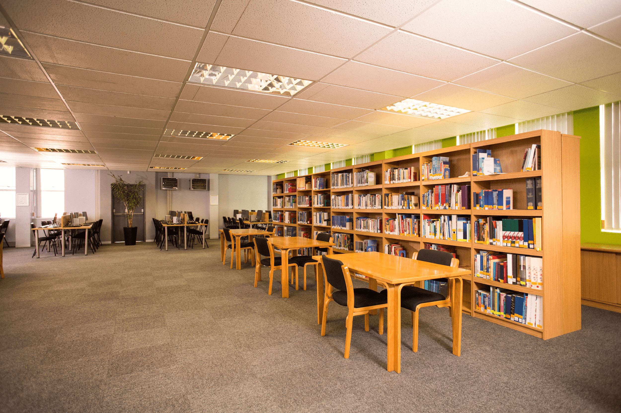
Library
/ˈlaɪbrəri/

Slide 24
Look and guess.

Slide 25
playground

Slide 26
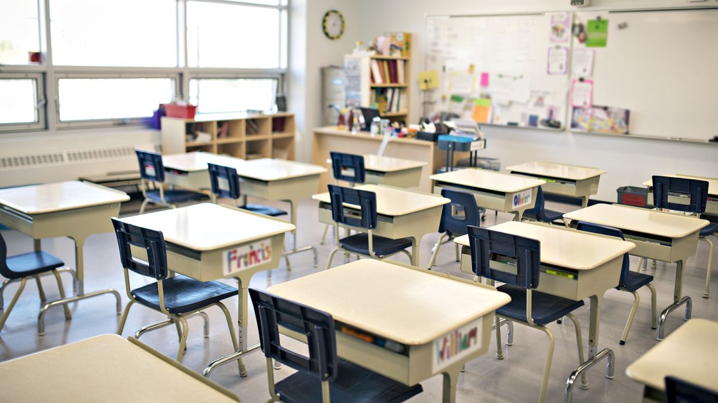
classroom

Slide 27
library

Slide 28
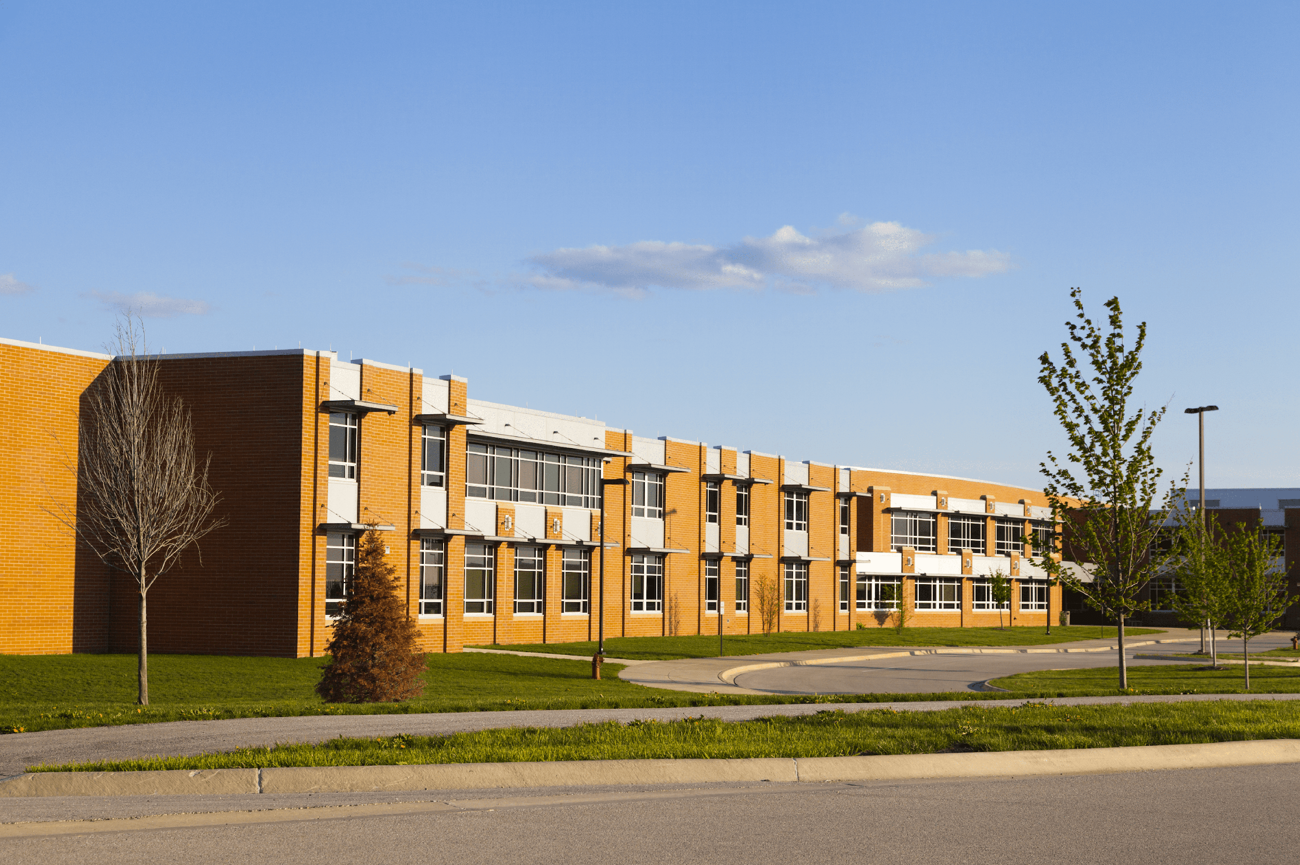
school

Slide 29


Is this our classroom?
No, it isn’t.
Yes, it is.

Slide 30
Is this our library?
Yes, it is.
No, it isn’t.

Slide 31
Is this our playground?
Yes, it is.
No, it isn’t.

Slide 32

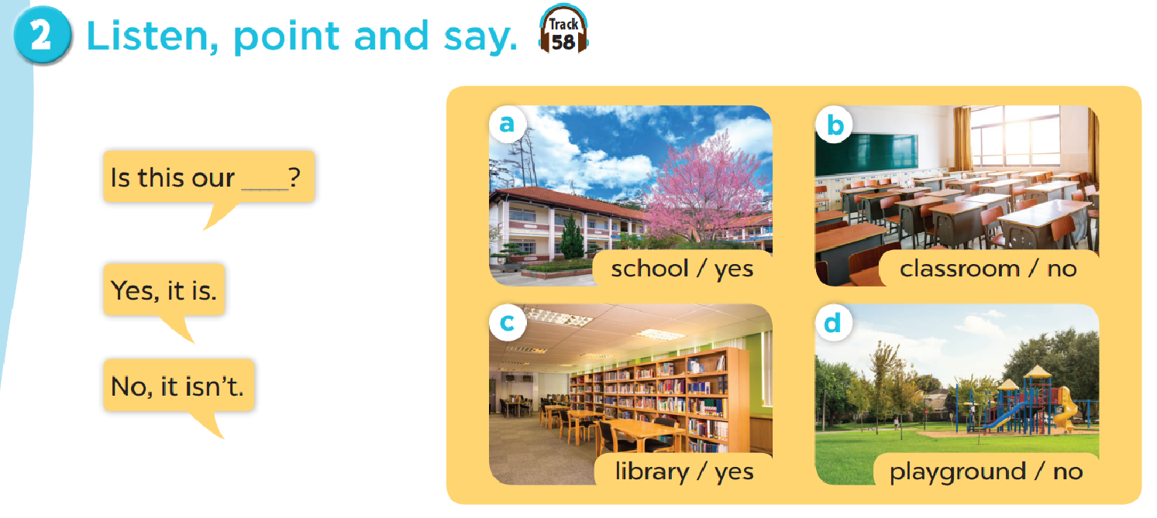
Work in pairs. Practise.

Slide 33

Let’s talk.

Slide 34
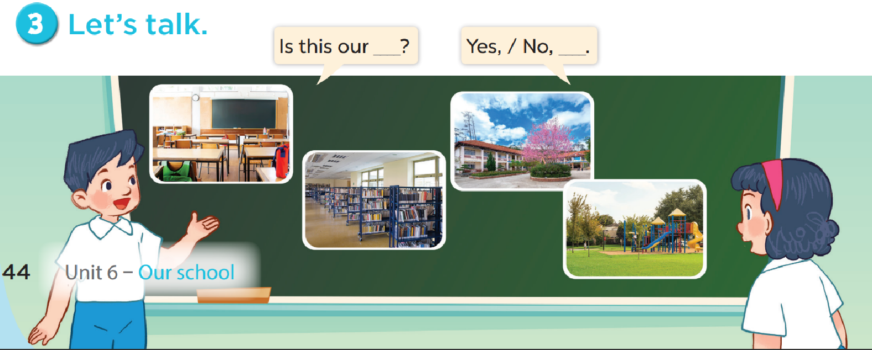

Slide 35

Fun corner

Slide 36
Let’s play a game!
3 points
10 points
No
Yes
classroom
library
4
bomb
playground
No
school
3
2
1
Yes
5
10 points
8
school
library
7
school
- 3 points
6
Yes
Yes
playground
1 point
No
Yes
4 points
Notes:
Gv chia 2 đội.
Hs chọn số, 1 bạn đặt câu hỏi, 1 bạn trả lời với từ cho sẵn và nhận điểm

