Slide 1






Welcome to
our class
Teacher Chi's Class

Slide 2
Unit 7: Numbers
Lesson 2.1: Vocabulary & Phonics
Page: 46

Slide 3

WARM UP

Slide 4

Two boys

Slide 5
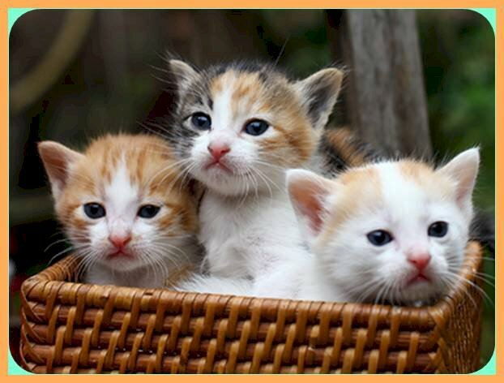
Three cats

Slide 6
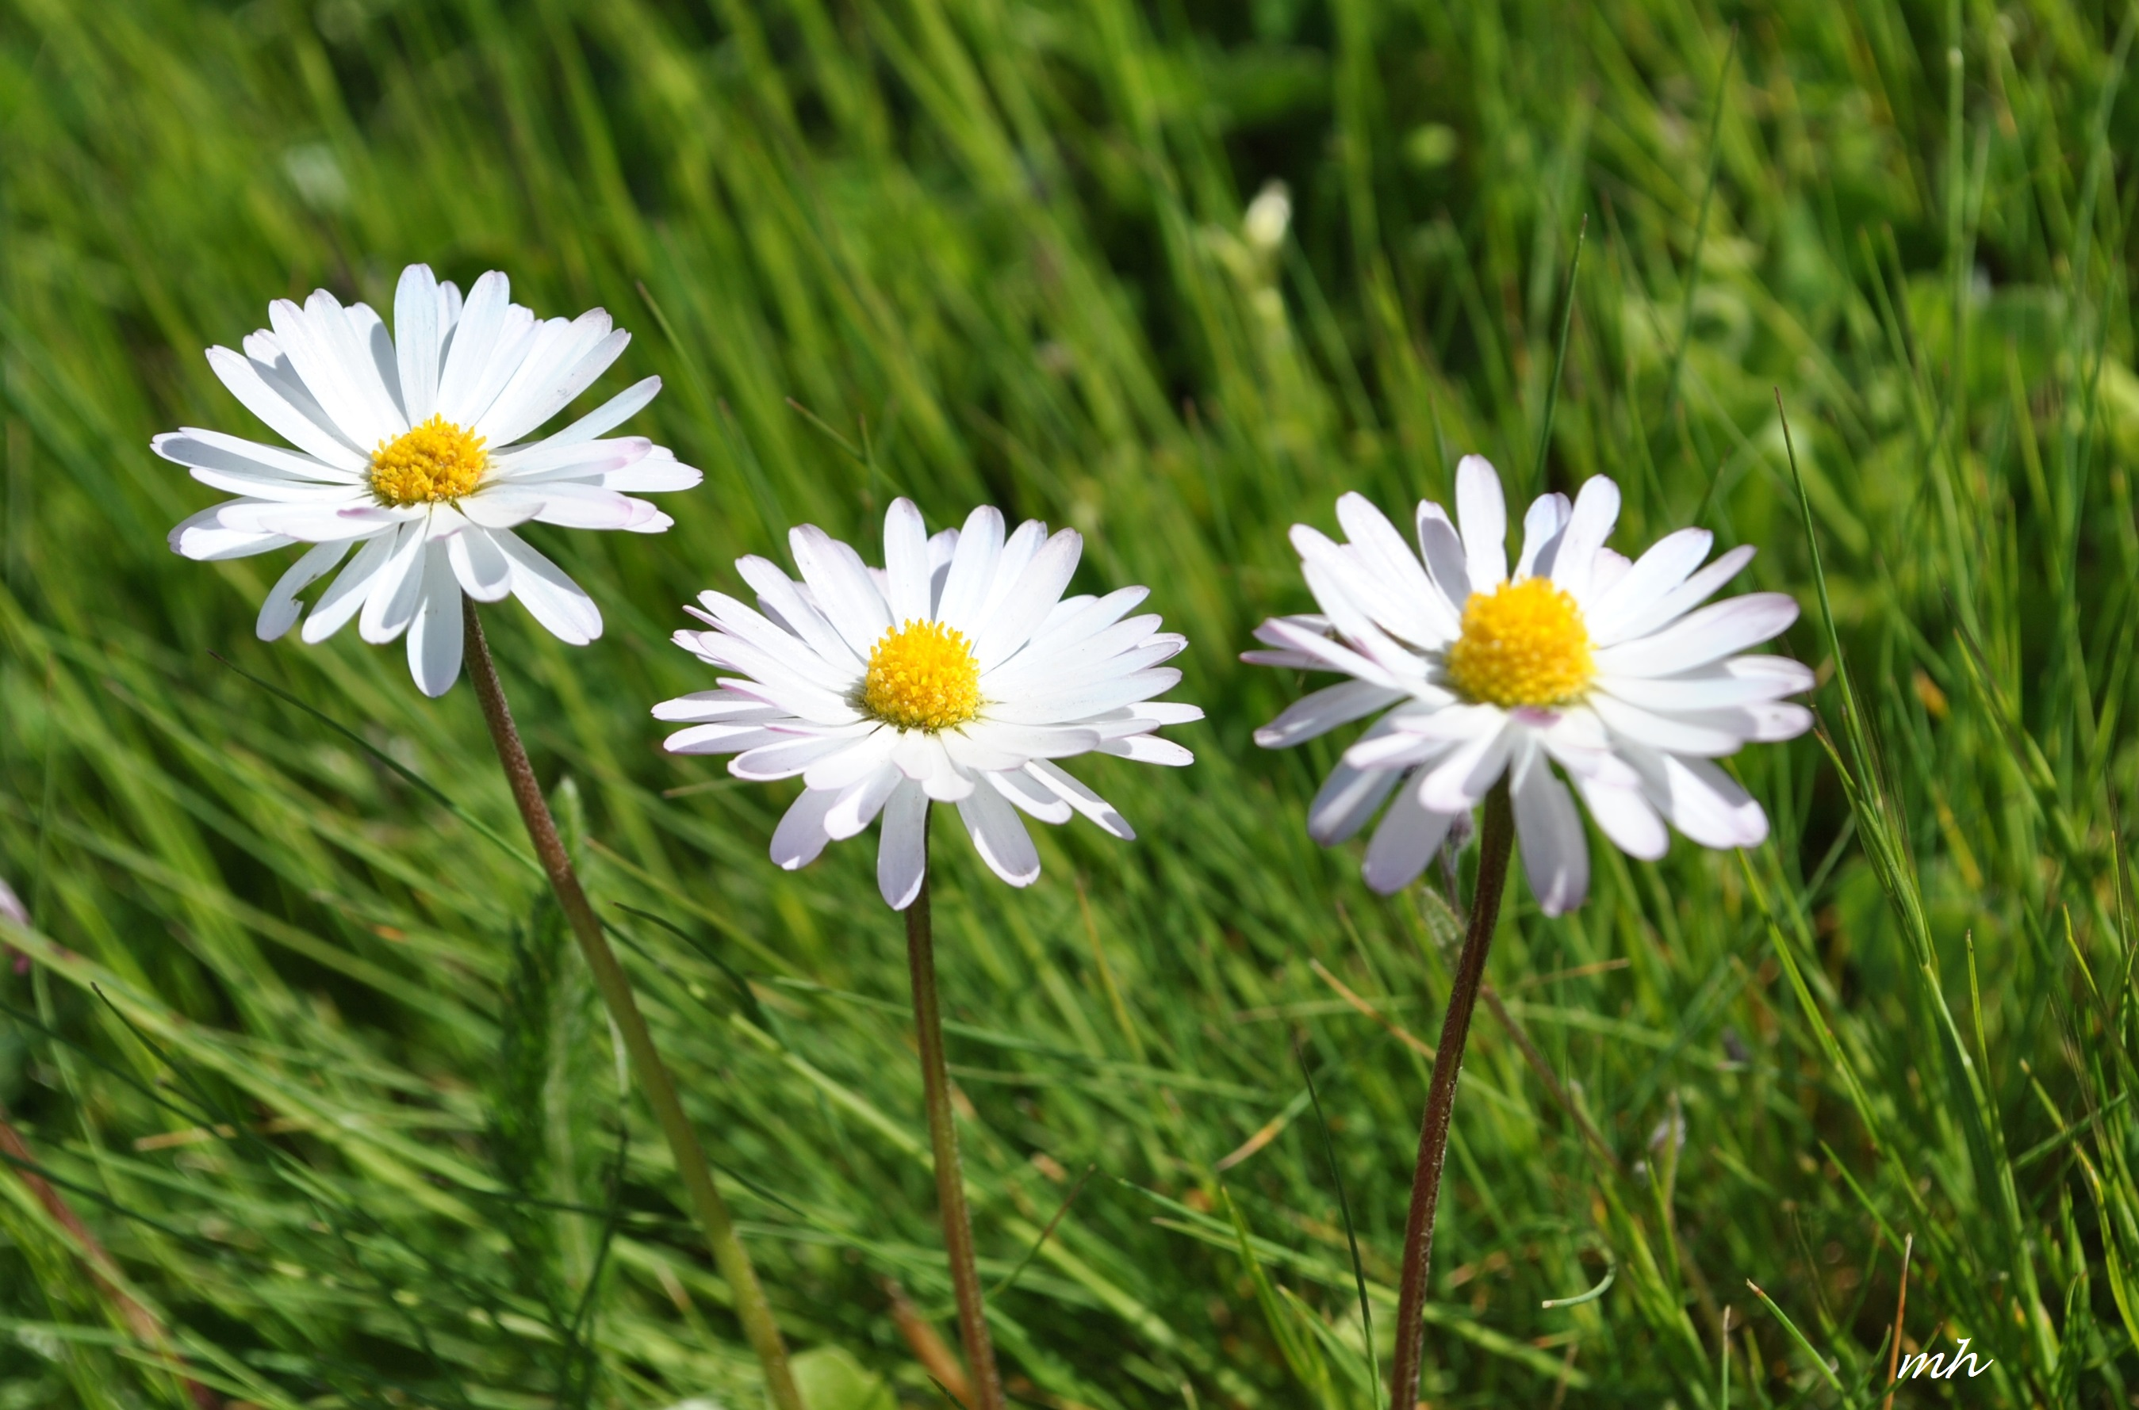
Three flowers

Slide 7

One pencil

Slide 8
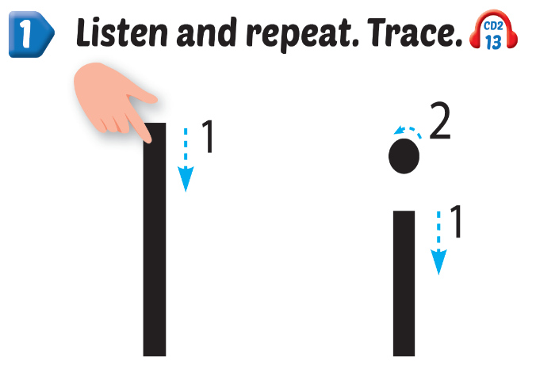
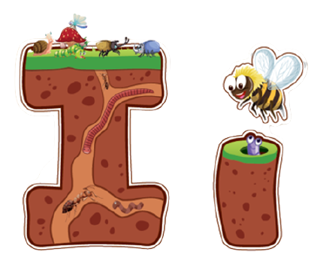
Click Alphabet to hear the sound
Notes:
Click vào hình A. 1. Listen and point. Repeat để cho cả audio full chạy

Slide 9


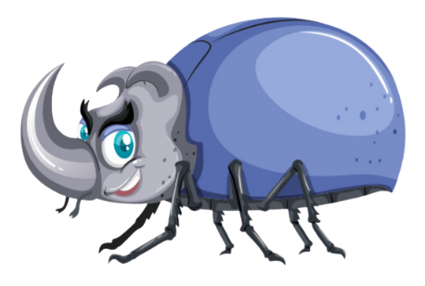


Notes:
Click vào hình A. 1. Listen and point. Repeat để cho cả audio full chạy

Slide 10
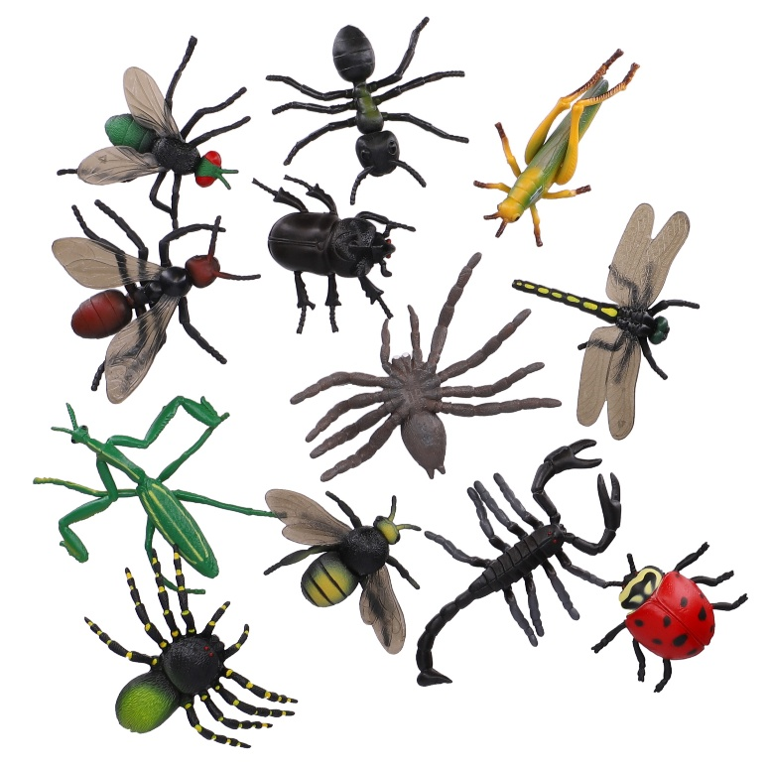



Slide 11

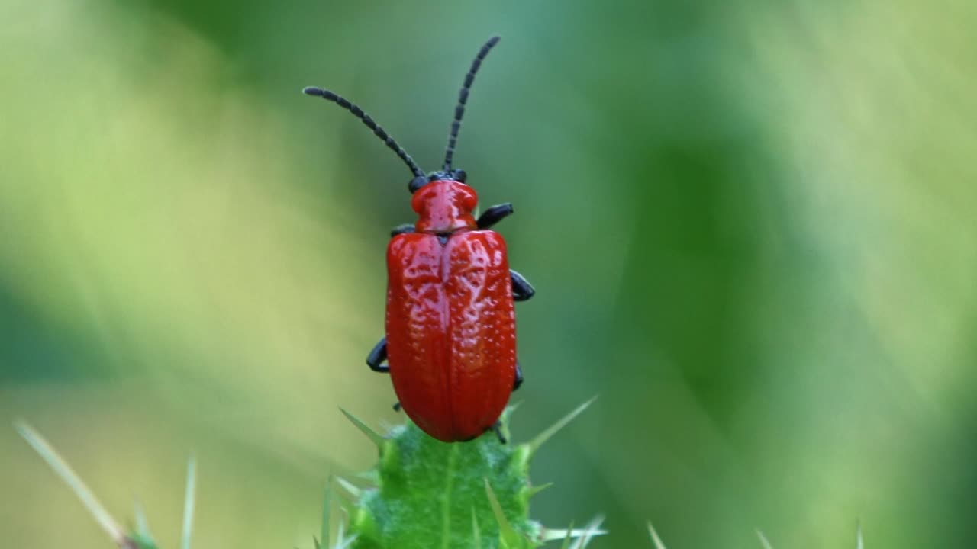
This is an insect

Slide 12

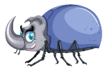


This is an ,
i, i, .
This is an ,
i, i, i.

Slide 13

Practice

Slide 14



Slide 15

It’s time to play …

Slide 16


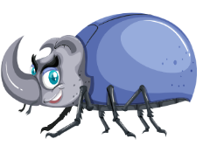
Listen and match

Slide 17
Fill the missing letters
i n
i n e c
k
s
t

Slide 18
Read and choose
ink

Slide 19
Read and choose
insect

Slide 20
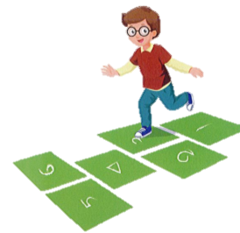

Choose the picture beginning with the sound “i”

Slide 21
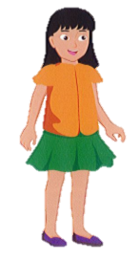
Choose the word beginning with the sound “i”

Slide 22

Further Practice

Slide 23

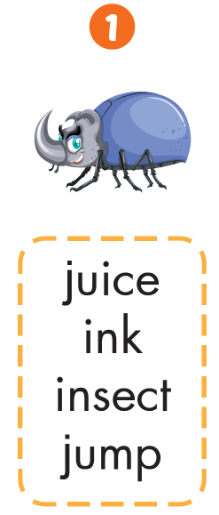



Slide 24

CONSOLIDATION

Slide 25
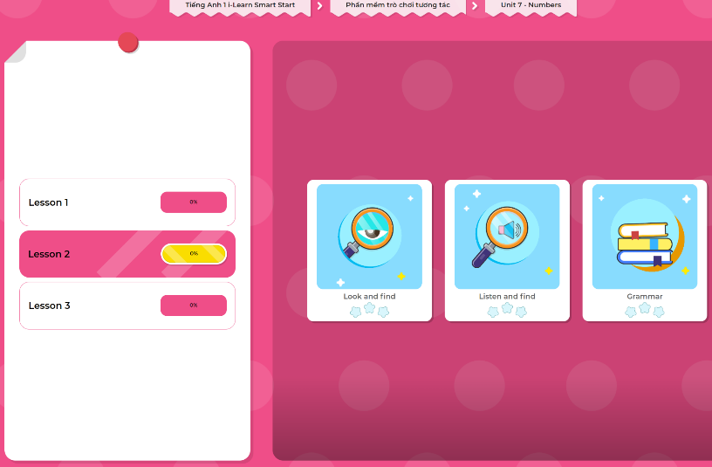
Extra Practice
DHA App
LET’S PLAY!
Click here to play the games

Slide 26

WRAP-UP

Slide 27
Today’s lesson
Phonics
/ɪ/
Vocabulary
insect, ink

