Slide 2





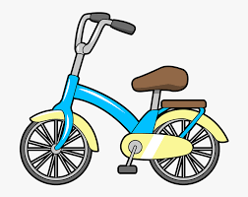

k
* Click to move pictures having the sound ‘’k’’ into the square.

Slide 3


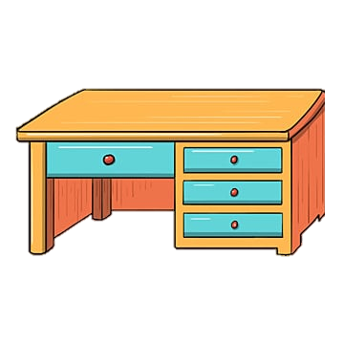


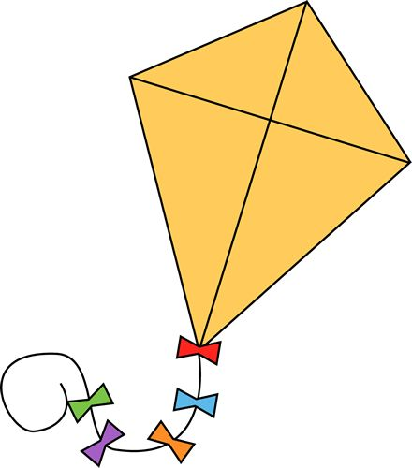
k
* Click to move pictures having the sound ‘’k’’ into the square.

Slide 4
Option 2
Game: Guess the word

Slide 5


