Slide 1





01
WARM-UP & REVIEW
Game: Word Search

Slide 2
02
Activity 3
Look, read and write. Then say aloud.

Slide 3


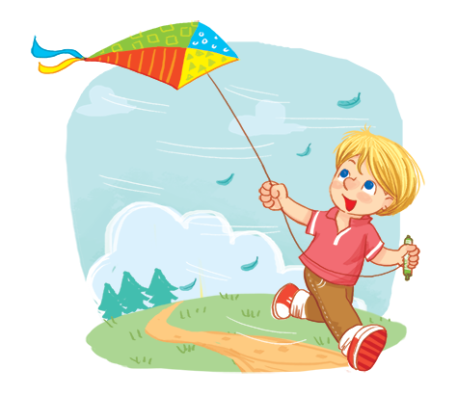
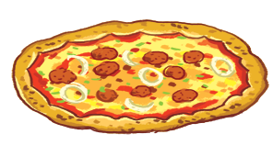


Look, read and write. Then say aloud.
2.
1.
A: Is he flying a _ _ _ _ ?
B: Yes, he is.
The _ _ _ _ _is yummy.
3.
A: Is she riding a _ _ _ _?
B: Yes, she is.
4.
The _ _ _ _ _ is yummy.

Slide 4

03
Activity 4
Let’s play.

Slide 5
04
Fun corner & Wrap-up
Game: What’s the picture?

