Slide 1

FUN TIME 1
Period 1

Slide 2

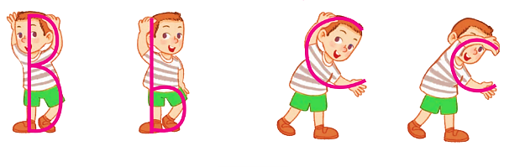
Simon says

Slide 3
Simon says

Slide 4


04
Fun corner and Wrap-up

Slide 5


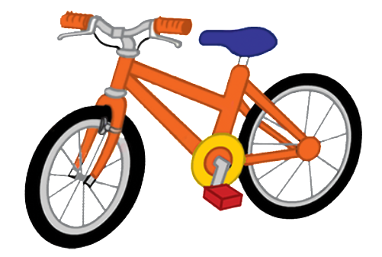





c
b
cup
Bill
bike
B
b
book
c
cake
c
cat
c
car
b
ball

