Slide 1

Table of contents
01
Warm-up and Review
02
Activity 1. Read and tick. Then colour and say.
03
Activity 2. Let’s play
04
Fun corner and Wrap-up

Slide 2


01
Warm-up and Review

Slide 3


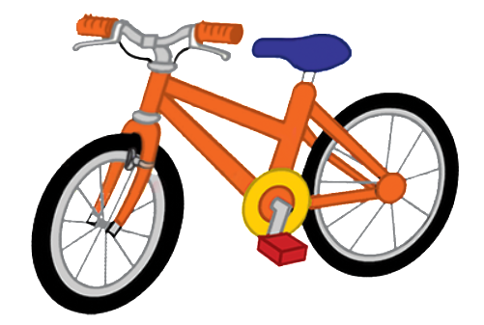

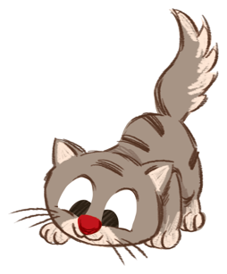

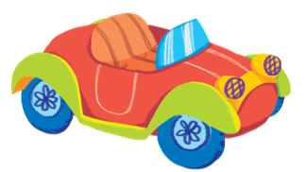

Review
bike
ball
book
cat
cake
car
cup

