Slide 2

Review 1
Period 1

Slide 3










Class Rules

Slide 4



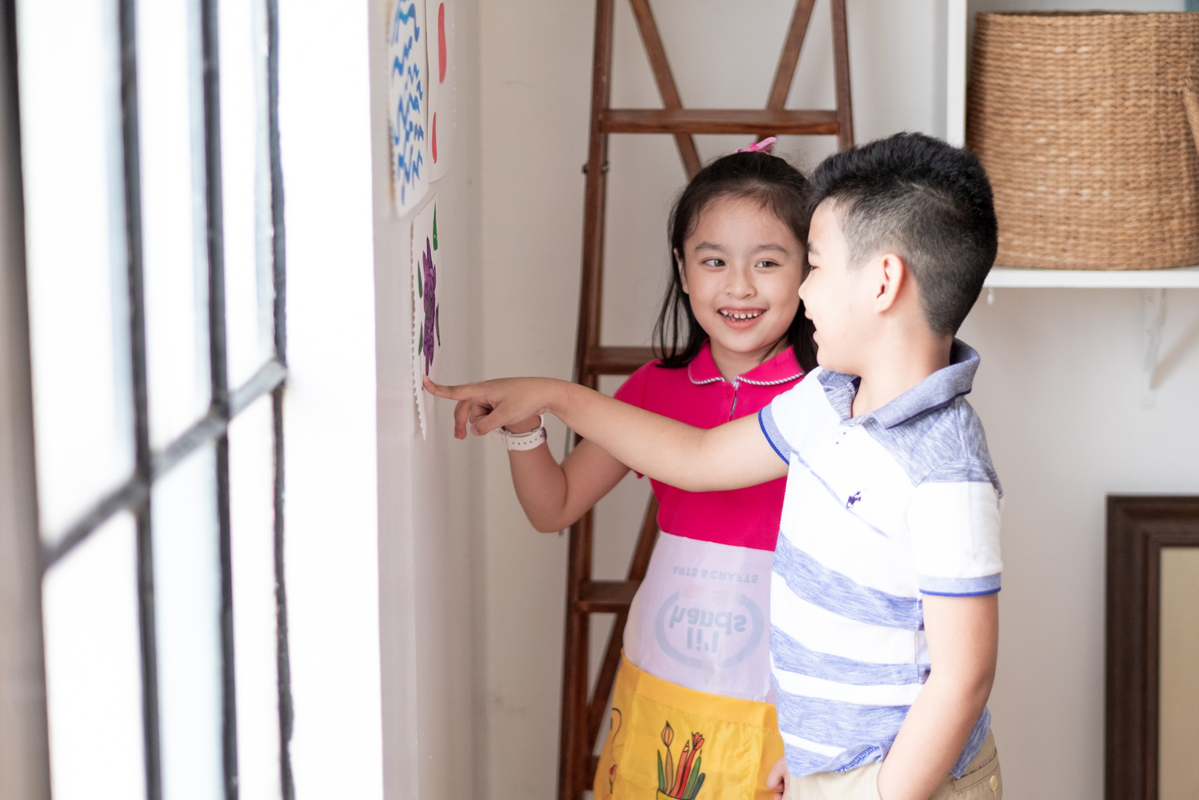


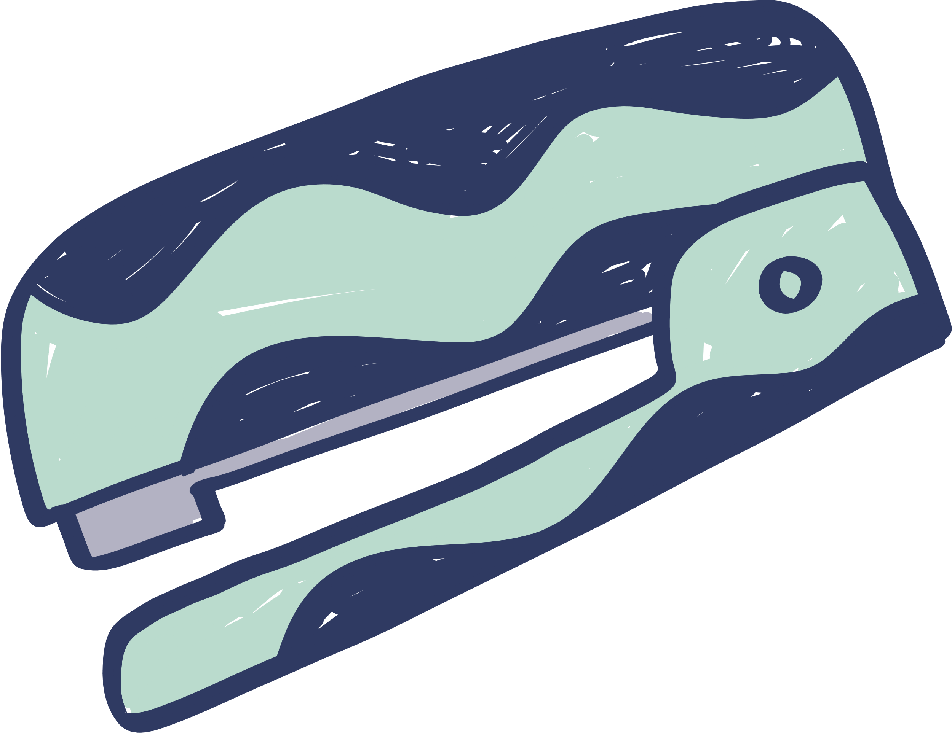
Rule 1
Listen to
your friend
talking in front.

Slide 5


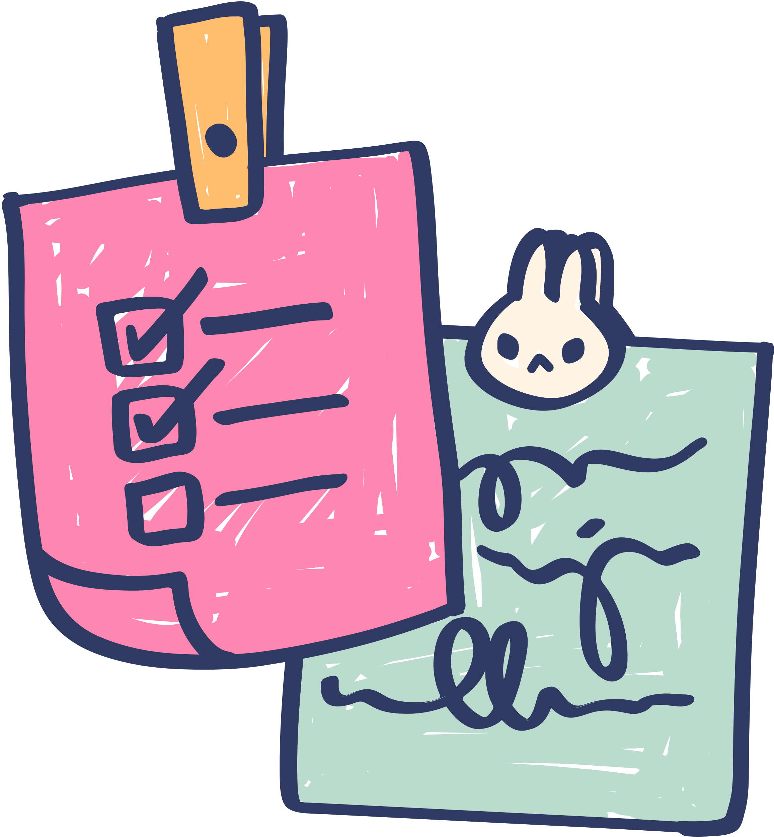





Rule 2
Raise your hand
if you have a question.

Slide 6




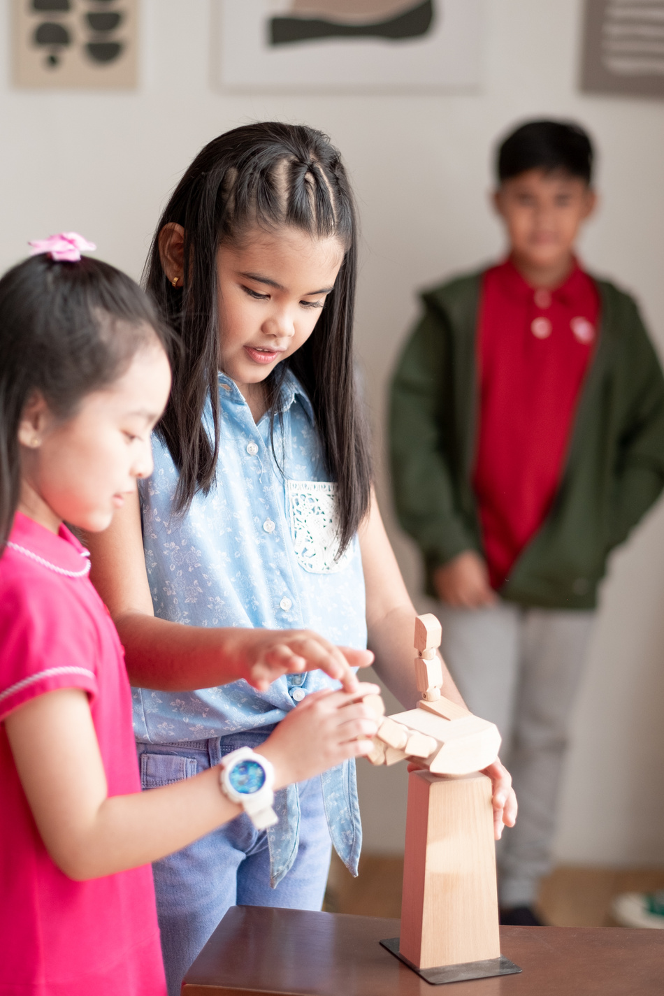


Rule 3
Wait for
your turn.

