Slide 2

Review 1
Period 2

Slide 3


Our class
To

Slide 4










Class Rules

Slide 5



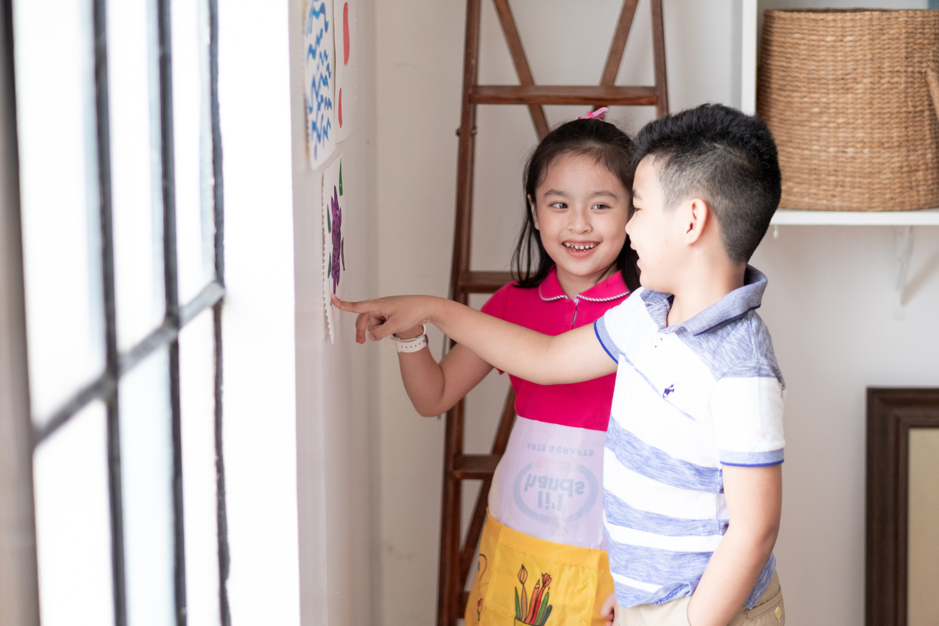



Rule 1
Listen to
your friend
talking in front.

Slide 6


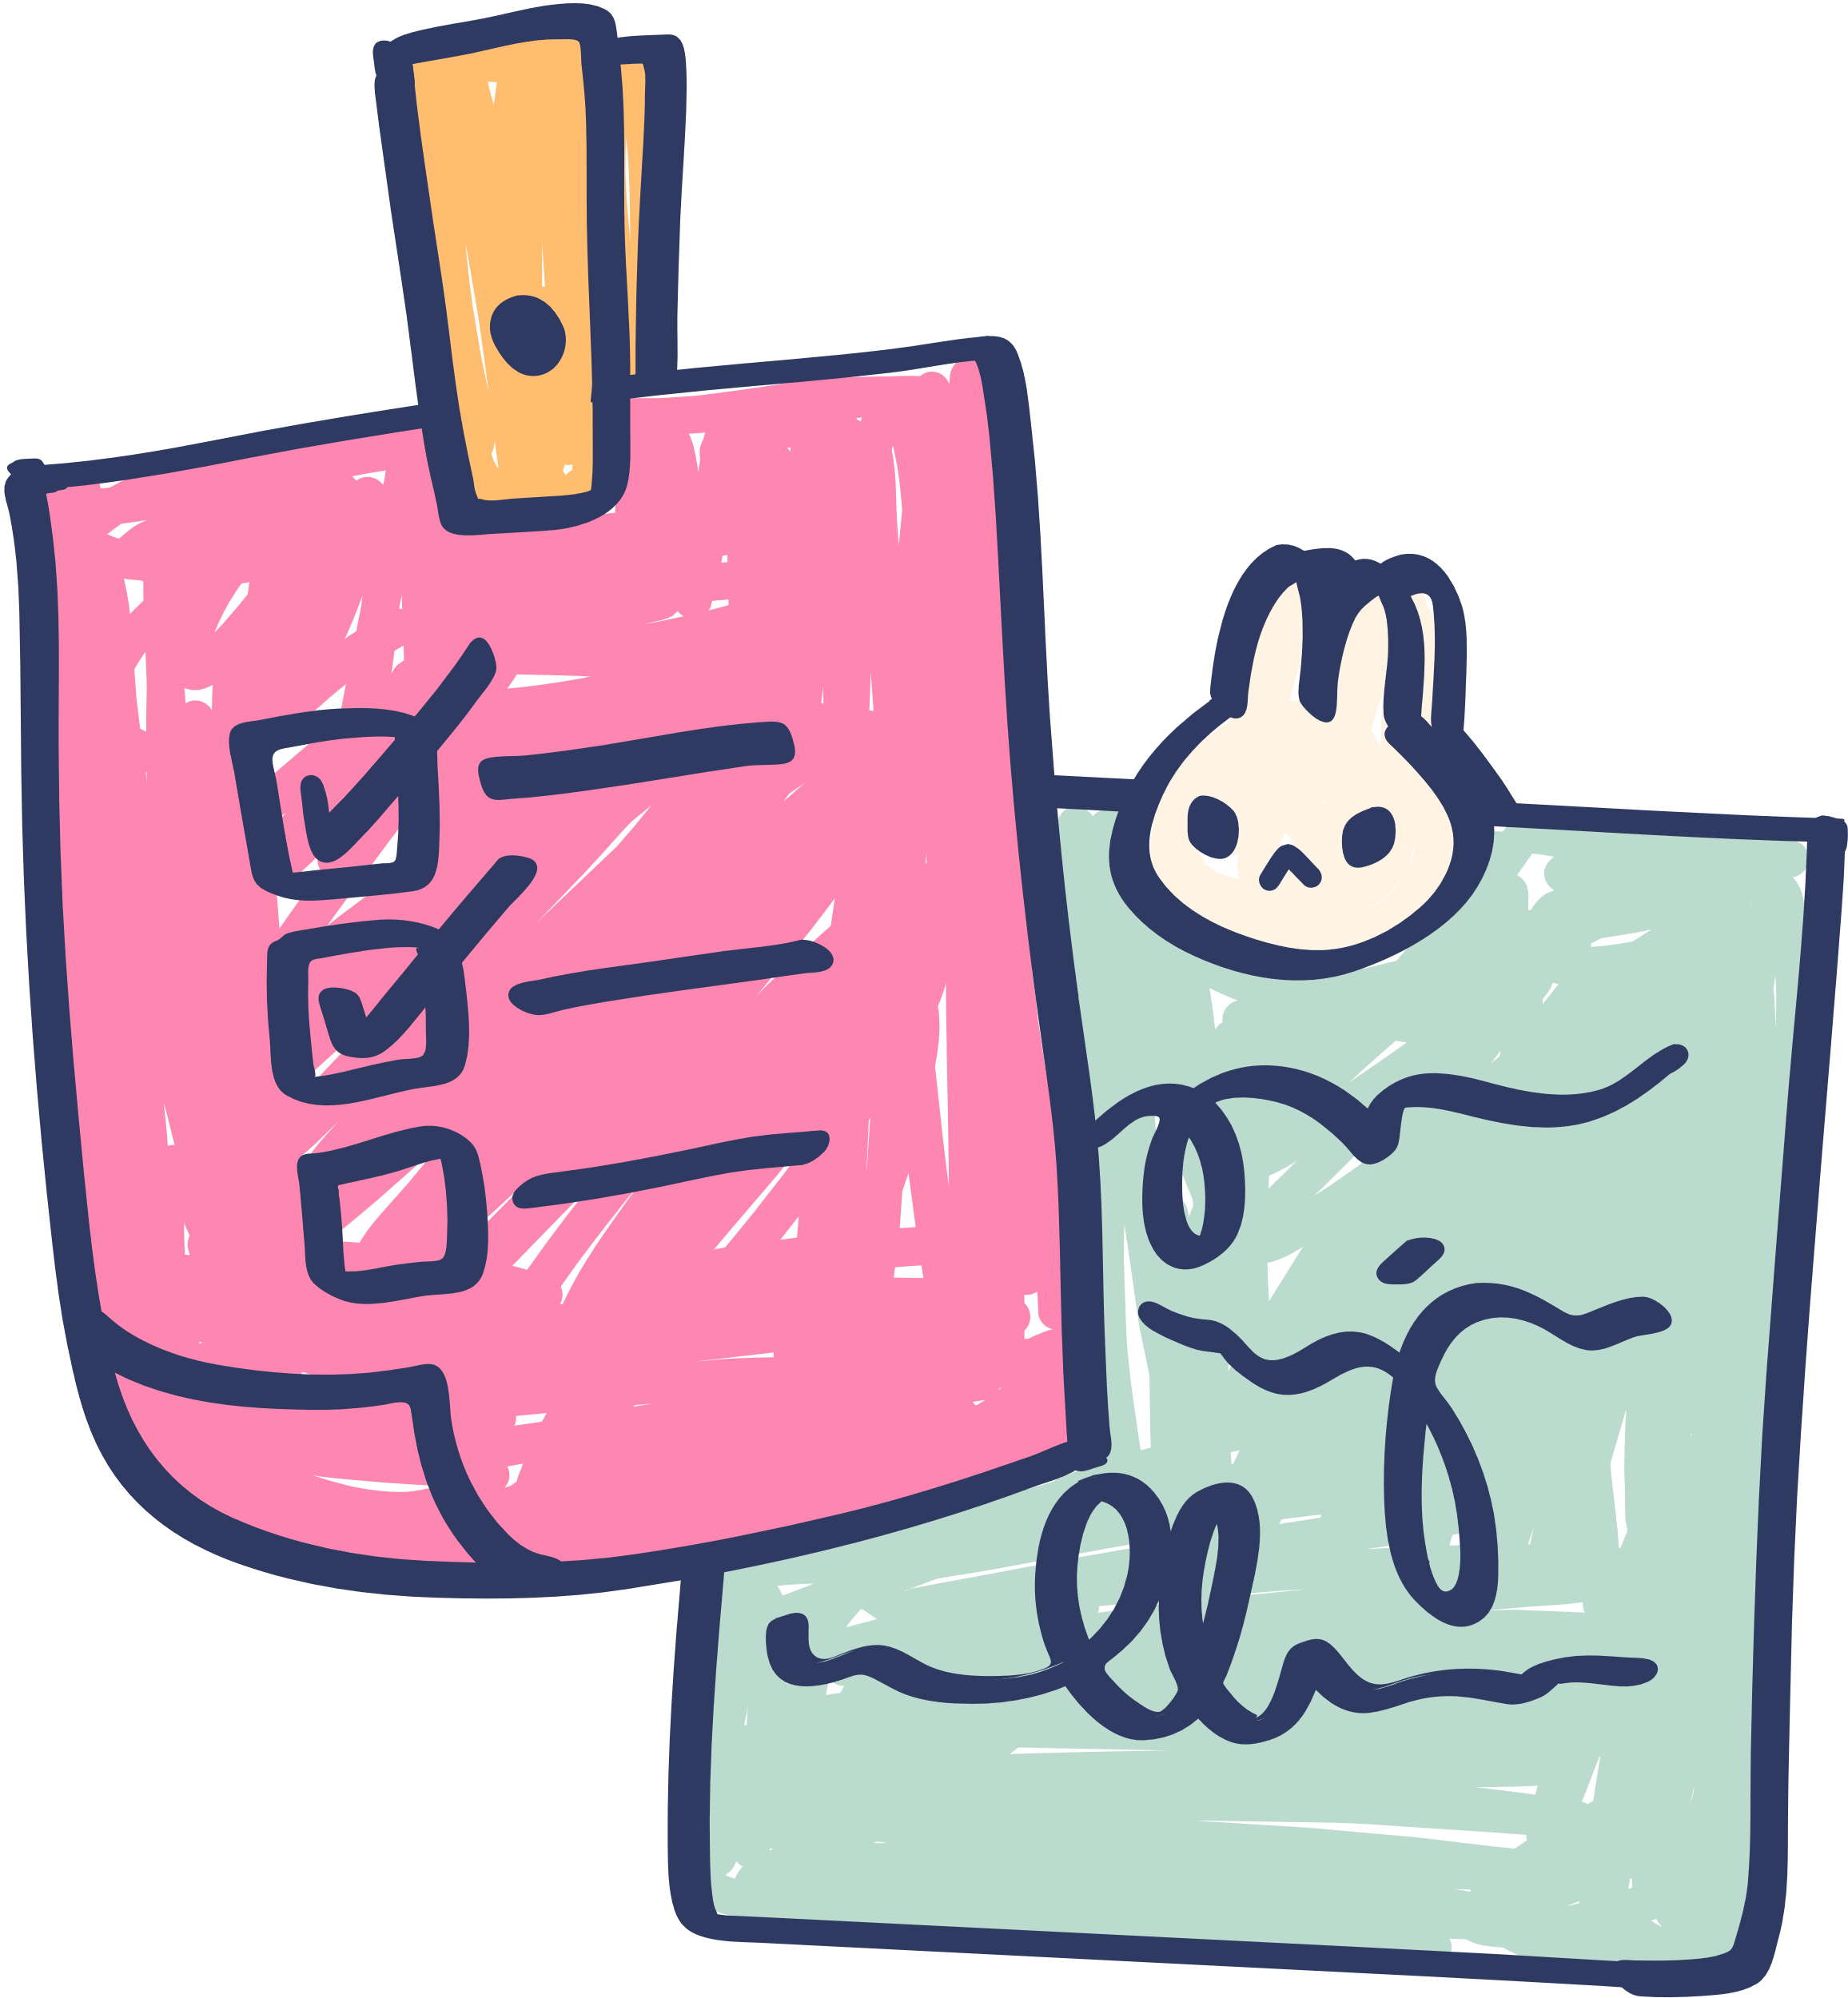





Rule 2
Raise your hand
if you have a question.

Slide 7




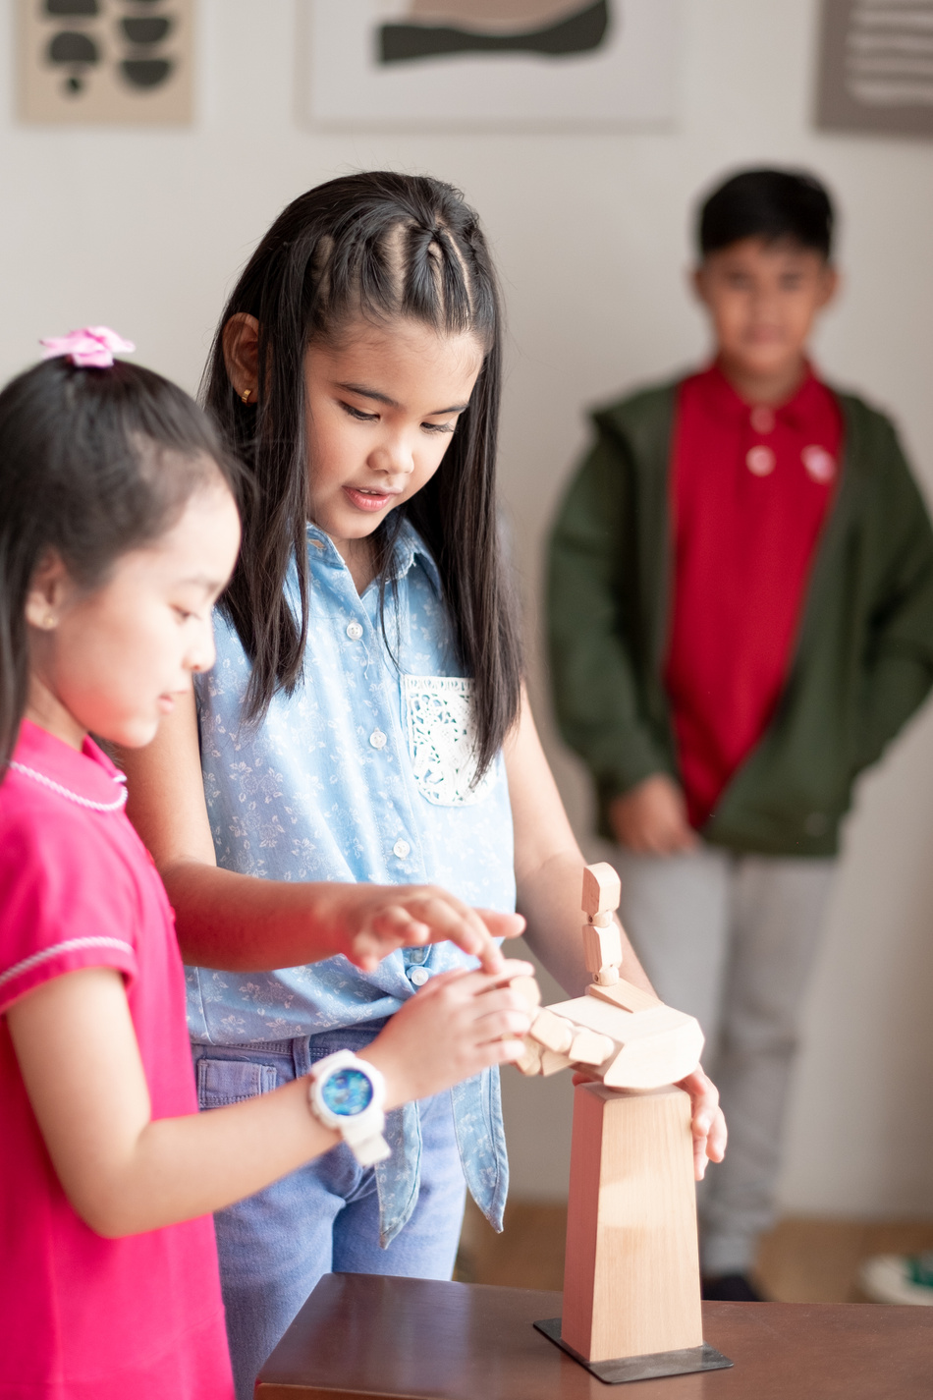


Rule 3
Wait for
your turn.

Slide 8

Review 1
Warm-up/ Review
Activity 1: Listen and tick.
Activity 2: Listen and circle.
Activity 3: Write and say.
Fun corner & wrap-up
TABLE OF CONTENTS

Slide 9
01
WARM-UP & REVIEW
‘’Network’’
GAME

Slide 10


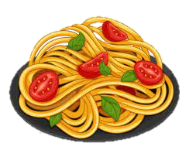
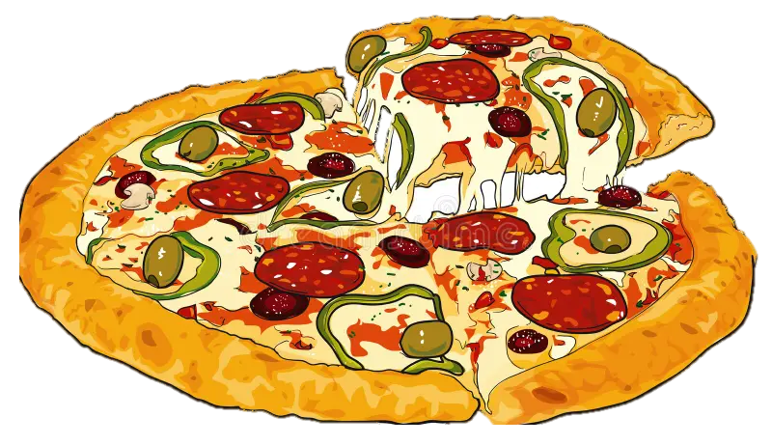



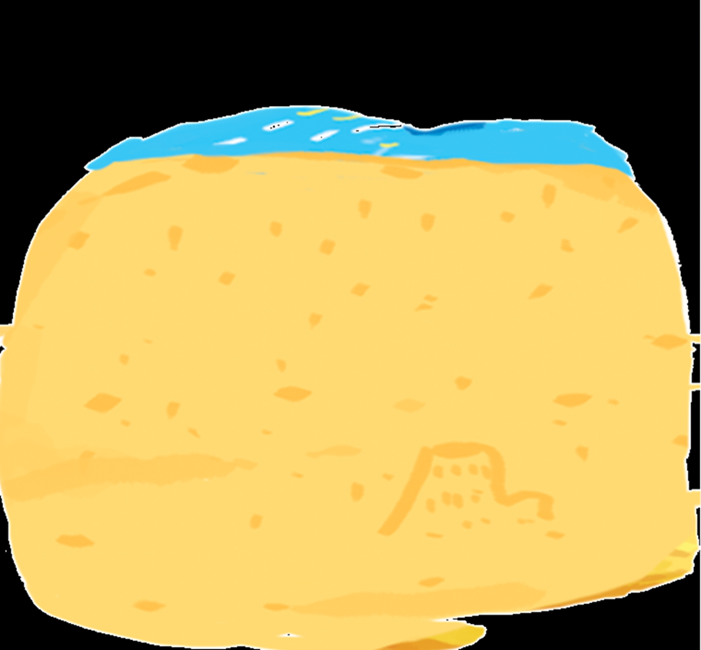



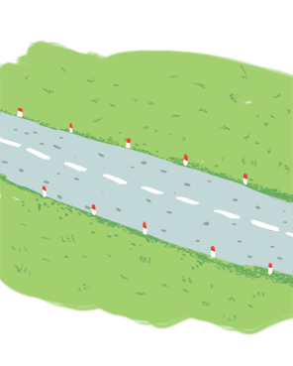
GAME
‘Network’’

