Slide 2

Review 1
Period 3

Slide 3




Slide 4










Class Rules

Slide 5



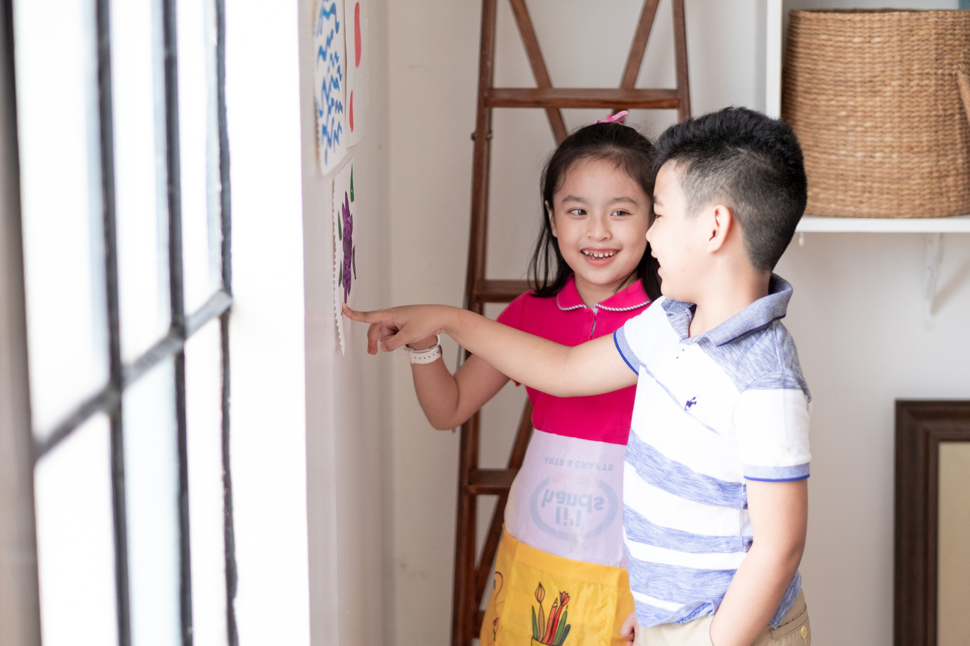



Rule 1
Listen to
your friend
talking in front.

Slide 6


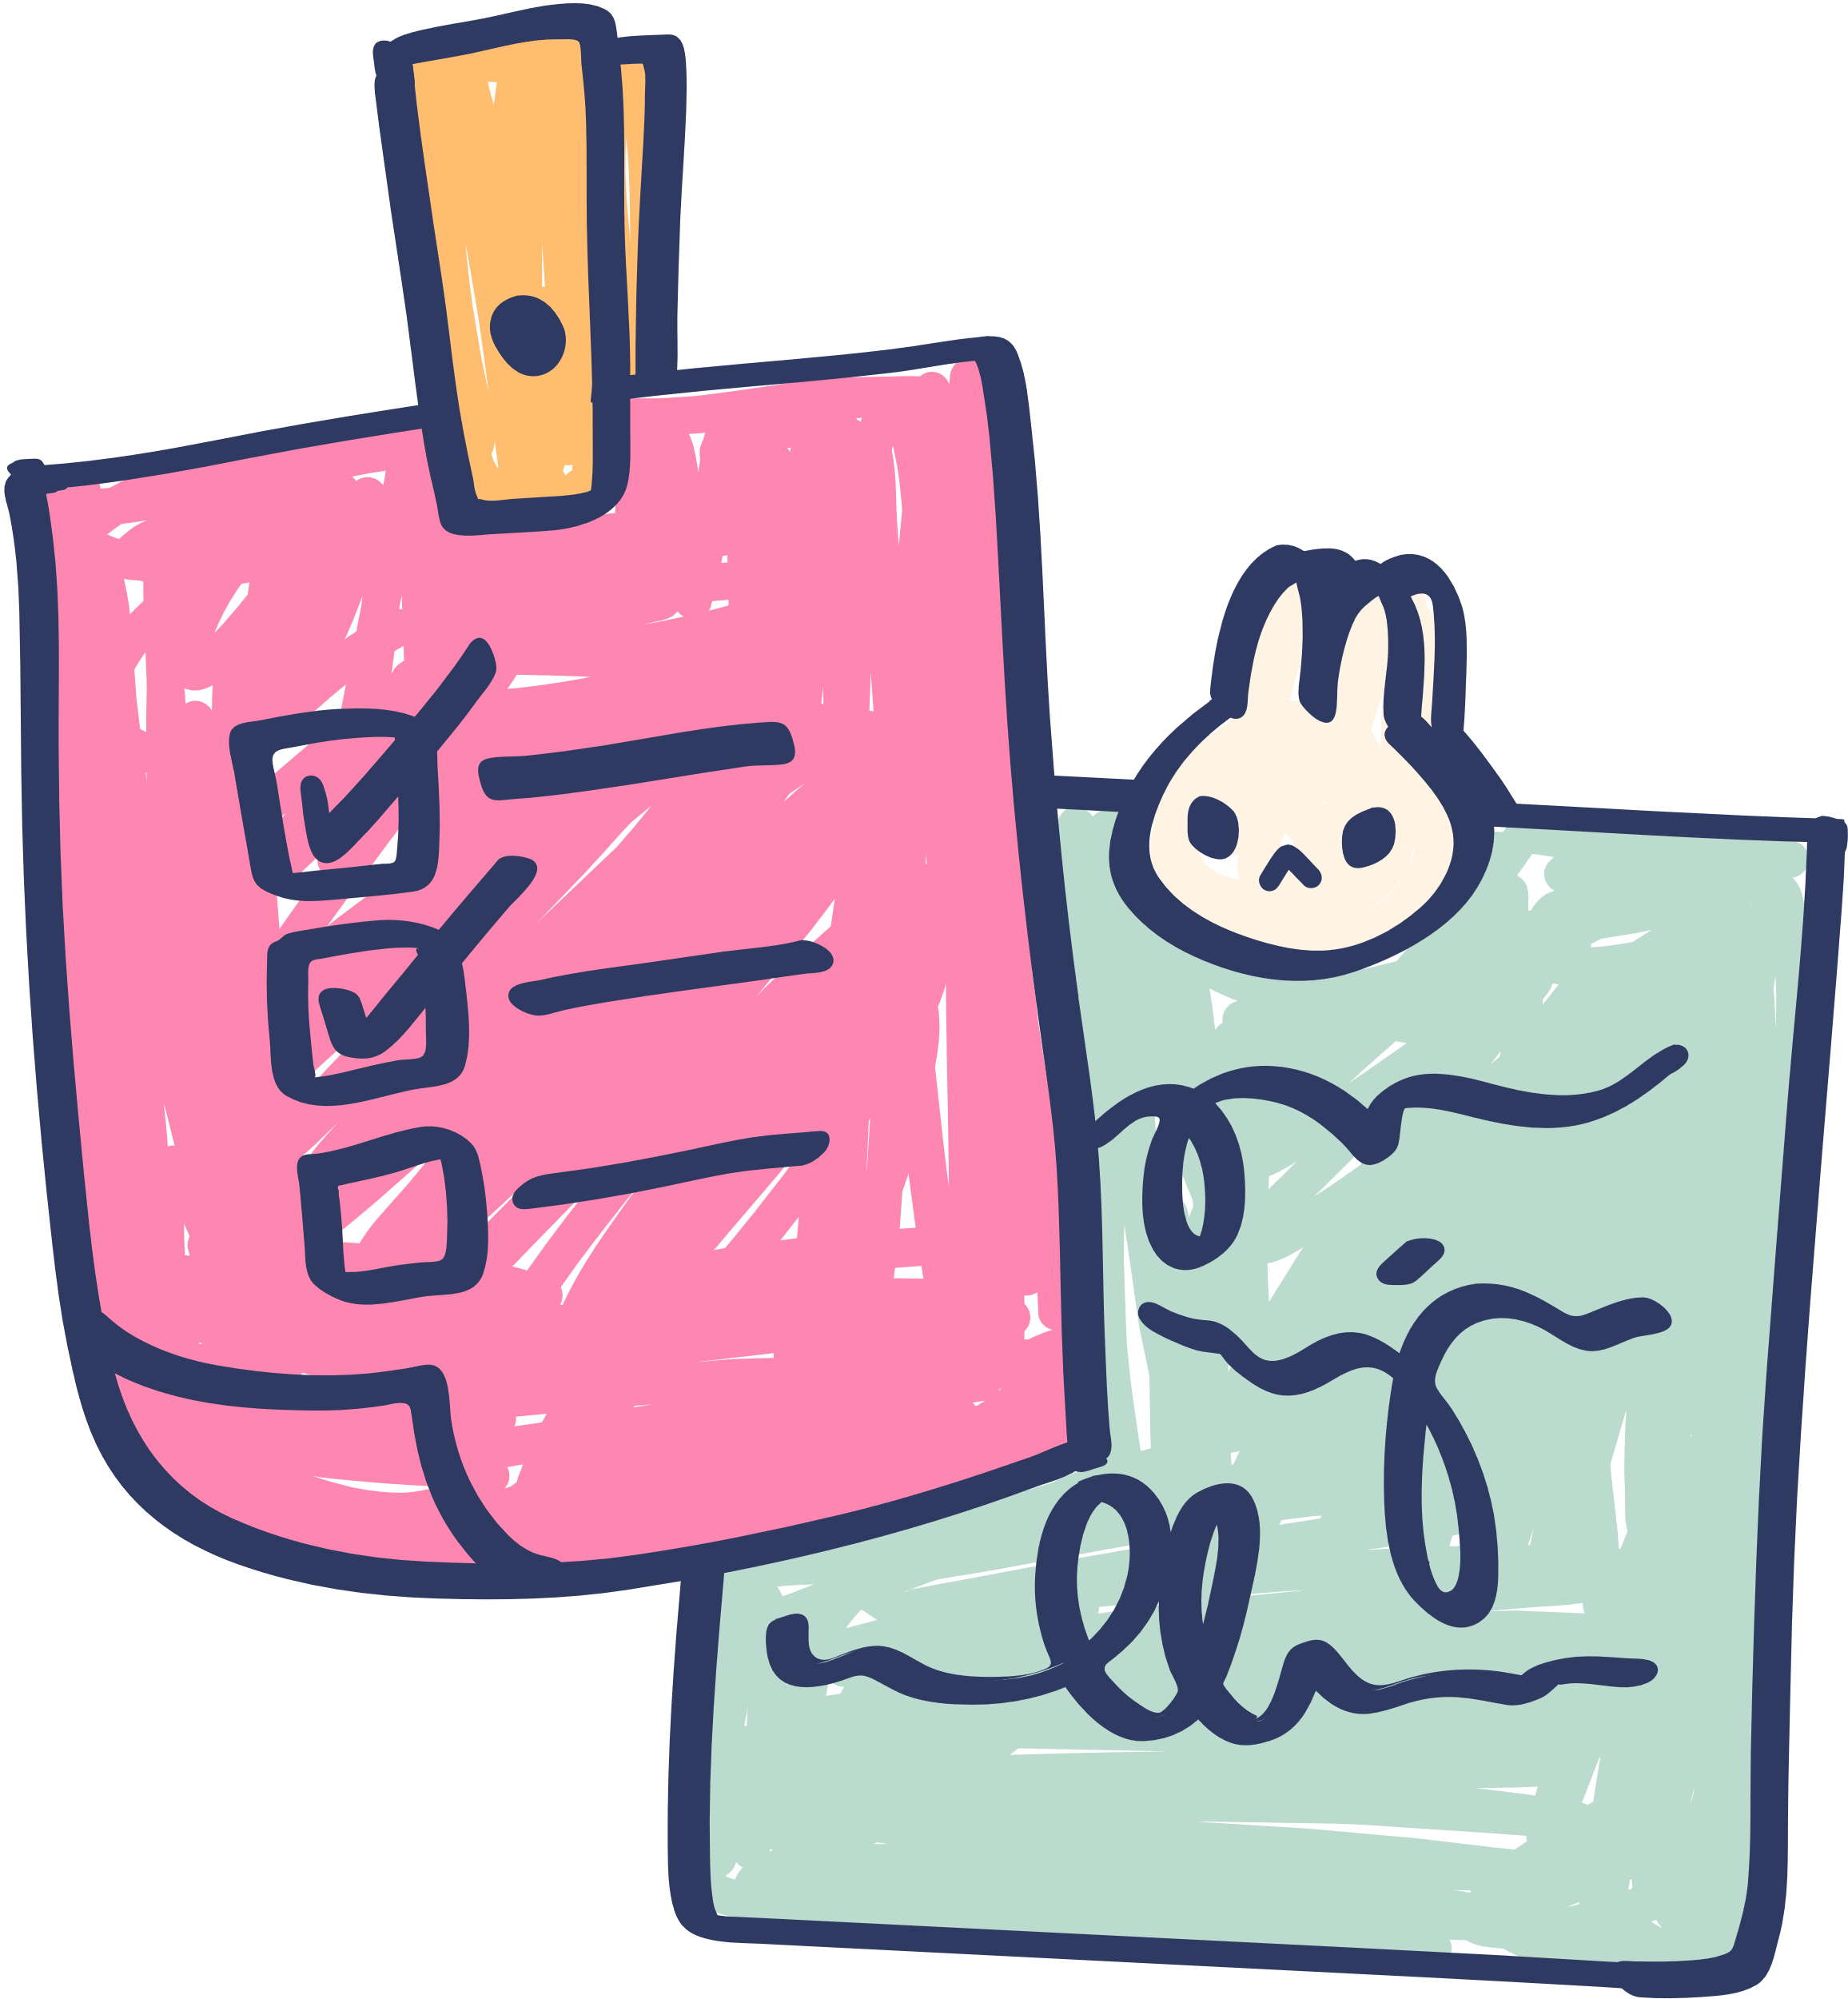





Rule 2
Raise your hand
if you have a question.

Slide 7




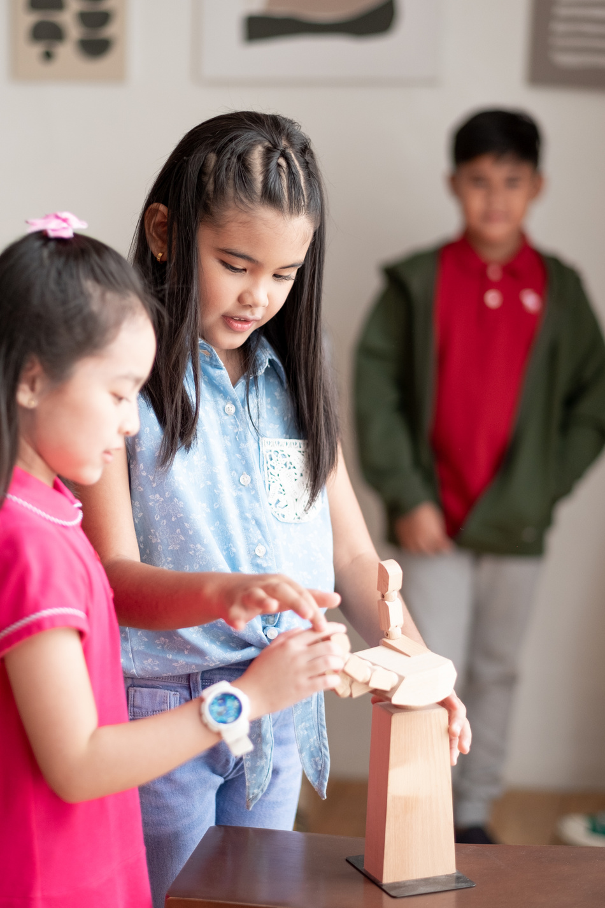


Rule 3
Wait for
your turn.

Slide 8







Review 1
1. Warm-up/ Review
2. Activity 4: Read and tick.
3. Activity 5: Guess, read and circle. Then say.
4. Activity 6: Write the words.

Slide 9
Review 1
01
Warm-up/ Review

