Slide 2

REVIEW 1
Period 2

Slide 3

Table of contents
01
Warm-up and Review
02
Activity 1. Listen and tick.
03
Activity 2. Listen and circle.
04
Activity 3. Listen and tick or cross.
05
Fun corner and Wrap-up

Slide 4


01
Warm-up and Review

Slide 5

Let’s play.

Slide 6


I’m Bill.
I have a bag.

Slide 7


ball

Slide 8
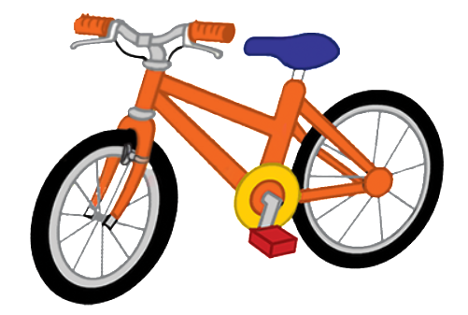
bike

Slide 9

book

Slide 10

car

Slide 11

cat

Slide 12

cup

Slide 13

cake

Slide 14

dog

Slide 15

duck

Slide 16

desk

Slide 17

door

Slide 18

hat

Slide 19

apple

Slide 20

can

Slide 21


Very Good!

Slide 22
02
Activity 1. Listen and tick.

Slide 23

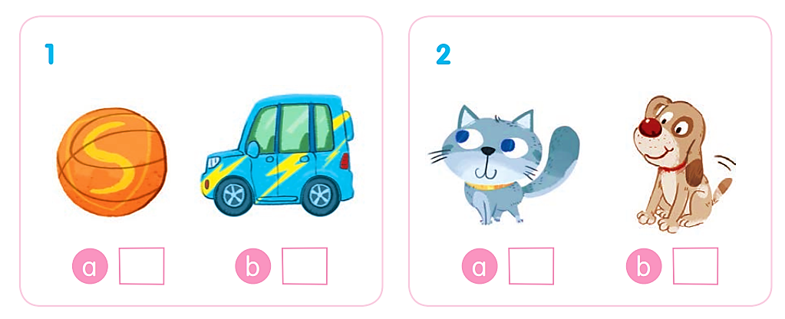
Listen and tick.

Slide 24
Listen and tick.
✓

Slide 25
Listen and tick.
✓

Slide 26
Listen and tick.
✓
✓

Slide 27
03
Activity 2. Listen and circle.

Slide 28
Listen and circle.
1 b d 2 a c
3 b c 4 c d

Slide 29
Listen and circle.
1 b d

Slide 30
Listen and circle.
2 a c

Slide 31
Listen and circle.
3 b c

Slide 32
Listen and circle.
4 c d

Slide 33
Listen and circle.
1 b d 2 a c
3 b c 4 c d

Slide 34
04
Activity 3.
Listen and tick or cross.

Slide 35
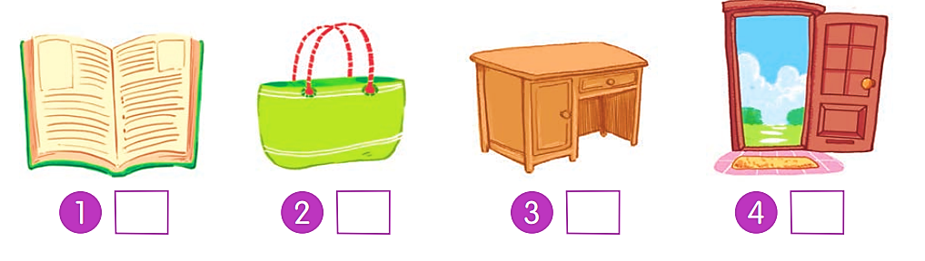
Listen and tick or cross.

Slide 36
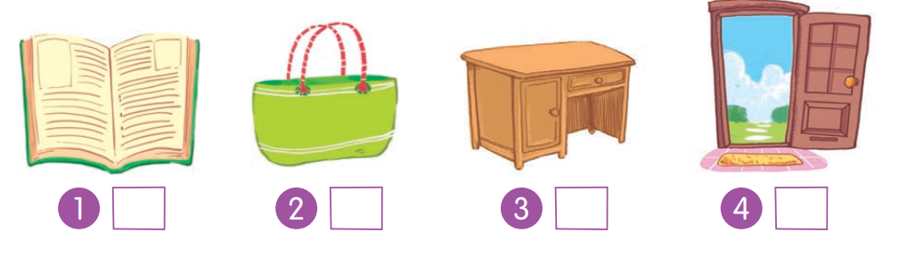
Listen and tick or cross.
✗

Slide 37
Listen and tick or cross.
✓

Slide 38
Listen and tick or cross.
✓

Slide 39
Listen and tick or cross.
✗

Slide 40
Listen and tick or cross.
✗
✓
✓
✗

Slide 41
05
Fun corner and Wrap-up

Slide 42
c
a
b
d

Slide 43
Website: hoclieu.vn
Fanpage: https://www.facebook.com/tienganhglobalsuccess.vn/

