Slide 2

REVIEW 1
Period 3

Slide 3

Table of contents
01
02
Warm-up and Review
Activity 4.
Read and tick.
03
Activity 5.
Colour the apple, the ball, the cat and the dog. Then point and say.
04
Fun corner and Wrap-up

Slide 4


01
Warm-up and Review

Slide 5

Hand Game

Slide 6


1
2
a
5
c
3
4
b
d
Notes:
Nháy vào chữ cái để đến trang có hình ảnh tương ứng.

Slide 7


apple

Slide 8


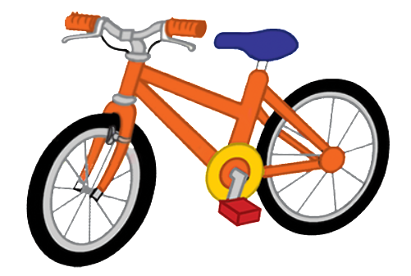
ball
bike
book

Slide 9





car
cat
cup
cake
can

Slide 10




dog
duck
desk
door

Slide 11
02
Activity 4. Read and tick.

Slide 12

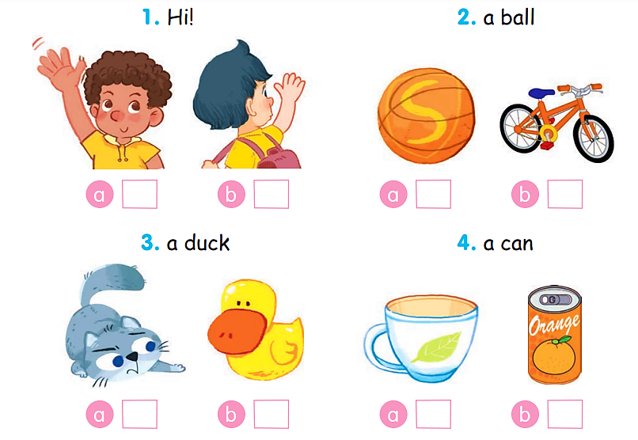
Read and tick.

Slide 13
Read and tick.
1. Hi!
✓

Slide 14
Read and tick.
2. a ball
✓

Slide 15
Read and tick.
3. a duck
✓

Slide 16
Read and tick.
4. a can
✓

Slide 17
Read and tick.
✓
✓
✓
✓

Slide 18
03
Activity 5. Colour the apple,
the ball, the cat and the dog.
Then point and say.

Slide 19



Colour the apple, the ball, the cat and the dog. Then point and say.
apple ball cat dog
Hi. I’m ______. This is my ______.

Slide 20








Colour the apple. Then point and say.
apple
Hi. I’m ______. This is my ______.

Slide 21















Colour the ball. Then point and say.
ball
Hi. I’m ______. This is my ______.

Slide 22











Colour the cat. Then point and say.
cat
Hi. I’m ______. This is my ______.

Slide 23










Colour the dog. Then point and say.
dog
Hi. I’m ______. This is my ______.

Slide 24
04
Fun corner and Wrap-up

Slide 25


Fill in the blanks.
This is ____ dog.
my

Slide 26

____ is my cat.
This

Slide 27

This is my ____.
ball

Slide 28

I have a ____.
cup

Slide 29


Very Good!

Slide 30
Website: hoclieu.vn
Fanpage: https://www.facebook.com/tienganhglobalsuccess.vn/

