Slide 2

REVIEW 2
Period 1

Slide 3

Table of contents
01
02
Warm-up and Review
Activity 1.
Listen and repeat.
03
04
Activity 2.
Look and circle.
Fun corner and Wrap-up

Slide 4


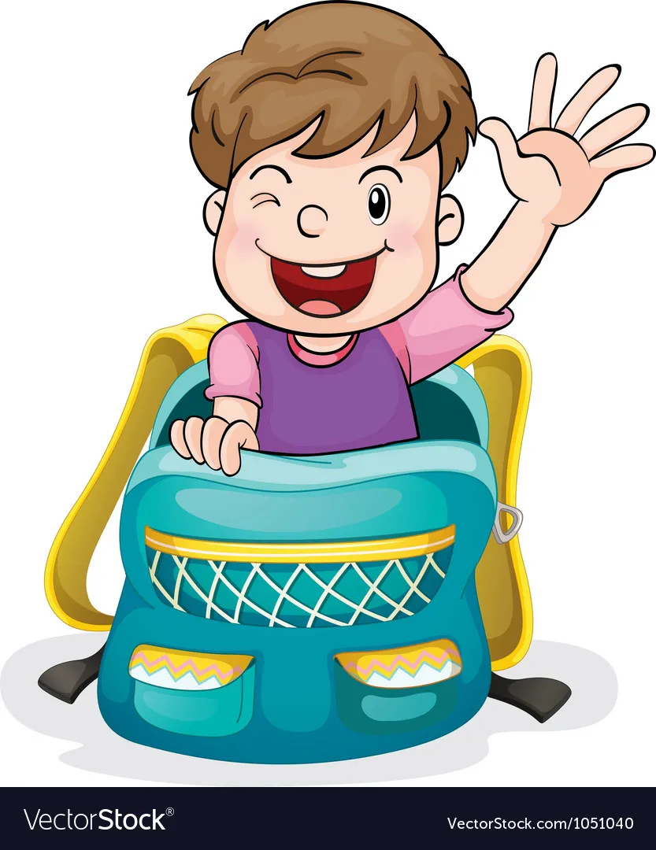

Slide 5


chips

Slide 6

fish

Slide 7

milk

Slide 8
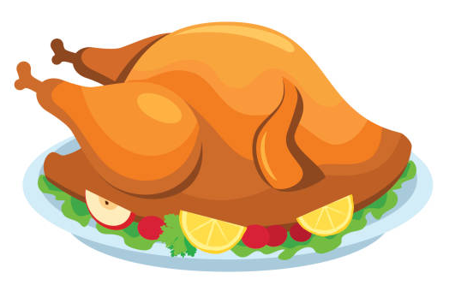
chicken

Slide 9

bell

Slide 10

pen

Slide 11

pencil

Slide 12

red

Slide 13
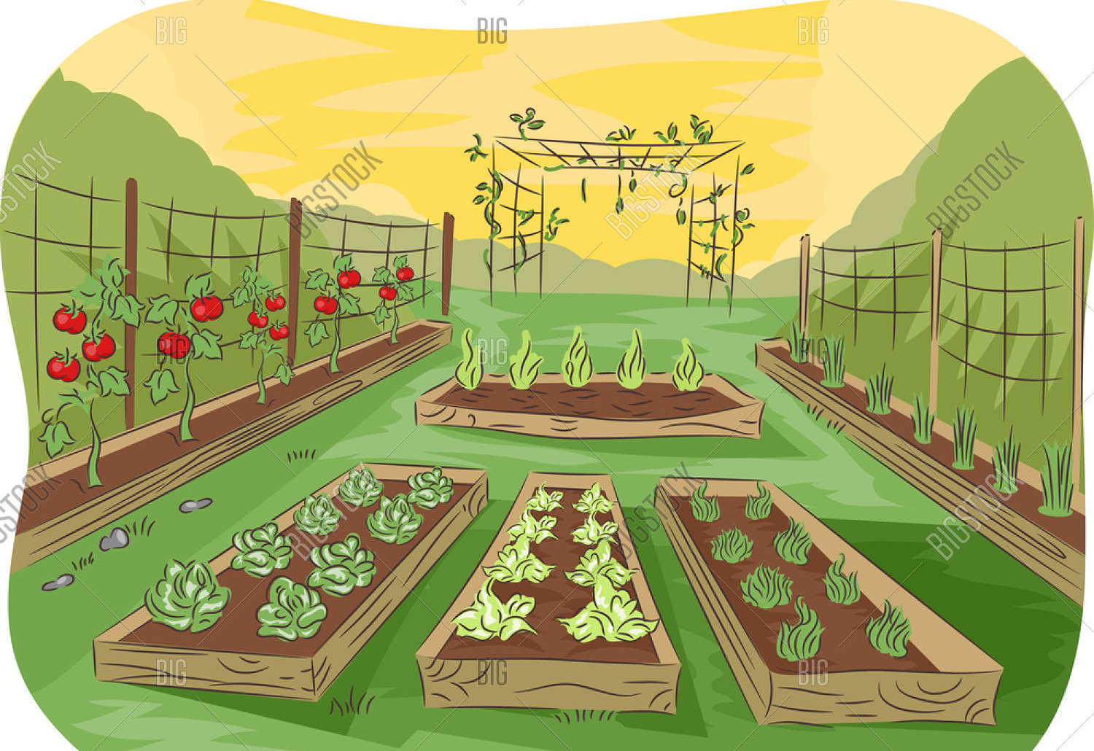
garden

Slide 14

head

Slide 15
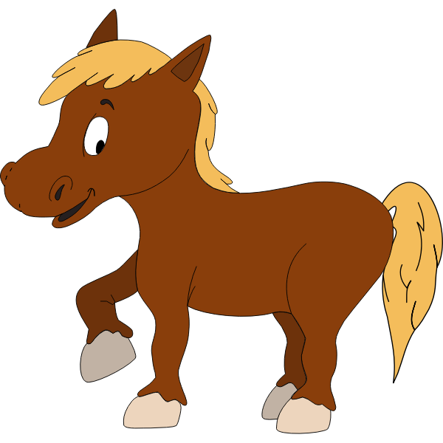
horse

Slide 16

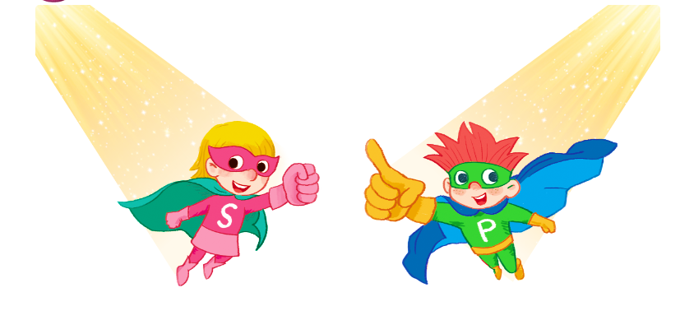
Listen and repeat.

Slide 17

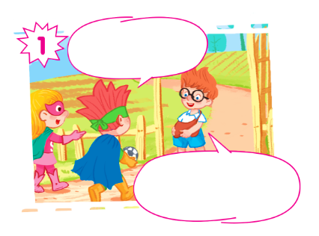
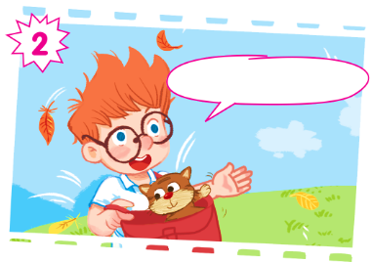
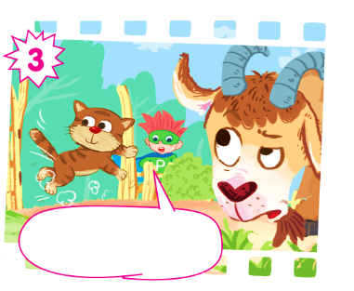
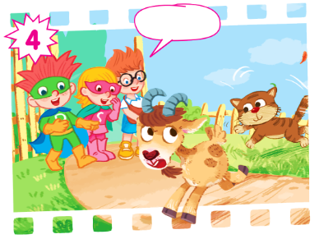

Slide 18
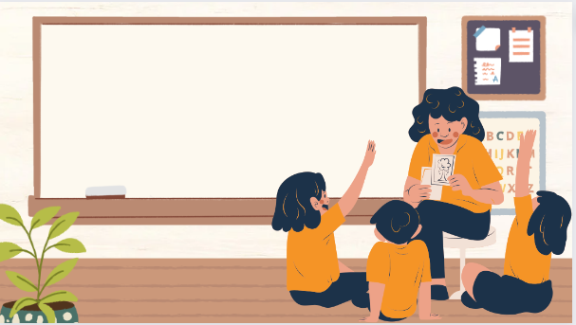
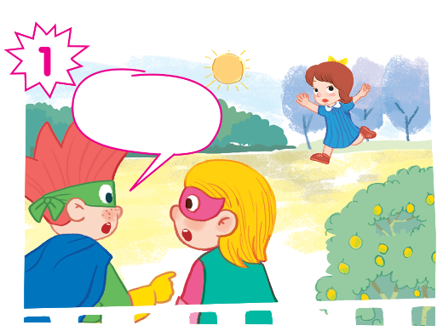
Play as a character

Slide 19
Hi, Ben! I have a ball.
And I have a cat.
Hello, Sue and Phil! Look! I have a bag.
Ha ha.
Look out, cat! There's a goat!

Slide 20

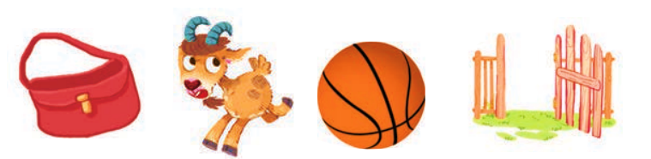
Look and circle.
cat gate girl goat hand head bag ball

Slide 21
Look and circle.
cat gate girl goat hand head bag ball

Slide 22
Look and circle.
cat gate girl goat hand head ball

Slide 23
Look and circle.
cat gate girl hand head ball

Slide 24
Look and circle.
cat gate girl hand head

Slide 25
Look and circle.
bag
goat
ball
gate

Slide 26
