Slide 1








starter
Period 1 – Back to school

Slide 2
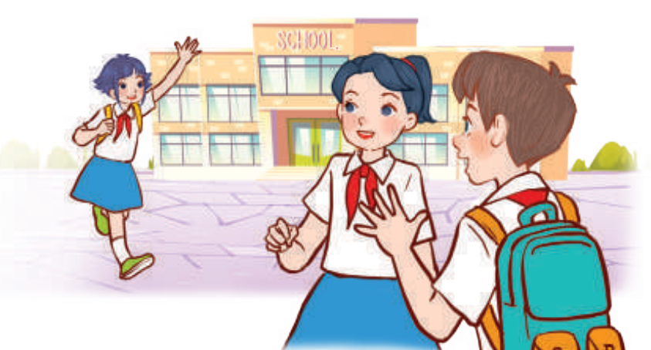

01
WARM-UP
and review

Slide 3
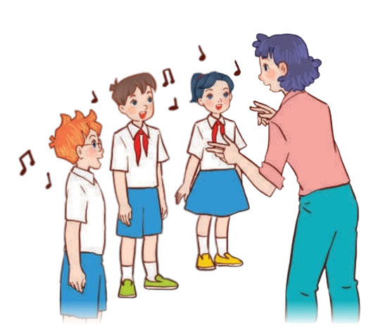
02
Let’s sing.

Slide 4
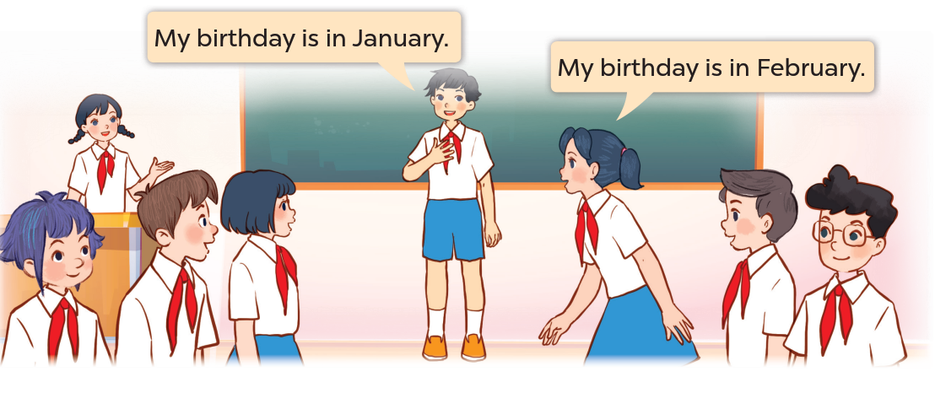
03
Let’s play.

Slide 5












Look and Say.
Notes:
Ask pupils to look and read 12 months of the year.

Slide 6










Let's sing "Happy Birthday“!
Notes:
Let’s sing Happy birthday! to all the pupils.

Slide 7

04
Write
and share.

