Slide 2








starter
Period 2 – Last summer

Slide 3



Table of contentS
01.
Warm-up and review
02.
Let’s play.
03.
Listen and match.
04.
Let’s talk.
05.
Fun corner and wrap-up

Slide 4
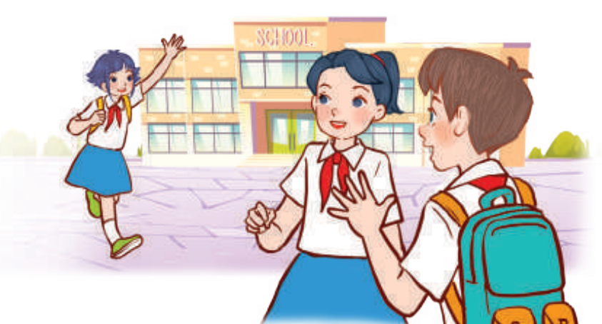
01
WARM-UP
and review

Slide 5
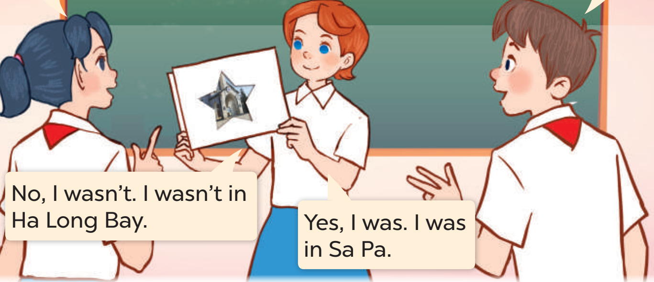
02
Let’s PLAY.

Slide 6

03
LISTEN
AND MATCH.

Slide 7

04
LET’S TALK.

Slide 8
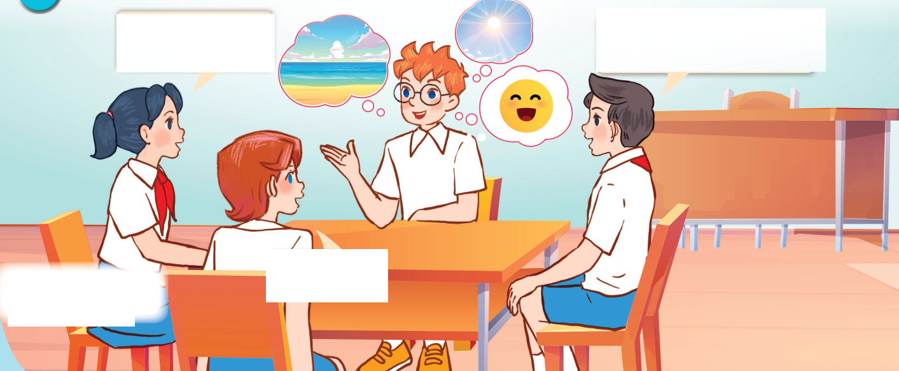
Look AND ANSWER.
Notes:
Step 1: Draw pupils’ attention to the picture. Ask questions to help them identify the context (see Input).

Slide 9
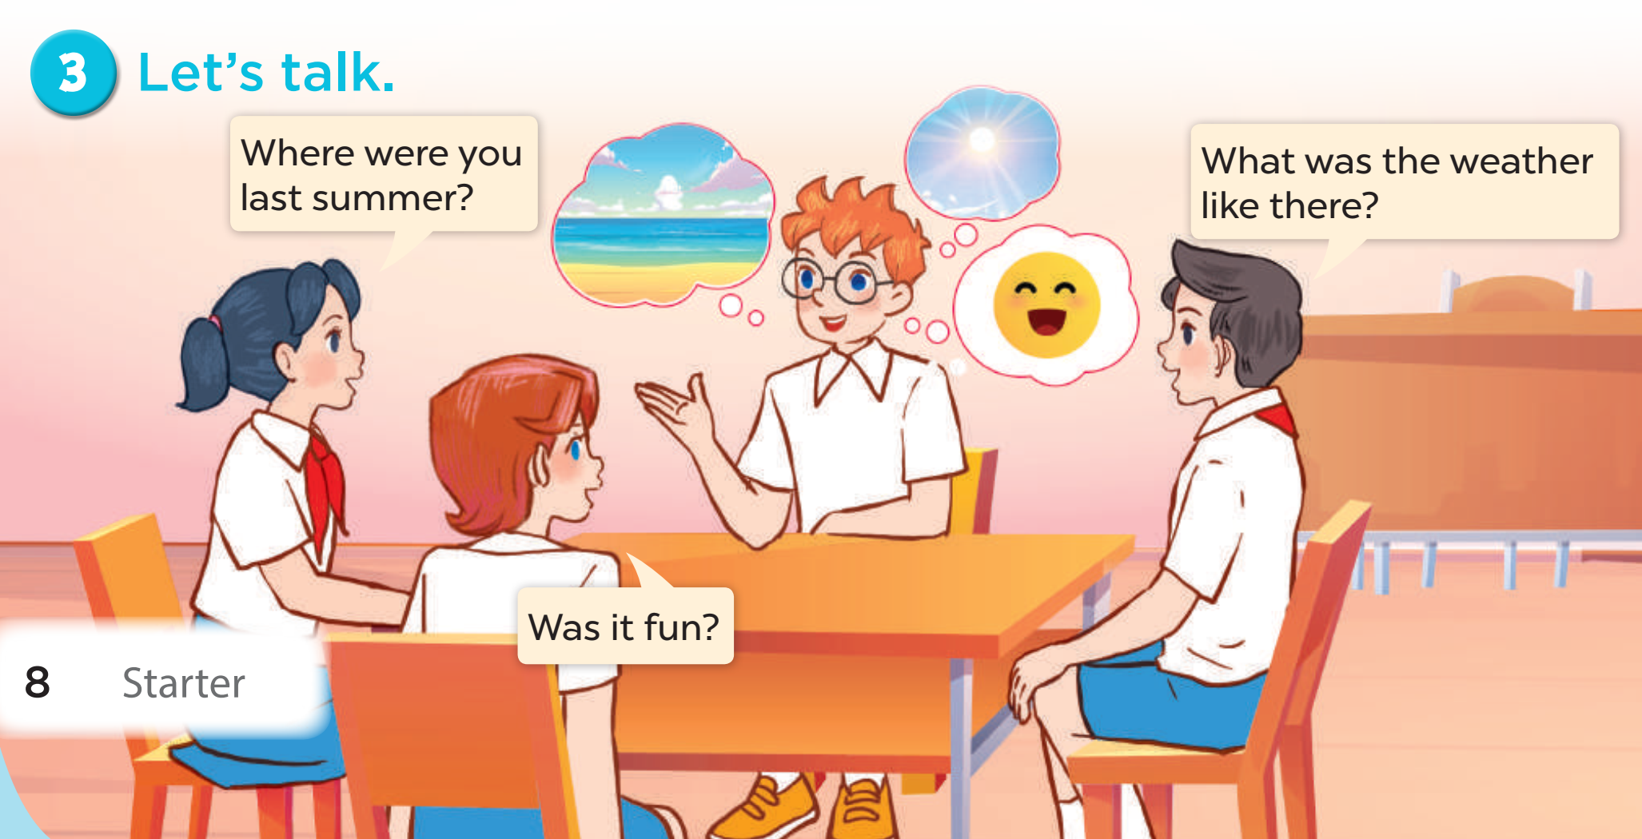


Look AND Read.
Where were you
last summer?
What was the weather
like there?
Was it fun?
Notes:
Step 2: Get pupils to read the speech bubbles and elicit possible answers.

Slide 10
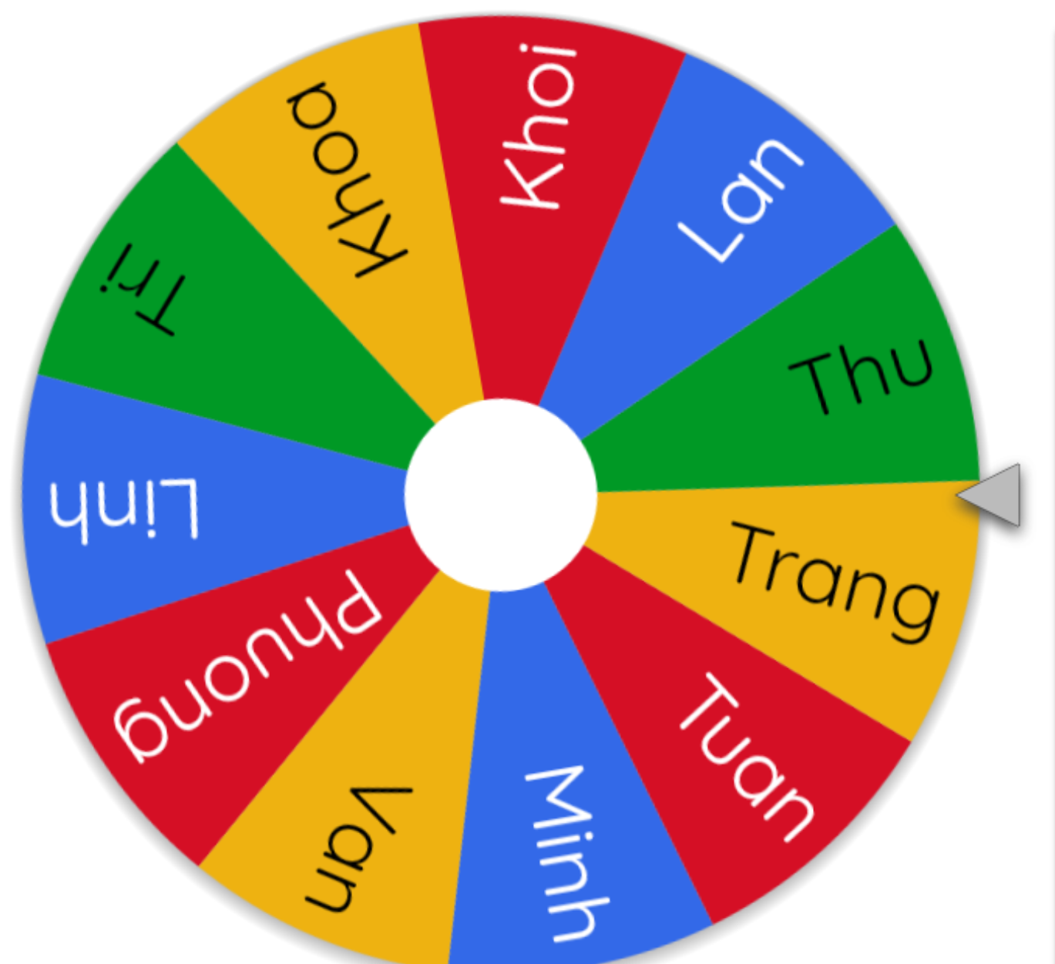
Let’s spin!
Notes:
Step 4: Invite a few pairs to the front of the classroom to ask and answer questions about their last summer.
Use this link to choose pupils in random: https://wheelofnames.com/

Slide 11

05
Fun corner and wrap-up

Slide 12
Website: hoclieu.vn
Fanpage: https://www.facebook.com/tienganhglobalsuccess.vn/

