Slide 2








starter
Period 3 – Classroom Instructions

Slide 3



Table of contentS
01.
Warm-up and review
02.
Let’s chant.
03.
Listen and tick.
04.
Let’s play.
05.
Fun corner and wrap-up

Slide 4

01
WARM-UP
and review

Slide 5

03
LISTEN
AND tick.

Slide 6
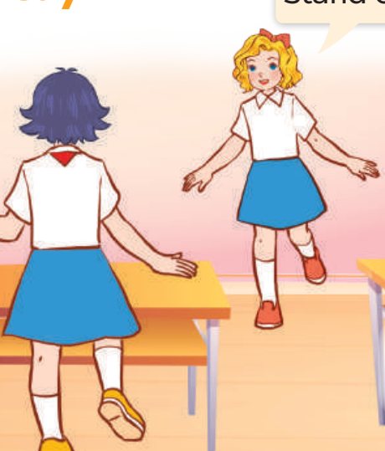
04
LET’S play.

Slide 7

05
Fun corner and wrap-up

Slide 8
Website: hoclieu.vn
Fanpage: https://www.facebook.com/tienganhglobalsuccess.vn/

