Slide 1
STARTER
A. HELLO AGAIN!

Slide 2
Table of contents
01
02
Warm-up
Let's sing.
04
Fun time
03
Listen and tick.
05
Let's play.

Slide 3
Warm-up
Let's meet new friends!
01

Slide 4

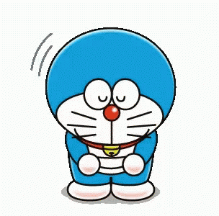
Hello.
Hi.
I’m Pikachu. What’s your name?
I’m Doraemon.
I'm fine, thank you.
How about you?
How are you?
I'm fine, thank you.

Slide 5
Let’s sing.
02

Slide 6
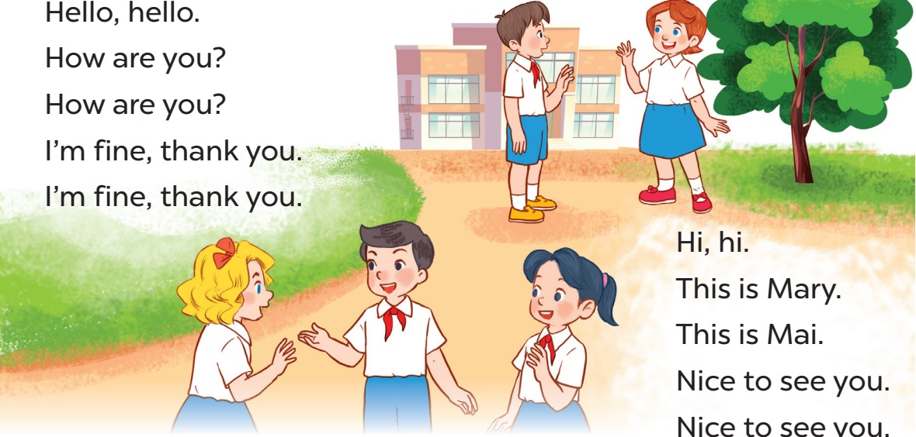

Where are they?
What are they doing?
Who are they?
They are new friends.
They are at school.
They are greeting.

Slide 8
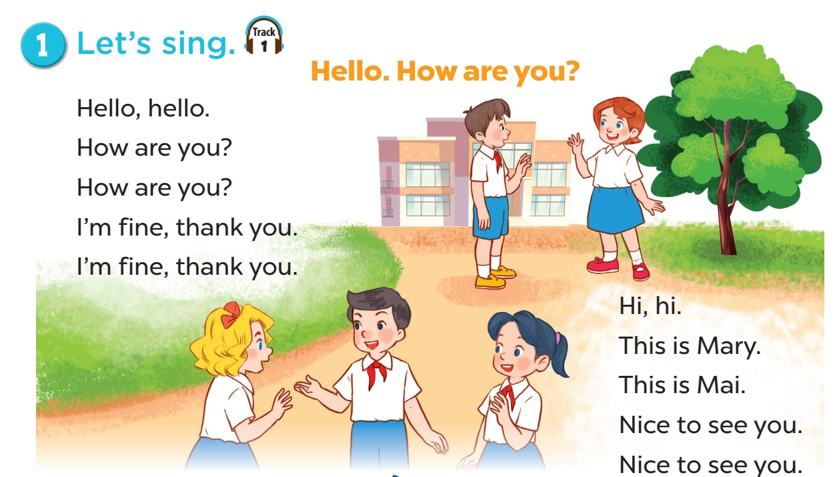

Minh
Lucy

Slide 9
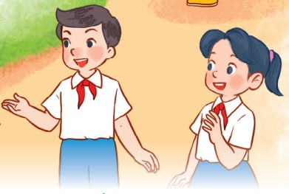
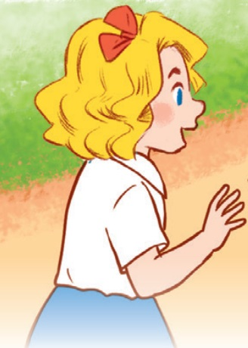
Nice to see you.
This is Mary.
This is Mai!
Hi!
Nice to see you.
Hello!

Slide 10

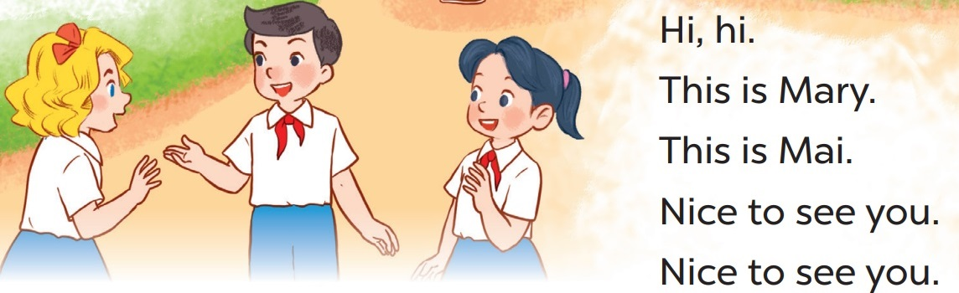

Slide 11
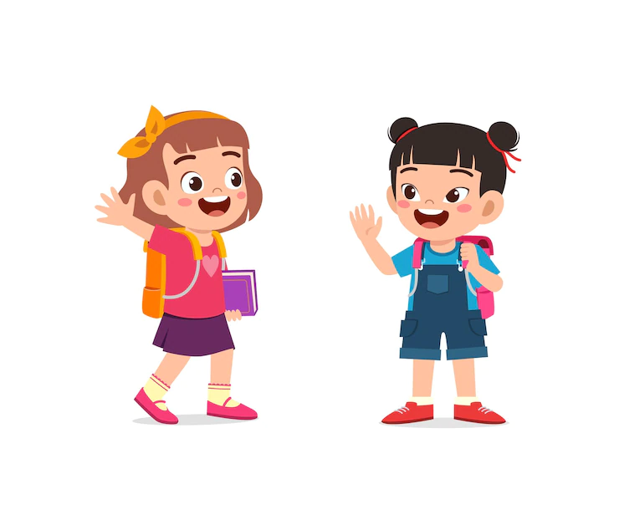
Greet 5 strangers challenge!!!
 | What’s your name?
Stranger 1 | NGUYÊN
Stranger 2 | ……………………………………
Stranger 3 | ……………………………………
Stranger 4 | ……………………………………
Stranger 5 | ……………………………………
Notes:
Step 1: Set the rule for the challenge. Ss greet 5 strangers at their school and introduce themselves, ask for the stranger's name. Then say Nice to see you.
Step 2: Give points to the Ss that complete the challenge.

Slide 12
Listen and tick.
03

Slide 13
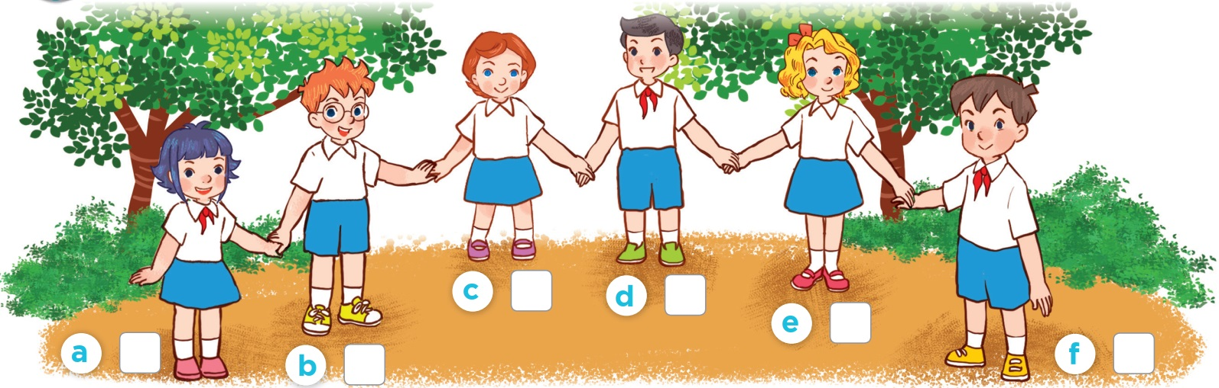

students
Ms Hoa

Slide 14
Who is she/ he?

Slide 15
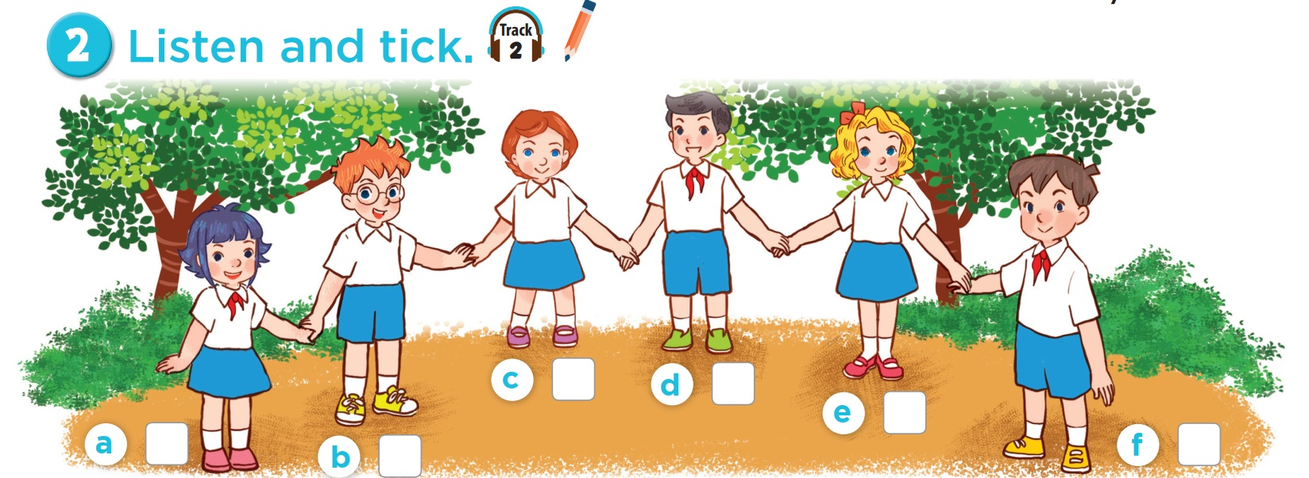


Slide 16
This is Lucy.
This is Minh.
This is Ben.
This is Linh.

Slide 17
Let's play.
03

Slide 18

Spelling bee
1.Say the words.
2.Spell the words.

