Slide 1
Starter
B. Classroom activites

Slide 2
Table of contents
01
Warm-up and Review
04
02
Activity 1
Games
Activity 3
05
03
Activity 2

Slide 3
Warm-up & Review
01

Slide 4
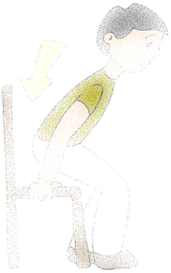
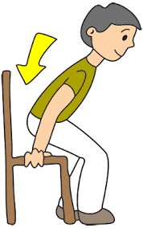
Sit down.

Slide 5

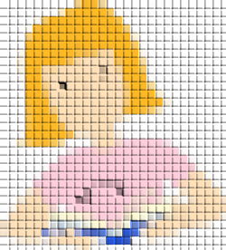
Open your book.

Slide 6


Read aloud.

Slide 7

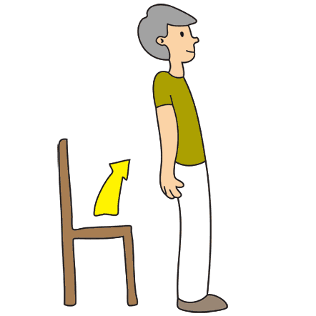
Stand up.

Slide 8
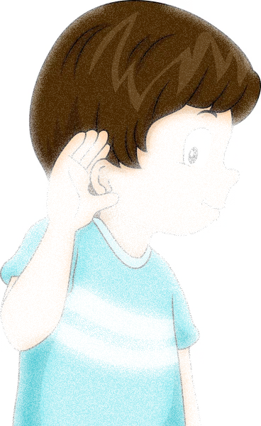
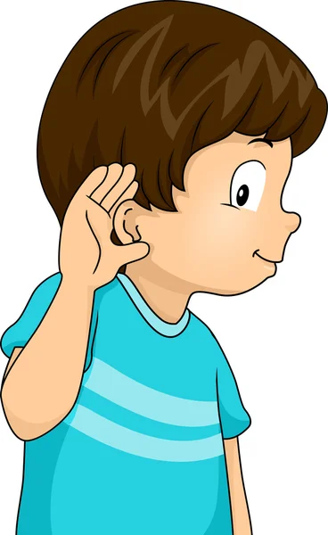
Listen.

Slide 9
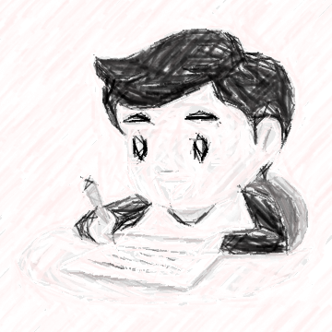

Write.

Slide 10
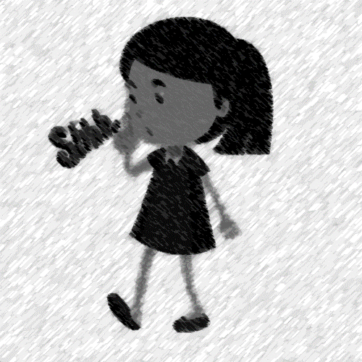

Be quiet.

Slide 11
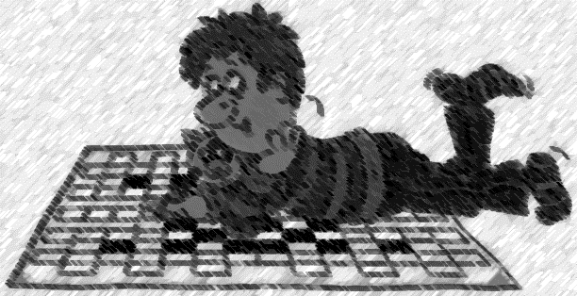
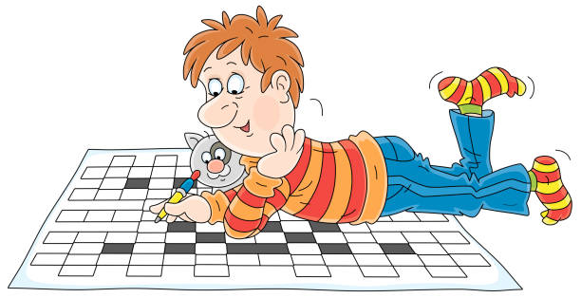
Do a puzzle.

Slide 12
Activity 1 Let’s chant.
02

Slide 13
Activity 2 Listen and number.
03

Slide 14
Look and say.

Slide 15

What is she doing?
Notes:
She’s reading ………….

Slide 16

What is he doing?
Notes:
He’s listening to ……………

Slide 17

What is he doing?
Notes:
He’s is writing

Slide 18
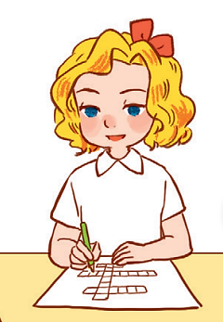
What is she doing?
Notes:
She’s doing a puzzle

Slide 19


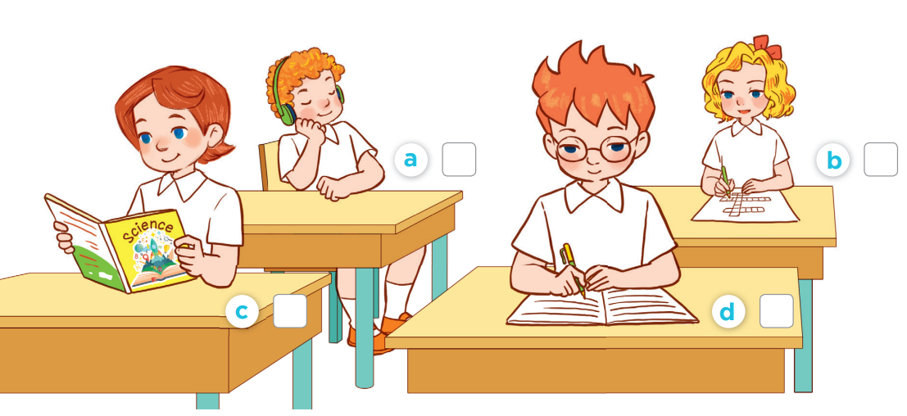
Listen and number.
1
4
2
3

Slide 20
Activity 3 Listen and act out.
04

Slide 21
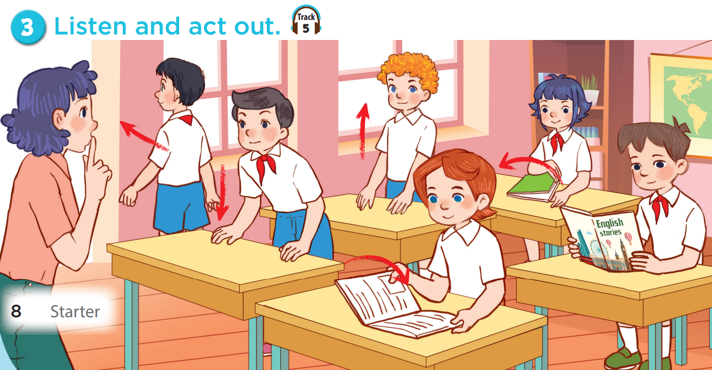
Look, point and say.

Slide 22
Listen and act out.

Slide 23
05
Games

