Slide 1
Starter
C. Outdoor activites

Slide 2
Table of contents
02
03
01
Warm-up & Review
04
Activity 1
Activity 2
05
06
Activity 3
Fun time

Slide 3
01
Warm-up & Review

Slide 4

sing

Slide 5

swim

Slide 6
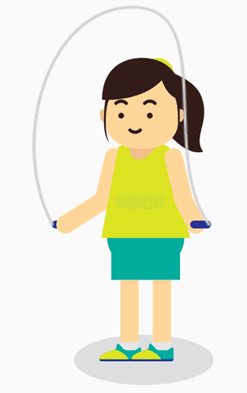
skip

Slide 7
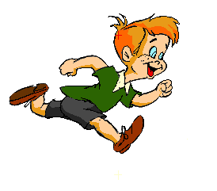
run

Slide 8
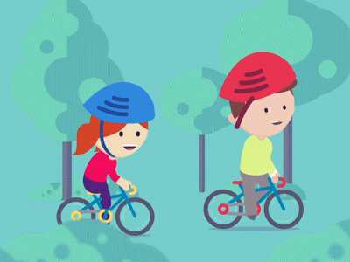
cycle

Slide 9

skate

Slide 10
Look
and guess.

Slide 11

skip

Slide 12
swim

Slide 13
run

Slide 14
skate

Slide 15
cycle

Slide 16
sing

Slide 17
02
Activity 1
Let’s play.

Slide 18
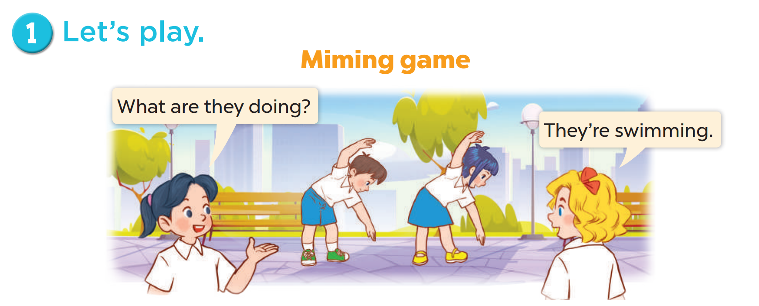
What are they doing?
Who are they?

Slide 19
03
Activity 2
Follow the lines and say.

Slide 20
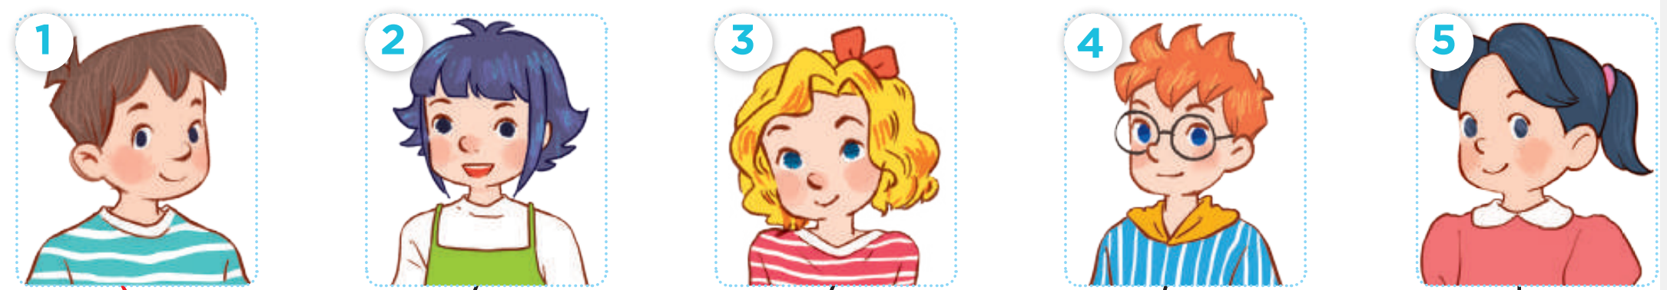
Who are they?
Minh
Linh
Mary
Ben
Mai

Slide 21
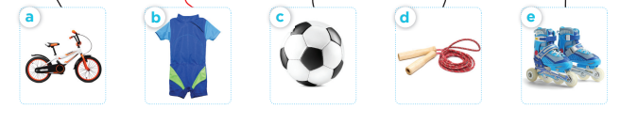
What are they?
a bike
a swimsuit
a football
a skipping
rope
a pair of
skates

Slide 22
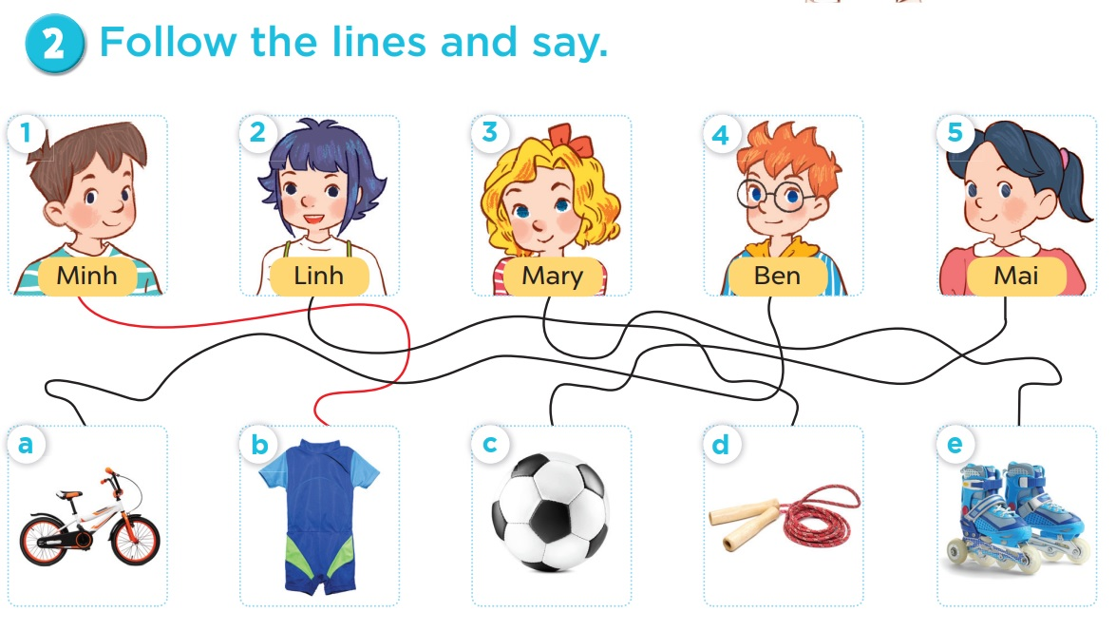
Follow the lines and say.

Slide 23
Follow the lines and say.
Look at Minh. His hobby is swimming.

Slide 24
Follow the lines and say.
Look at Linh. Her hobby is skipping.

Slide 25
Follow the lines and say.
Look at Mary. Her hobby is roller skating.

Slide 26
Follow the lines and say.
Look at Ben. His hobby is cycling.

Slide 27
Follow the lines and say.
Look at Mai. Her hobby is playing football.

Slide 28
04
Activity 3
Read and act out.

Slide 29
