Slide 2

Unit 1. All about me!
Lesson 1 - Period 1

Slide 3

Table of contents
01
Warm-up and review
02
Look, listen and repeat.
03
Listen, point and say.
04
Let’s talk.
05
Fun corner and wrap-up

Slide 4


01
Warm-up and review

Slide 5

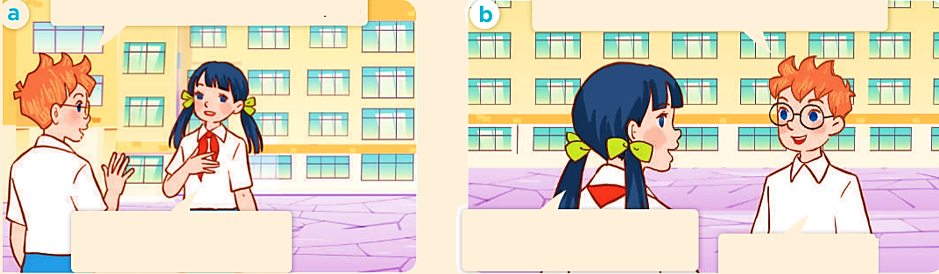
Look, listen and repeat.
a
b

Slide 6
Can you tell me about yourself, Lan?
Well, I’m in Class 5C. I live in the countryside.

Slide 7
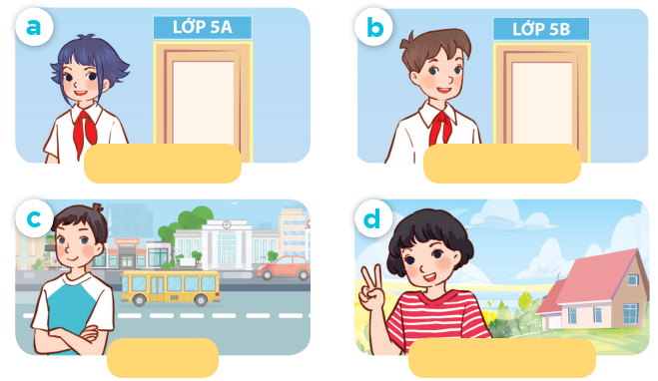
Listen, point and say.
Class 5A
Class 5B
city
countryside

Slide 8
Can you tell me about yourself?
Class 5A
Class 5B
I’m in ____.
I live in the __.
city
countryside

Slide 9
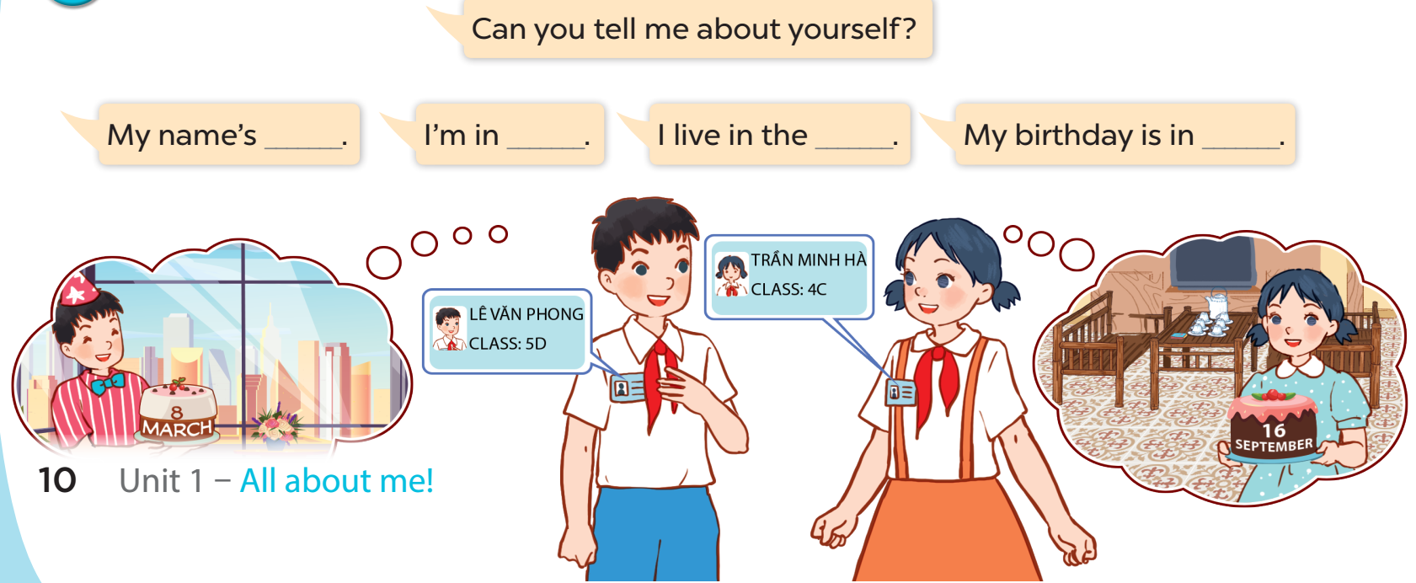
Let’s talk.
Can you tell me about yourself?
My name's ___.
I'm in ___.
I live in the ___.
My birthday is in ___.

Slide 10


Slide 11

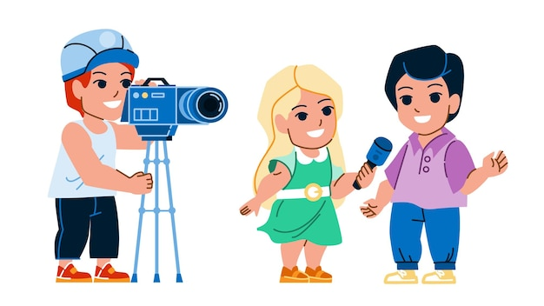
Can you tell me about yourself?
____.

Slide 12
Website: hoclieu.vn
Fanpage: https://www.facebook.com/tienganhglobalsuccess.vn/

