Slide 2

Unit 1. All about me!
Lesson 2 - Period 3

Slide 3

Table of contents
01
Warm-up and review
02
Look, listen and repeat.
03
Listen, point and say.
04
Let’s talk.
05
Fun corner and wrap-up

Slide 4


01
Warm-up and review

Slide 5

Game

Slide 6








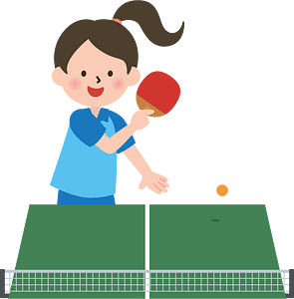

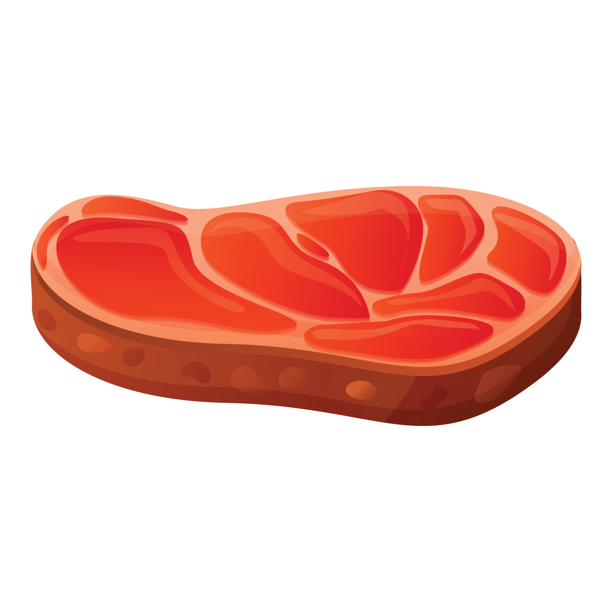






swim
Notes:
Nháy chuột để biến mất hình ảnh và xuất hiện hình ảnh tiếp theo

Slide 7

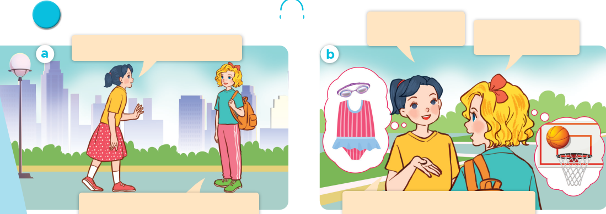
Look, listen and repeat.

Slide 8

What’s your favourite sport?
It’s basketball.

Slide 9
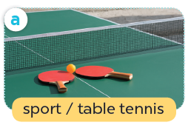
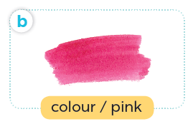
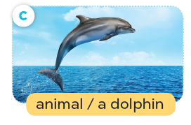
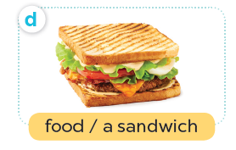
Listen, point and say.

Slide 10

What’s your favourite ____?
It’s ____.

Slide 11
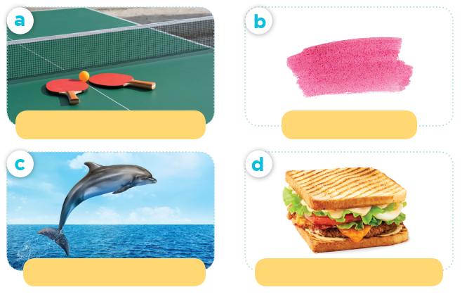
What’s your favourite ____?
sport / table tennis
colour / pink
It’s ____.
animal / a dolphin
food / a sandwich

Slide 12
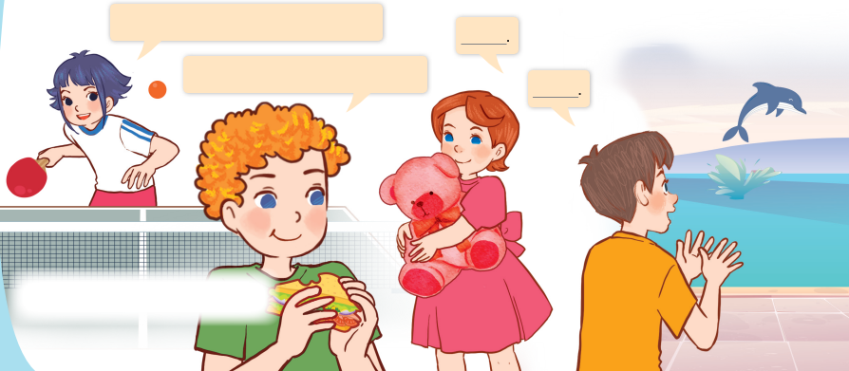
Let’s talk.
Can you tell me about yourself?
What’s your favourite ___?

Slide 13
Can you tell me about yourself?
It’s ____.
What’s your favourite ____?
____.

Slide 14
Website: hoclieu.vn
Fanpage: https://www.facebook.com/tienganhglobalsuccess.vn/

