Slide 2



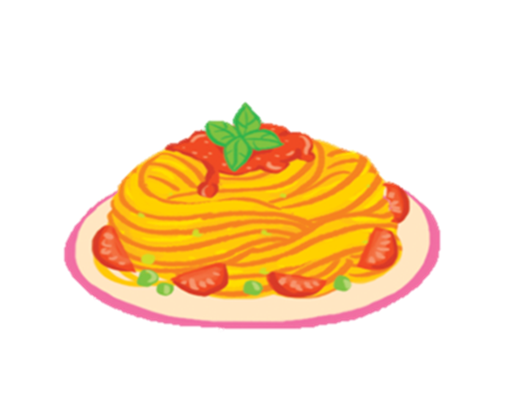


7. Let’s talk.
GROUP WORK
The _______ is yummy.

Slide 3


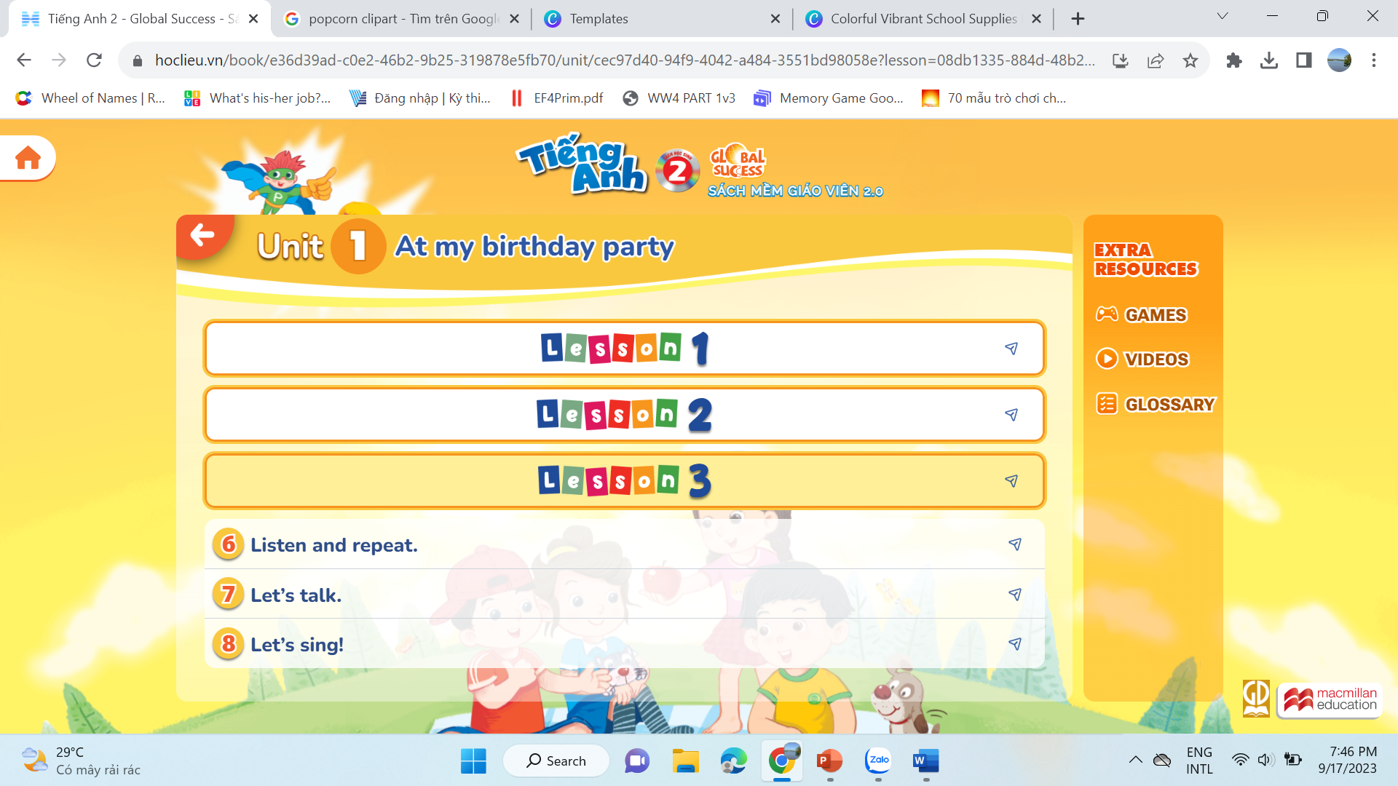






04
Activity 8 Let’s sing.

Slide 4
WORK IN GROUPS

Slide 5


8. Let’s sing.

Slide 6
05
Fun corner & Wrap-up

Slide 7

GAME
Pass the card
The …… is yummy.

Slide 8
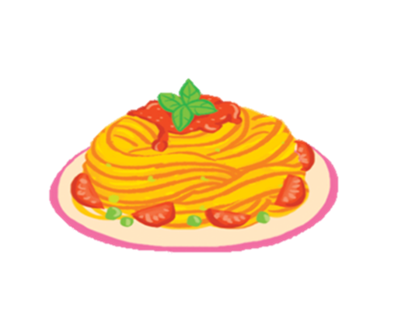


GAME
Pass the card

Slide 9
GAME
Pass the card

Slide 10
GAME
Pass the card

Slide 11




Slide 12



Slide 13
Website: hoclieu.vn
Fanpage: https://www.facebook.com/tienganhglobalsuccess.vn/

