Slide 2

Unit 1. All about me!
Lesson 3 - Period 5

Slide 3

Table of contents
01
Warm-up and review
02
Listen and repeat.
03
Circle, listen and check.
04
Let’s chant.
05
Fun corner and wrap-up

Slide 4

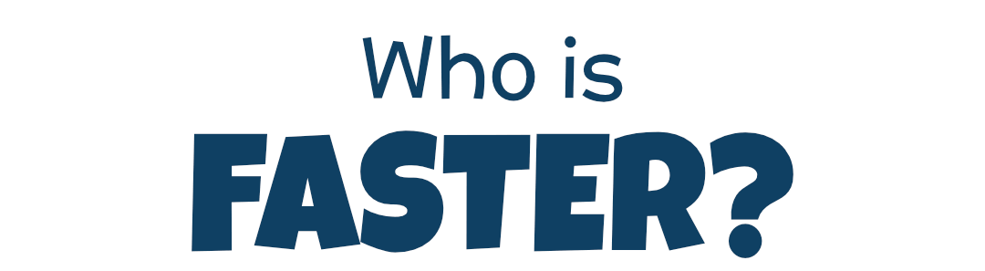
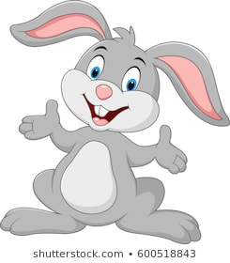
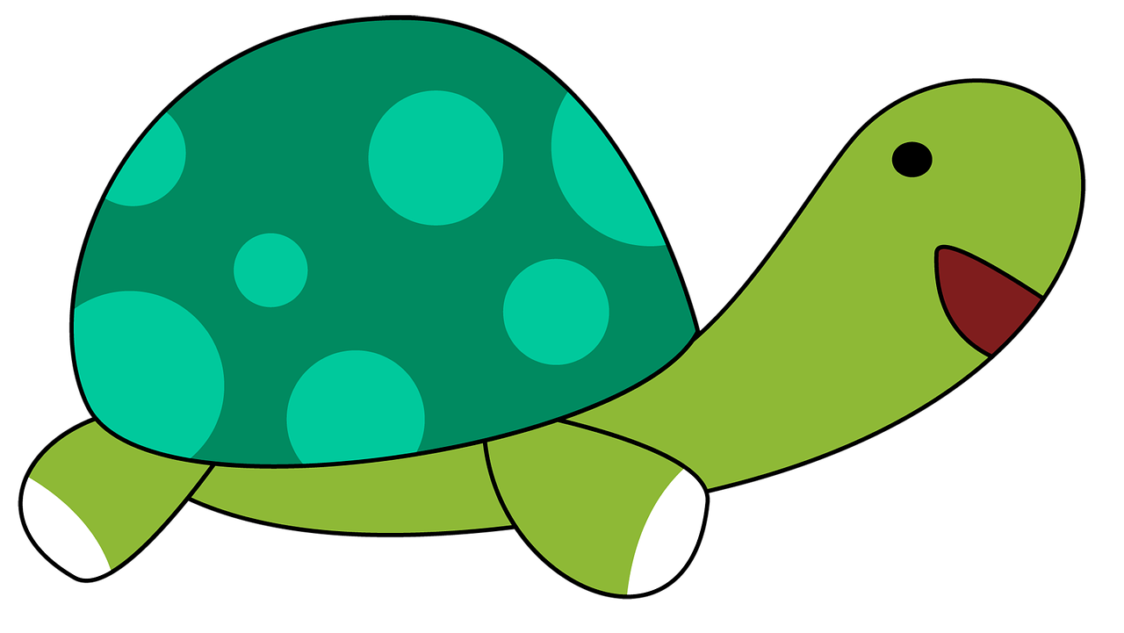
Team Turtle
Team Rabbit

Slide 5

Choose the correct answer a,b or c.
A: What’s your favourite _______?
B: It’s basketball.
a
b
c
food
animal
sport

Slide 6
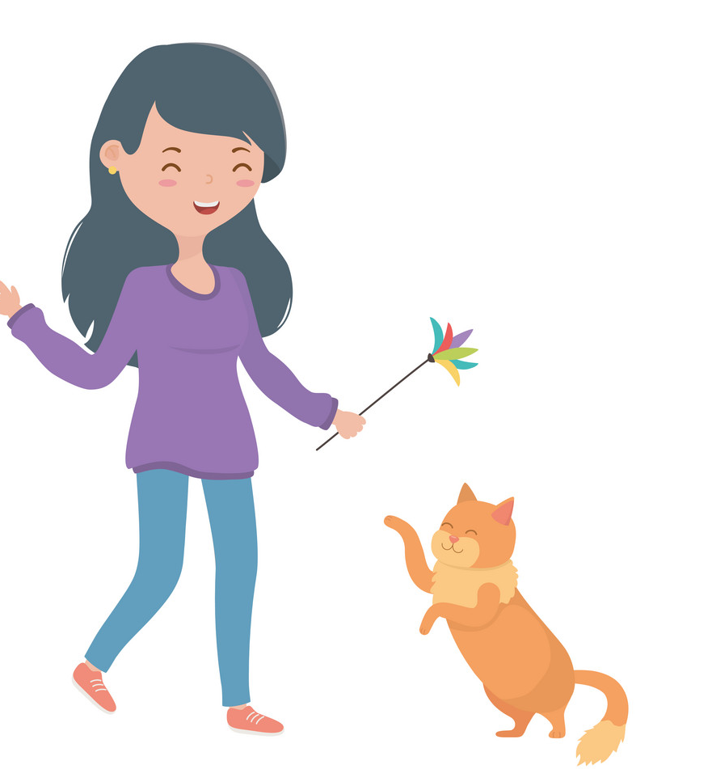
Choose the correct answer a,b or c.
A: What’s your favourite animal?
B: It’s _____.
a
b
c
cat
a cat
a dog

Slide 7

Choose the correct answer a,b or c.
A: What’s your favourite colour?
B: ___ red.
a
b
c
It
A
It’s

Slide 8
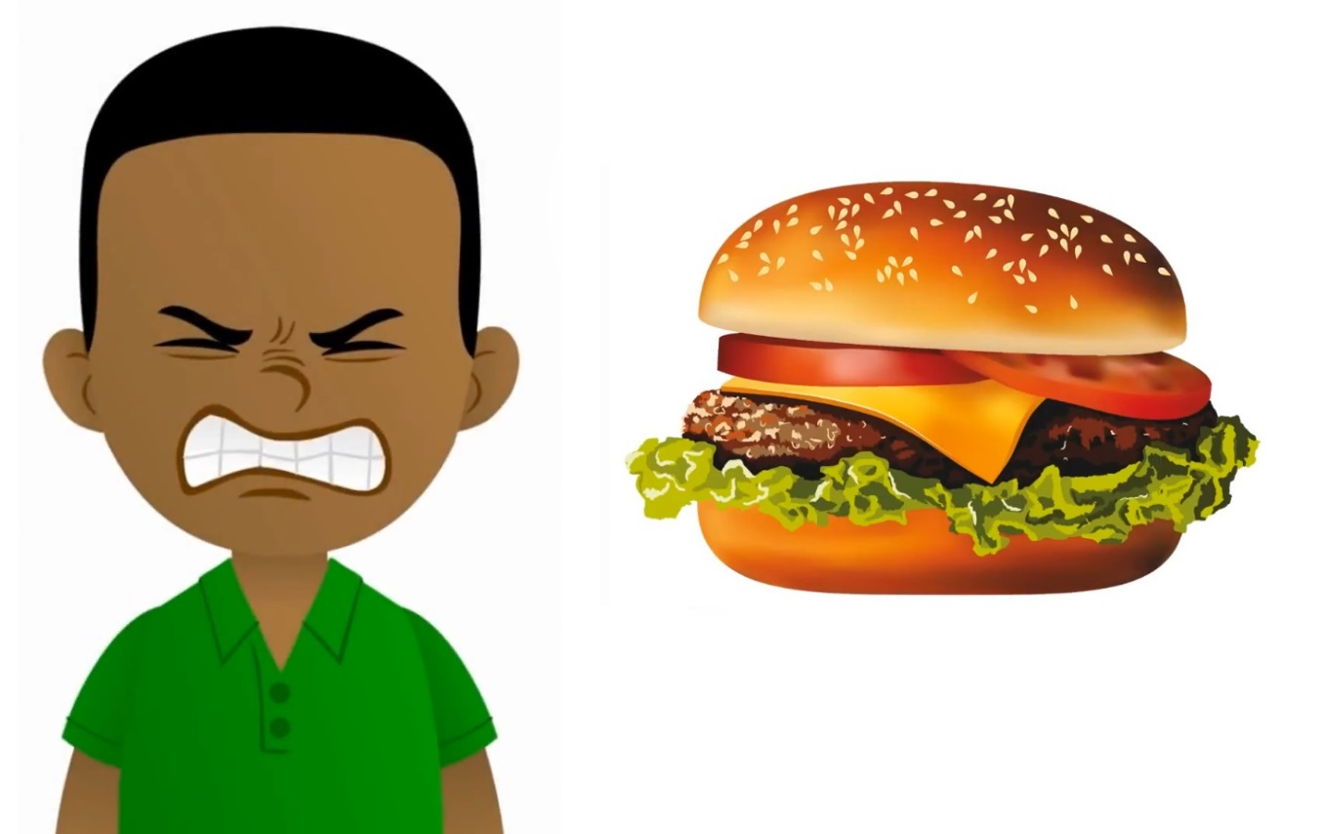
Choose the correct answer a,b or c.
A: My favourite food is hamburger.
Do you like hamburger, too?
B: No, I ____.
a
b
c
don’t
do
am

Slide 9

Summary
Notes:
GV nháy vào biểu tượng của đội chơi để tính điểm cho các đội. Mỗi lần nháy 1 ngôi sao xuất hiện.

Slide 10


03
Circle, listen and check.

Slide 11

Circle, listen and check.
1.
a. dolphin
b. giraffe
c. behind
2.
a. Japan
b. July
c. England
3.
a. tennis
b. hello
c. goodbye

Slide 12
Circle, listen and check.
1.
a. dolphin
b. giraffe
c. behind
2.
a. Japan
b. July
c. England
3.
a. tennis
b. hello
c. goodbye

Slide 13
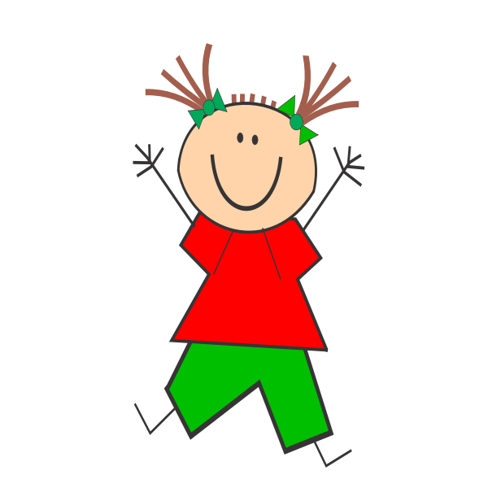
Jumping Games

Slide 14

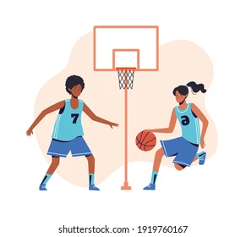
football

Slide 15

Japan

Slide 16
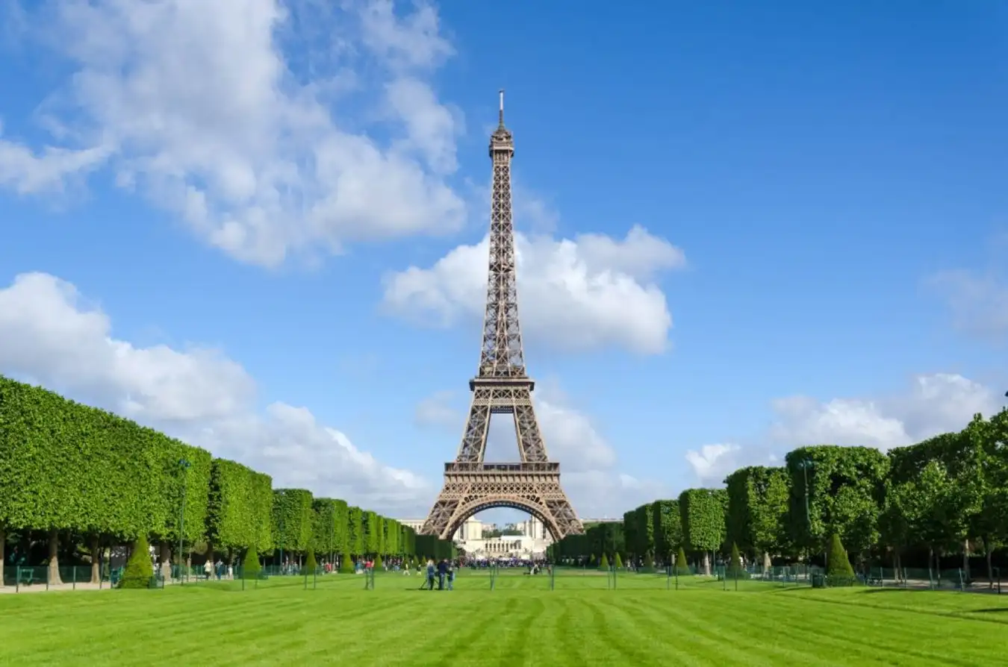
England

Slide 17
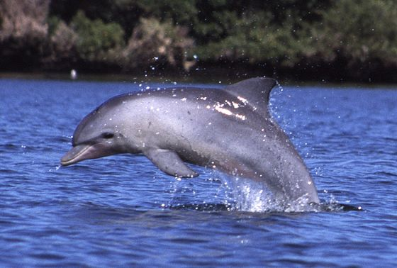
dolphin

Slide 18
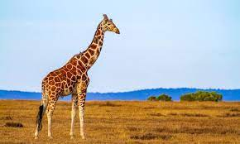
giraffe

Slide 19
Website: hoclieu.vn
Fanpage: https://www.facebook.com/tienganhglobalsuccess.vn/

