Slide 2
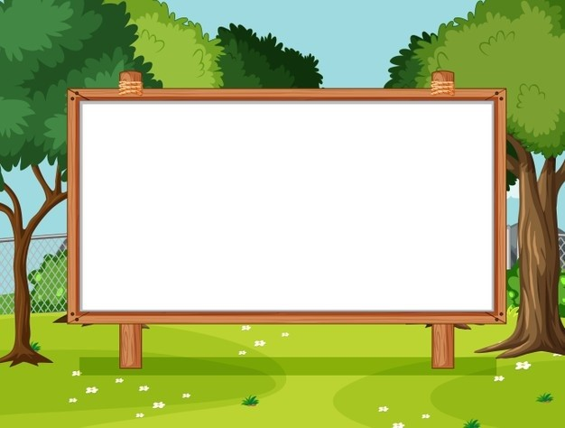
Unit 1. All about me!
Lesson 3 - Period 6

Slide 3

Table of contents
01
Warm-up and review
02
Read and circle.
03
Let’s write.
04
Project
05
Fun corner and wrap-up

Slide 4
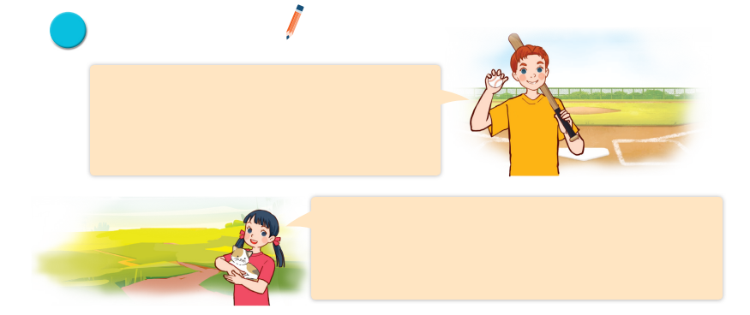
Read and circle.
Hi, all. Let me tell you a little bit about myself. My name’s Tom. I’m in Grade 5. I live in a big city. My favourite subject is maths. My favourite food is fish and chips. I’m a big fan of baseball.
It’s really fun.
Hello, everyone. Let me introduce myself. My full name’s Le Mai Lan. You can call me Lan. I’m in Class 5C. I live in the countryside. I love pets. I have two kittens and a rabbit. My favourite colour is pink. My favourite food is chicken pho. Yum!

Slide 5
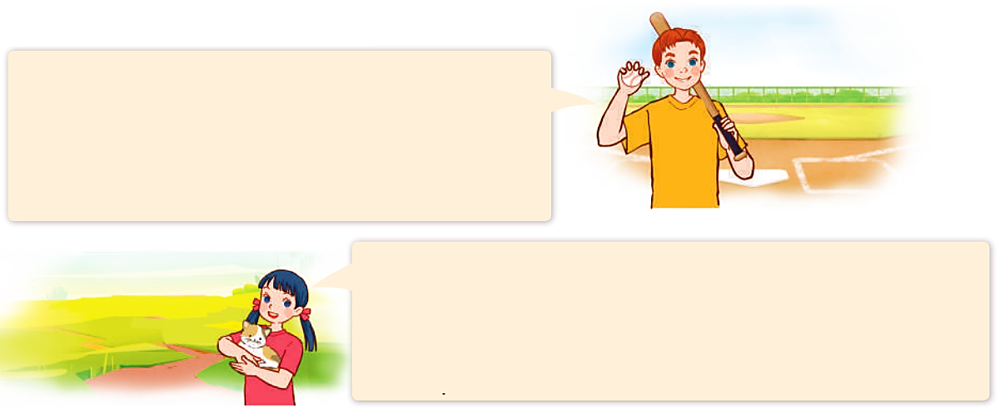
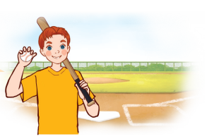

Read and circle.
Hi, all. Let me tell you a little bit about myself. My name’s Tom. I’m in Grade 5. I live in a big city. My favourite subject is maths. My favourite food is fish and chips. I’m a big fan of baseball.
It’s really fun.
Hello, everyone. Let me introduce myself. My full name’s Le Mai Lan. You can call me Lan. I’m in Class 5C. I live in the countryside. I love pets. I have two kittens and a rabbit. My favourite colour is pink. My favourite food is chicken pho. Yum!
1. Tom lives in _______.
a. a big village b. a big city c. a big town

Slide 6
Read and circle.
Hi, all. Let me tell you a little bit about myself. My name’s Tom. I’m in Grade 5. I live in a big city. My favourite subject is maths. My favourite food is fish and chips. I’m a big fan of baseball.
It’s really fun.
Hello, everyone. Let me introduce myself. My full name’s Le Mai Lan. You can call me Lan. I’m in Class 5C. I live in the countryside. I love pets. I have two kittens and a rabbit. My favourite colour is pink. My favourite food is chicken pho. Yum!
2. He likes _______.
a. fish and rice b. chicken and chips c. fish and chip

Slide 7
Read and circle.
Hi, all. Let me tell you a little bit about myself. My name’s Tom. I’m in Grade 5. I live in a big city. My favourite subject is maths. My favourite food is fish and chips. I’m a big fan of baseball.
It’s really fun.
Hello, everyone. Let me introduce myself. My full name’s Le Mai Lan. You can call me Lan. I’m in Class 5C. I live in the countryside. I love pets. I have two kittens and a rabbit. My favourite colour is pink. My favourite food is chicken pho. Yum!
3. Lan is in _______.
a. Class 4C b. Class 5C c. Class 3C

Slide 8
Read and circle.
Hi, all. Let me tell you a little bit about myself. My name’s Tom. I’m in Grade 5. I live in a big city. My favourite subject is maths. My favourite food is fish and chips. I’m a big fan of baseball.
It’s really fun.
Hello, everyone. Let me introduce myself. My full name’s Le Mai Lan. You can call me Lan. I’m in Class 5C. I live in the countryside. I love pets. I have two kittens and a rabbit. My favourite colour is pink. My favourite food is chicken pho. Yum!
4. Her favourite colour is _______.
a. pink b. green c. blue

Slide 9
Read and circle.
Hi, all. Let me tell you a little bit about myself. My name’s Tom. I’m in Grade 5. I live in a big city. My favourite subject is maths. My favourite food is fish and chips. I’m a big fan of baseball.
It’s really fun.
Hello, everyone. Let me introduce myself. My full name’s Le Mai Lan. You can call me Lan. I’m in Class 5C. I live in the countryside. I love pets. I have two kittens and a rabbit. My favourite colour is pink. My favourite food is chicken pho. Yum!
4. Her favourite colour is _______.
a. pink b. green c. blue

Slide 10
Read and circle.
Hi, all. Let me tell you a little bit about myself. My name’s Tom. I’m in Grade 5. I live in a big city. My favourite subject is maths. My favourite food is fish and chips. I’m a big fan of baseball.
It’s really fun.
Hello, everyone. Let me introduce myself. My full name’s Le Mai Lan. You can call me Lan. I’m in Class 5C. I live in the countryside. I love pets. I have two kittens and a rabbit. My favourite colour is pink. My favourite food is chicken pho. Yum!
1. Tom lives in _______.
a. a big village b. a big city c. a big town
2. He likes _______.
a. fish and rice b. chicken and chips c. fish and chips
3. Lan is in _______.
a. Class 4C b. Class 5C c. Class 3C
4. Her favourite colour is _______.
a. pink b. green c. blue

Slide 11

Let’s write.
My name is _________. I live in the __________________. I am in Class _______. My favourite sport is ____________. My favourite food is ___________________. My favourite colour is ___________________. My favourite animal is ___________________.
What about you? What are your favourite things?

Slide 12
Let’s write.
Nam
My name is _____.

Slide 13

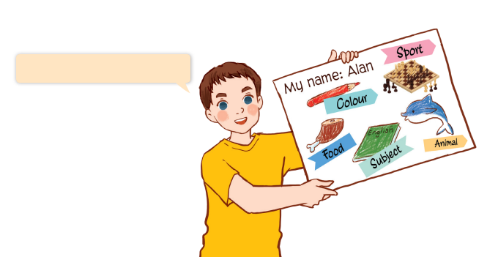
Project
My favourite things
My favourite colour is red.

Slide 14
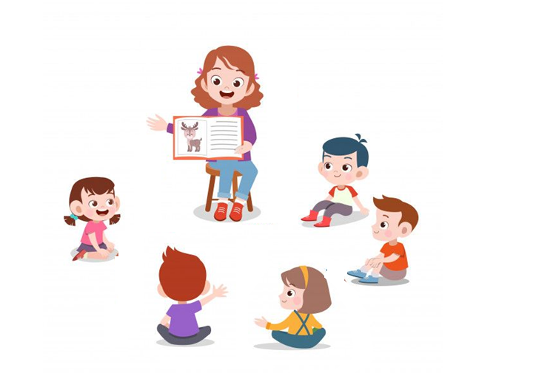
My favourite food is chicken.
My favourite sport is chess.

Slide 15

05
Fun corner and wrap-up

Slide 16
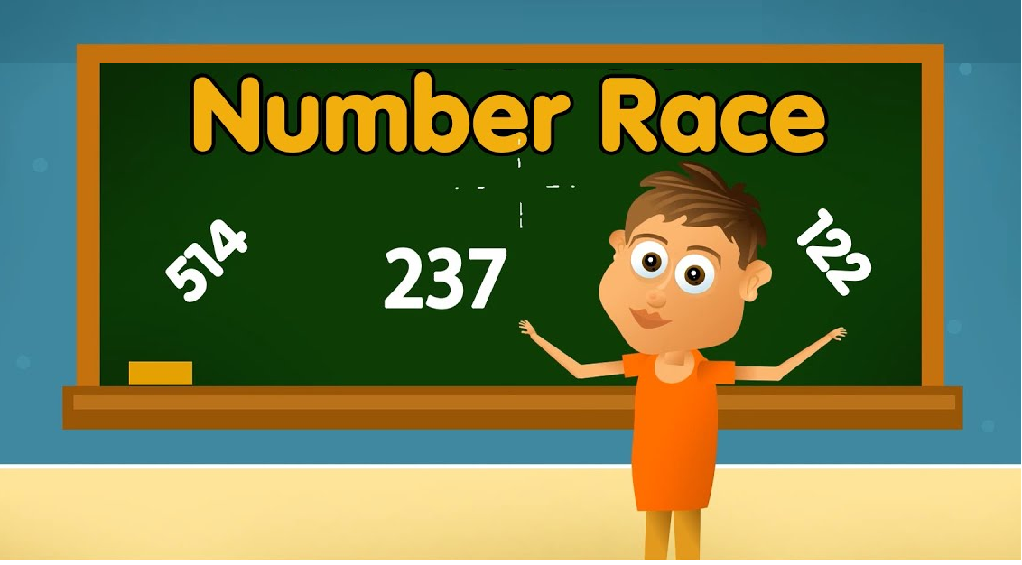

Slide 17

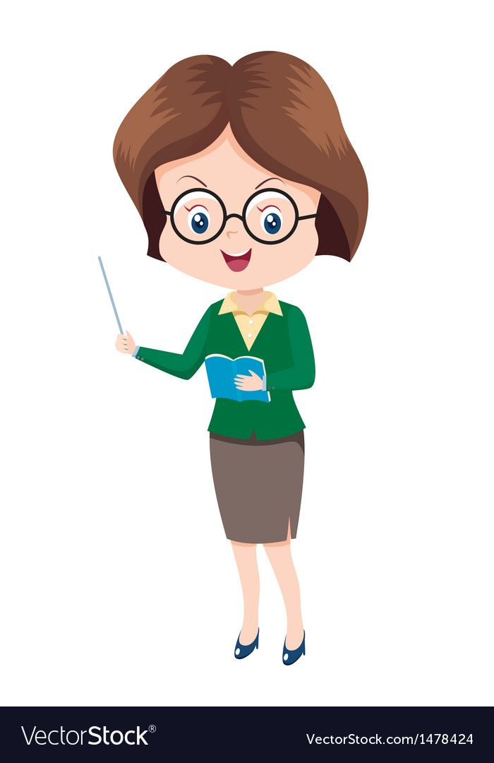
What’s your favourite animal?

Slide 18
What’s your favourite sport?

Slide 19
What’s your favourite food?

Slide 20
What’s your favourite colour?

Slide 21
Website: hoclieu.vn
Fanpage: https://www.facebook.com/tienganhglobalsuccess.vn/

