Slide 1
Unit 1 My friends
Lesson 1 - Period 2

Slide 2
01
Warm-up

Slide 3
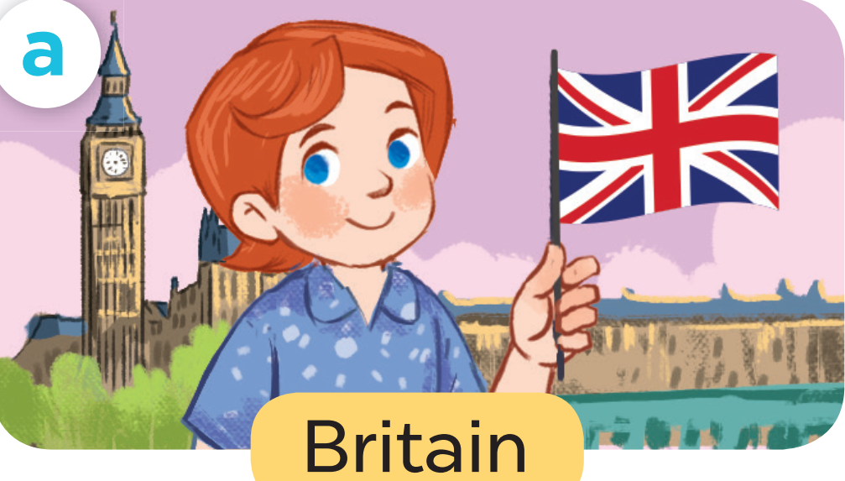
Where are you from?
I'm from Britain.
?
?

Slide 4

Where are you from?
I'm from Viet Nam.
?
?

Slide 5

Where are you from?
I'm from America.
?
?

Slide 6

Where are you from?
I'm from Australia.
?
?

Slide 7
02
Activity 4
Listen and number.

Slide 8
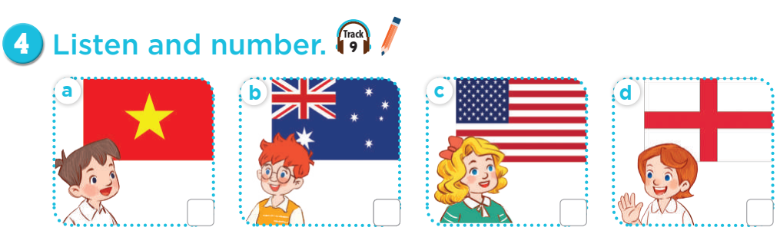
Where's he from?

Slide 9
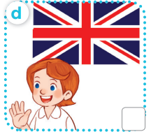
Where's she from?

Slide 10
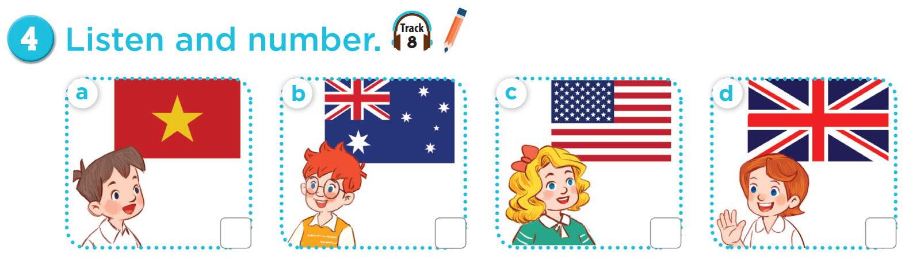


Slide 11
Let's check.
4
1
3
2

Slide 12
03
Activity 5
Look,complete and read.

Slide 13
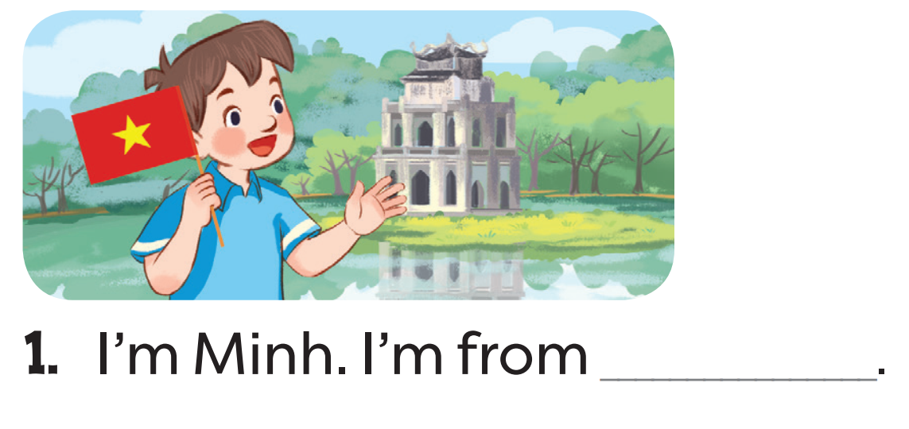
Read. What's the missing word?
Viet Nam

Slide 14
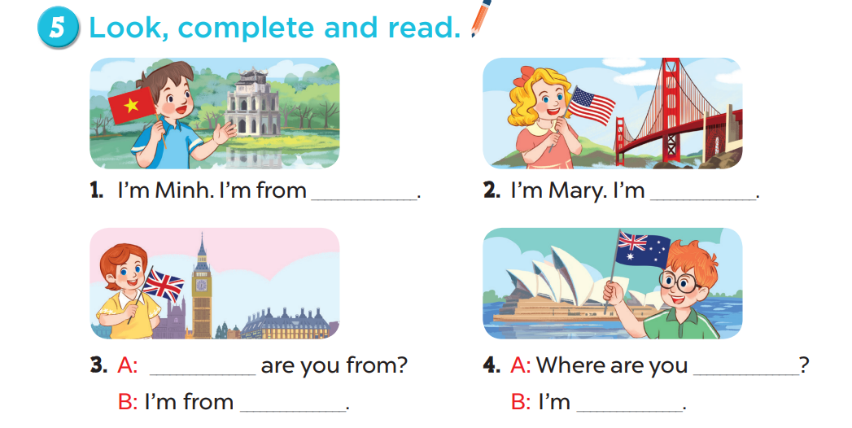
Viet Nam
from America
Where
from
Britain
from Australia

Slide 15
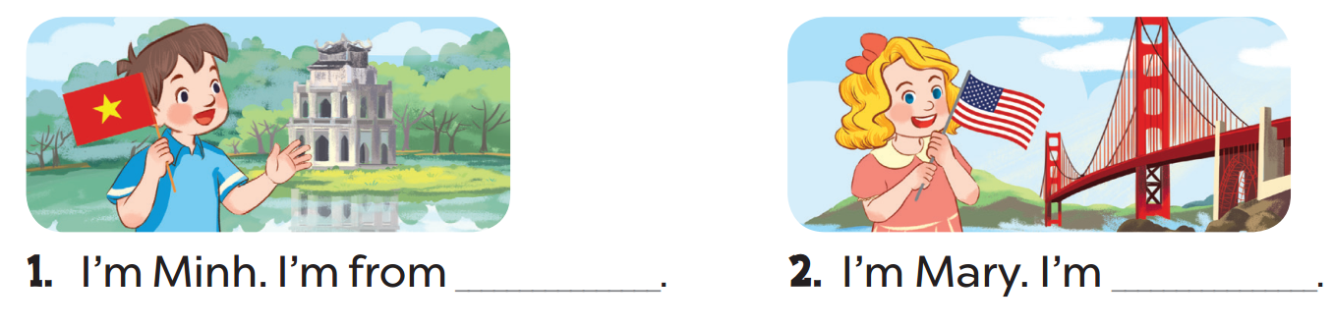
Read aloud.
Viet Nam
from
America

Slide 16
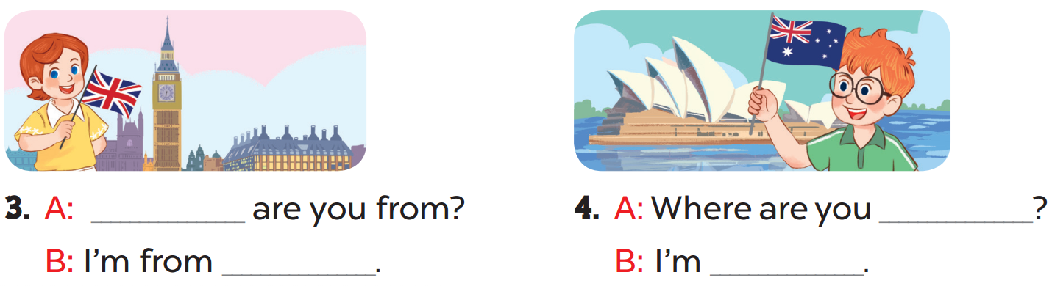
Act it out.
Where
from
Britain
from Australia

Slide 17
04
Activity 6
Let's sing.

