Slide 1
Unit 1
My friends
Lesson 2 - Period 3

Slide 2
Table of contents
Warm-up
Activity 1
New words
Activity 2
Activity 3
Fun time
01
02
03
05
06
04

Slide 3
01
Warm-up
Sing a song.

Slide 4
02
Activity 1
Look, listen and repeat.

Slide 5
02
New words

Slide 6

Singapore

Slide 7

Malaysia

Slide 8

Thailand

Slide 9

Japan

Slide 10
04
Activity 2
Listen, point and say.

Slide 11
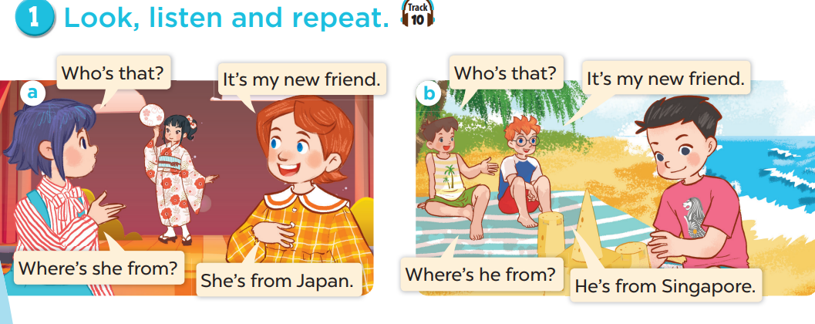
Look and think.
Notes:
Draw pupils' attention to the words HE and SHE. Ask them to think of the differences.

Slide 12



Where’s he from?
He’s from Singapore.

Slide 13

Where’s she from?
She’s from Thailand.

Slide 14
05
Activity 3
Let’s talk.

