Slide 1
Unit 1 My friends
Lesson 2 - Period 4

Slide 2
Table of contents
Warm-up
Activity 4
Activity 5
Activity 6
Fun time
01
02
03
04
05

Slide 3
01
Warm-up
Look and guess!

Slide 4



Japan

Slide 5
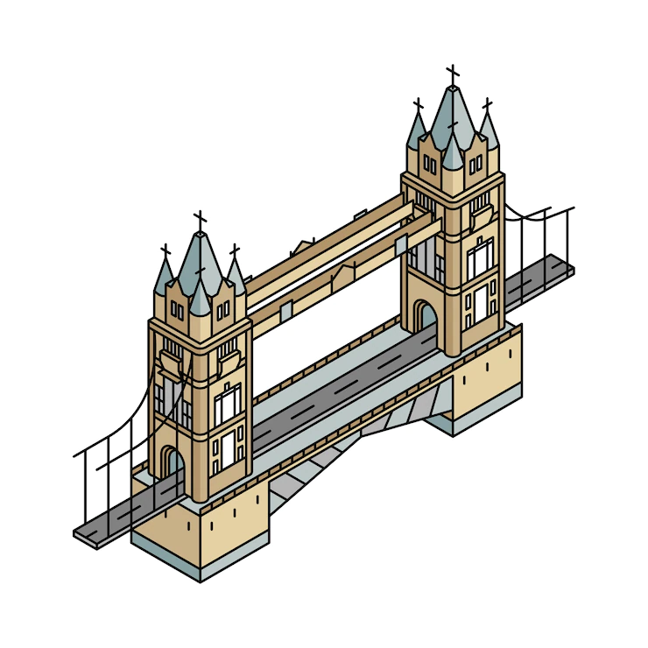


Britain

Slide 6

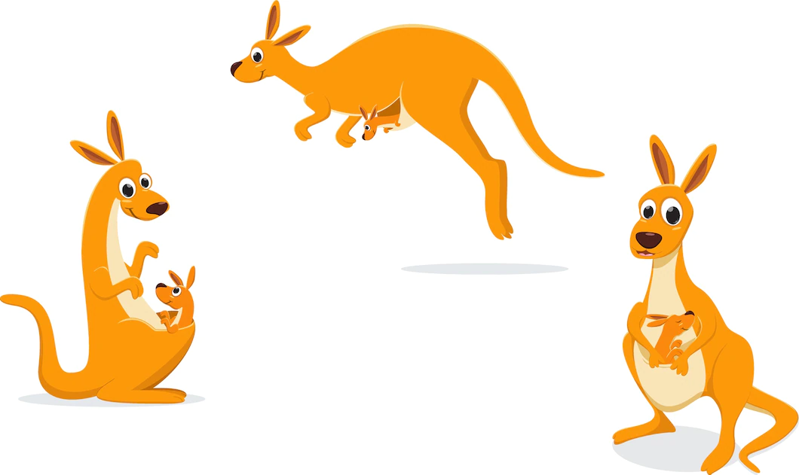
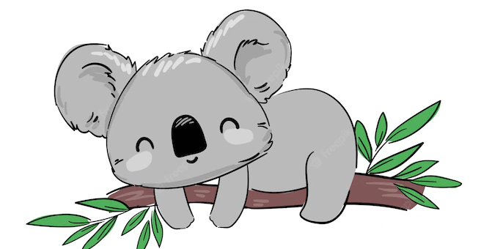
Australia

Slide 7
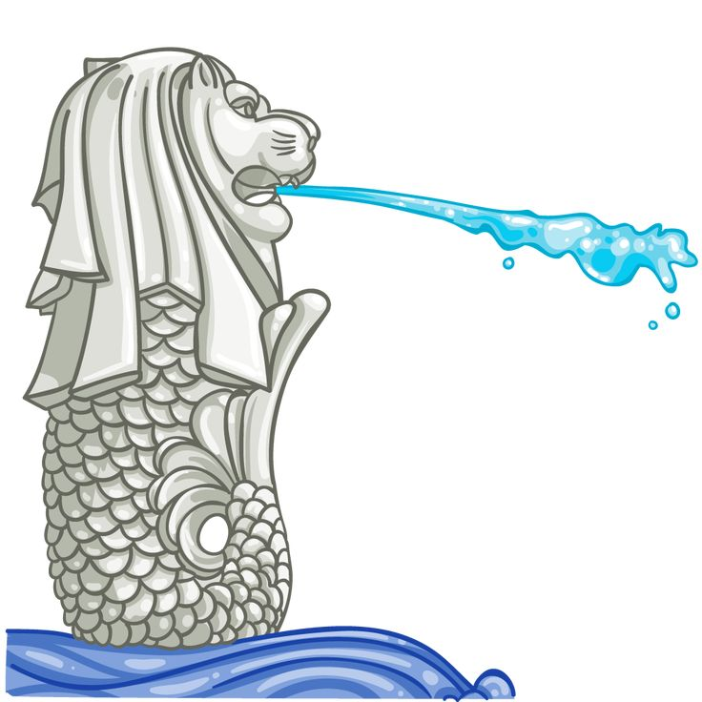
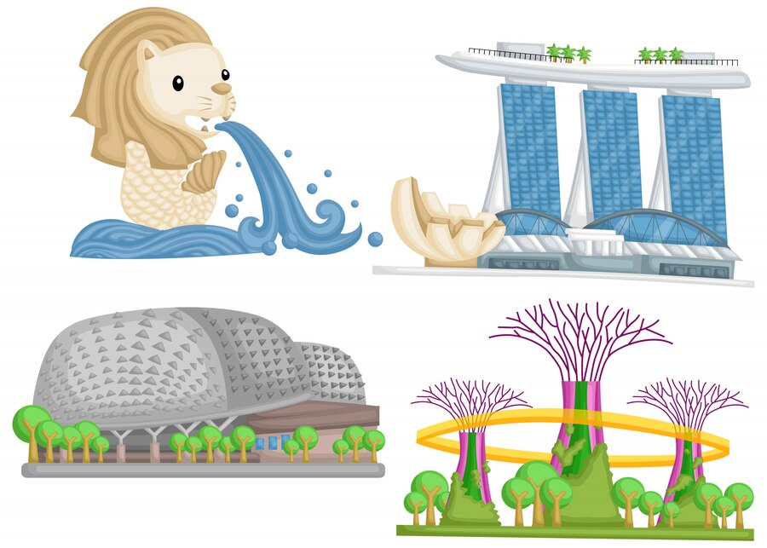
Singapore

Slide 8



Thailand

Slide 9



Malaysia

Slide 10
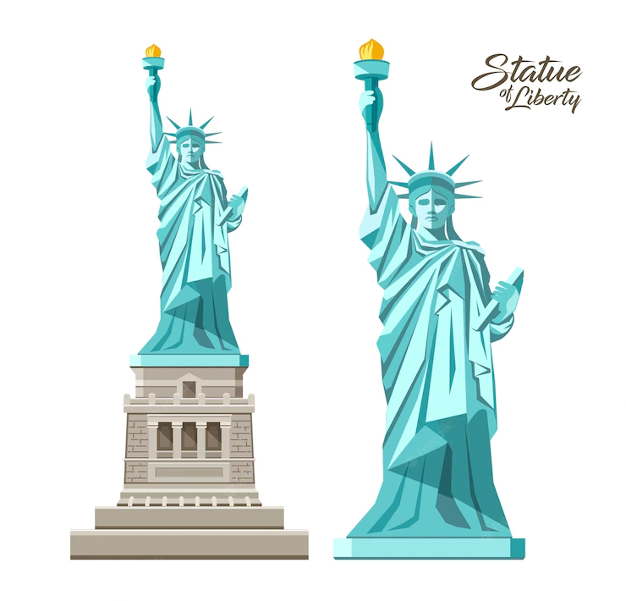


America

Slide 11
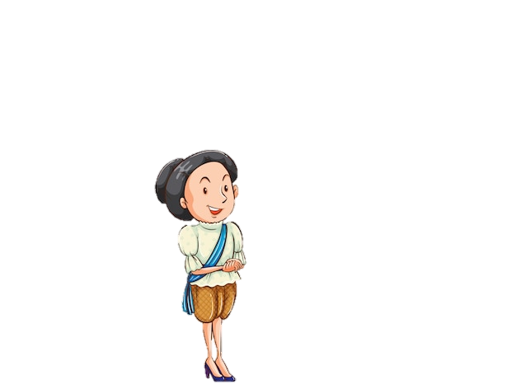

Where are you from?
I'm from Thailand.
Where are you from?
I'm from Japan.

Slide 12
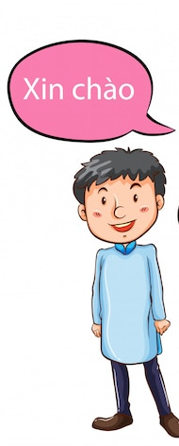
Where is he from?
He's from Viet Nam.

Slide 13
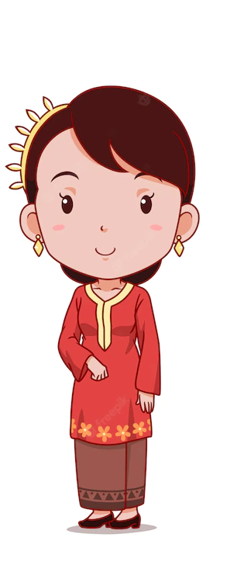
Where is she from?
She's from Malaysia.

Slide 14
02
Activity 4
Listen and tick.

Slide 15
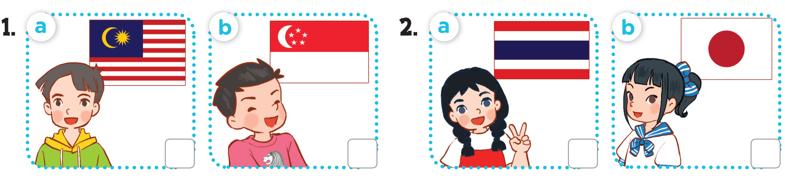
Look and answer.

Slide 16
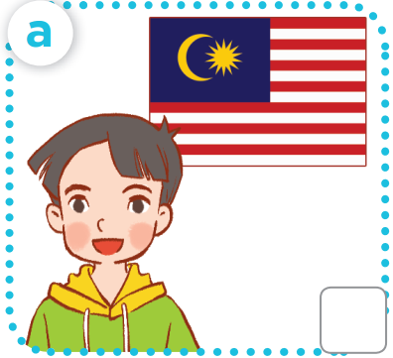
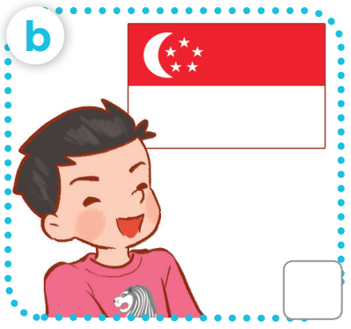
Where's he from?

Slide 17
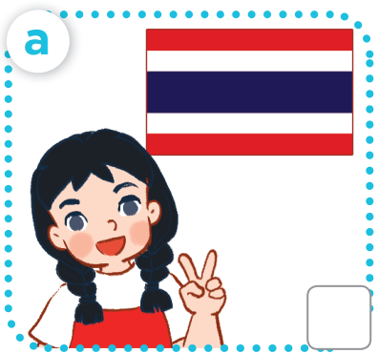
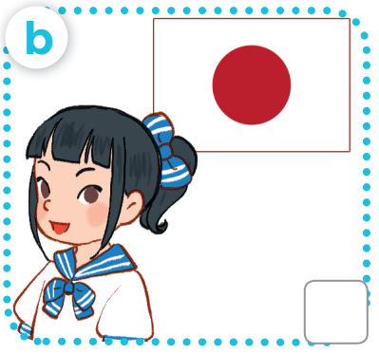
Where's she from?

Slide 18
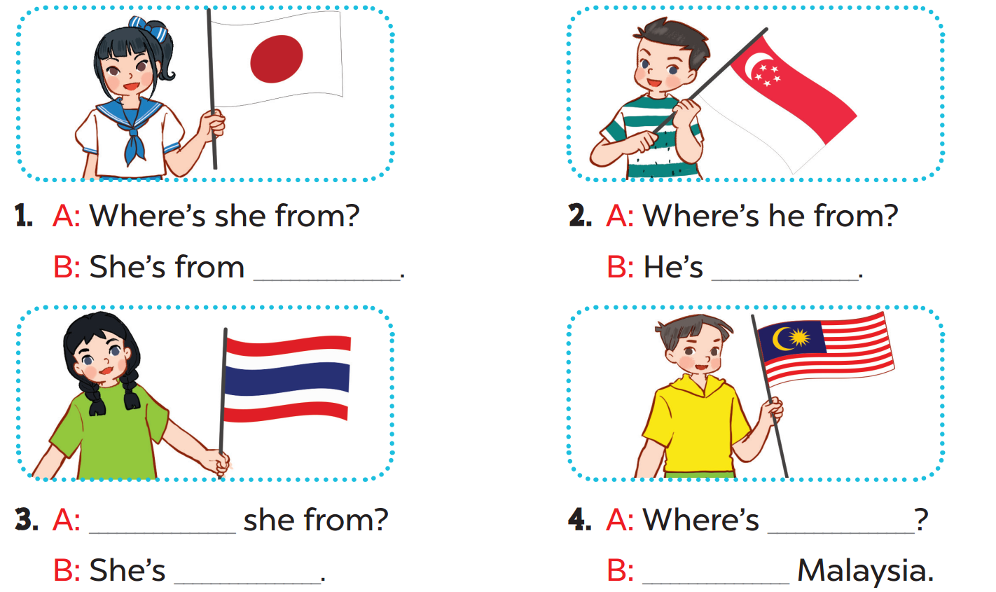
Japan
from Singapore
Where's
he from
from Thailand
He's from

