Slide 1
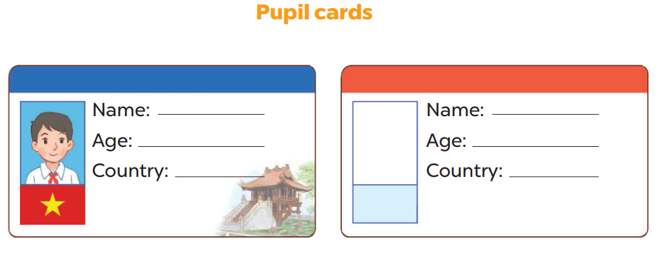

Slide 2
Work in groups.
This ……. .She is …... years old. She is from …….
This ……...He is … years old. He is from …….
is Thu
is Hieu
ten
ten
Viet Nam
Viet Nam

Slide 3
Let’s talk.
Yourself

