Slide 2









Our home
Lesson 1 - Period 1

Slide 3








01
Warm-up and review

Slide 4
03
Listen, point and say.

Slide 5
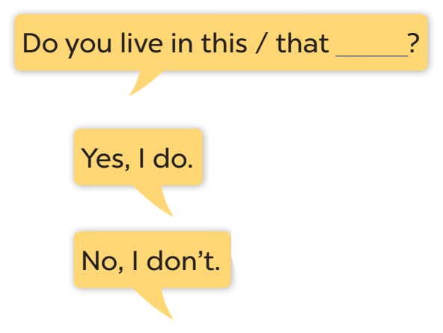




Slide 6
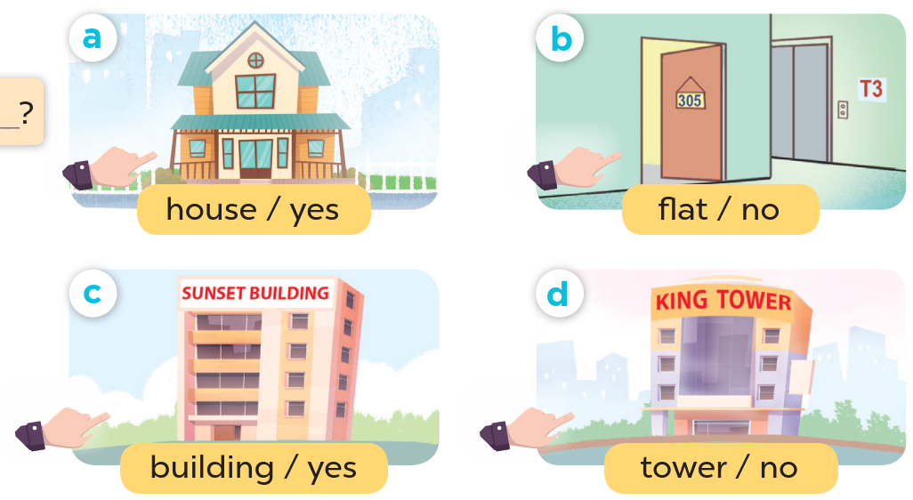
Look at the hands.

Slide 7
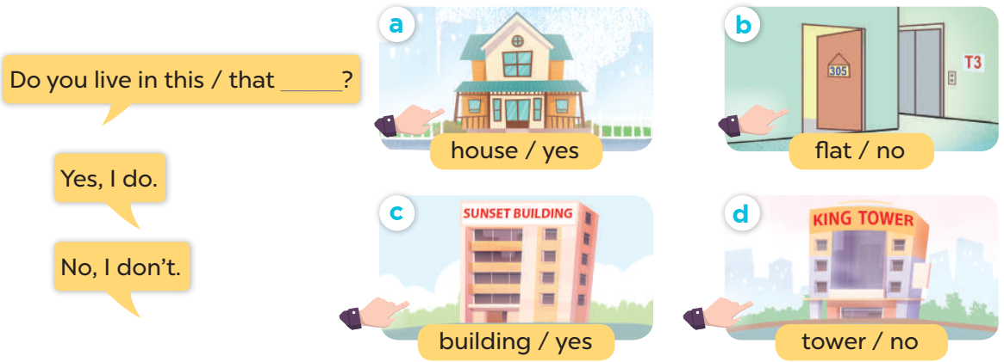
Work in pairs. Ask and answer.

Slide 8
04
Let's talk.

Slide 9
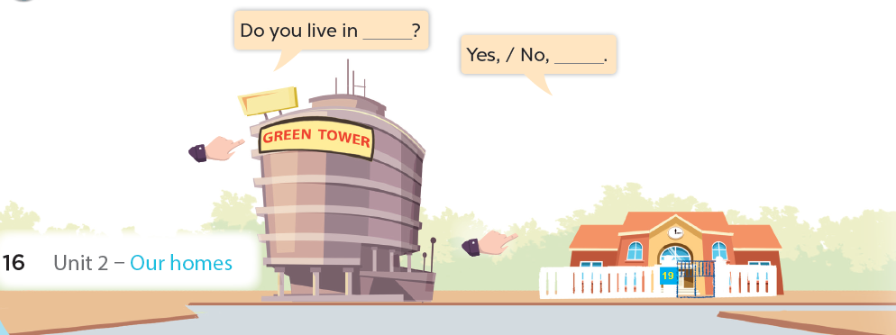

Slide 10



Do you live in that building?
No, I don't.

Slide 11


Do you live in this house?
Yes, I do.

Slide 12
Website: hoclieu.vn
Fanpage: facebook.com/www.tienganhglobalsuccess.vn

